Slide 1
Selenium Webdriver: 1st-Jul-2021 to 5th-Aug-2021

Slide 2
Selenium Webdriver
Session 1st-Jul-2021

Slide 3
Table of Contents
Agenda
How to select single and multiple values from a dropdown and bootstrap dropdown
How to select Radio Button
How to access Links in Selenium
Alert and Popup Handing
Difference between FindElement and FindElements
Mouse Hover & Mouse Event using Action Class

Slide 4
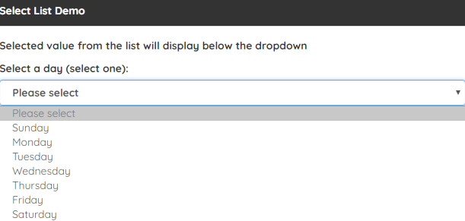
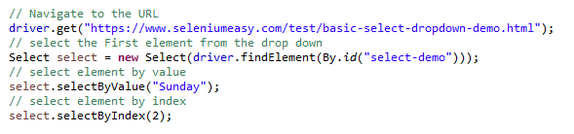
Selenium Webdriver continues..
How to select single and multiple values from a DropDown
Single value selection “https://www.demoqa.com/select-menu”

Slide 5
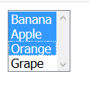
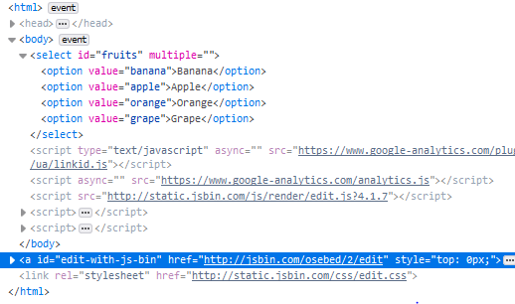
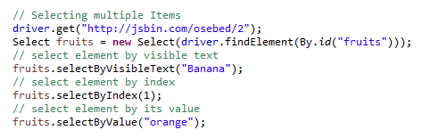
Selenium Webdriver DropDown continues..
Multiple value selection

Slide 6
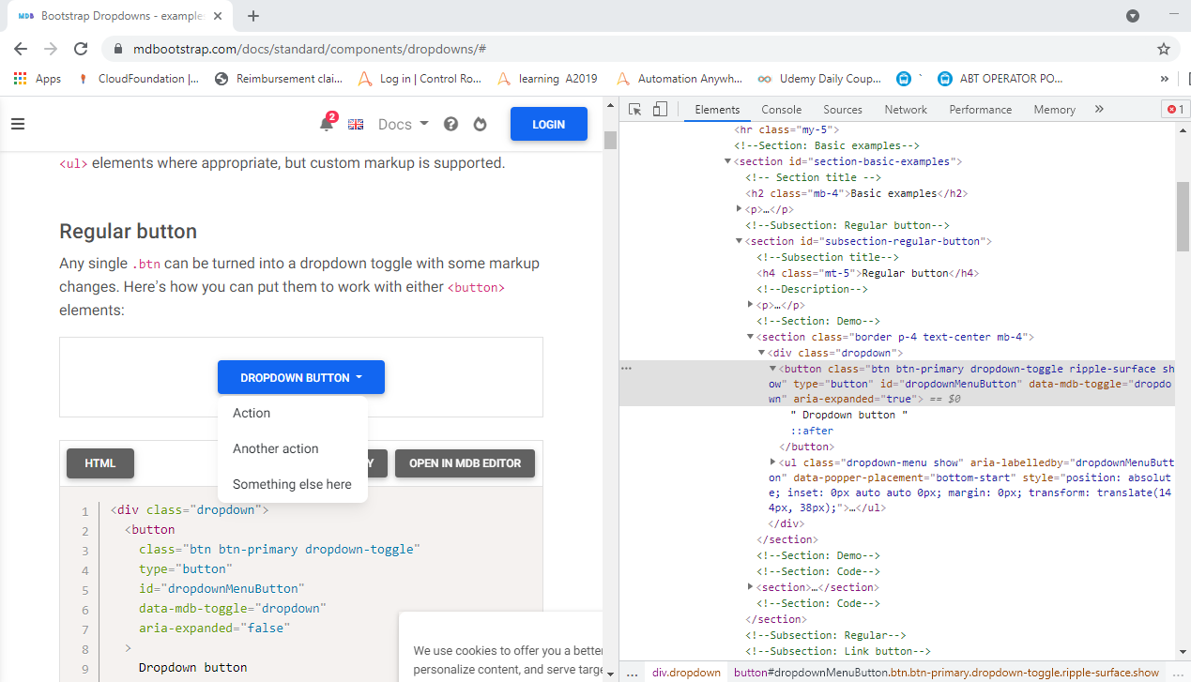
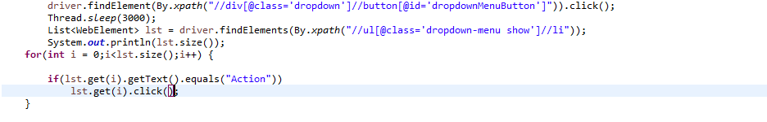
Selenium Webdriver DropDown continues..
Bootstrap Dropdown value selection
https://mdbootstrap.com/docs/standard/components/dropdowns/#

Slide 7

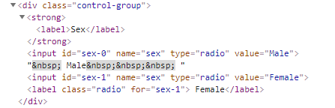
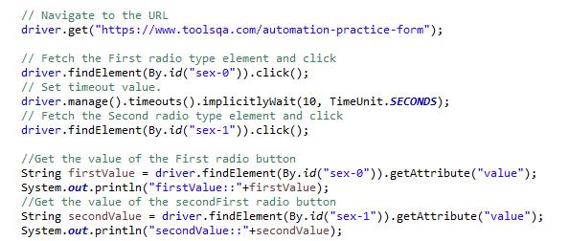
Selenium Webdriver continues..
How to select Radio Button
https://www.demoqa.com/radio-button

Slide 8

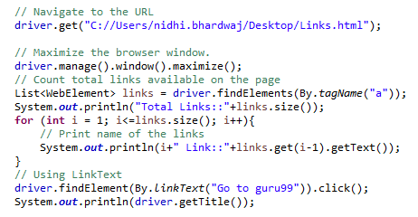
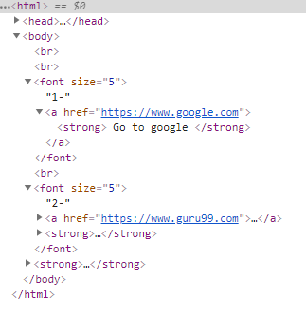
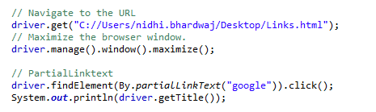
Selenium Webdriver continues..
How to access Links
By linkText
By partiallinkText
https://www.demoqa.com/links

Slide 9
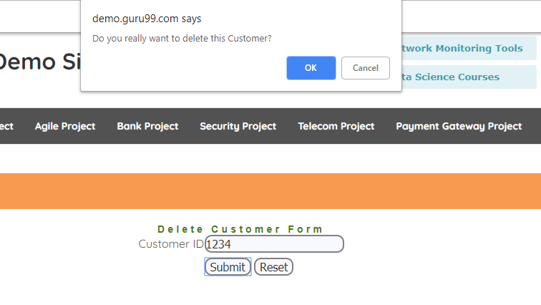
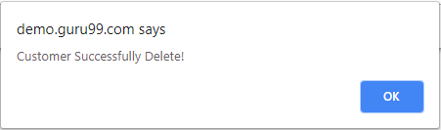
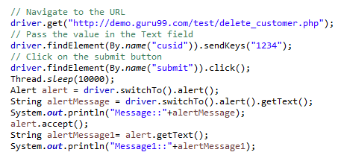
Selenium Webdriver continues..
Alerts and Pop up Handling
https://www.demoqa.com/alerts

Slide 10
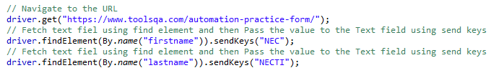
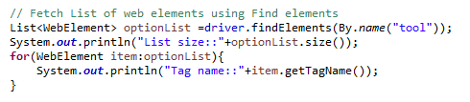
Selenium Webdriver continues..
Difference between FindElement and FindElements
FindElement: This method is used to access a single web element on a page. It returns the first matching element. It throws a NoSuchElementException exception when it fails to find the element.
FindElements: This method returns the list of all matching elements. The findElement method throws a NoSuchElementException exception when the element is not available on the page. Whereas, the findElements method returns an empty list when the element is not available or doesn’t exist on the page. It doesn’t throw NoSuchElementException.

Slide 11
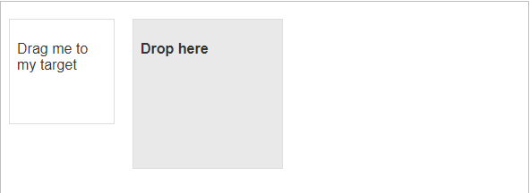
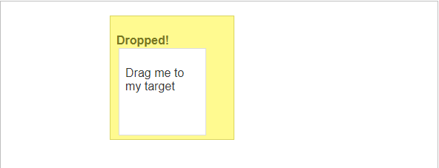
Selenium Webdriver continues..
Verify Tooltip- Mouse Hover & Mouse Event using Action Class
https://www.guru99.com/verify-tooltip-selenium-webdriver.html
https://jqueryui.com/droppable/
Before Drag Box to Target
After Drag Box to Target

Slide 12
Selenium Webdriver continues..
Topics covered
Dropdown
Radio Button
Web Links
Alerts and Pop ups
Diff between FindElement & FindElements
Mouse Hover & Mouse Event using Action Class

Slide 13
Selenium Webdriver
Session 8th Jul

Slide 14
Table of Contents
Agenda
What is a Web Table. It’s types and how to handle Web Tables
Handling Iframes
Switching between different Windows Tabs

Slide 15
Selenium Webdriver continues..
What is a Web Tables. It’s types and how to handle Web Table
A Table is made of rows and columns. When we create a table for a web page, that is called as a web table. In HTML, table is created using <table> tag. Web table is a HTML structure for creating rows and columns on a Web page.
Web Table can consists below parts:
Header(s): It is created using <th> tag.
Row(s):It is created using <tr> tag.
Columns(s):It is created using <td> tag.
Types of Web Table:
Static Web table: Number of rows and columns will be definite. Eg. Table of months, Table of days etc.
Dynamic Web table: Number of rows and columns will be dynamic. It will be keep on increasing or decreasing based on data. For Eg: Sales table, Student table.

Slide 16
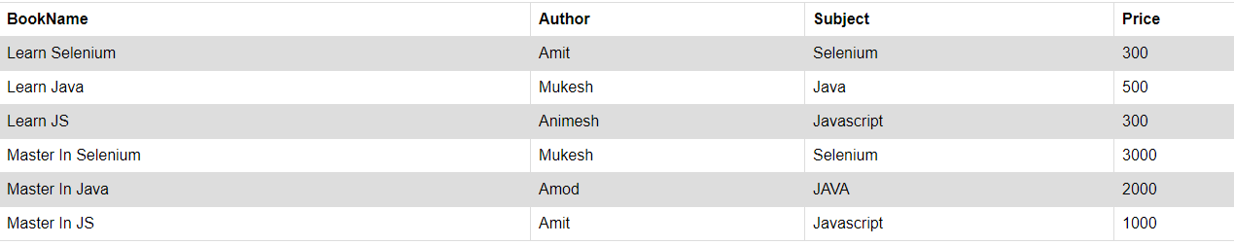
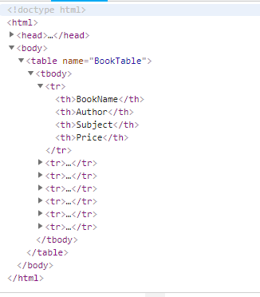
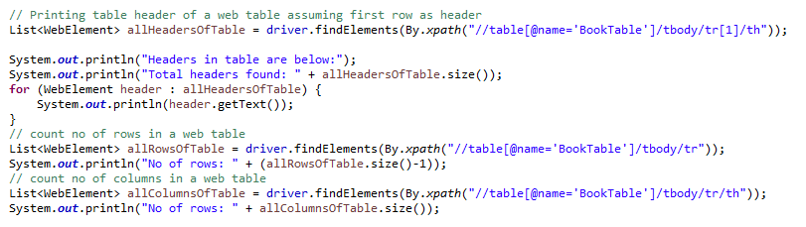
Selenium Webdriver Web Table continues..
Static Web tables

Slide 17
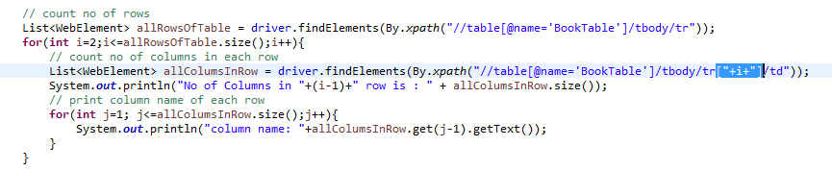
Selenium Webdriver Web Table continues..
Dynamic Web tables

Slide 18
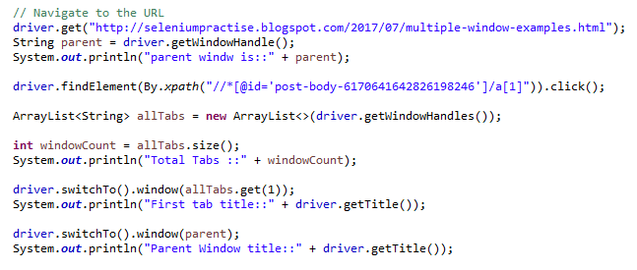
Selenium Webdriver continues..
How to switch between different Tabs
get.windowhandle(): helps in getting the window handle of the current window
get.windowhandles(): helps in getting the handles of all the windows opened
switch to: helps in switching between the windows

Slide 19
Selenium Webdriver continues..
Topics covered
What are Web tables and how to handle Web tables
How to switch between diff Tabs
How to switch between diff Windows

Slide 20
Selenium Webdriver
Session 15th Jul

Slide 21
Table of Contents
Agenda
How to Reading & Writing Data to Excel
How to run selenium script using Cross Browser Testing
how to create config. file
Data driven Testing(Read Data from excel and write in Application)

Slide 22
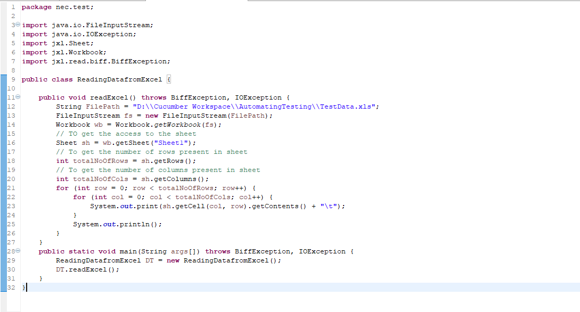
Reading from Excel using JXL API
JXL API (a.k.a. Java Excel API) allows users to read, write, create, and modify sheets in an Excel(.xls) workbook at runtime.

Slide 23
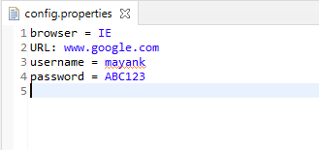
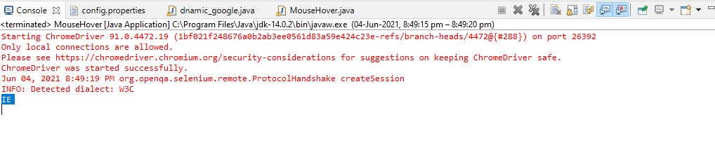
Reading from Excel using JXL API
Create and Read data from Config file.
Write code in Eclipse
Result

Slide 24
Selenium Webdriver continues..
Topics covered
Reading & Writing Data to Excel
Run selenium script using Cross Browser Testing
Config. file
Data driven Testing

Slide 25
Selenium Webdriver
Session 22nd Jul

Slide 26
Table of Contents
Agenda
Testing Framework - TestNG
Installation of TestNG
TestNG Library
TestNG Annotations
Test cases with Priority set
Reports

Slide 27
Selenium Webdriver continues..
TestNG
Automation Testing framework
NG stands for “Next Generation”
Free, Open source
TestNG is inspired from JUnit which uses the annotations
Annotations are easier to understand
Test cases can be grouped more easily
Used for Reporting

Slide 28
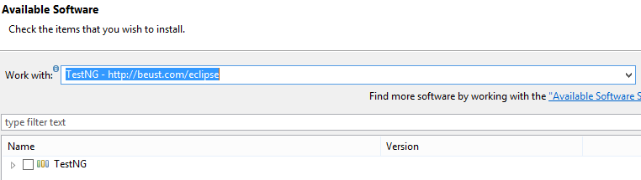
TestNG continues..
Installation of Test NG
https://testng.org/testng-eclipse-update-site/

Slide 29
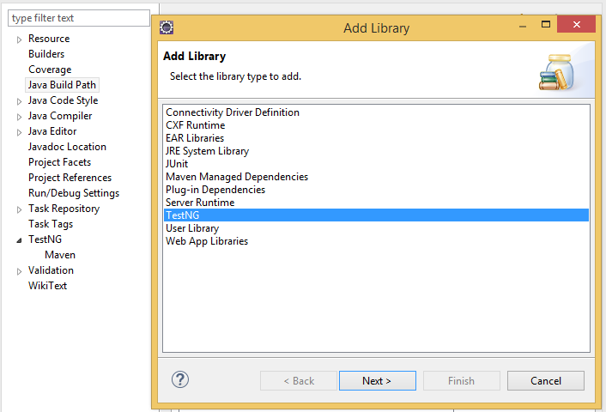
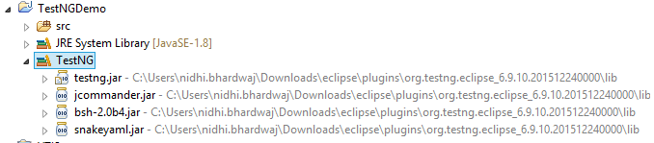
TestNG continues..
Test NG Library
Go to Project-> Properties-> Java Build path

Slide 30
TestNG continues..
TestNG Annotations
@BeforeSuite
@BeforeTest
@BeforeClass
@BeforeMethod
@Test
@AfterMethod
@AfterClass
@AfterTest
@AfterSuite
No main method required to write

Slide 31
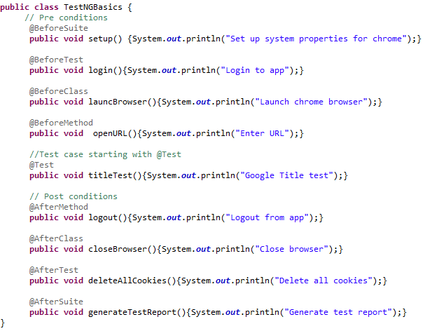

TestNG Annotation continues..
Annotation Example:
Run as TestNG Test

Slide 32
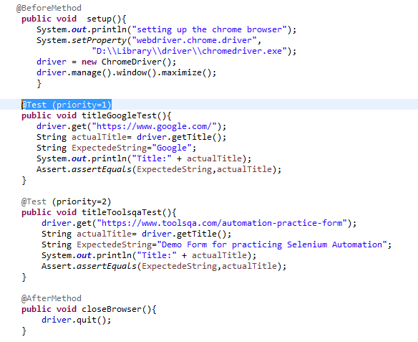
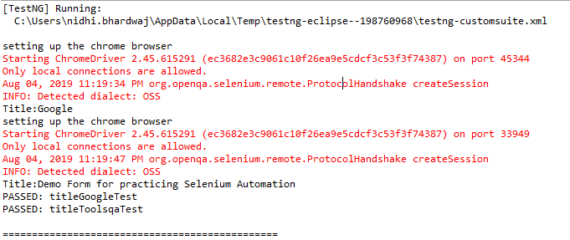
TestNG continues..
Test cases with Priority set

Slide 33
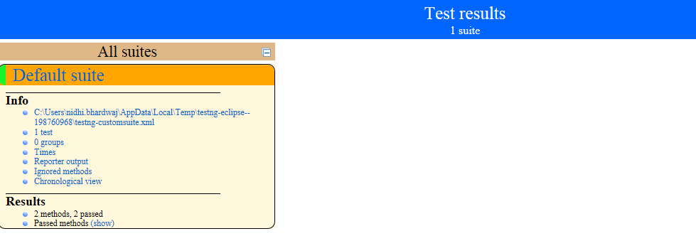
TestNG continues..
Reports : test-output-> index.html

Slide 34
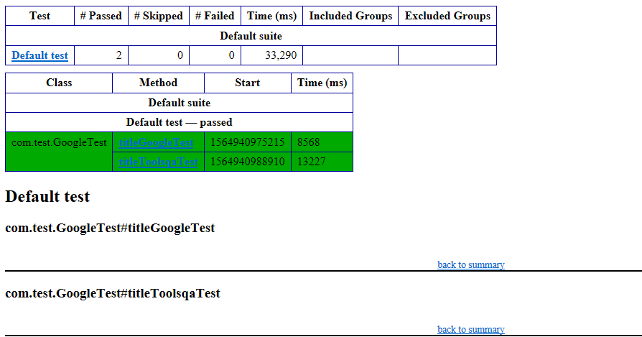
TestNG Reports continues..
Reports: test-output -> emailable-report.html

Slide 35
Selenium Webdriver continues..
Topics covered
Testing Framework - Test NG
Installation of TestNG
TestNG Library
TestNG Annotations
Test cases with Priority set
Reports

Slide 36
Selenium Webdriver
Session 29th July

Slide 37
Table of Contents
Agenda
How to Connect with Database
How to Get the data using select query
How to Insert, Update and Deleted in database

Slide 38
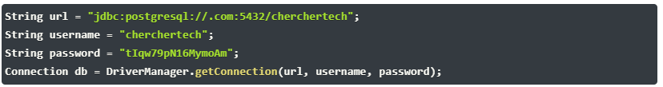

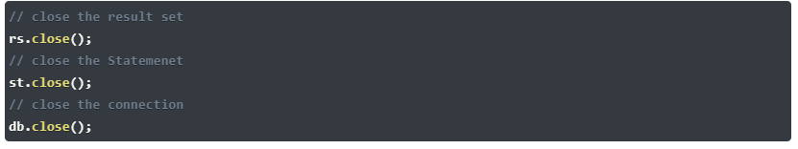
Database Testing using Selenium
Make a connection to the Database
Send Queries to the Database
Process the results

Slide 39
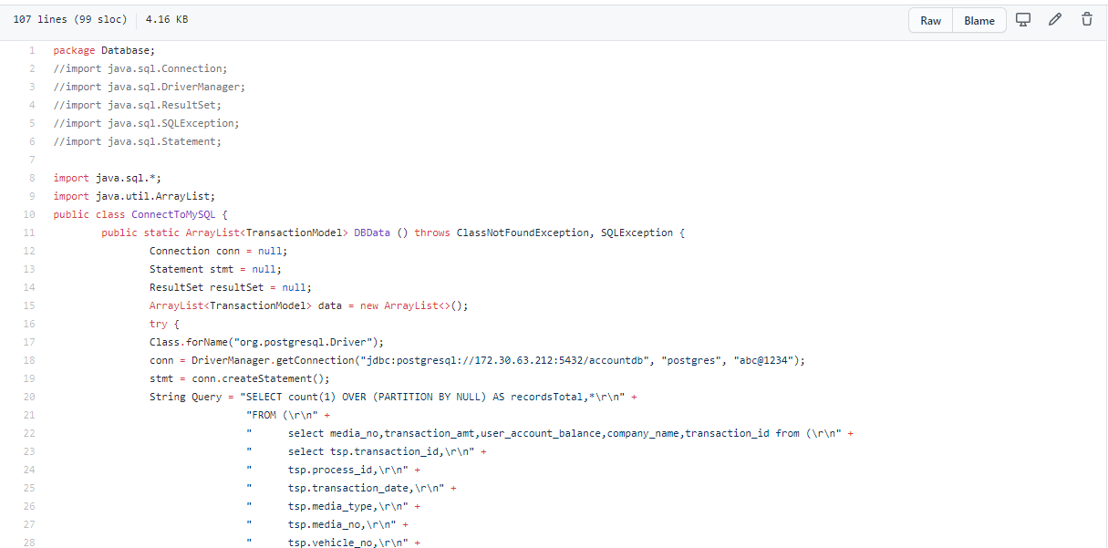
Database Testing using Selenium
Make a connection to the Database
Send Queries to the Database
Process the results

Slide 40
Database Testing using Selenium
public static void main(String[] args) throws SQLException {
Connection conn = null;
Statement stmt = null;
ResultSet resultSet = null;
try {
Class.forName("org.postgresql.Driver");
conn = DriverManager.getConnection("jdbc:postgresql://port:5432/table", "postgres", "abc@1234");
stmt = conn.createStatement();
String Query = "SELECT * from abt_config ";
String InsertQuery= "INSERT INTO abt_config (config_type, config_code, config_name, config_value, is_active, is_encrypted, is_deleted, created_by, created_date, updated_by,updated_date, pgm_id, version) VALUES ('ReturnJourneyDiscoun',0004,'ReturnJourneyDiscount1',100,'Y','N','N','Null','2021-05-11 14:30:02.802','Null','2021-05-11 14:30:02.802','Null',1)";
String DeleteQuery = "Delete from abt_config where config_code = '4'";
resultSet = stmt.executeQuery(Query);
while (resultSet .next()) {
System.out.println(resultSet .getString(1) + " | " + resultSet .getString(2) +" | "+ resultSet .getString(3));
}
}
catch(Exception e) {
System.out.println(e);
}
conn.close();
}

Slide 41
Selenium Webdriver continues..
Topics covered
Connect with Database
Get the data from table
Insert, Update and Deleted data in table

Slide 42
Selenium Webdriver
Session 5th Aug

Slide 43
Selenium Webdriver continues..
Agenda
Integration with CI/CD- Jenkins
Installation of TestNG plugin in Jenkins
Run TestNG Test cases from Jenkins
TestNG Reports
Scheduling TestNG Test cases
Pros and Cons of Selenium
Challenges/Limitations

Slide 44
Selenium Webdriver continues..
Integration with CI/CD- Jenkins
Download Jenkins.war
Start the Jenkins server on Port 8080/8082
Run java -jar jenkins.war --httpPort=8082 to start the Jenkins server
Access the Jenkins dashboard via http://localhost:8080

Slide 45
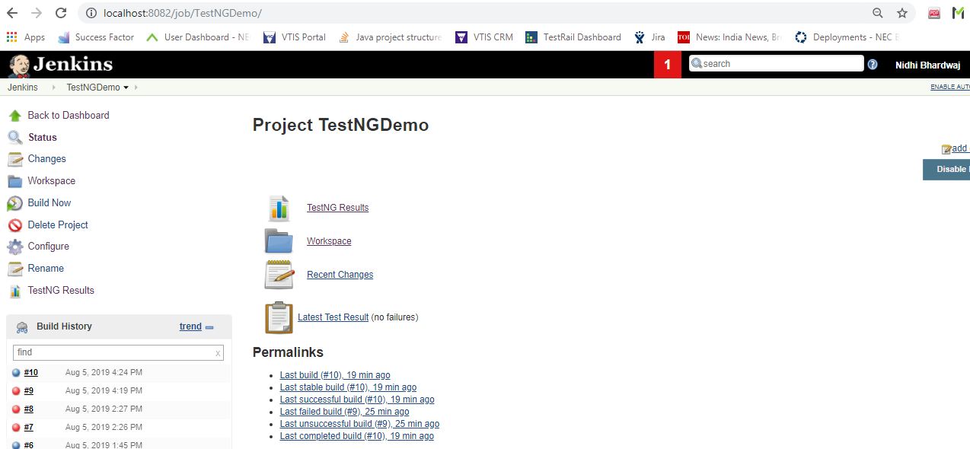
Integration with CI/CD- Jenkins continues..
Create a new Job named- TestNGDemo

Slide 46
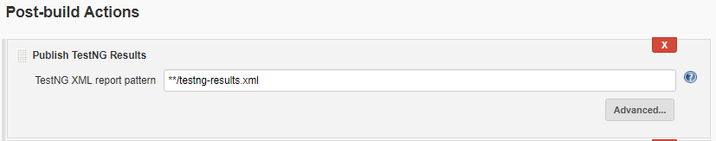
Integration with CI/CD- Jenkins continues..
Installation of TestNG plugin in Jenkins
Download the “testng-plugin/” from the https://updates.jenkins-ci.org/download/plugins/
Go to Jenkins -> Manage Jenkins -> Manage plugins -> Advanced -> Upload Plugin
Go to the TestNGDemo-> configure -> Post-build Actions -> Add -> Publish TestNG Results

Slide 47
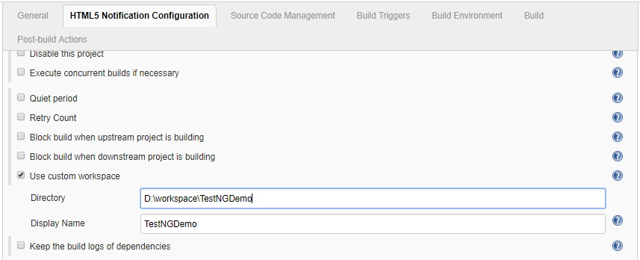
Integration with CI/CD- Jenkins continues..
Run TestNG Test cases from Jenkins
Go to TestNGDemo -> configure -> HTML5 Notification Configuration

Slide 48
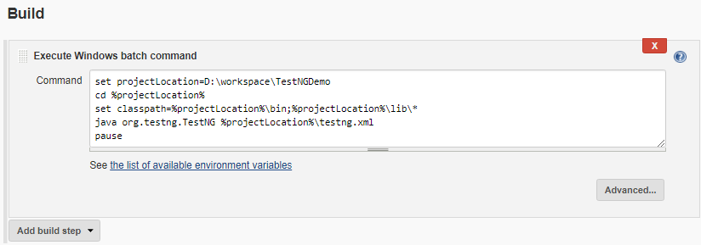
Integration with CI/CD- Jenkins continues..
Go to TestNGDemo -> configure ->Build
set projectLocation=D:\workspace\TestNGDemo
cd %projectLocation%
set classpath=%projectLocation%\bin;%projectLocation%\lib\*
java org.testng.TestNG %projectLocation%\testng.xml
pause

Slide 49
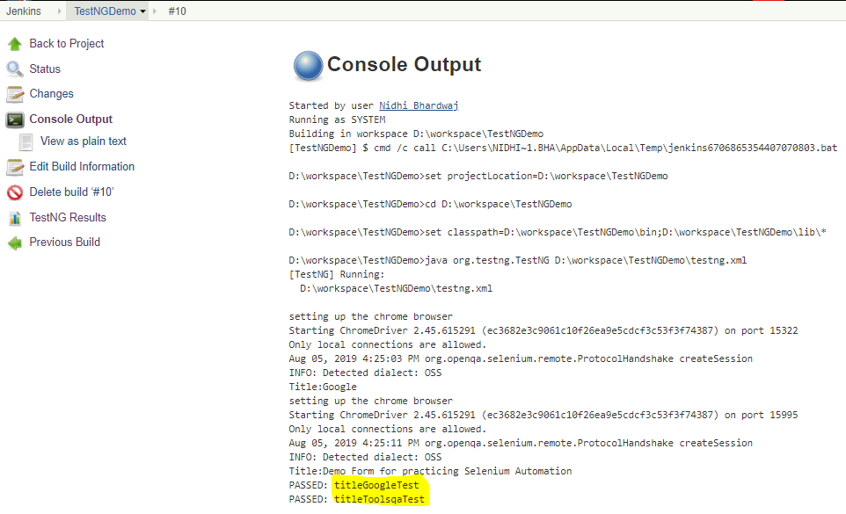
Integration with CI/CD- Jenkins continues..
Go to TestNG Demo -> Build Now
It will build your project and public TestNG reports.
Go to Build number and click on the console output for the logs.

Slide 50
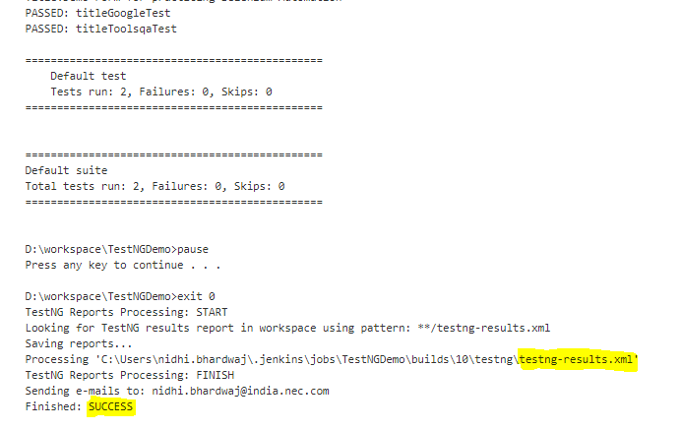
Integration with CI/CD- Jenkins continues..
Build Console

Slide 51
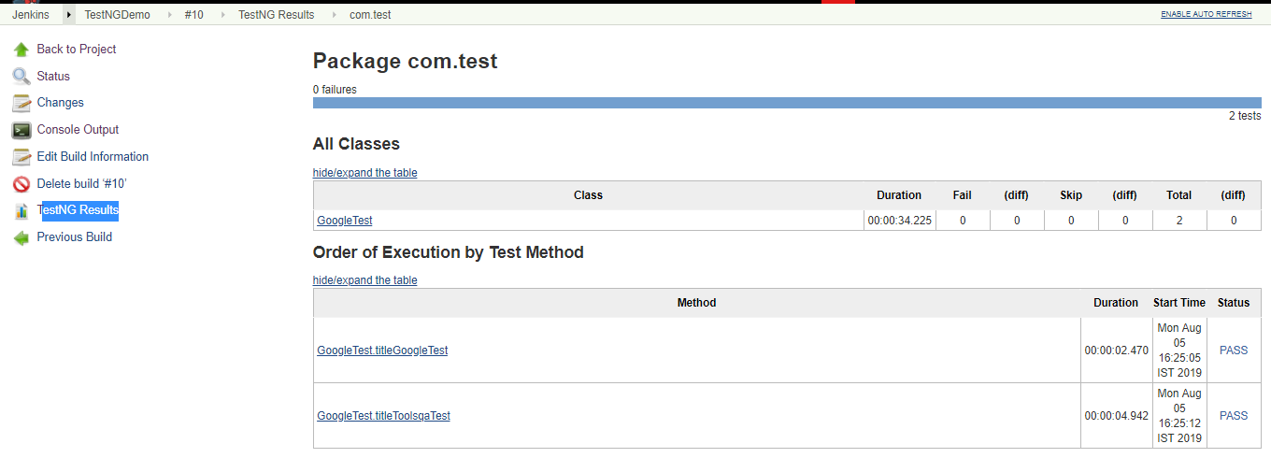
Integration with CI/CD- Jenkins continues..
TestNG Reports

Slide 52
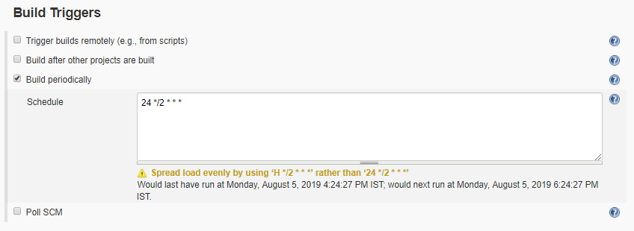
Integration with CI/CD- Jenkins continues..
Scheduling TestNG Test cases from Jenkins
Go to TestNGDemo -> configure -> Build Triggers
Cron job syntax * * * * *
MINUTES Minutes in one hour (0-59)
HOURS Hours in one day (0-23)
DAYMONTH Day in a month (1-31)
MONTH Month in a year (1-12)
DAYWEEK Day of the week (0-7) where 0 and 7 are sunday

Slide 53
Selenium Webdriver continues..
Pros and Cons of Selenium
Pros
Open source
Integrated with Agile, DevOps, Continuous Delivery workflow
Supports mobile testing
Wide range of supported languages, platforms, and browsers
supports parallel test execution using selenium grid
Huge Community
Large Library of plugins

Slide 54
Selenium Webdriver continues..
Cons of Selenium
Cons
No Reporting
No Tech support
Web based stuff only, e.g no windows applications
Not supported to Automate Scenario like barcode/code captcha.
Programming knowledge is must

Slide 55

Selenium Webdriver continues..

Slide 56

Selenium Webdriver continues..

Slide 57
Selenium Webdriver continues..
References
https://www.toolsqa.com/selenium-tutorial/
https://www.javatpoint.com/selenium-tutorial
https://www.guru99.com/selenium-tutorial.html
https://www.softwaretestinghelp.com/selenium-webdriver-selenium-tutorial-8/
Email : Nidhi.Bhardwaj@india.nec.com

