Slide 1
Introduction to Selenium: A Functional Automation Tool 6th - Aug-2019 to 1st - Oct -2019

Slide 2
Table of Contents
What is Selenium?
Selenium Components
Selenium IDE:
Installation, Execution
Selenium RC
Selenium WebDriver:
Architecture, Sample script creation
Usage of different locators
Frequently used Selenium Commands
Using AutoIT with Selenium
Database Testing

Slide 3
Session 1: 6 ^{th} Aug

Slide 4

What is Selenium?
Selenium is a functional automation tool for web applications
It is an open source tool (free of cost)
It supports different browsers (IE, Firefox, Chrome, Opera, Safari) and platforms (Windows, Linux, Mac)
Embeds test automation engine in your browser
Used for functional regression testing
Uses JavaScript
Notes:
History of Selenium
Selenium was created by Jason Huggins in 2004. An engineer at ThoughtWorks, he was working on a web application that required frequent testing.

Slide 5
Selenium Components
Selenium Suite
Selenium IDE
Selenium RC
Selenium WebDriver
Selenium Grid
Merged
Selenium 2
New & Improved
Selenium 3

Slide 6
Selenium IDE (Integrated Development Environment)
Selenium IDE is the simplest framework in the selenium suite, used for record and playback the scripts
Can be installed as a plugin in Firefox or Chrome
Scripts recorded through this, can be run in another browsers by using selenium RC
However, is not a overall solution for developing and maintaining complex test suites

Slide 7
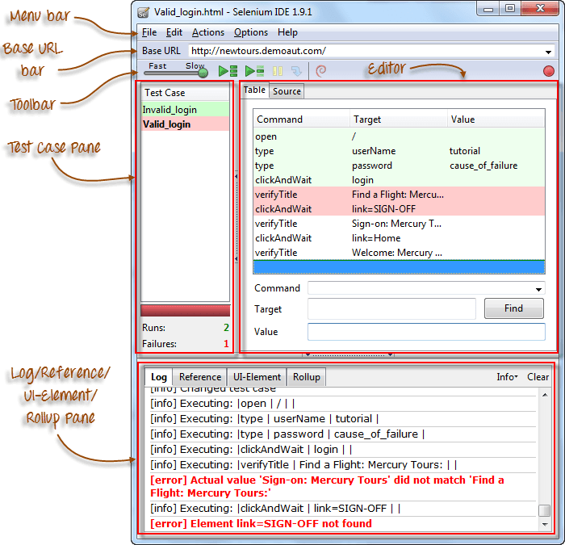
Selenium IDE in Firefox

Slide 8
Selenium IDE: Practical in Chrome
Test Scenario 1 :
Launch Browser
Open https://www.toolsqa.com/automation-practice-form/
Fill Fields (First name, Last Name, Sex, Years of Experience)
Test Scenario 2 :
Launch Browser
Open https://www.toolsqa.com/automation-practice-form/
Fill Fields (Profession, Automation Tool, Continents)
Upload Profile Picture

Slide 9
Pros & Cons of Selenium IDE
PROS | CONS
Very easy to use and install | Designed only to create prototypes of tests
No programming experience is required, though knowledge of HTML and DOM are needed | No support for iteration and conditional operations
Can export tests to format usable in Selenium RC and WebDriver | Test execution is slow compared to that of Selenium RC and Web Driver
Has built-in help and test results reporting module

Slide 10
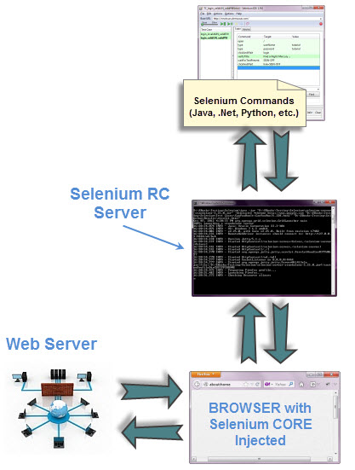
Selenium Remote Control (RC)
It is a server and launches the browser
It is a test tool that allows you to write automated web application UI tests in any programming language

Slide 11
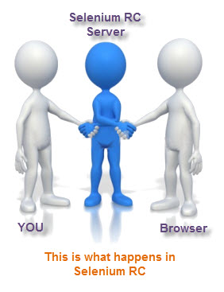
How Selenium RC works?
A separate application called Selenium Remote Control (RC) Server before you can start testing
The selenium RC server acts as a “middleman” between your selenium commands and your browser
When you begin testing, Selenium RC Server “injects” a JavaScript program called Selenium Core into the browser
Once injected, Selenium Core will start receiving instructions relayed by the RC Server from your test program.
When the instructions are received, Selenium Core will execute them as Javascript commands
The browser will obey the instructions of Selenium Core and will relay its response to the RC Server.
The RC Server will receive the response of the browser and then display the results to you.
RC Server will fetch the next instruction from your test script to repeat the whole cycle.

Slide 12
Pros & Cons of Selenium RC
PROS | CONS
Cross browser and Cross platform | Installation is more complicated than IDE
Can perform looping and conditional operations | Must have programming knowledge
Can support data driven testing | Needs Selenium RC server to be running
Faster Execution than IDE | API contains redundant and confusing commands
Can readily support new browsers | Shower execution time than WebDriver

Slide 13





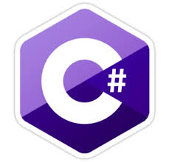




What is Selenium WebDriver?
Easy Cross Browser Testing
Chrome, Firefox, Safari, IE, .etc.
Supports Different Language Scripting
Java, C#, Ruby, Perl, PHP, Python, .etc.
Selenium WebDriver
Easy Framework Development
Data Driven, Keyword Driven & Hybrid.
On multiple browsers at same time
Parallel Testing

Slide 14
Selenium WebDriver: Architecture
HTTP via HTTP Server
Browser Drivers
(Chrome Driver, Firefox Driver, Internet Explorer Driver, Microsoft Edge Driver)
Real Drivers
(Chrome, Firefox, Internet Explorer, Microsoft Edge )
Selenium Client Libraries
(Java, Python, C#, Perl, etc.)
JSON Wire Protocol
Language Binding
Jar files
Language in which selenium framework is written
JSON Wired protocol Send the data in JSON format.
HTTP via HTTP Server
Notes:
Selenium API:
API is particular set of Rules(Code) and Specification that software programs can follow to communicate with each other. It Serve as an interface between software programs and facilates their interaction, similarly to the way the user interface facilate interaction between human and Computers.
JSON is a light weight data interchange format
It is a Syntax for storing and exchanging data.
It is used primarily to transfer the data between a server and a client on the web
It is very much alternative of XML
A Simple JSON file have .json extension
JSON Wired protocol Send the data in JSON format. The Server firstly parse the data and then execute the data. Response given back to Server sent back to the client in JSON format. The process of converting an object’s data to JSON format and JSON format to an object is named as serialization and de-serialization
Our WebDriver uses the same approach to communicate between client libraries and drivers such as FirefoxDriver, IE Driver etc.

Slide 15
Selenium WebDriver: Architecture Continued..
1) Tester write the test Script in any preferred language. Like in java, C# etc.
2) The language binding communicate with Selenium API and this API Send the command taken from language level binding to Browser Driver with the help of JSON wired protocol.
3) When you click on the run, then all the commands write in script i.e.. All the commands you write will be converted with the help of JSON Wired protocol over HTTP. It will converted in To a URL.
4) The HTTP Request is created and send to the browser Driver.
5) The Browser Drivers uses a HTTP Server for getting the HTTP Request.
6) After that HTTP Server determines the steps needed for implementation of Selenium Commands.
7) The Implementation Steps are executed on The Browser.
8) The Execution Status is sent back to HTTP Server.
9) The HTTP Server Sends the Status back to automation Script

Slide 16

Difference between Selenium RC and Selenium Web driver
Selenium RC
Selenium WebDriver
Does not Supports to test iPhone/Android applications
No support for implementation of listeners
Required to start server before executing script
Supports to test iPhone/Android applications
Server start before execution is not required
Supports implementation of listeners
Interacts natively with browser application
It doesn’t support Record and playback.
Supports all browsers like Firefox, IE, Chrome, Safari, Opera, .etc.

Slide 17
Selenium WebDriver: Installation
Install JAVA (JDK) on windows machine
https://www.oracle.com/technetwork/java/javase/downloads/index.html
2. Download ECLIPSE IDE
http://www.eclipse.org/downloads/
3. Download Selenium Java Client Driver
https://docs.seleniumhq.org/download/
4. Download ChromeDriver
http://chromedriver.chromium.org/downloads
5. Configure Eclipse with WebDriver
a. Open Eclipse>>File >> New>> Java Project>>Fill Java Project Name
b. Right click on created project>> Select Build Path>>Configure Build Path
c. Under tab ‘Libraries’ >>Click on ‘Add External JARs’
d. Select selenium jar files (downloaded above in step 3)
You are ready to use Eclipse to automate application running on Chrome using selenium WebDriver

Slide 18
Session 2 : 13 ^{th} Aug

Slide 19
Selenium Web Driver First Test Script
Test Script 1:
Launch Chrome browser and open url “https://www.toolsqa.com/automation-practice-form/”
package nec.test;
import org.openqa.selenium.WebDriver;
import org.openqa.selenium.chrome.ChromeDriver;
public class ID {
public static void main (String arg[]){
WebDriver driver=new ChromeDriver();
System.setProperty("webdriver.chrome.driver","D://chromedriver.exe");
driver.get("https://www.toolsqa.com/automation-practice-form/");
}
}
Package
Import Statements
Class begins here
Main function
Statements for launching chrome browser
Opening Url
Class ends here

Slide 20
Test Script Creation Using Web driver
Locators:
Selenium uses what is called locators to find and match the elements of your page that it needs to interact with.
Locators
ID
Name
UI-element
Link
Identifier
CSS
Xpath
DOM

Slide 21
1) ID Locator
ID’s are unique for each element so it is common way to locate elements using ID Locator.
They are the fastest and safest locators out of all locators
Code :
public class ID {
public static void main (String arg[]){
WebDriver driver=new ChromeDriver();
System.setProperty("webdriver.chrome.driver","D://chromedriver.exe");
driver.get("https://www.toolsqa.com/automation-practice-form/");
driver.manage().window().maximize();
driver.findElement(By.id("datepicker")).sendKeys("13-08-2019");
}
}

Slide 22
2) CSS Selector Locator
CSS Selectors are no different than the XPaths. But they are resilient and robust.
Unlike the XPath, they aren’t dependent on the DOM structure. They can help you perform actions that are difficult to do with Xpath
Code :
public class ID {
public static void main (String arg[]){
WebDriver driver=new ChromeDriver();
System.setProperty("webdriver.chrome.driver","D://chromedriver.exe");
driver.get("https://www.toolsqa.com/automation-practice-form/");
driver.manage().window().maximize();
driver.findElement(By.cssSelector(“#datepicker")) .sendKeys("14-08-2019");
}
}
Notes:
CSS stands for Cascading Style Sheets. CSS describes how HTML elements are to be displayed on screen, paper, or in other media
CSS is the language for describing the presentation of Web pages, including colors, layout, and fonts. It allows one to adapt the presentation to different types of devices, such as large screens, small screens, or printers. CSS is independent of HTML and can be used with any XML-based markup language.

Slide 23
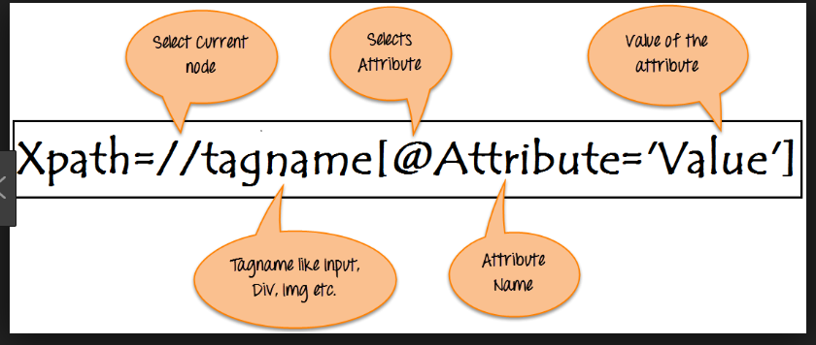
3) Xpath Locator
XPath is a syntax for defining parts of an XML document
XPath can be used to navigate through elements and attributes in an XML document
Notes:
CSS stands for Cascading Style Sheets. CSS describes how HTML elements are to be displayed on screen, paper, or in other media
CSS is the language for describing the presentation of Web pages, including colors, layout, and fonts. It allows one to adapt the presentation to different types of devices, such as large screens, small screens, or printers. CSS is independent of HTML and can be used with any XML-based markup language.

Slide 24
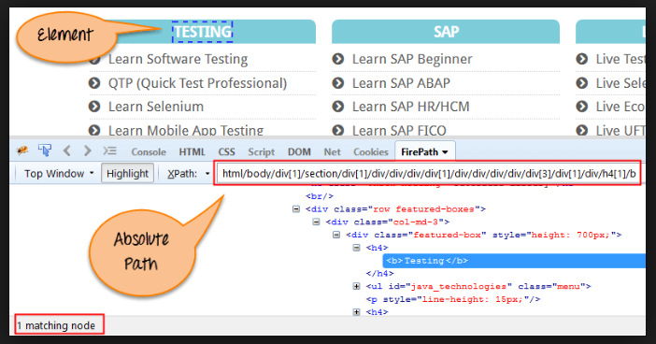
Absolute Xpath
Notes:
CSS stands for Cascading Style Sheets. CSS describes how HTML elements are to be displayed on screen, paper, or in other media
CSS is the language for describing the presentation of Web pages, including colors, layout, and fonts. It allows one to adapt the presentation to different types of devices, such as large screens, small screens, or printers. CSS is independent of HTML and can be used with any XML-based markup language.

Slide 25
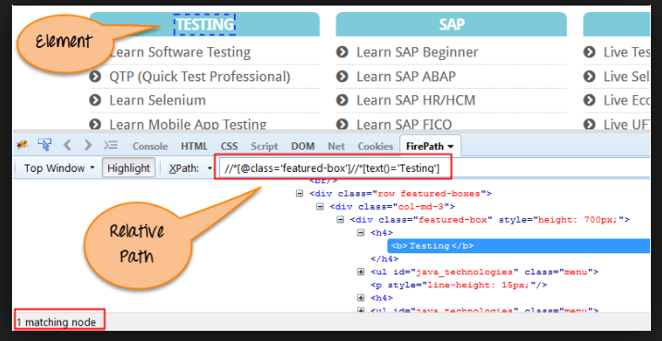
Relative Xpath
Notes:
CSS stands for Cascading Style Sheets. CSS describes how HTML elements are to be displayed on screen, paper, or in other media
CSS is the language for describing the presentation of Web pages, including colors, layout, and fonts. It allows one to adapt the presentation to different types of devices, such as large screens, small screens, or printers. CSS is independent of HTML and can be used with any XML-based markup language.

Slide 26
Xpath Locator
Code :
public class ID {
public static void main (String arg[]){
WebDriver driver=new ChromeDriver();
System.setProperty("webdriver.chrome.driver","D://chromedriver.exe");
driver.get("https://www.toolsqa.com/automation-practice-form/");
driver.manage().window().maximize();
driver.findElement(By.xpath("//input[@name='firstname']")).sendKeys(“Suman”);
}
}
Notes:
The Document Object Model (DOM) is a programming API for HTML and XML documents. It defines the logical structure of documents and the way a document is accessed and manipulated.

Slide 27
4) Name Locator
To identify element with name, use below code
Code :
public class ID {
public static void main (String arg[]){
WebDriver driver=new ChromeDriver();
System.setProperty("webdriver.chrome.driver","D://chromedriver.exe");
driver.get("https://www.toolsqa.com/automation-practice-form/");
driver.manage().window().maximize();
driver.findElement(By.name(“firstname")).sendKeys(“Vohra”);
}
}

Slide 28
Session 3 : 20 ^{th} Aug

Slide 29
Selenium Webdriver Commands
Selenium WebDriver
Browser Commands
Get Commands
Navigation Commands
WebElement Commands
Creating WebDriver Object
Close( )
Quit( )
implicitlywait( ) :
driver.get( “ “);
driver.getTitle( );
driver.getCurrentUrl( );
driver.getPageSource( );
driver.navigate( ).to(“ “);
driver.navigate.( ). forward( );
driver.navigate.( ). back( );
driver.navigate.( ). Refresh( );
element.clear( );
.sendKeys( );
click( );
element.isDisplayed( );
element.isEnabled( );

Slide 30
Capturing Screenshot
Code :
File src= ((TakesScreenshot)driver).getScreenshotAs(OutputType.FILE);
try {
// now copy the screenshot to desired location using copyFile //method
FileUtils.copyFile(src, new File("C:/selenium/snapshot.png"));
}
catch (IOException e)
{
System.out.println(e.getMessage());
}
Notes:
https://mvnrepository.com/artifact/commons-io/commons-io/2.6 >> for FileUtils jar

Slide 31
Session 4 :10 ^{th} Sep

Slide 32
Auto It
What is Auto It & How to use it?
Selenium is an open source tool that is designed to automate web-based applications on different browsers but to handle window GUI and non HTML popups in application.
AutoIT is required as these window based activity are not handled by Selenium.
AutoIt v3 is also freeware.
It uses a combination of mouse movement, keystrokes and window control manipulation to automate a task which is not possible by selenium webdriver.

Slide 33

Auto It : Installation
Step 1: Go to Link https://www.autoitscript.com/site/autoit/downloads/
Step 2: Hover on 'Autoit' and 'Autoit Editor' dropdown.
Step 3: Click on 'AutoIT' Downloads option.
Step 4: Download "Autoit" by clicking on 'Download Autoit' button .
Step 5: Now download "Autoit editor" by clicking on 'Downloads' button .
Step 6: Click on the file link.

Slide 34
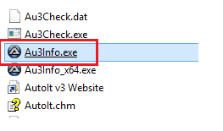
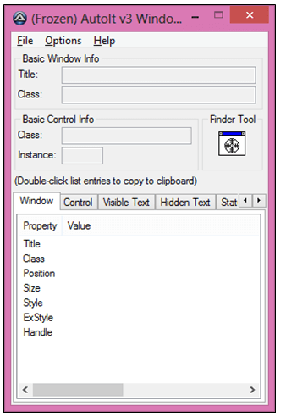
Creation of AutoIt Script - 1
Click Here to open Element Identifier Window

Slide 35
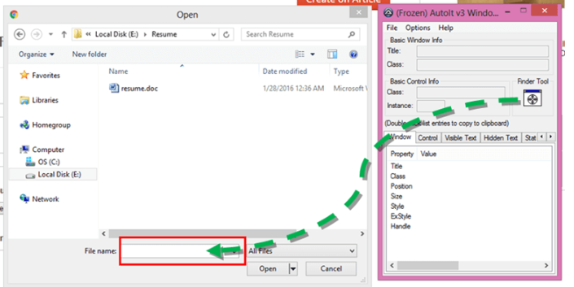
Creation of AutoIt Script - 2

Slide 36
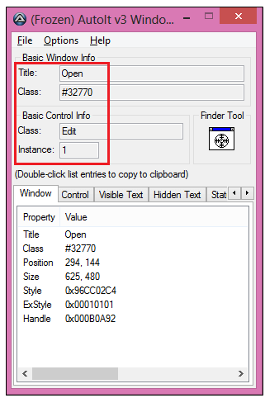
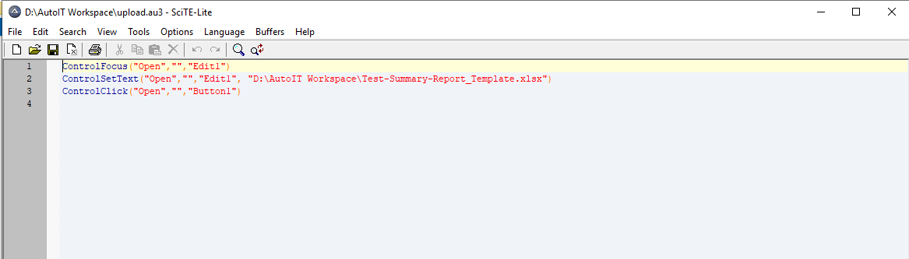
Creation of AutoIt Script -3

Slide 37
Use of AutoIT Script in Eclipse
public class AutoIT {
public static void main(String[] args)throws IOException, InterruptedException {
WebDriver driver=new ChromeDriver();
System.setProperty("webdriver.chrome.driver","D://chromedriver.exe");
driver.get("https://www.freepdfconvert.com");
driver.manage().window().maximize();
driver.manage().timeouts().implicitlyWait(10,TimeUnit.SECONDS);
//clicking on select files button
driver.findElement(By.xpath("//span[@class='file-select-icon img-file']")).click();
// below line execute the AutoIT script .
Runtime.getRuntime().exec("D:\\AutoIT Workspace\\upload.exe");
}
}

Slide 38
Session 5 : 24 ^{th} Sep

Slide 39
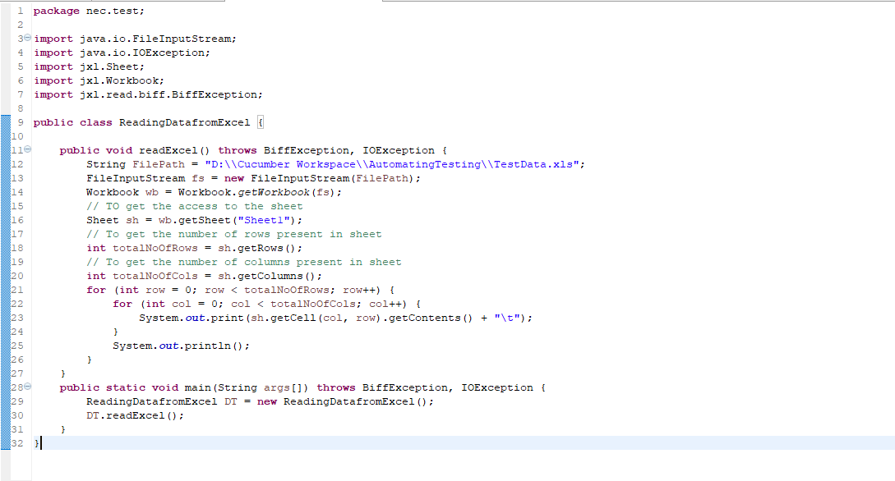
Reading from Excel using JXL API
JXL API (a.k.a. Java Excel API) allows users to read, write, create, and modify sheets in an Excel(.xls) workbook at runtime.

Slide 40
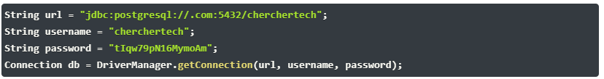

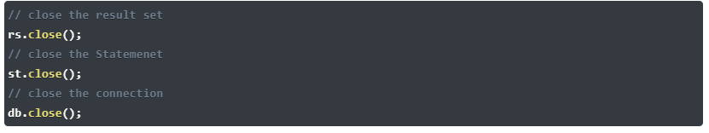
Database Testing using Selenium
Make a connection to the Database
Send Queries to the Database
Process the results

Slide 41
References
https://www.seleniumhq.org/
https://www.softwaretestinghelp.com/selenium-webdriver-commands-selenium-tutorial-17/
https://github.com/SeleniumHQ/selenium/wiki/JsonWireProtocol
https://www.techbeamers.com/important-selenium-webdriver-commands/
For Practice:
https://www.toolsqa.com/automation-practice-form/
https://www.toolsqa.com/automation-practice-table/
Notes:
Theimplicit wait will tell to the web driver to wait for certain amount of time before it throws a "No Such Element Exception". ... It means that if the element is not located on the web page within that time frame, it will throw an exception

Slide 42
Questions?

Slide 43
Thank You!

