Slide 1
Selenium Webdriver
Session-4 (6th Jul)

Slide 2
Table of Contents
Agenda
What is a Web Table. It’s types and how to handle Web Tables
Handling Iframes
Switching between different Windows Tabs

Slide 3
Selenium Webdriver continues..
What is a Web Tables. It’s types and how to handle Web Table
A Table is made of rows and columns. When we create a table for a web page, that is called as a web table. In HTML, table is created using <table> tag. Web table is a HTML structure for creating rows and columns on a Web page.
Web Table can consists below parts:
Header(s): It is created using <th> tag.
Row(s):It is created using <tr> tag.
Columns(s):It is created using <td> tag.
Types of Web Table:
Static Web table: Number of rows and columns will be definite. Eg. Table of months, Table of days etc.
Dynamic Web table: Number of rows and columns will be dynamic. It will be keep on increasing or decreasing based on data. For Eg: Sales table, Student table.

Slide 4
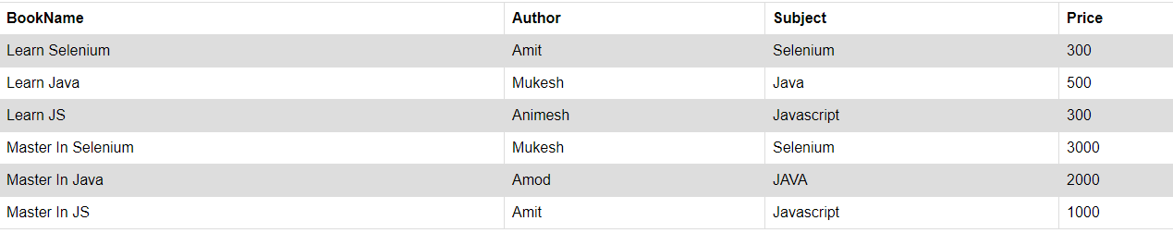
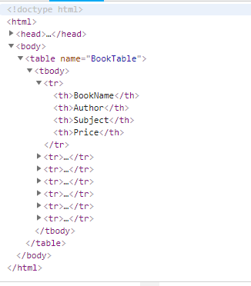
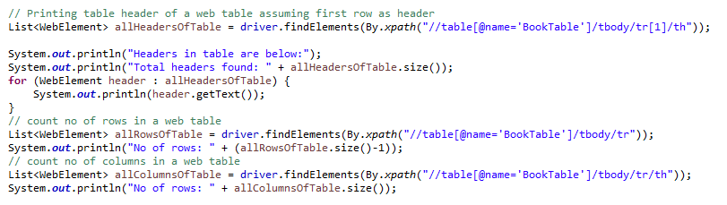
Selenium Webdriver Web Table continues..
Static Web tables

Slide 5
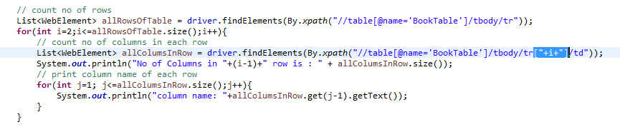
Selenium Webdriver Web Table continues..
Dynamic Web tables

Slide 6
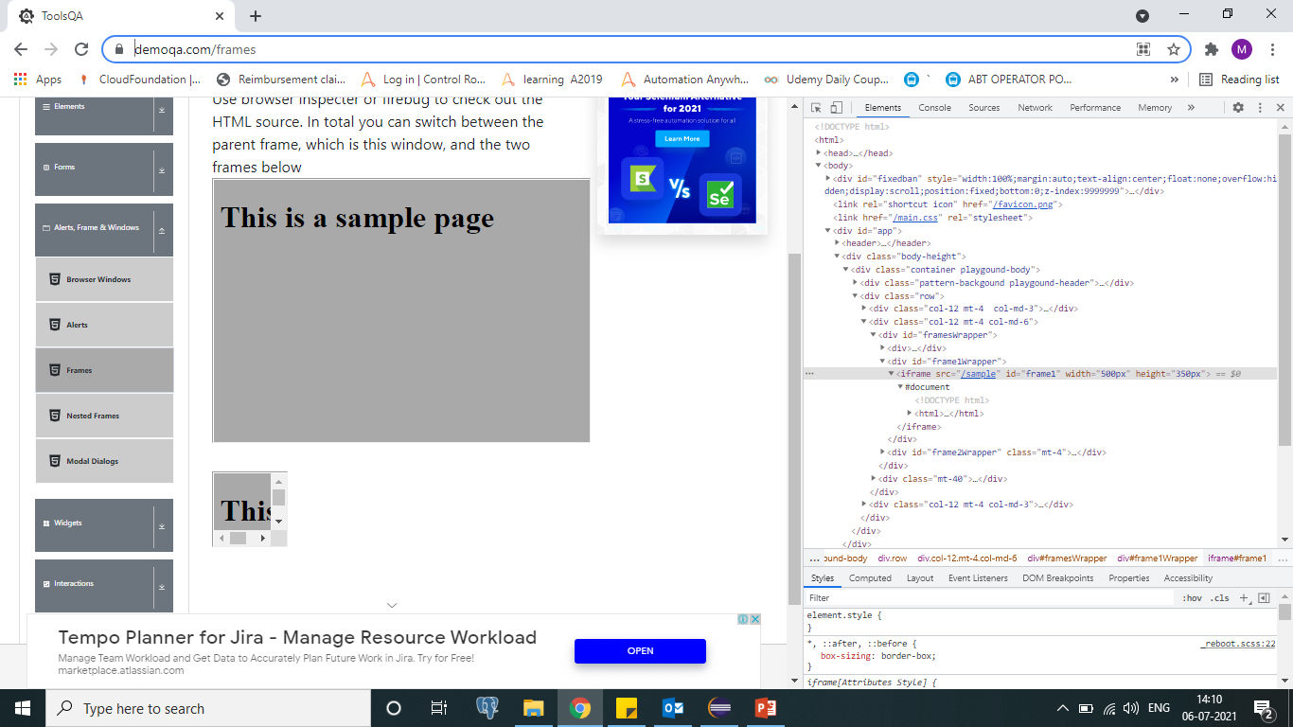

Selenium Webdriver Iframe
How to switch between frames
IFrame in Selenium Webdriver is a web page.
A web page which is embedded in another web page or an HTML document embedded inside another HTML document.
The iframe is often used to add content from other sources like an advertisement into a web page.
URLhttps://demoqa.com/frames

Slide 7
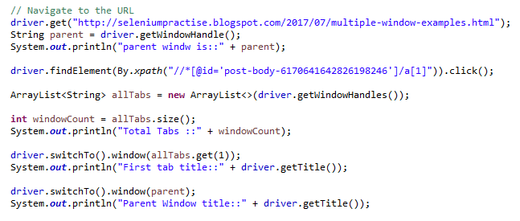
Selenium Webdriver continues..
How to switch between different Tabs
get.windowhandle(): helps in getting the window handle of the current window
get.windowhandles(): helps in getting the handles of all the windows opened
switch to: helps in switching between the windows

Slide 8
Selenium Webdriver continues..
Topics covered
What are Web tables and how to handle Web tables
how to Handling Iframes
how to Switching between different Windows Tabs

