Slide 1
Selenium Webdriver
Session 15th Jul

Slide 2
Table of Contents
Agenda
How to Reading & Writing Data to Excel
How to run selenium script using Cross Browser Testing
how to create config. file
Data driven Testing(Read Data from excel and write in Application)

Slide 3
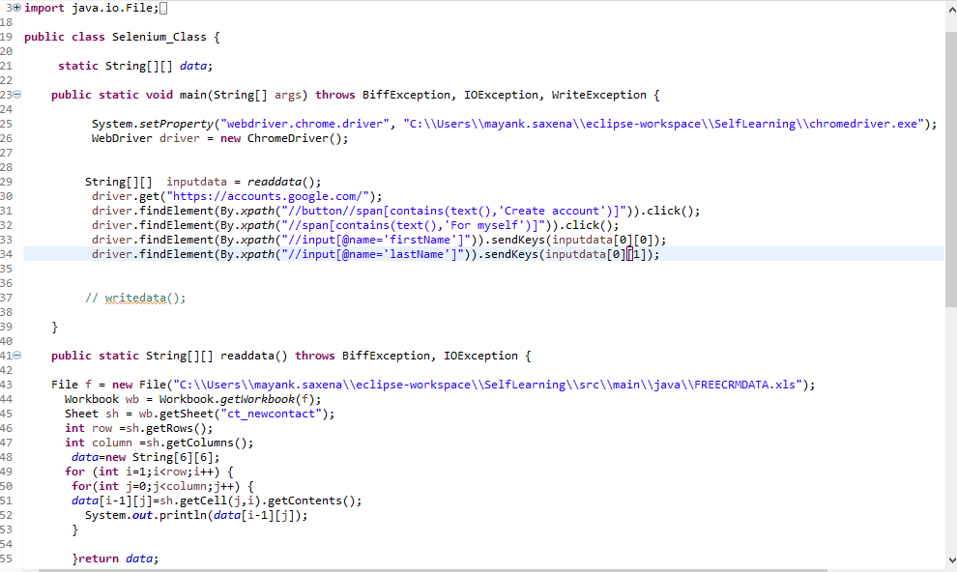
Reading from Excel using JXL API
JXL API (a.k.a. Java Excel API) allows users to read, write, create, and modify sheets in an Excel(.xls) workbook at runtime.

Slide 4
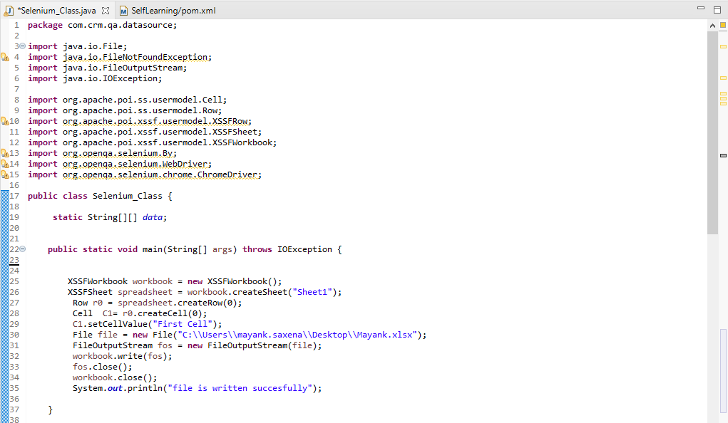
Writing to Excel using JXL API
JXL API (a.k.a. Java Excel API) allows users to read, write, create, and modify sheets in an Excel(.xls) workbook at runtime.

Slide 5
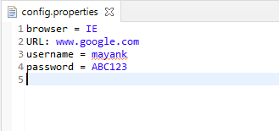
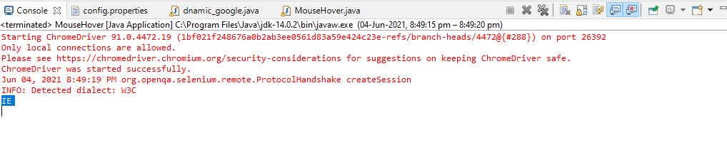
Reading from Excel using JXL API
Create and Read data from Config file.
Write code in Eclipse
Result

Slide 6
Selenium Webdriver continues..
Topics covered
Reading & Writing Data to Excel
Run selenium script using Cross Browser Testing
Config. file
Data driven Testing

Slide 7
Pom Dependencies
<!-- https://mvnrepository.com/artifact/net.sourceforge.jexcelapi/jxl -->
<dependency>
<groupId>net.sourceforge.jexcelapi</groupId>
<artifactId>jxl</artifactId>
<version>2.6.12</version>
</dependency>
<!-- https://mvnrepository.com/artifact/org.apache.poi/poi -->
<dependency>
<groupId>org.apache.poi</groupId>
<artifactId>poi</artifactId>
<version>4.1.2</version>
</dependency>
<dependency>
<groupId>org.freemarker</groupId>
<artifactId>freemarker</artifactId>
<version>2.3.28</version>
</dependency>
<!-- https://mvnrepository.com/artifact/org.apache.poi/poi-ooxml -->
<dependency>
<groupId>org.apache.poi</groupId>
<artifactId>poi-ooxml</artifactId>
<version>4.1.2</version>
</dependency>
<!-- https://mvnrepository.com/artifact/dom4j/dom4j -->
<dependency>
<groupId>dom4j</groupId>
<artifactId>dom4j</artifactId>
<version>1.5.2</version>
</dependency>

