Slide 1
Selenium Webdriver
Session 22nd Jul

Slide 2
Table of Contents
Agenda
Testing Framework - TestNG
Installation of TestNG
TestNG Library
TestNG Annotations
Test cases with Priority set
Reports

Slide 3
Selenium Webdriver continues..
TestNG
Automation Testing framework
NG stands for “Next Generation”
Free, Open source
TestNG is inspired from JUnit which uses the annotations
Annotations are easier to understand
Test cases can be grouped more easily
Used for Reporting

Slide 4
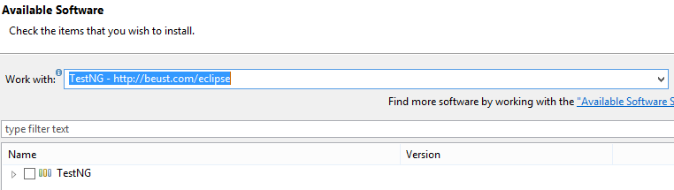
TestNG continues..
Installation of Test NG
https://testng.org/testng-eclipse-update-site/

Slide 5
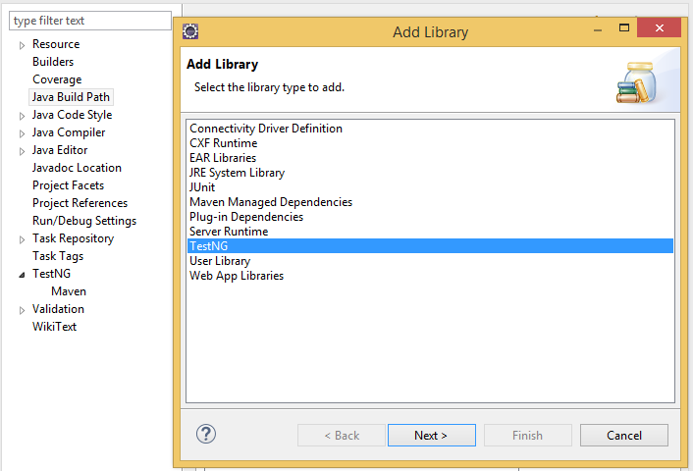
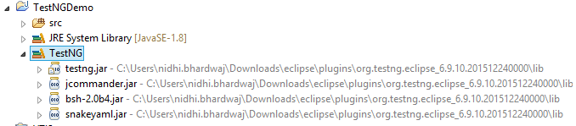
TestNG continues..
Test NG Library
Go to Project-> Properties-> Java Build path

Slide 6
TestNG continues..
TestNG Annotations
@BeforeSuite
@BeforeTest
@BeforeClass
@BeforeMethod
@Test
@AfterMethod
@AfterClass
@AfterTest
@AfterSuite
No main method required to write

Slide 7
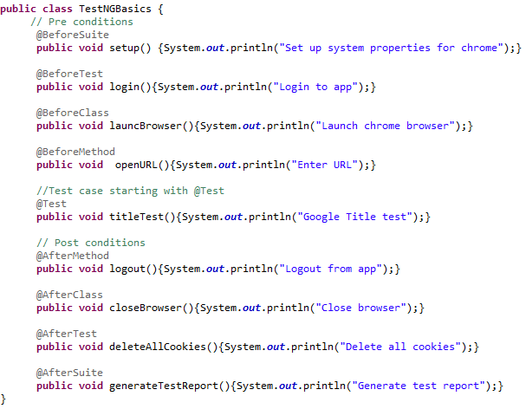

TestNG Annotation continues..
Annotation Example:
Run as TestNG Test

Slide 8
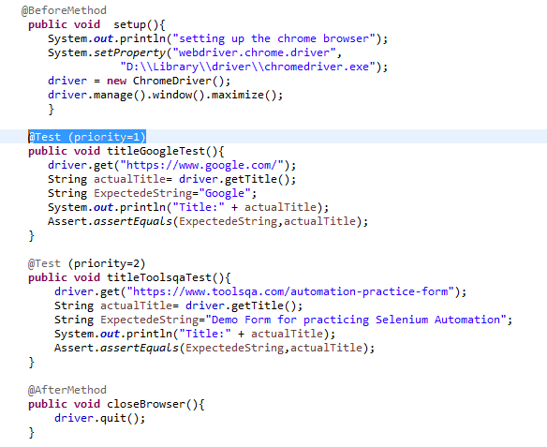
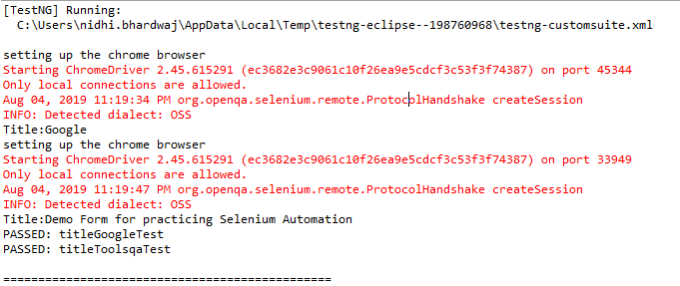
TestNG continues..
Test cases with Priority set

Slide 9
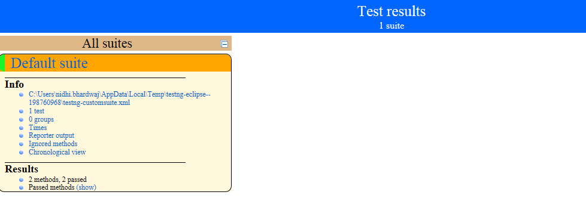
TestNG continues..
Reports : test-output-> index.html

Slide 10
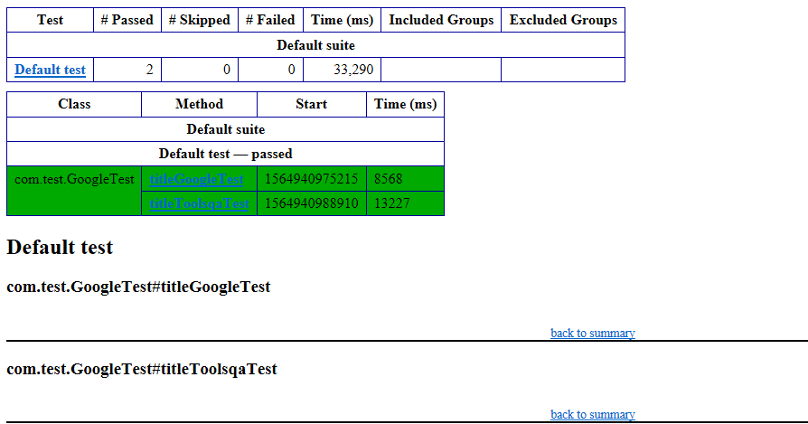
TestNG Reports continues..
Reports: test-output -> emailable-report.html

Slide 11
Selenium Webdriver continues..
Topics covered
Testing Framework - Test NG
Installation of TestNG
TestNG Library
TestNG Annotations
Test cases with Priority set
Reports
TestNG.xml

