Slide 1
Selenium Webdriver
Session 29th July

Slide 2
Table of Contents
Agenda
How to Connect with Database
How to Get the data using select query
How to Insert, Update and Deleted in database

Slide 3
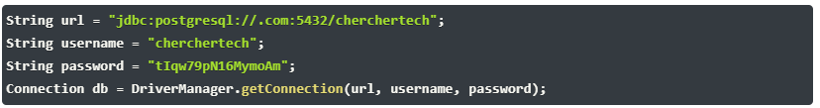

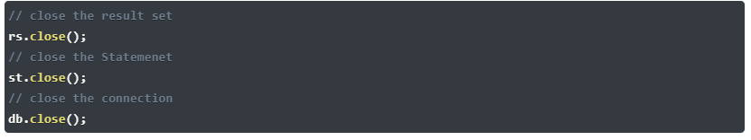
Database Testing using Selenium
Make a connection to the Database
Send Queries to the Database
Process the results

Slide 4
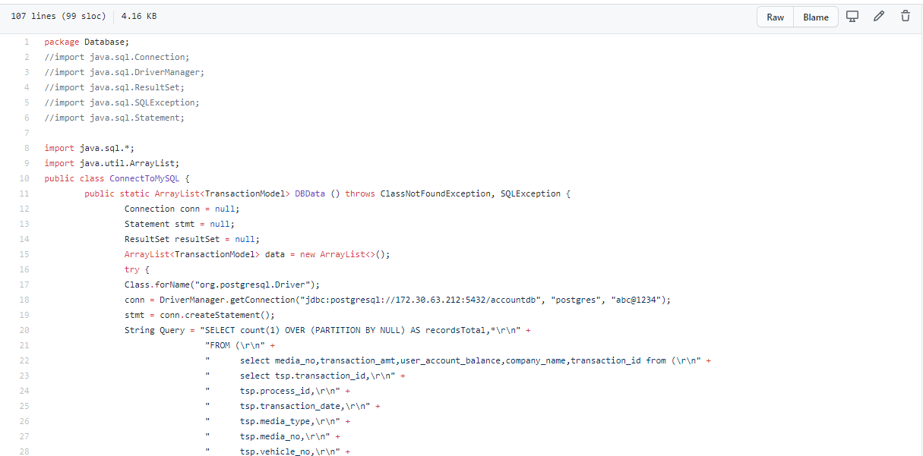
Database Testing using Selenium
Make a connection to the Database
Send Queries to the Database
Process the results

Slide 5
Selenium Webdriver continues..
Topics covered
Connect with Database
Get the data from table
Insert, Update and Deleted data in table

