Slide 1
Selenium Webdriver
Session 17th Aug

Slide 2
Selenium Webdriver continues..
Agenda
Integration with CI/CD- Jenkins
Installation of Maven plugin in Jenkins
Update pom.xml file.
Run Test cases from Jenkins
Scheduling Test cases
Pros and Cons of Selenium
Challenges/Limitations

Slide 3
Selenium Webdriver continues..
Integration with CI/CD- Jenkins
Download Jenkins.war
Start the Jenkins server on Port 8080/8082
Run java -jar jenkins.war --httpPort=8082 to start the Jenkins server
Access the Jenkins dashboard via http://localhost:8080

Slide 4
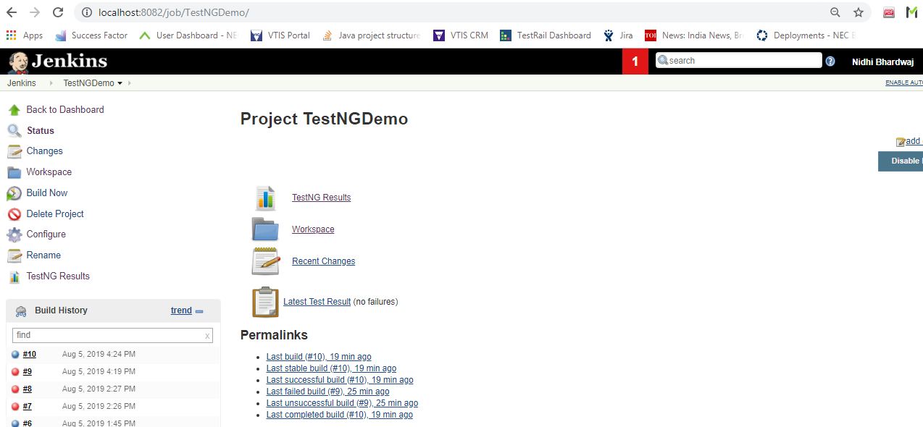
Integration with CI/CD- Jenkins continues..
Create a new Job named- TestNGDemo

Slide 5
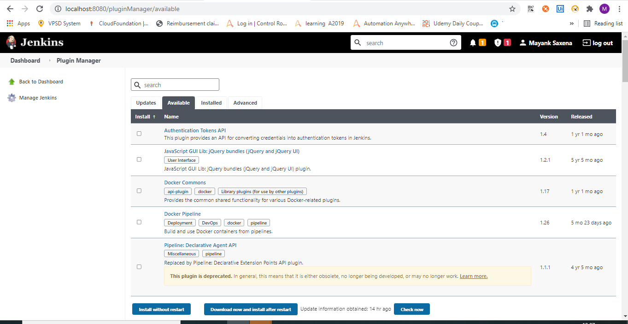
Integration with CI/CD- Jenkins continues..
Installation of TestNG plugin in Jenkins
Download the “Maven”
Go to Jenkins -> Manage Jenkins -> Manage plugins -> Available ->Download Maven plugin

Slide 6
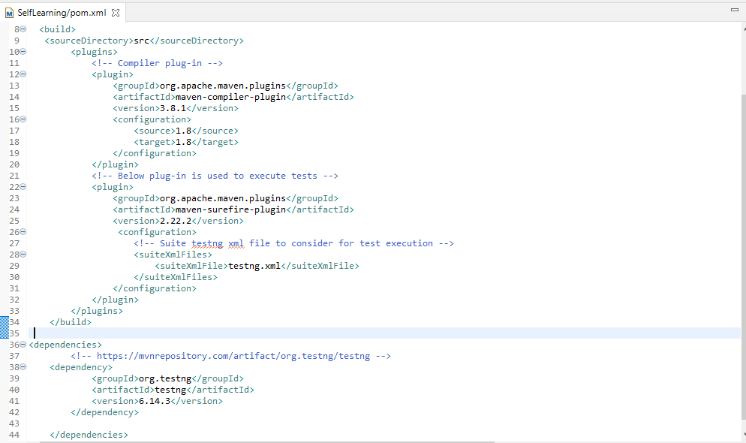
Update pom.xml
Add TestNG file Path in Pom.xml
<configuration>
<!-- Suite testng xml file to consider for test execution -->
<suiteXmlFiles>
<suiteXmlFile>testng.xml</suiteXmlFile>
</suiteXmlFiles>
</configuration>

Slide 7
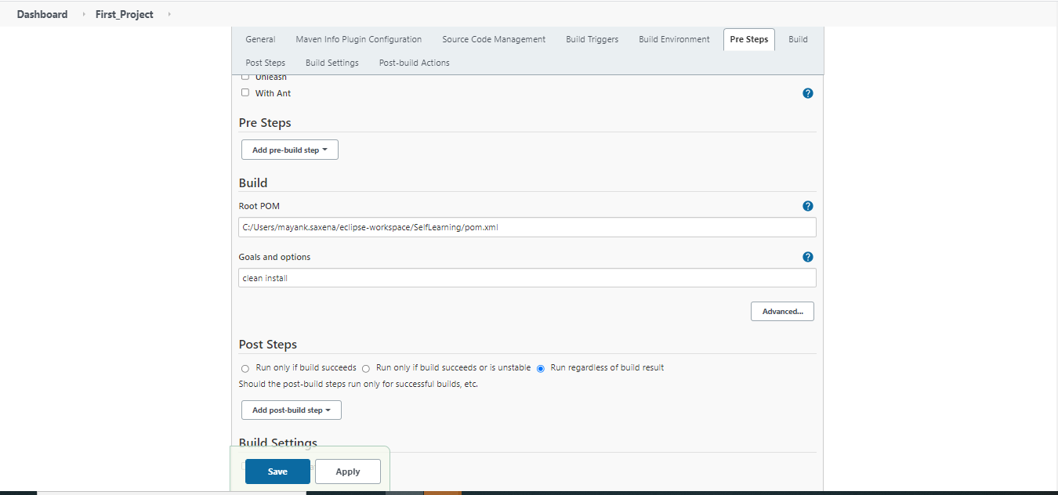
Integration with CI/CD- Jenkins continues..
Run Test cases from Jenkins
Go to Project -> configure -> Pre Steps > Path of pom.xml file

Slide 8
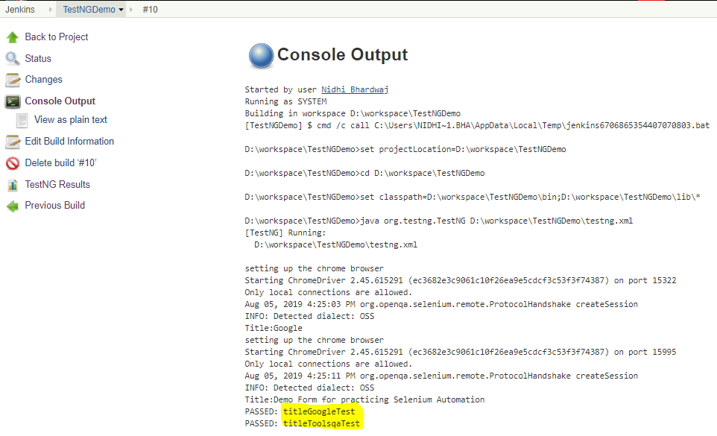
Integration with CI/CD- Jenkins continues..
Go to Project-> Build Now
It will build your project and public TestNG reports.
Go to Build number and click on the console output for the logs.

Slide 9
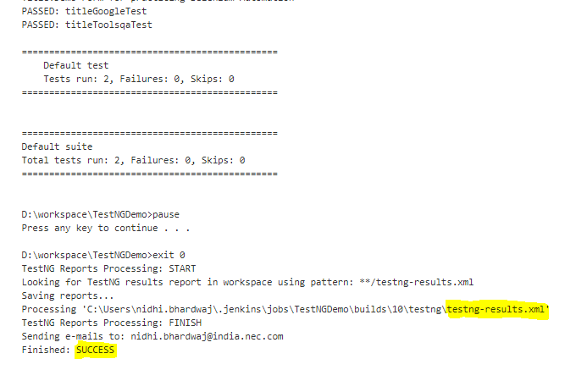
Integration with CI/CD- Jenkins continues..
Build Console

Slide 10
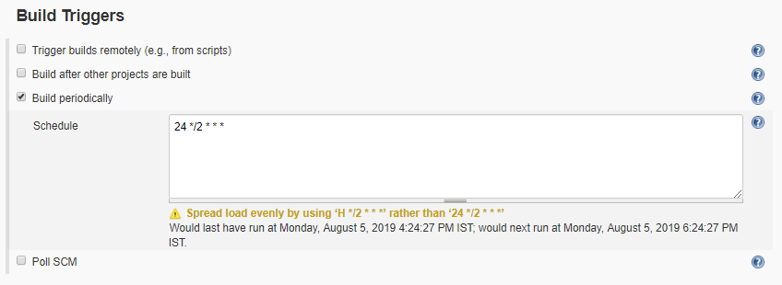
Integration with CI/CD- Jenkins continues..
Scheduling TestNG Test cases from Jenkins
Go to TestNGDemo -> configure -> Build Triggers
Cron job syntax * * * * *
MINUTES Minutes in one hour (0-59)
HOURS Hours in one day (0-23)
DAYMONTH Day in a month (1-31)
MONTH Month in a year (1-12)
DAYWEEK Day of the week (0-7) where 0 and 7 are sunday

Slide 11
Selenium Webdriver continues..
Pros and Cons of Selenium
Pros
Open source
Integrated with Agile, DevOps, Continuous Delivery workflow
Supports mobile testing
Wide range of supported languages, platforms, and browsers
supports parallel test execution using selenium grid
Huge Community
Large Library of plugins

Slide 12
Selenium Webdriver continues..
Cons of Selenium
Cons
No Reporting
No Tech support
Web based stuff only, e.g no windows applications
Not supported to Automate Scenario like barcode/code captcha.
Programming knowledge is must

Slide 13

Selenium Webdriver continues..

Slide 14

Selenium Webdriver continues..

Slide 15
Selenium Webdriver continues..
References
https://www.toolsqa.com/selenium-tutorial/
https://www.javatpoint.com/selenium-tutorial
https://www.guru99.com/selenium-tutorial.html
https://www.softwaretestinghelp.com/selenium-webdriver-selenium-tutorial-8/
Email : Mayank.Saxena@india.nec.com

