Slide 1
NPU
Tightly Coupled Memory
RISC-V Scalar CPU
I$
D$
RF
LSU
RISC-V Vector (VPU)
EXU
VRF
VLSU
RISC-V Matrix (MPU)
MAC Array
MRF
MLSU
Data Movement Engine

Slide 2
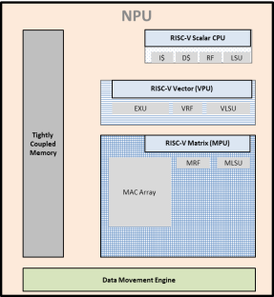
SoC
Apps CPU
Apps CPU
Apps CPU
Apps CPU
On Chip SRAM
System Interconnect
EMIF
DDR

Slide 3
n
k
k
m
n
m
A
B
C

Slide 5
Registers
Cache/TCM
On-Chip SRAM
DDR
Storage
Speed
Cost
Storage
Capacity

