Slide 1
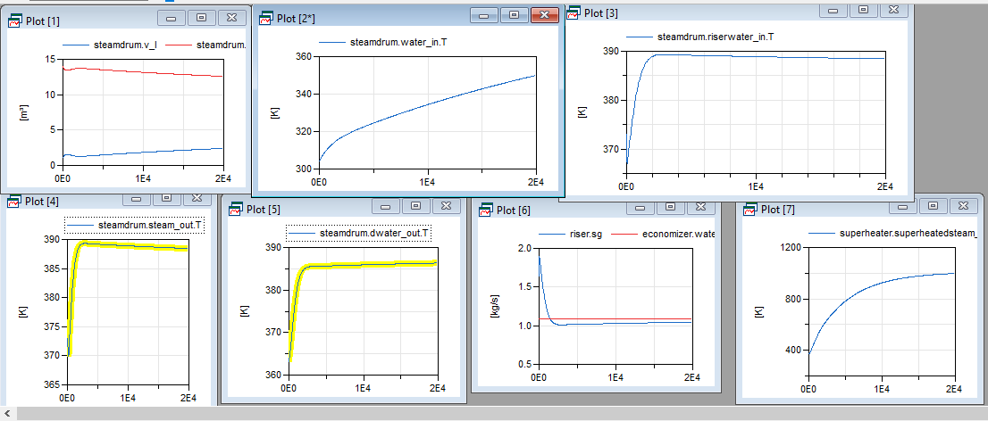
Normal temperature profiles when the dry air source is at 873 K(600 C)

Slide 2
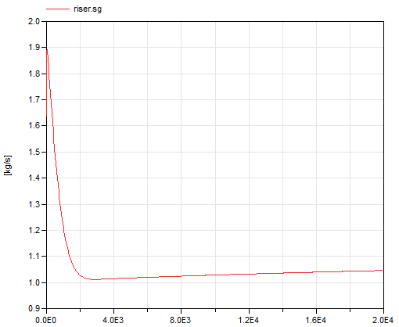
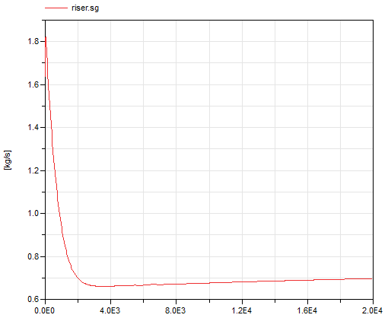
Effect of dry air temperature change in the steam generation
At dry air source temeperature of 873 K
At dry air source temperature of 673 K

Slide 3
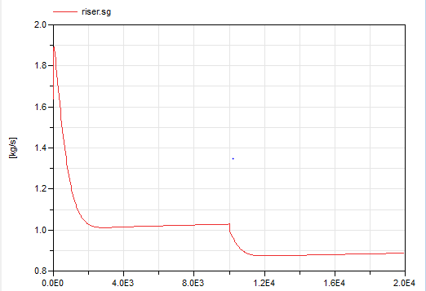
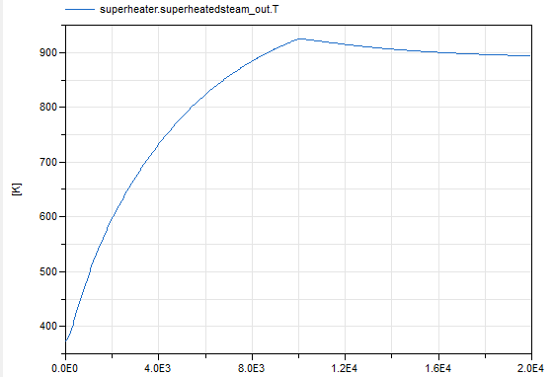
When there is a cloud passing by and the temperature drops to a value 773 K it’s corresponding changes in the outlet temperature profiles
The effect on steam generation
The effect on temperature on outlet superheated steam

Slide 4
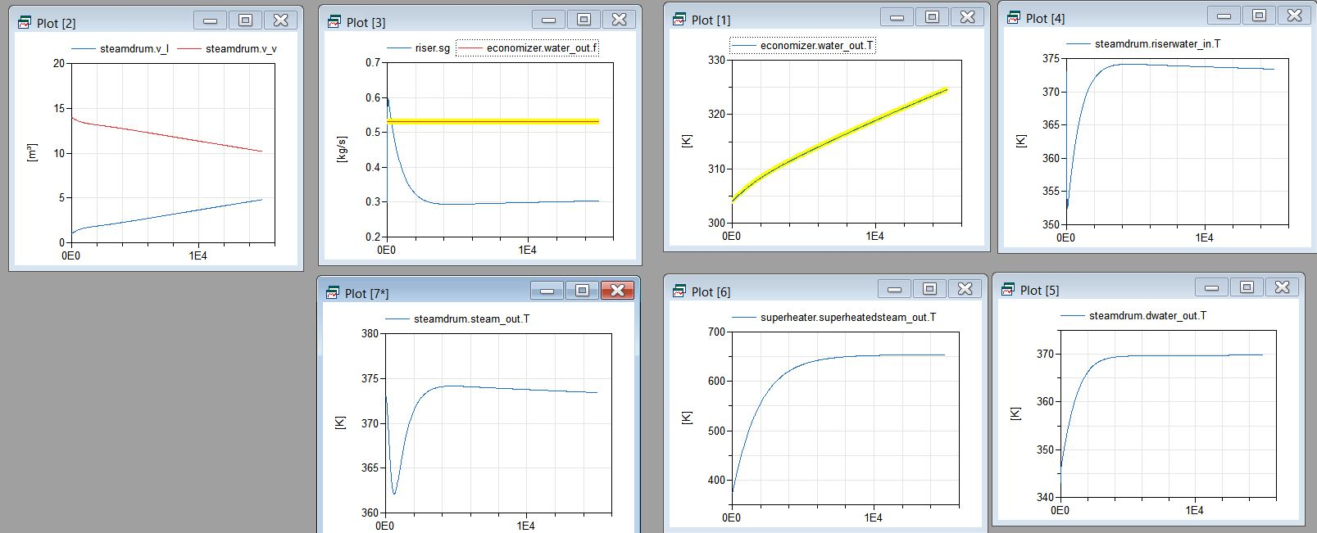
When The temperature inlet from thermal energy storage is at about 673 K(400 C)

Slide 5
When the mass hold up is 1 kg

Slide 6
When the mass hold up is considerably high

