Slide 1
Feed Forward And Back Propagation

Slide 2
Introduction
Implemented feed forward neural network with back propagation for the following problems :
2-input NAND
2-input XOR
5-input palindrome
5-input majority
5-input parity
Seven segment display
Twitter sentiment Analysis
IRIS and MONK data sets

Slide 3
Plot for Number of Iterations with Learning Rate

Slide 4
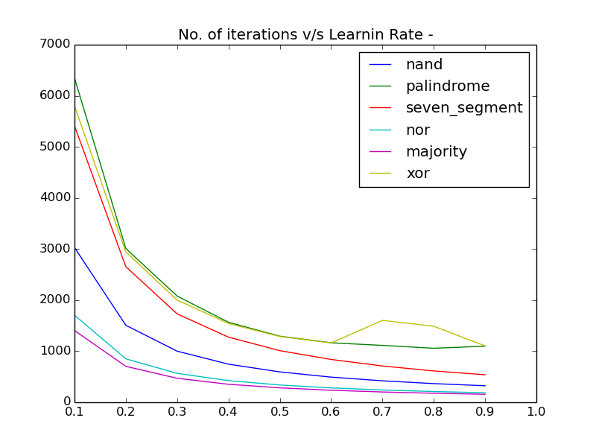
No. of iterations v/s Learning rate
It is observed from the graph that the number of iterations for the convergence of FFNN decreases as the learning rate increases.

Slide 5
Plots for Variation of Error with Learning Rate

Slide 6
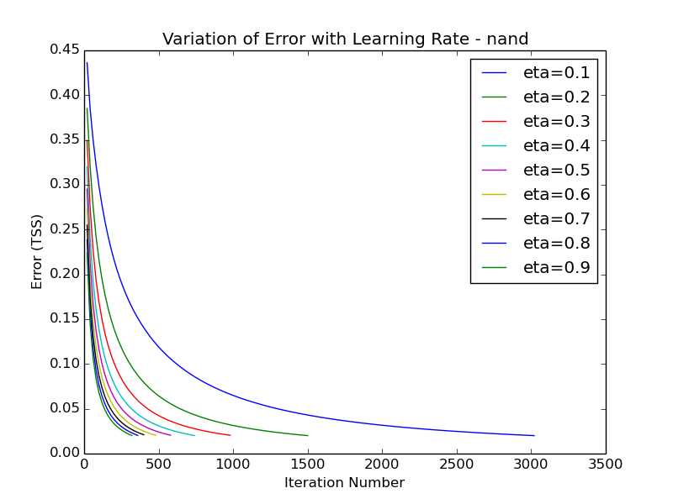
2-input NAND

Slide 7
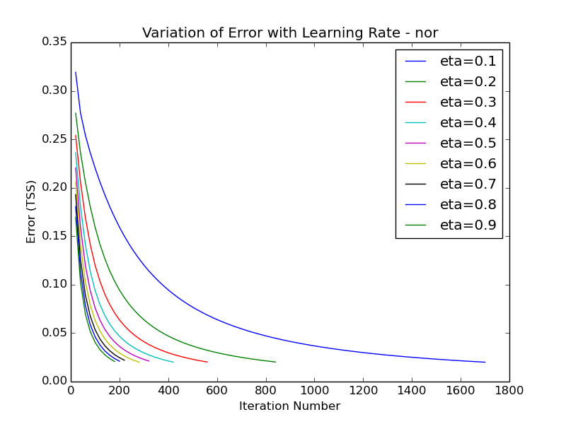
2-Input NOR

Slide 8
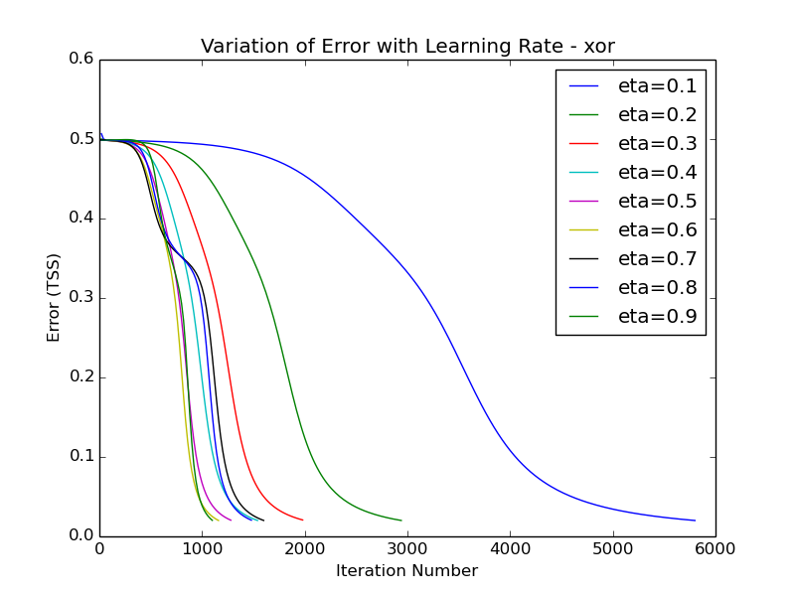
2-Input XOR

Slide 9
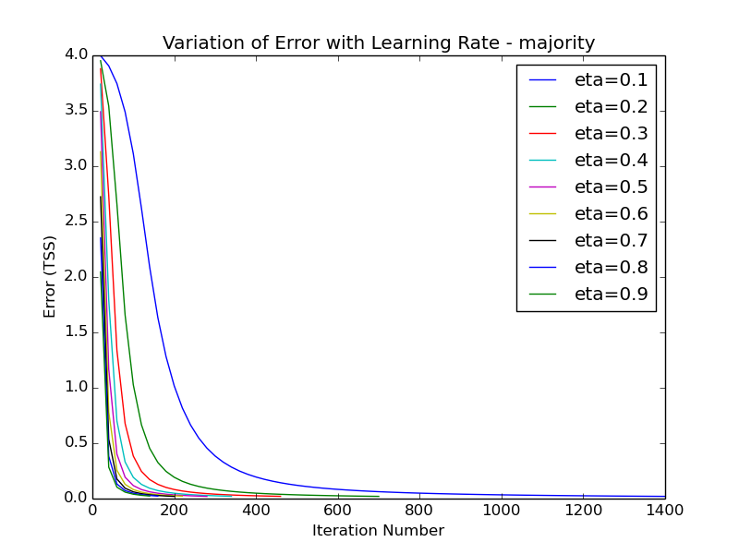
5-input Majority

Slide 10
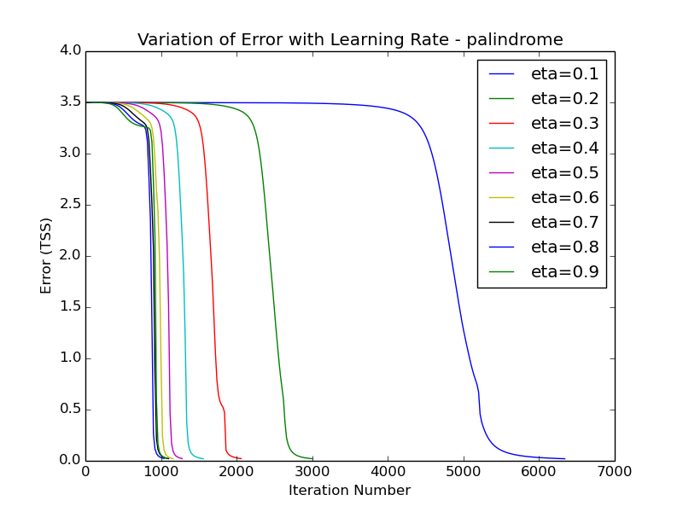
5-Input Palindrome

Slide 11
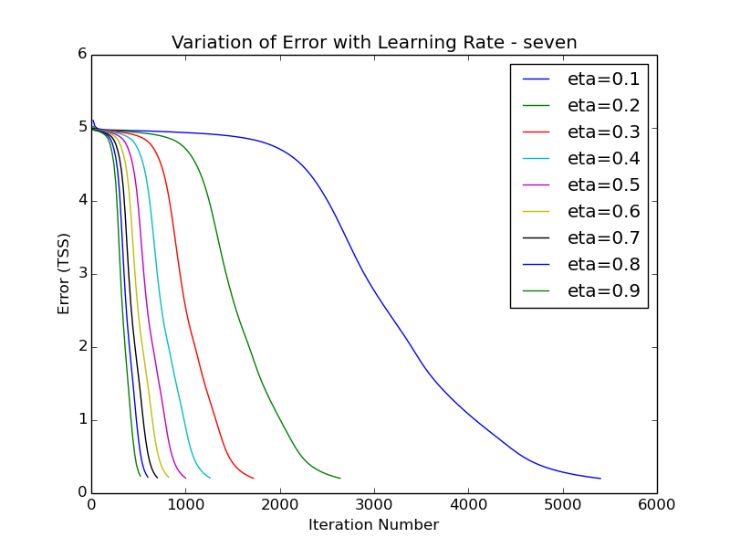
Seven Segment Display

Slide 12
Local Minima and Saturation
The back propagation algorithm can get stuck in the local minimum. This is because back propagation algorithm tries greedily to reduce the error by updating weights.
In such case, the error does not reduce below the local minimum value , hence BP goes into a state of saturation, thereby not attaining global minimum.

Slide 13
Momentum
To avoid saturation, momentum factor is introduced in the algorithm which while updating weights also takes into account the weight updates in the previous iteration.
It helps to avoid the local minimum by accelerating the movement out of the trough and dampening the oscillations inside the trough.

Slide 14
Plots for Variation of Error with Moment

Slide 15
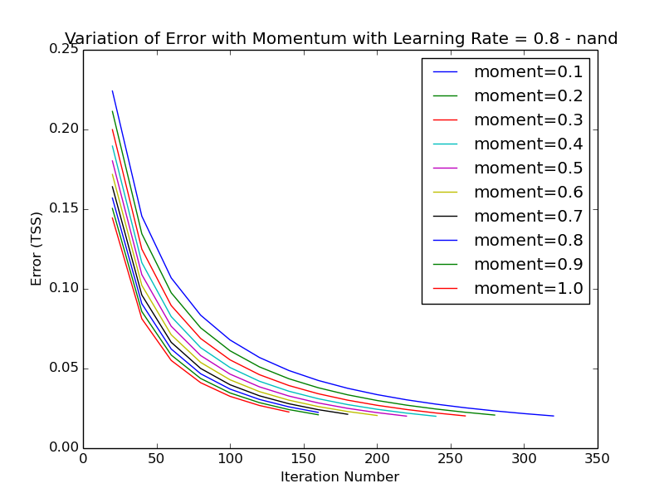
2-Input NAND

Slide 16
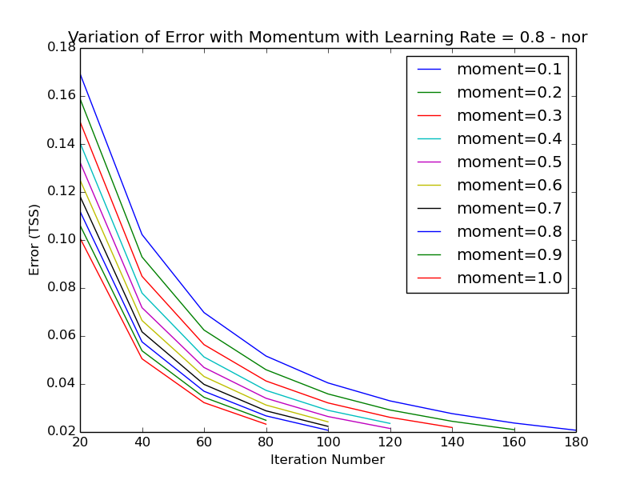
2-Input NOR

Slide 17
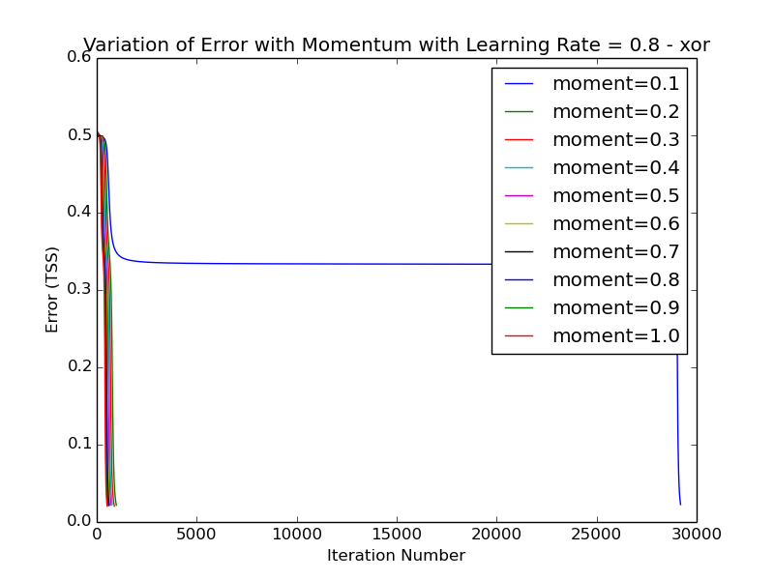
2-Input XOR

Slide 18
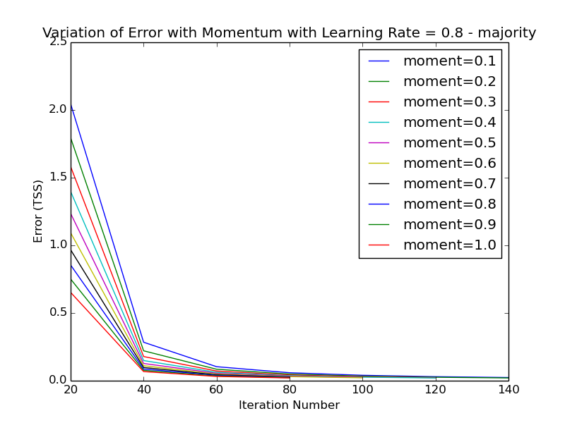
5-Input Majority

Slide 19
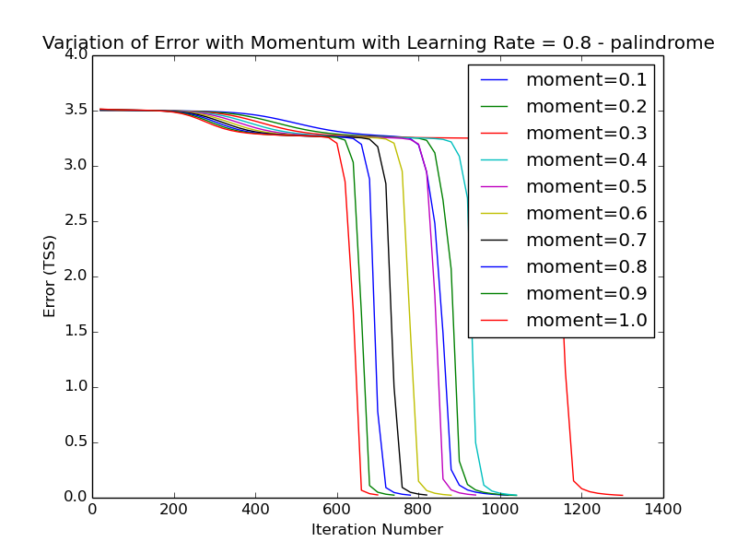
5-Input Palindrome

Slide 20
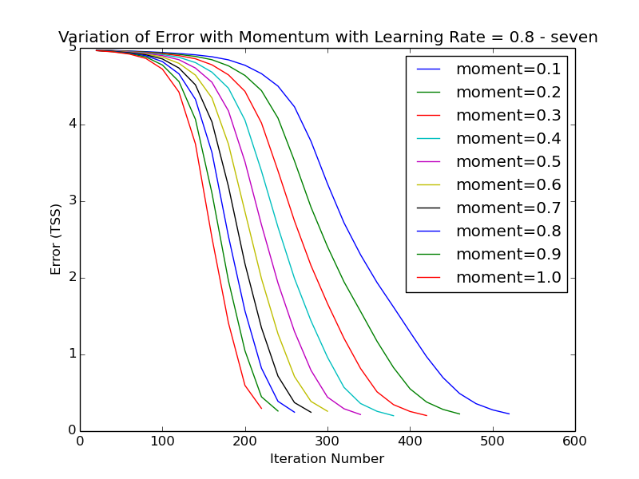
Seven Segment Display

Slide 21
Analysis of Hidden Layers

Slide 22
Analysis of Hidden Layers
Number of hidden layers used :
2-input XOR : 2 hidden layers
5-input palindrome : 3 hidden layers
In case of XOR, the hidden layers behaved differently for different ranges of learning rate( η ).
For η < 0.7 and η >=0.7, the functionality of hidden layers changes.

Slide 23
Analysis of Hidden Layers : XOR
For η < 0.7
 | 0 | 1
0 | 1 | 1
1 | 1 | 0
 | 0 | 1
0 | 0 | 1
1 | 1 | 1
x2
x2
x1
x1
Hidden layer1 :
h1 = ¬(x1 ∧ x2)
Hidden layer2 :
h2 = x1 ∨ x2
 | 0 | 1
0 | X | 0
1 | 0 | 1
h2
h1
Final layer:
O = h1 ∧ h2

Slide 24
Analysis of Hidden Layers : XOR
For η >= 0.7
 | 0 | 1
0 | 0 | 0
1 | 0 | 1
 | 0 | 1
0 | 0 | 1
1 | 1 | 1
x2
x2
x1
x1
Hidden layer1 :
h1 = x1 ∧ x2
Hidden layer2 :
h2 = x1 ∨ x2
 | 0 | 1
0 | 0 | 1
1 | X | 0
h2
h1
Final layer:
O = ¬h1 ∧ h2

Slide 25
Analysis of Hidden Layers : Palindrome
For Hidden Layer 1 (h1)
x4x5
x4x5
 | 00 | 01 | 11 | 10
00 | 0 | 0 | 0 | 0
01 | 0 | 0 | 0 | 0
11 | 1 | 1 | 0 | 0
10 | 1 | 1 | 0 | 0
 | 00 | 01 | 11 | 10
00 | 0 | 0 | 0 | 0
01 | 0 | 0 | 0 | 0
11 | 1 | 1 | 0 | 0
10 | 1 | 1 | 0 | 0
x2x3
x2x3
x1 = 0
x1 = 1
Hidden layer1 :
h1 = x2 ∧ ¬ x4

Slide 26
Analysis of Hidden Layers : Palindrome
For Hidden Layer 2 (h2)
x4x5
x4x5
 | 00 | 01 | 11 | 10
00 | 0 | 1 | 1 | 1
01 | 0 | 1 | 1 | 1
11 | 0 | 1 | 1 | 0
10 | 0 | 1 | 1 | 0
 | 00 | 01 | 11 | 10
00 | 1 | 1 | 1 | 1
01 | 1 | 1 | 1 | 1
11 | 1 | 1 | 1 | 1
10 | 1 | 1 | 1 | 1
x2x3
x2x3
x1 = 0
x1 = 1
Hidden layer2 :
h2 = x1 ∨ x5 ∨ (¬x2 ∧ x4)

Slide 27
Analysis of Hidden Layers : Palindrome
For Hidden Layer 3 (h3)
x4x5
x4x5
 | 00 | 01 | 11 | 10
00 | 0 | 0 | 0 | 0
01 | 0 | 0 | 0 | 0
11 | 0 | 0 | 1 | 0
10 | 0 | 0 | 1 | 0
 | 00 | 01 | 11 | 10
00 | 0 | 1 | 0 | 0
01 | 0 | 1 | 0 | 0
11 | 1 | 1 | 1 | 0
10 | 1 | 1 | 1 | 0
x2x3
x2x3
x1 = 0
x1 = 1
Hidden layer3:
h3 = ¬x4 ∧((x2 ∧ x5) ∨ (x1 ∧ x5) ∨ (x1 ∧ x2)) ∨(x1 ∧ x2 ∧ x5)

Slide 28
Analysis of Hidden Layers : Palindrome
For Final Layer (O)
h2h3
 | 00 | 01 | 11 | 10
0 | 1 | X | 1 | 0
1 | 0 | X | 0 | X
h1
Output Layer (O):
O = ¬x1 ∧ (¬ x2 ∨ x3)

Slide 29
Symmetry Breaking
If all weights are initialized to the same value then back propagation does not converge.
Explanation – On initializing with equal weights, FFNN on each successive iteration modifies weights by equal amount. This symmetric update of weights leads to non convergence of back propagation.

Slide 30
Twitter Sentiment Analysis
Feature Vector Extraction
Separate out the words from tweets.
Remove duplicate and unwanted words from the list using sorting and stemming.
Length of feature vector = # of words extracted
If the word is present in the tweet, set the value 1, else 0.
Five Fold Cross Validation
Shuffle the input data(tweets).
Separate out the data into five sets.
At a time, four are used for training and the remaining one is used as validation set.

Slide 31
Twitter Sentiment Analysis : Error v/s Iteration Number
The graph represents the variation of error with the iteration number during the training phase.
The error values are quite close for all the five folds.

Slide 32
Twitter Sentiment Analysis : Accuracy and Iterations
The graph represents the accuracy on validation and # of iterations on convergence for five fold data.
Average Accuracy = 64.25%

Slide 33
Back Propagation on Benchmark Data Sets : IRIS and MONK

Slide 34
FFNN Configuration : IRIS Data
# of inputs = 4
# of hidden layers = 1 (with 10 neurons)
# of outputs = 3
Learning Rate = 0.01
Momentum = 0.01
Size of training data = 150

Slide 35
IRIS Data: Accuracy
The graph represents the accuracy on validation data sets for five fold IRIS data.
Average Accuracy = 92.00%

Slide 36
IRIS Data: # of Iterations
The graph represents the # of iterations taken for convergence of five fold IRIS data.

Slide 37
FFNN Configuration : MONK Data
# of inputs = 6
# of outputs = 1
Learning Rate = 0.9
Momentum = 0.0
MONK-1
# of hidden layers = 1( with 4 neurons)
MONK-2
# of hidden layers = 1( with 20 neurons)
MONK-3
# of hidden layers = 1( with 7 neurons)

Slide 38
MONK Data: Accuracy
The graph represents the accuracy on MONK data sets ( MONK-1, MONK-2, MONK-3)

Slide 39
MONK Data: # of Iterations
The graph represents the # of iterations taken for convergence of MONK data sets ( MONK-1, MONK-2, MONK-3).

