Slide 1
A* Algorithm

Slide 2
Introduction
Implemented A* algorithm and applied it on the following problems :
8-tiles Puzzle Problem
Missionaries and Cannibal Problem
Implemented bidirectional search and compared it with the A* algorithm.
Compared performance of various heuristics with both A* and Bidirectional search.

Slide 3
A* Implementation
Created a class called “Node” consisting of following data members :
ID: unique identifier for node, represents state.
isVisited: set when a node is removed from open list
parent : pointer to the parent node
gvalue and hvalue
Compute_hvalue( ): Returns hvalue according to the heuristic
Get_children( ): Returns all possible states obtained from the node after applying one operation on that node

Slide 4
A* Implementation
Parent Pointer Redirection
Whenever an alternate shorter path to an already visited node is found, the parent pointer of that node and its gvalue is readjusted.
The gvalue of the descendants of that node is also updated.
Parent pointer redirection ensures that already visited node i.e. a node is in closed list is never put again into the open list.

Slide 5
8-Tiles Puzzle Problem
Configuration
The eight puzzle consists of a three by three board with eight numbered tiles and a blank space.
Operation
A tile adjacent to the blank space can slide into the space.
Objective
The object is to figure out the steps needed to get from one configuration of the tiles to another.

Slide 6
8-Tiles Puzzle Problem : Heuristics
H0 : Trivial Heuristic
hvalue = 0
Satisfies admissibility of A* .
Follows Montone Restriction.
H1 : No. of Displaced Tiles
hvalue = No. of tiles which are displaced from their actual position in the goal node.
Satisfies admissibility of A* .
Follows Monotone Restriction.
.

Slide 7
8-Tiles Puzzle Problem : Heuristics
H2 : Manhattan Distance
hvalue = sum of manhattan distances of tiles from their destined position.
Satisfies admissibility of A* .
Follows Monotone Restriction.
H3 : No. of inversion pairs/2
hvalue = abs([#Inv_pairs(Node) - #Inv_pairs(Goal)]/2)
Satisfies admissibility of A* .
Follows Monotone Restriction.

Slide 8
H3 : Proof of admissibility and MR
One operation i.e. moving a tile to the blank space results in change in number of inversion pairs either by 0 or 2.
For MR satisfiability,
h(p) <= h(c) + cost(p,c)
Here, h(n) = #inversion_pairs(n)/2
Cost(p, c) = 1
Also, MR => Admissibility

Slide 9
Proof of Monotone Restriction
Case 1:
#inversion_pairs(c) = #inversion_pairs(p) + 2
h(c) = h(p) + 1
Then, h(p) <= h(c) + cost(p,c) is satisfied trivially.
Case 2:
#inversion_pairs(c) = #inversion_pairs(p) - 2
h(c) = h(p) - 1
Then, h(p) = h(c) + cost(p,c)
Thus, h(p) <= h(c) + cost(p,c) is satisfied.
Case 3:
#inversion_pairs(c) = #inversion_pairs(p)
h(c) = h(p)
Then, h(p) <= h(c) + 1 is satisfied.
H3 satisfies MR.
Hence, Heuristic H3 is admissible.

Slide 10
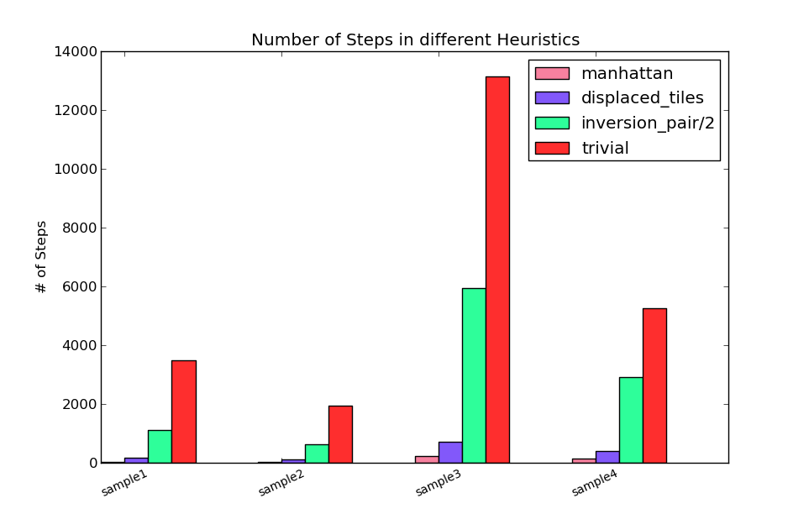
8-Tiles : Better Heuristic Performs Better
1. Comparison of various heuristics employed for 8-tiles problem.
2. Manhattan distance performs best whereas the trivial heuristic is the poorest.
3. The inversion_pairs/2 heuristic performs worse than Manhattan and displaced tiles.

Slide 11
8-Tiles Puzzle Problem : Heuristics
H4 : No. of inversion pairs
hvalue = abs[#Inv_pairs(Node) - #Inv_pairs(Goal)]
Violates admissibility of A*.
Violates Monotone Restriction.
h(n) = 2, h*(n) = 1 h(goal) = 0
Since h(n) > h*(n), H4 is inadmissible.
1 | 2 | 3
4 | 5
7 | 8 | 6
1 | 2 | 3
4 | 5 | 6
7 | 8

Slide 12
8-Tiles: Parent Pointer Redirection with H4
Keeping the final state = [[1,2,3],[8,0,4],[7,6,5]]
Start State | Parent Pointer Direction Happens
[[3,5,8],[4,1,6],[2,7,0]] | ✓
[[3,1,4],[6,2,8],[0,5,7]] | ✓
[[8,3,5],[4,1,6],[2,7,0]] | ✓
[[2,8,1],[4,6,3],[0,7,5]] | ✗
[[1,2,3],[6,5,4],[0,7,8]] | ✗
[[1,3,2],[4,0,8],[7,6,5]] | ✗

Slide 13
8-Tiles Puzzle Problem : Heuristics
H5 : modified displaced tiles
hvalue =[#displaced tiles w.r.t. start state]*20 + 20
Violates admissibility of A*.
Violates Monotone Restriction.
start state n final state
h(n) = 1*20+20 = 40 , h*(n) = 1
Since h(n) > h*(n), H5 is inadmissible.
1 | 2 | 3
4 |  | 5
7 | 8 | 6
1 | 2 | 3
4 | 5
7 | 8 | 6
1 | 2 | 3
4 | 5 | 6
7 | 8

Slide 14
Non-optimality of H5
Start state = [[0, 1, 2][3, 4, 5][6, 7, 8]]
Final state = [[4, 1, 2][0, 6, 3][7, 5, 8]]
With manhattan distance heuristic
#steps = 114
Pathlength = 16
With H5 heuristic
#steps = 1085
Pathlength = 18
H5 gives sub-optimal path.

Slide 15
Non-optimality of H5
Start state = [[1, 3, 6], [4, 0, 2], [7, 5, 8]]
Final state = [[1, 2, 3], [4, 5, 6], [7, 8, 0]]
With trivial heuristic i.e. h = 0
#steps = 108
Pathlength = 7
With H5 heuristic
#steps = 101
Pathlength = 7
H5 gives optimal path in smaller number of steps.

Slide 16
8-Tiles Puzzle : Non-Reachability
One operation i.e. moving a tile to the blank space results in change in number of inversion pairs either by 0 or 2.
Therefore, the difference between the number of inversion pairs of the start configuration and the goal configuration should be even for reachability.
If the difference between the number of inversion pairs is odd, then the 8-puzzle problem is not solvable.

Slide 17
Non-Reachability : Example
Start state Final State
No. of inversion pairs in start state = 16
No. of inversion pairs in final state = 7
➔ Difference = 9, which is odd.
Hence, Not solvable.
8 | 3 | 5
4 | 6 | 1
2 | 7
1 | 2 | 3
8 |  | 4
7 | 6 | 5

Slide 18
Missionaries and Cannibal Problem
Configuration
<#M, #C, P>
#M = Number of missionaries on bank L
#C = Number of cannibals on bank L
P = Position of the boat
Constraint
For both banks, if there are missionaries present on the bank, they cannot be outnumbered by cannibals (if they were, the cannibals would eat the missionaries).
Objective
How can the boat be used to safely carry all the missionaries and cannibals across the river?

Slide 19
Missionaries and Cannibals: Heuristics
H0 : Trivial Heuristic
hvalue = 0
Satisfies admissiblity of A* .
Follows Montone Restriction.
H1 : No. of persons left on L bank / 2
hvalue = (#M + #C)/2
Satisfies admissiblity of A* .
Follows Montone Restriction.

Slide 20
H1 : Proof of admissibility
A boat can carry at most two persons at a time.
The number of persons at the left bank = #M + #C.
Therefore,
Min # steps required = (#M + #C)/2
Also, h*(n) >= min steps required.
h(n) = min steps required = (#M + #C)/2.
Therefore, h(n) <= h*(n).
Hence, Heuristic H1 is admissible.

Slide 21
Missionaries and Cannibals: Heuristics
H2 : No. of persons left on L bank
hvalue = (#M + #C)
Violates admissiblity of A* .
Violates Montone Restriction.
Let the configuration of node n be <1, 1, L >
Then, h(n) = 2
Here, h*(n)=1 since M and C can be carried in a single boat safely.
Hence, h(n) > h*(n) violates admissibility of H2.

Slide 22
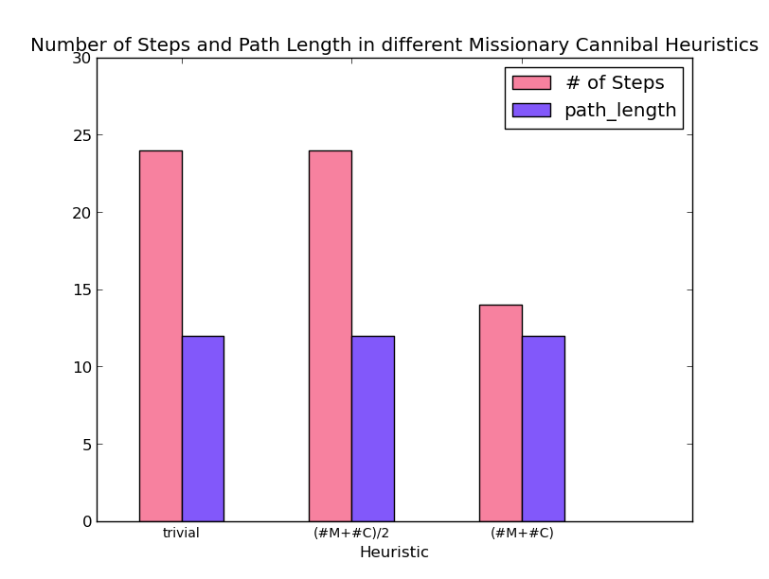
Missionary-Cannibal Heuristics
1. The trivial heuristic(H0) as well as ‘#persons/2’ (H1) take the same no. of steps and same path length.
2. ‘#persons’ (H2), though inadmissible, gives the optimal path as well as takes fewer steps to converge.

Slide 23
Bidirectional Search
Runs two simultaneous searches :
One forward from initial state
One backward from the goal state
Termination Condition
The search is terminated when the two search frontiers meet each other.
Construct the single path extending from start node through intersection node to the goal.
Bidirectional search does not guarantee optimality.

Slide 24
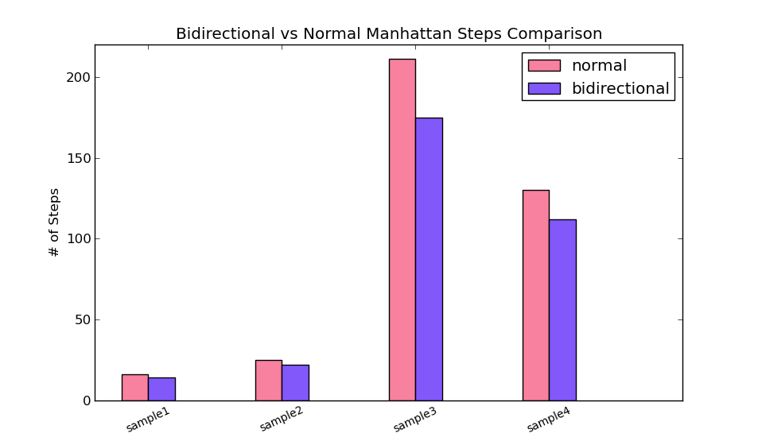
Bidirectional Search : 8-Tiles
1.Bidirectional search converges faster than even the Manhattan heuristic.
2. It follows from previous results that bidirectional search will converge faster than other heuristics as well.
3. However, the optimality is not guaranteed.

Slide 25
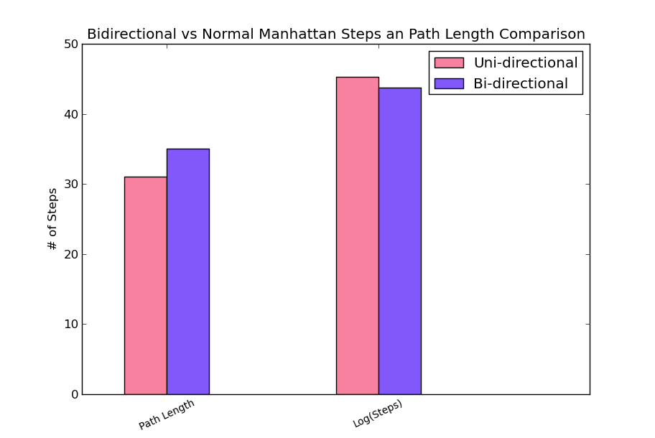
Non-optimality of Bidirectional Search : 8-Tiles
1. Start state = [[5,6,7],[4,0,8],[3,2,1]] Final state = [[1,2,3],[8,0,4],[7,6,5]]
2. Unidirectional search : Steps = 3837; PL= 31
Bidirectional search : steps = 2925; PL= 35
3. Bidirectional Search converges faster than the Manhattan heuristic but violates optimality.

