Slide 1
A* Algorithm

Slide 2
Introduction
Implemented A* algorithm and applied it on the following problems :
8-tiles Puzzle Problem
Missionaries and Cannibal Problem
Implemented bidirectional search and compared it with the A* algorithm.
Compared performance of various heuristics with both A* and Bidirectional search.

Slide 3
A* Implementation
Created a class called “Node” consisting of following data members :
ID: unique identifier for node, represents state.
isVisited: set when a node is removed from open list
parent : pointer to the parent node
gvalue and hvalue
Compute_hvalue( ): Returns hvalue according to the heuristic
Get_children( ): Returns all possible states obtained from the node after applying one operation on that node

Slide 4
A* Implementation
Parent Pointer Redirection
Whenever an alternate shorter path to an already visited node is found, the parent pointer of that node and its gvalue is readjusted.
The gvalue of the descendants of that node is also updated.
Parent pointer redirection ensures that already visited node i.e. a node is in closed list is never put again into the open list.

Slide 5
8-Tiles Puzzle Problem
Configuration
The eight puzzle consists of a three by three board with eight numbered tiles and a blank space.
Operation
A tile adjacent to the blank space can slide into the space.
Objective
The object is to figure out the steps needed to get from one configuration of the tiles to another.

Slide 6
8-Tiles Puzzle Problem : Heuristics
H0 : Trivial Heuristic
hvalue = 0
Satisfies admissiblity of A* .
Follows Montone Restriction.
H1 : No. of Displaced Tiles
hvalue = No. of tiles which are displaced from their actual position in the goal node.
Satisfies admissiblity of A* .
Follows Montone Restriction.
.

Slide 7
8-Tiles Puzzle Problem : Heuristics
H2 : Manhattan Distance
hvalue = sum of manhattan distances of tiles from their destined position.
Satisfies admissiblity of A* .
Follows Montone Restriction.
H3 : No. of inversion pairs/2
hvalue = abs([#Inv_pairs(Node) - #Inv_pairs(Goal)]/2)
Satisfies admissiblity of A* .
Follows Montone Restriction.

Slide 8
H3 : Proof of admissibility and MR
One operation i.e. moving a tile to the blank space results in change in number of inversion pairs either by 0 or 2.
For MR satisfiability,
h(p) <= h(c) + cost(p,c)
Here, h(n) = #inversion_pairs(n)/2
Cost(p, c) = 1
Also, MR => Admissibility

Slide 9
Proof of Montone Restriction
Case 1:
#inversion_pairs(c) = #inversion_pairs(p) + 2
h(c) = h(p) + 1
Then, h(p) <= h(c) + cost(p,c) is satisfied trivially.
Case 2:
#inversion_pairs(c) = #inversion_pairs(p) - 2
h(c) = h(p) - 1
Then, h(p) = h(c) + cost(p,c)
Thus, h(p) <= h(c) + cost(p,c) is satisfied.
Case 3:
#inversion_pairs(c) = #inversion_pairs(p)
h(c) = h(p)
Then, h(p) <= h(c) + 1 is satisfied.
H3 satisfies MR.
Hence, Heuristic H3 is admissible.

Slide 10
8-Tiles Puzzle Problem : Heuristics
H4 : No. of inversion pairs
hvalue = abs[#Inv_pairs(Node) - #Inv_pairs(Goal)]
Violates admissiblity of A*.
Violates Montone Restriction.
h(n) = 2, h*(n) = 1 h(goal) = 0
Since h(n) > h*(n), H4 is inadmissible.
1 | 2 | 3
4 | 5
7 | 8 | 6
1 | 2 | 3
4 | 5 | 6
7 | 8

Slide 11
8-Tiles Puzzle : Non-Reachability
One operation i.e. moving a tile to the blank space results in change in number of inversion pairs either by 0 or 2.
Therefore, the difference between the number of inversion pairs of the start configuration and the goal configuration should be even for reachability.
If the difference between the number of inversion pairs is odd, then the 8-puzzle problem is not solvable.

Slide 12
Missionaries and Cannibal Problem
Configuration
<#M, #C, P>
#M = Number of missionaries on bank L
#C = Number of cannibals on bank L
P = Position of the boat
Constraint
For both banks, if there are missionaries present on the bank, they cannot be outnumbered by cannibals (if they were, the cannibals would eat the missionaries).
Objective
How can the boat be used to safely carry all the missionaries and cannibals across the river?

Slide 13
Missionaries and Cannibals: Heuristics
H0 : Trivial Heuristic
hvalue = 0
Satisfies admissiblity of A* .
Follows Montone Restriction.
H1 : No. of persons left on L bank / 2
hvalue = (#M + #C)/2
Satisfies admissiblity of A* .
Follows Montone Restriction.

Slide 14
H1 : Proof of admissibility
A boat can carry at most two persons at a time.
The number of persons at the left bank = #M + #C.
Therefore,
Min # steps required = (#M + #C)/2
Also, h*(n) >= min steps required.
h(n) = min steps required = (#M + #C)/2.
Therefore, h(n) <= h*(n).
Hence, Heuristic H1 is admissible.

Slide 15
Missionaries and Cannibals: Heuristics
H2 : No. of persons left on L bank
hvalue = (#M + #C)
Violates admissiblity of A* .
Violates Montone Restriction.
Let the configuration of node n be <1, 1, L >
Then, h(n) = 2
Here, h*(n)=1 since M and C can be carried in a single boat safely.
Hence, h(n) > h*(n) violates admissibility of H2.

Slide 16
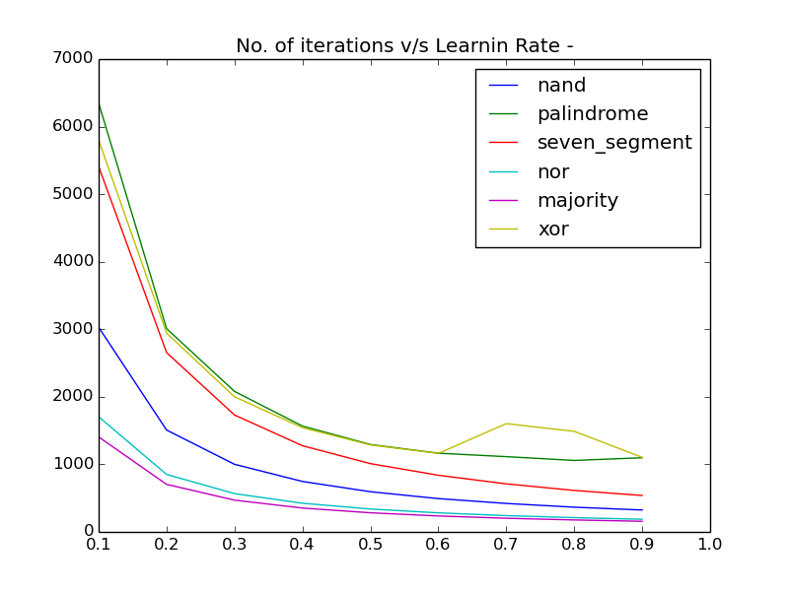
No. of iterations v/s Learning rate
It is observed from the graph that the number of iterations for the convergence of FFNN decreases as the learning rate increases.

Slide 17
Plots for Variation of Error with Learning Rate

Slide 18
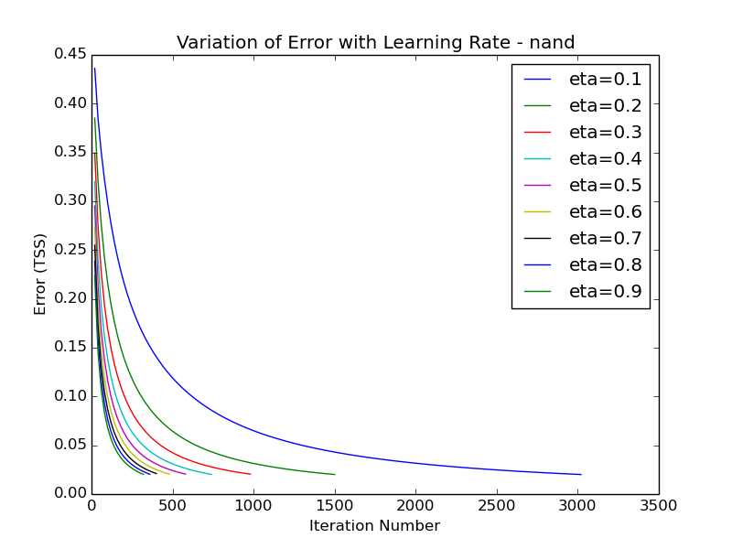
2-input NAND

Slide 19
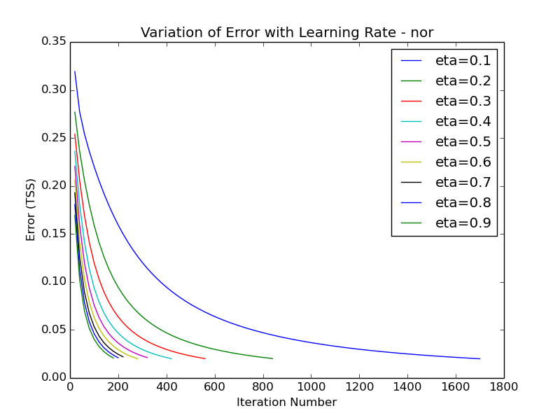
2-Input NOR

Slide 20
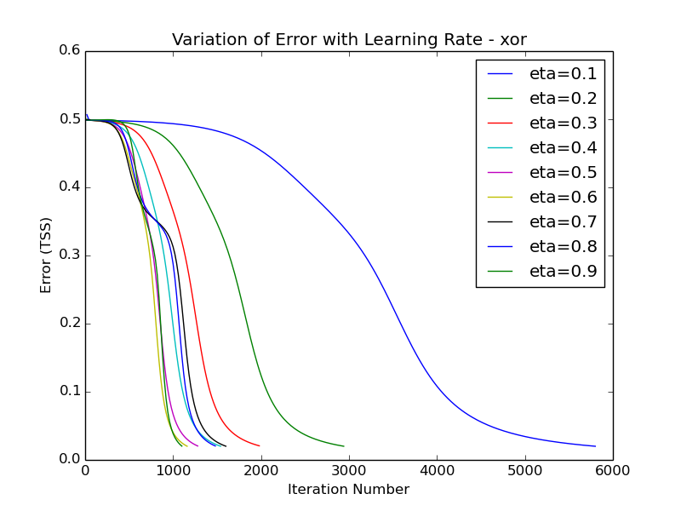
2-Input XOR

Slide 21
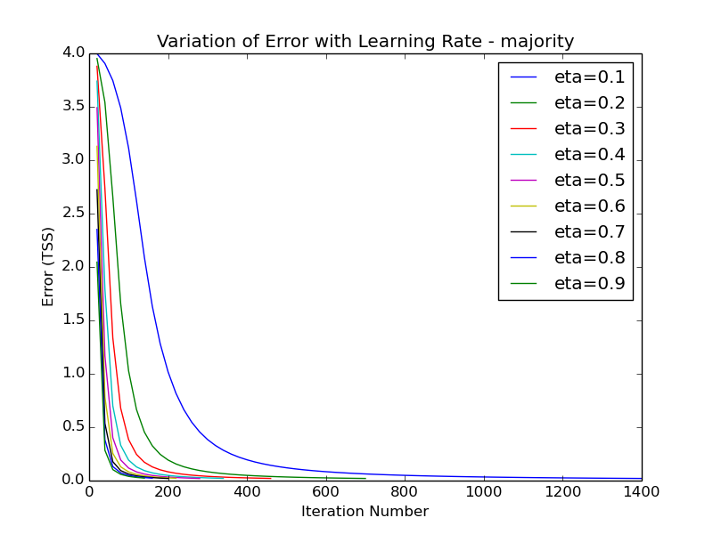
5-input Majority

Slide 22
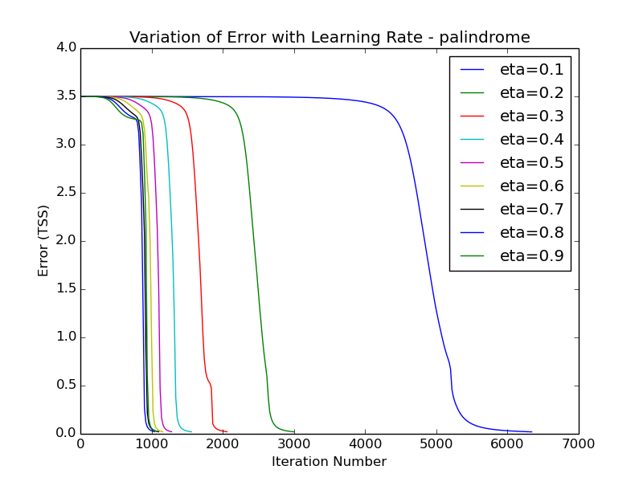
5-Input Palindrome

Slide 23
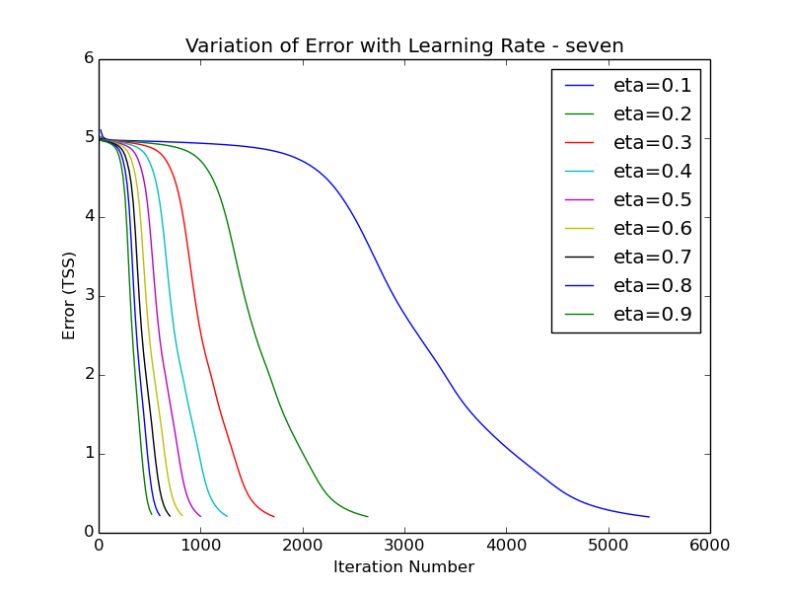
Seven Segment Display

Slide 24
Local Minima and Saturation
The back propagation algorithm can get stuck in the local minimum. This is because back propagation algorithm tries greedily to reduce the error by updating weights.
In such case, the error does not reduce below the local minimum value , hence BP goes into a state of saturation, thereby not attaining global minimum.

Slide 25
Momentum
To avoid saturation, momentum factor is introduced in the algorithm which while updating weights also takes into account the weight updates in the previous iteration.
It helps to avoid the local minimum by accelerating the movement out of the trough and dampening the oscillations inside the trough.

Slide 26
Plots for Variation of Error with Moment

Slide 27
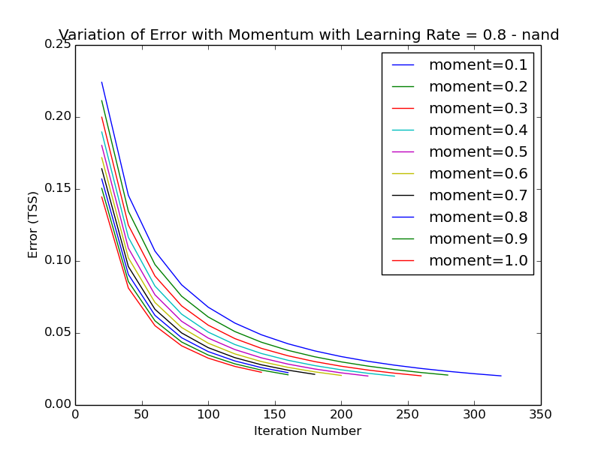
2-Input NAND

Slide 28
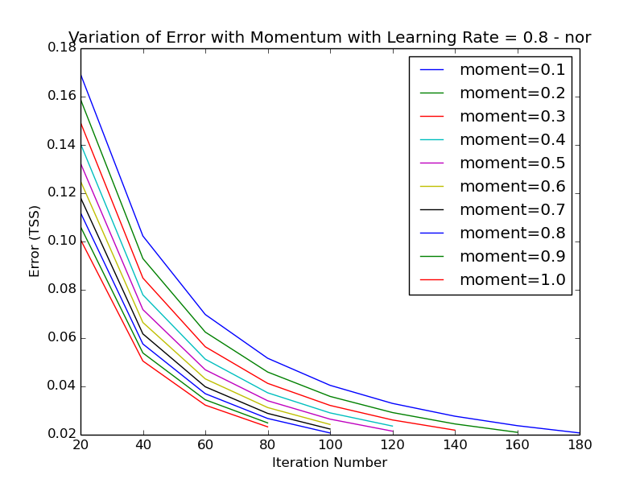
2-Input NOR

Slide 29
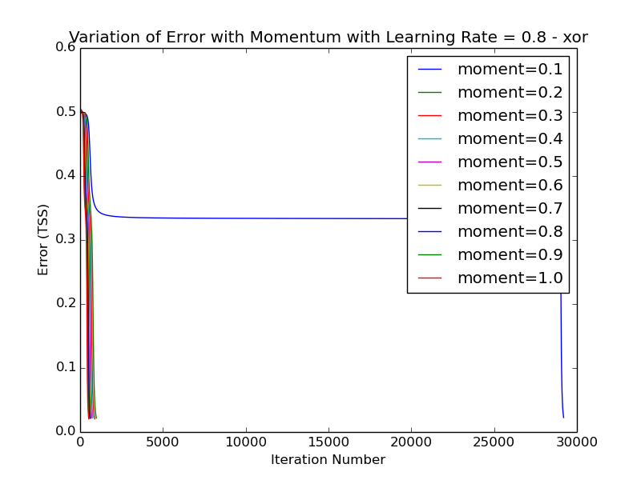
2-Input XOR

Slide 30
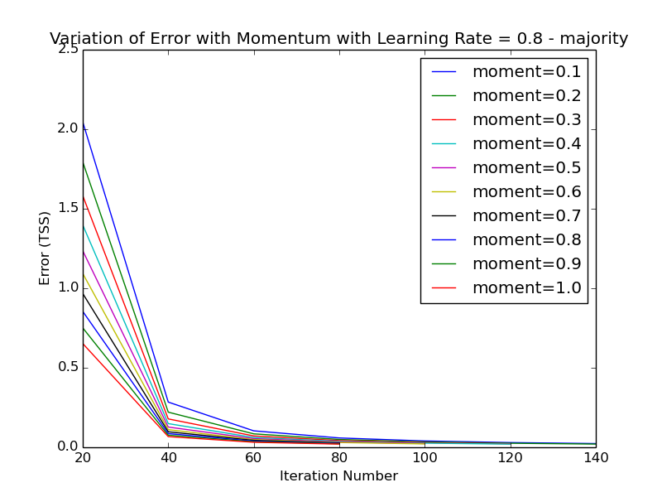
5-Input Majority

Slide 31
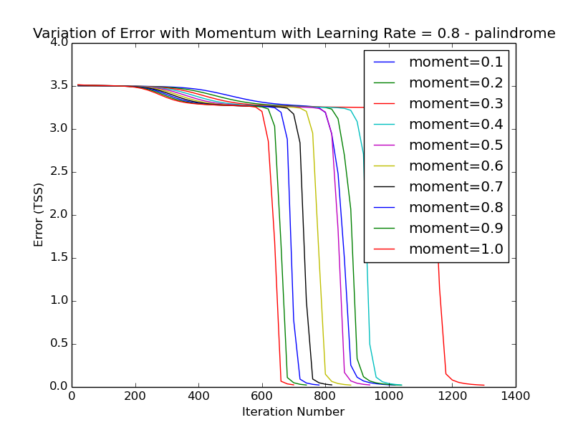
5-Input Palindrome

Slide 32
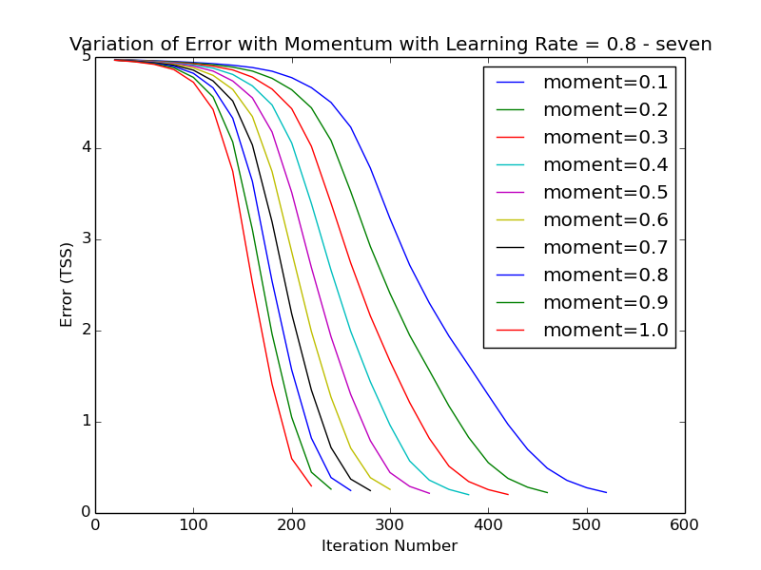
Seven Segment Display

Slide 33
Analysis of Hidden Layers

Slide 34
Analysis of Hidden Layers
Number of hidden layers used :
2-input XOR : 2 hidden layers
5-input palindrome : 3 hidden layers
In case of XOR, the hidden layers behaved differently for different ranges of learning rate( η ).
For η < 0.7 and η >=0.7, the functionality of hidden layers changes.

Slide 35
Analysis of Hidden Layers : XOR
For η < 0.7
 | 0 | 1
0 | 1 | 1
1 | 1 | 0
 | 0 | 1
0 | 0 | 1
1 | 1 | 1
x2
x2
x1
x1
Hidden layer1 :
h1 = ¬(x1 ∧ x2)
Hidden layer2 :
h2 = x1 ∨ x2
 | 0 | 1
0 | X | 0
1 | 0 | 1
h2
h1
Final layer:
O = h1 ∧ h2

Slide 36
Analysis of Hidden Layers : XOR
For η >= 0.7
 | 0 | 1
0 | 0 | 0
1 | 0 | 1
 | 0 | 1
0 | 0 | 1
1 | 1 | 1
x2
x2
x1
x1
Hidden layer1 :
h1 = x1 ∧ x2
Hidden layer2 :
h2 = x1 ∨ x2
 | 0 | 1
0 | 0 | 1
1 | X | 0
h2
h1
Final layer:
O = ¬h1 ∧ h2

Slide 37
Analysis of Hidden Layers : Palindrome
For Hidden Layer 1 (h1)
x4x5
x4x5
 | 00 | 01 | 11 | 10
00 | 0 | 0 | 0 | 0
01 | 0 | 0 | 0 | 0
11 | 1 | 1 | 0 | 0
10 | 1 | 1 | 0 | 0
 | 00 | 01 | 11 | 10
00 | 0 | 0 | 0 | 0
01 | 0 | 0 | 0 | 0
11 | 1 | 1 | 0 | 0
10 | 1 | 1 | 0 | 0
x2x3
x2x3
x1 = 0
x1 = 1
Hidden layer1 :
h1 = x2 ∧ ¬ x4

Slide 38
Analysis of Hidden Layers : Palindrome
For Hidden Layer 2 (h2)
x4x5
x4x5
 | 00 | 01 | 11 | 10
00 | 0 | 1 | 1 | 1
01 | 0 | 1 | 1 | 1
11 | 0 | 1 | 1 | 0
10 | 0 | 1 | 1 | 0
 | 00 | 01 | 11 | 10
00 | 1 | 1 | 1 | 1
01 | 1 | 1 | 1 | 1
11 | 1 | 1 | 1 | 1
10 | 1 | 1 | 1 | 1
x2x3
x2x3
x1 = 0
x1 = 1
Hidden layer2 :
h2 = x1 ∨ x5 ∨ (¬x2 ∧ x4)

Slide 39
Analysis of Hidden Layers : Palindrome
For Hidden Layer 3 (h3)
x4x5
x4x5
 | 00 | 01 | 11 | 10
00 | 0 | 0 | 0 | 0
01 | 0 | 0 | 0 | 0
11 | 0 | 0 | 1 | 0
10 | 0 | 0 | 1 | 0
 | 00 | 01 | 11 | 10
00 | 0 | 1 | 0 | 0
01 | 0 | 1 | 0 | 0
11 | 1 | 1 | 1 | 0
10 | 1 | 1 | 1 | 0
x2x3
x2x3
x1 = 0
x1 = 1
Hidden layer3:
h3 = ¬x4 ∧((x2 ∧ x5) ∨ (x1 ∧ x5) ∨ (x1 ∧ x2)) ∨(x1 ∧ x2 ∧ x5)

Slide 40
Analysis of Hidden Layers : Palindrome
For Final Layer (O)
h2h3
 | 00 | 01 | 11 | 10
0 | 1 | X | 1 | 0
1 | 0 | X | 0 | X
h1
Output Layer (O):
O = ¬x1 ∧ (¬ x2 ∨ x3)

Slide 41
Symmetry Breaking
If all weights are initialized to the same value then back propagation does not converge.
Explanation – On initializing with equal weights, FFNN on each successive iteration modifies weights by equal amount. This symmetric update of weights leads to non convergence of back propagation.

