Slide 1
Prolog
Circuit Simulator

Slide 2
Introduction
Implemented a circuit simulator in Prolog and verified using following circuits
3 input Full Adder
5 input Palindrome
5 input Majority
Implemented Multi-Input AND, OR, XOR gates and single input NOT gate.

Slide 3
Input Specification
Description of Input wires:
value(wire_id, value).
Description of a gate (circuit element):
ckt_elem(elem_id).
type(elem_id, gate_type).
inputs(elem_id, number_of_inputs).
Description of connections:
connected(wire_id1, wire_id2).
connected(in(input_num, elem_id), wire_id).
connected(out(elem_id), wire_id).

Slide 4
Implementation : Predicates Used
are_connected(T1, T2)
To check if wire T1 and wire T2 are connected.
wire(T)
To check if T is a wire
wire can be an input value, an output port or input port of a circuit element
elem_def(G, N)
To get number of inputs of circuit element G in N
all(G, X)
To check if all inputs of circuit element G has value X
count(G)
To check if number of inputs with value 1 are odd

Slide 5
Implementation : Predicates Used
signal(T, X)
If T is an assigned value then X gets its value
If T is an output of a circuit element i.e. out(G) then it is evaluated accordingly
AND Gate –
1 if all(G, 1), 0 otherwise
OR Gate –
1 if all(G, 0) , 0 otherwise
NOT Gate –
1 if input is 0, 0 otherwise
XOR Gate –
1 if count(G) , 0 otherwise
If T is a wire, and there is another wire connected to it then assign the same value to it

Slide 6
Full Adder Truth Table
X1 | X2 | C1 | Y | C2
0 | 0 | 0 | 0 | 0
0 | 0 | 1 | 1 | 0
0 | 1 | 0 | 1 | 0
0 | 1 | 1 | 0 | 1
1 | 0 | 0 | 1 | 0
1 | 0 | 1 | 0 | 1
1 | 1 | 0 | 0 | 1
1 | 1 | 1 | 1 | 1

Slide 7
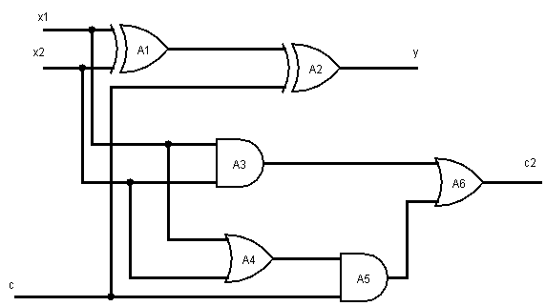
Full Adder Circuit

Slide 8
Palindrome Truth Table
A | B | C | D | E | Y
0 | 0 | 0 | 0 | 0 | 1
0 | 0 | 0 | 0 | 1 | 0
0 | 0 | 0 | 1 | 0 | 0
0 | 0 | 0 | 1 | 1 | 0
0 | 0 | 1 | 0 | 0 | 1
0 | 0 | 1 | 0 | 1 | 0
0 | 0 | 1 | 1 | 0 | 0
0 | 0 | 1 | 1 | 1 | 0
0 | 1 | 0 | 0 | 0 | 0
0 | 1 | 0 | 0 | 1 | 0
0 | 1 | 0 | 1 | 0 | 1
0 | 1 | 0 | 1 | 1 | 0
0 | 1 | 1 | 0 | 0 | 0
0 | 1 | 1 | 0 | 1 | 0
0 | 1 | 1 | 1 | 0 | 1
0 | 1 | 1 | 1 | 1 | 0

Slide 9
Palindrome Truth Table
A | B | C | D | E | Y
1 | 0 | 0 | 0 | 0 | 0
1 | 0 | 0 | 0 | 1 | 1
1 | 0 | 0 | 1 | 0 | 0
1 | 0 | 0 | 1 | 1 | 0
1 | 0 | 1 | 0 | 0 | 0
1 | 0 | 1 | 0 | 1 | 1
1 | 0 | 1 | 1 | 0 | 0
1 | 0 | 1 | 1 | 1 | 0
1 | 1 | 0 | 0 | 0 | 0
1 | 1 | 0 | 0 | 1 | 0
1 | 1 | 0 | 1 | 0 | 0
1 | 1 | 0 | 1 | 1 | 1
1 | 1 | 1 | 0 | 0 | 0
1 | 1 | 1 | 0 | 1 | 0
1 | 1 | 1 | 1 | 0 | 0
1 | 1 | 1 | 1 | 1 | 1

Slide 10
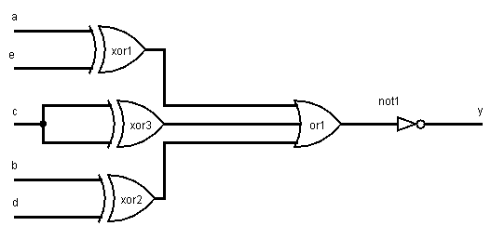
Palindrome Circuit

Slide 11
Majority Truth Table
A | B | C | D | E | Y
0 | 0 | 0 | 0 | 0 | 0
0 | 0 | 0 | 0 | 1 | 0
0 | 0 | 0 | 1 | 0 | 0
0 | 0 | 0 | 1 | 1 | 0
0 | 0 | 1 | 0 | 0 | 0
0 | 0 | 1 | 0 | 1 | 0
0 | 0 | 1 | 1 | 0 | 0
0 | 0 | 1 | 1 | 1 | 1
0 | 1 | 0 | 0 | 0 | 0
0 | 1 | 0 | 0 | 1 | 0
0 | 1 | 0 | 1 | 0 | 0
0 | 1 | 0 | 1 | 1 | 1
0 | 1 | 1 | 0 | 0 | 0
0 | 1 | 1 | 0 | 1 | 1
0 | 1 | 1 | 1 | 0 | 1
0 | 1 | 1 | 1 | 1 | 1

Slide 12
Majority Truth Table
A | B | C | D | E | Y
1 | 0 | 0 | 0 | 0 | 0
1 | 0 | 0 | 0 | 1 | 0
1 | 0 | 0 | 1 | 0 | 0
1 | 0 | 0 | 1 | 1 | 1
1 | 0 | 1 | 0 | 0 | 0
1 | 0 | 1 | 0 | 1 | 1
1 | 0 | 1 | 1 | 0 | 1
1 | 0 | 1 | 1 | 1 | 1
1 | 1 | 0 | 0 | 0 | 0
1 | 1 | 0 | 0 | 1 | 1
1 | 1 | 0 | 1 | 0 | 1
1 | 1 | 0 | 1 | 1 | 1
1 | 1 | 1 | 0 | 0 | 1
1 | 1 | 1 | 0 | 1 | 1
1 | 1 | 1 | 1 | 0 | 1
1 | 1 | 1 | 1 | 1 | 1

Slide 13
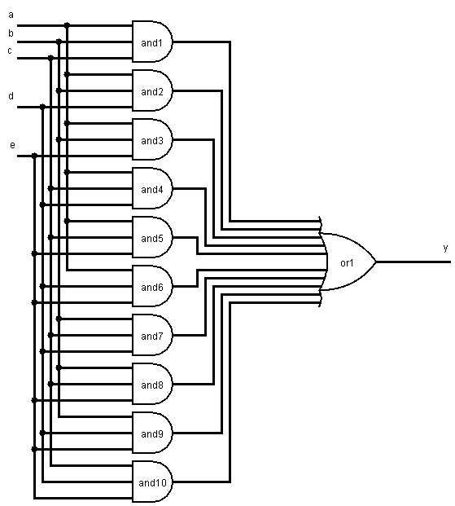
Majority Circuit

