Slide 1


Configurable Multimodal Semantic Validation System
Document vs. Document Validation using GenAI & Multimodal NLP
Mallesh Mayara (21f2001118)
Mayank Dode (22f1000781)
Karthik Ganesh (21f2000775)
Ayush Verma (21f3000500)

Slide 2

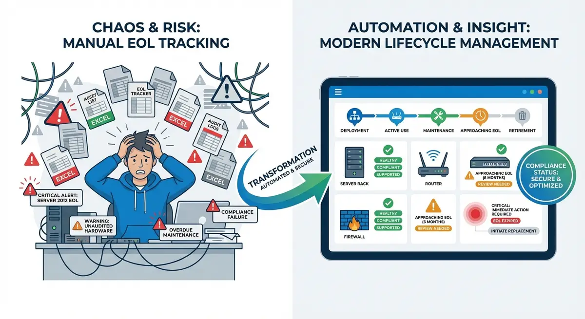
The Problem Background
•
Organizations face major bottlenecks validating critical information across heterogeneous documents.
•
Multimodal Complexity: Crucial information is locked in complex visual layouts, scanned images, and tables.
•
Semantically Diverse: Different terms are used for identical concepts (e.g., "Net 30" vs. "Payment due in one month").
•
Structurally Inconsistent: Target information shifts across different sections depending entirely on the document type.

Slide 3


Limitations of Current Solutions
Rigid & Fragile Frameworks
Narrow Utility Tools
Traditional validation systems rely heavily on exact string matching or rigid rule-based templates that fail when encountering minor structural shifts.
Most tools available in the market today are highly restrictive and fall into two limited categories:
"Point Solutions" designed for a single, narrow task (e.g., exclusively processing invoices).
Furthermore, traditional pipelines use separate OCR engines, which convert complex visual structures into messy raw text and completely lose layout context.
"Simple Diff Tools" capable only of highlighting basic text changes without any actual semantic understanding.

Slide 4

Our Proposed Solution
A Generalized, Config-Driven Document-to-Document Validation System directly powered by Multimodal Large Language Models.
Features a User-Defined Entity Configuration Layer where domain experts can explicitly define validation targets, semantic descriptions, and provide few-shot examples.
Achieves high performance and domain-agnostic capabilities through Contextual Prompt Engineering and Configuration-Based Grounding, entirely eliminating the need for expensive model fine-tuning.

Slide 5








Technical Workflow
Ingestion & Perception
Config-Driven Extraction
Semantic Reasoning
Multimodal LLMs perform layout-aware parsing on both Scanned and E-printed PDFs, perfectly preserving visual relationships without requiring a separate OCR engine.
The system intelligently reads a user-provided JSON/YAML configuration file outlining specific Entity Names and semantic Entity Descriptions for extraction.
Employs Chain-of-Thought (CoT) reasoning to compare extracted values based on the underlying business logic rather than relying on simple distance metrics.

Slide 6
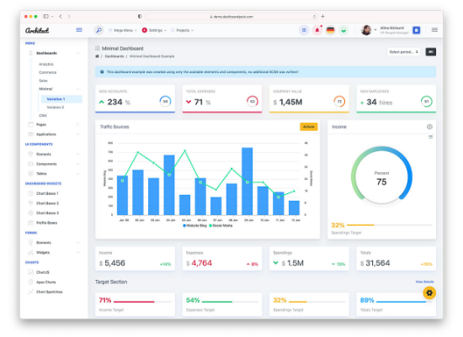
Validation Output & Metrics
For every processed field, the system generates precise, actionable outputs:
•
Audit Status: Categorized strictly into defined states: Match, Mismatch, Partial Match, or Ineligible (if missing).
•
Reasoning Output: A clear, natural language explanation detailing the AI's step-by-step decision process for transparency.
•
Confidence Score: A precise 0-1 metric indicating the model's certainty, used directly for triggering human-in-the-loop workflows.

Slide 7



Ensuring Reliability & Trust
Evidence Grounding To ensure enterprise-grade reliability, every extraction must explicitly include source document citations or coordinate locations, enabling rapid human-in-the-loop verification.
Strict Instruction Set The LLM operates under a "Restricted Output Schema." It is heavily penalized for hallucinations or making assumptions outside the strictly provided document context.
Confidence Thresholding Validations falling below a pre-set certainty score (e.g., 0.85) are automatically flagged and routed for manual review, effectively managing and mitigating false positives.

Slide 8





Key Differentiators
User Control
Semantic Intelligence
Multimodal Native
Provides a low-code configuration layer allowing a non-technical user to adapt the tool from a "Legal Contract Reviewer" to a "Medical Claim Validator" in minutes.
Moves far beyond "Search & Find" to true "Understand & Validate," easily handling complex cross-lingual and cross-terminology discrepancies.
Designed from the ground up to handle scanned images and complex table structures directly as visual inputs rather than converting them to messy raw text.

Slide 9
Thank You :)

