Slide 1
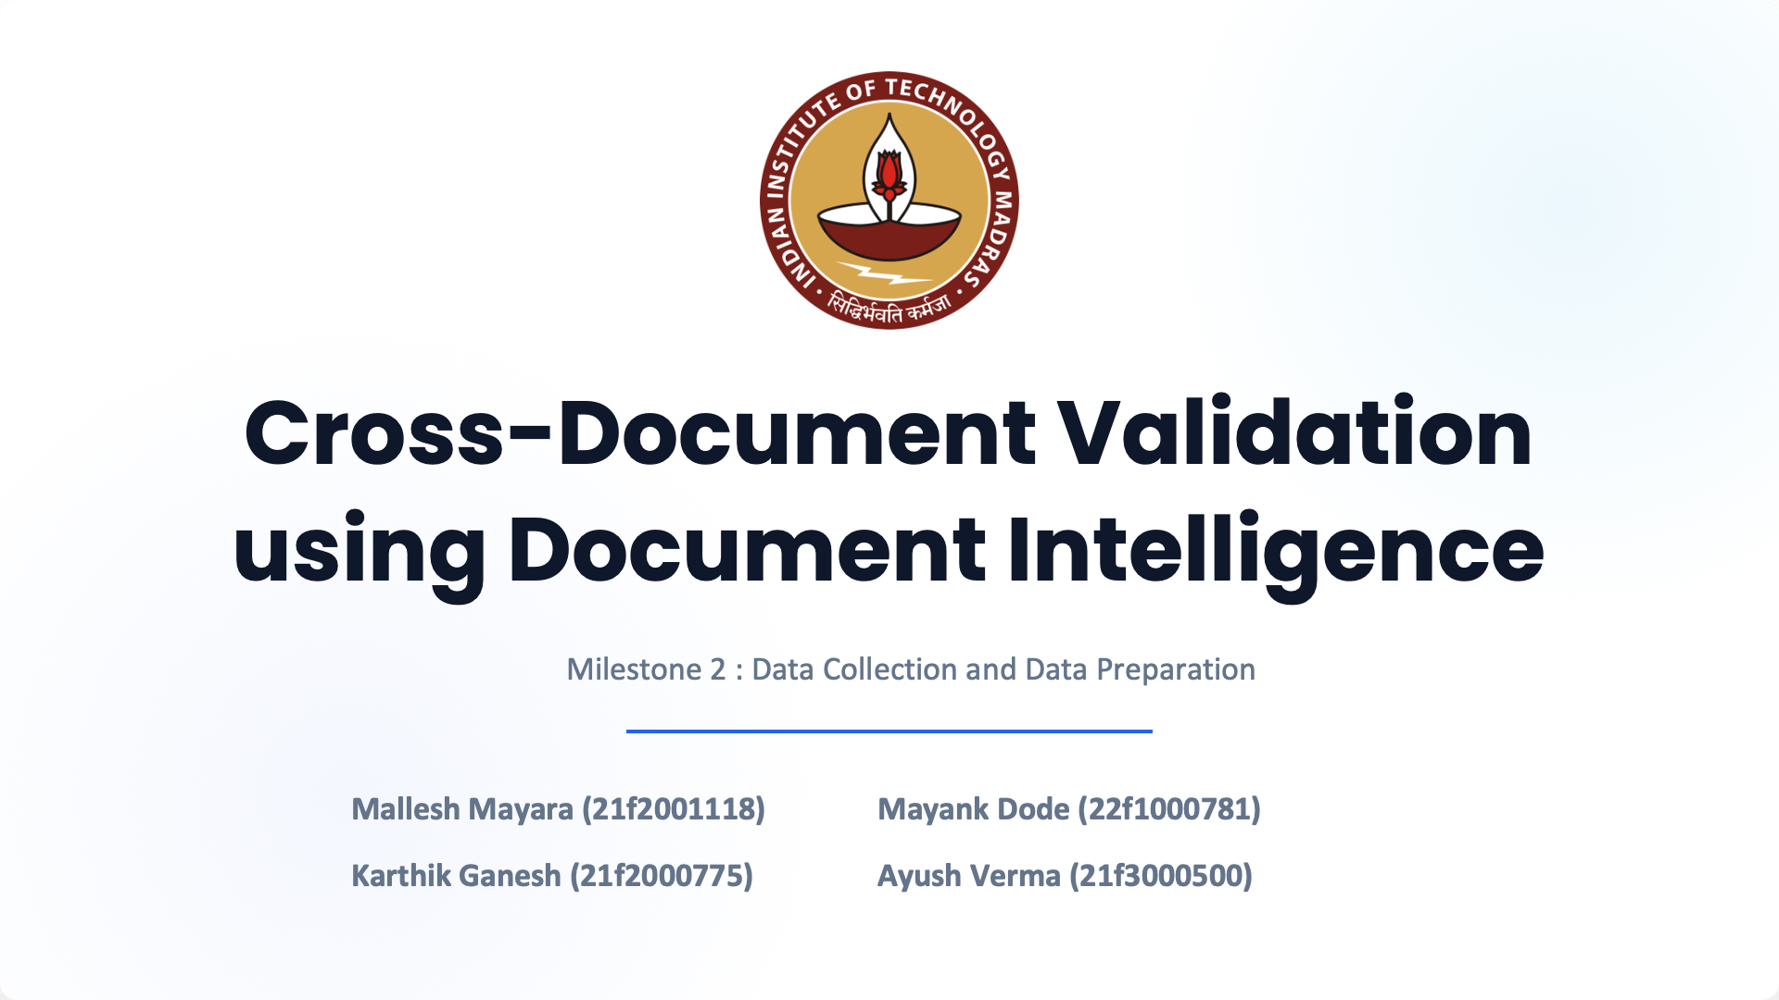

Slide 2
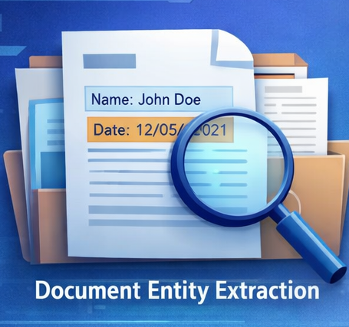
Milestone Objective
Prepare datasets required to evaluate a system that can perform :
Document entity extraction
Cross-document validation
Semantic equivalence detection
Numeric normalization
Conflict detection
Two datasets were prepared to support these tasks:
1.⁠ ⁠FUNSD Dataset
2.⁠ ⁠Healthcare SBC & Benefit Grid Dataset

Slide 3
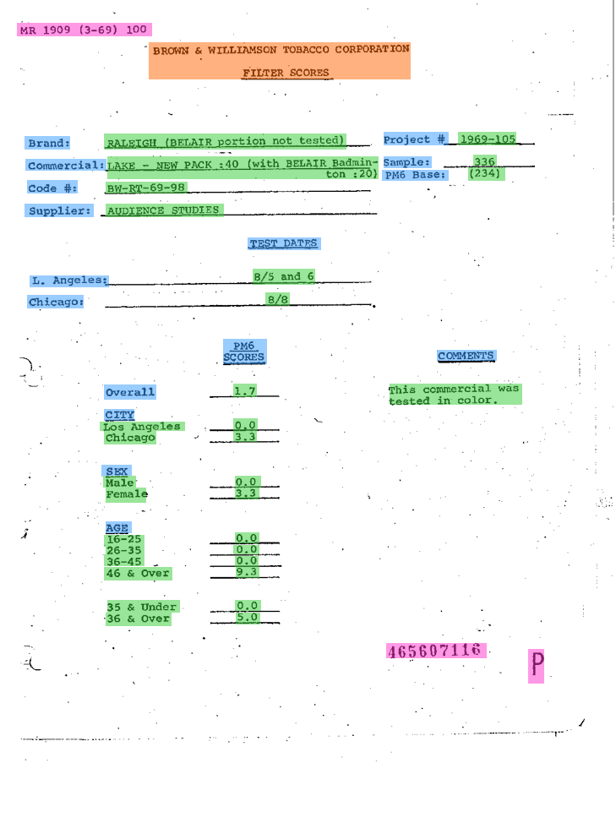
Dataset Overview
Two complementary datasets were used:
1.⁠ ⁠FUNSD Dataset
Form understanding
Key-value extraction
Document entity recognition
2.⁠ ⁠SBC & Benefit Grid Dataset
Cross-document validation
Coverage comparison
Cost-sharing verification
Together they simulate real-world document validation workflows.

Slide 4
FUNSD Dataset
FUNSD (Form Understanding in Noisy Scanned Documents)
Key characteristics:
Scanned form documents
Layout-aware annotations
Key-value entity pairs
Real-world document noise

Slide 5
FUNSD DATA PREPARATION
Steps performed:
1.⁠ ⁠Selected sample documents from FUNSD dataset
2.⁠ ⁠Identified logical document sections
3.⁠ ⁠Defined entity groups within each section
Example entities:
Name
Address
Date
Numeric values
Identifiers
Prepared dataset for entity extraction experiments.

Slide 6
FUNSD Data Augmentation
To simulate real-world document variations:
Several modifications were introduced:
Synonym replacement
Numeric format variations
Layout modifications
OCR-style noise
Examples:
11% → 0.11
Interest Rate → Applicable Interest
Purpose: Test robustness of entity extraction models.

Slide 7
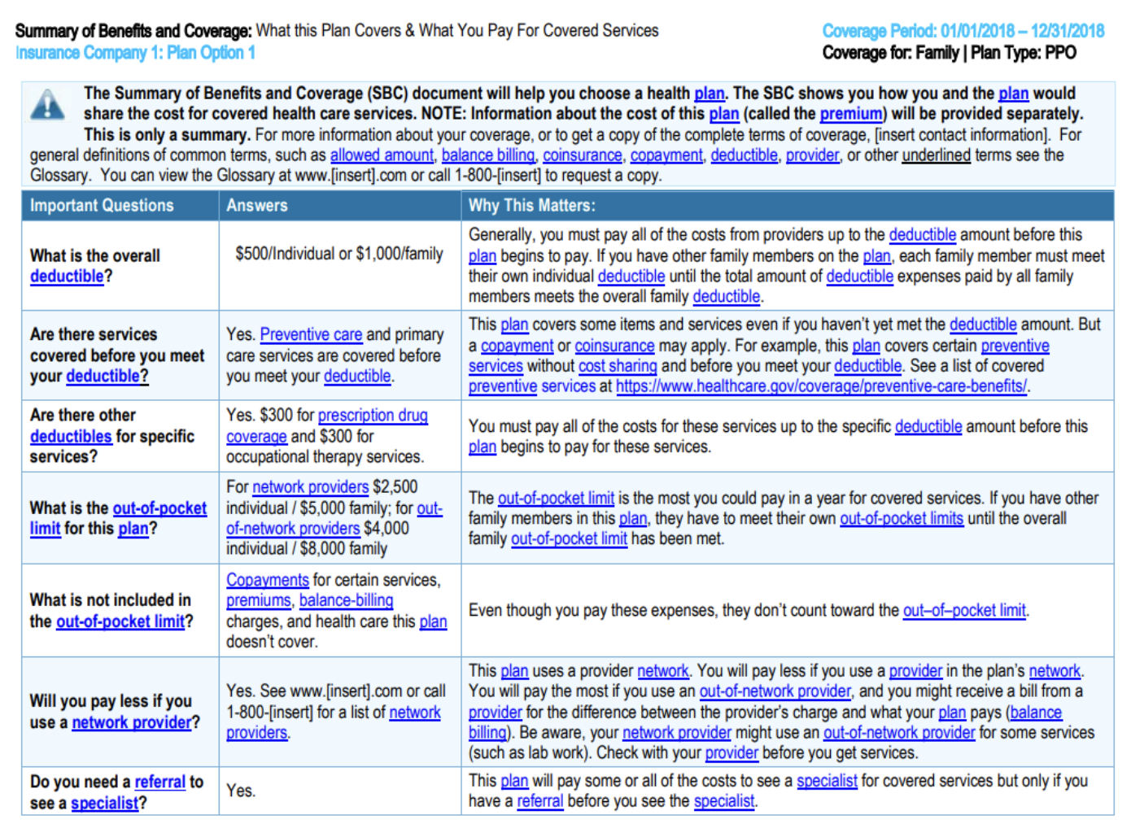
SBC Dataset
Summary of Benefits and Coverage (SBC) documents
Healthcare insurance documents containing:
Coverage information
Cost-sharing details
Healthcare service descriptions
Typical document size: 2 to 11 pages
These documents serve as Doc A in the dataset.

Slide 8
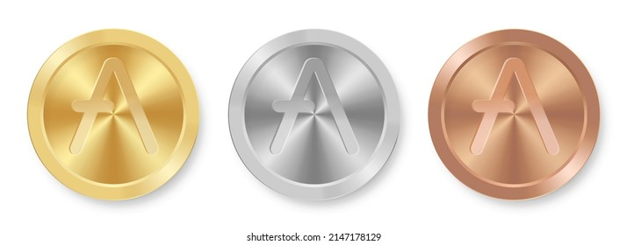
SBC Data Collection
SBC documents were collected by searching for:
Highmark PPO insurance plans
Challenges encountered:
Duplicate documents
Different formatting styles
Solutions:
Searching across plan tiers
Gold
Silver
Bronze
Using multiple plan identifiers
Total collected: 20 SBC documents

Slide 9
Benefit Grid Creation
To standardize SBC information: A Benefit Grid template was created.
The grid includes columns for:
Service Name
In-Network Cost
Out-of-Network Cost
Notes
Example services:
Doctor visits
Emergency care
Hospital stay
Prescription drugs
Each SBC was converted into a Benefit Grid document (Doc B).

Slide 10
Document Pair Structure
Each dataset sample consists of:
Doc A: SBC Document
Doc B: Benefit Grid
Example relationship:
SBC Document → Detailed explanation
Benefit Grid → Structured summary
This structure enables cross-document validation.

Slide 11
Data Augmentation (Benefit Grid)
Controlled modifications were applied to simulate real-world inconsistencies.
Out of 20 benefit grids:
12 kept unchanged
8 intentionally modified
Modifications were applied using PDF editing tools.

Slide 12
Augmentation Types
Semantic Changes
Example: "No charge" → "Covered in full"
Numeric Format Changes
Example: "$6,550" → "6550"
Value Conflicts
Example: "$525 copay" → "$400 copay"
Coverage Changes
Example: "$30 copay" → "Fully covered"

Slide 13
Ground Truth JSON Creation
Ground truth JSON files were created for augmented document pairs.
Each JSON contains:
Entity name
Value in Doc A
Value in Doc B
Normalized value
Validation type
Match or mismatch result
Also includes perturbation logs to track modifications.

Slide 14
Validation Scenarios Covered
Dataset supports multiple validation cases:
1.⁠ ⁠Exact Match
2.⁠ ⁠Semantic Equivalence
3.⁠ ⁠Numeric Normalization
4.⁠ ⁠OCR Noise Handling
5.⁠ ⁠Conflict Detection
6.⁠ ⁠Coverage Change Detection
These scenarios represent real-world document inconsistencies.

Slide 15
Dataset Output
Final dataset produced:
Dataset Component Count
FUNSD Samples Multiple
SBC Documents (Doc A) 20
Benefit Grid Documents (Doc B) 20
Ground Truth JSON Files 8
This dataset supports both:
Entity extraction
Cross-document validation

Slide 16
Challenges Faced
During dataset preparation:
Duplicate Documents Many identical SBC files online.
Complex Tables Multiple network tiers in SBC tables.
Formatting Issues PDF extraction caused misaligned columns.
Ambiguous Service Descriptions Some rows combined multiple services.
Manual verification was performed to resolve these issues.

Slide 17
Team Contributions
Karthik
Researched the validation use case, Identified FUNSD and SBC datasets,Designed augmentation scenarios
Mayank
Worked on FUNSD data augmentation, Created modified document samples
Ashish
Performed SBC and Benefit Grid augmentation
Generated ground truth JSON files
Mallesh
Documentation.

Slide 18
Milestone Summary
Milestone 2 successfully achieved:
Dataset research and selection
Data collection from multiple sources
Document standardization
Controlled data augmentation
Ground truth generation
Prepared dataset enables:
Entity extraction evaluation
Cross-document validation experiments

Slide 19


