Slide 1
So What Is Machine Learning?
Automating automation
Getting computers to program themselves
Writing software is the bottleneck
Let the data do the work instead!

Slide 2
Traditional Programming
Machine Learning
Data
Computer
Output
Program
Data
Computer
Program
Output

Slide 3

Magic?
No, more like gardening
Seeds = Algorithms
Nutrients = Data
Gardener = You
Plants = Programs

Slide 4
Sample Applications
Web search
Computational biology
Finance
E-commerce
Space exploration
Robotics
Information extraction
Social networks
Debugging
[Your favorite area]

Slide 5
ML in a Nutshell
Tens of thousands of machine learning algorithms
Hundreds new every year
Every machine learning algorithm has three components:
Representation
Evaluation
Optimization

Slide 6
Representation
Decision trees
Sets of rules / Logic programs
Instances
Graphical models (Bayes/Markov nets)
Neural networks
Support vector machines
Model ensembles
Etc.

Slide 7
Evaluation
Accuracy
Precision and recall
Squared error
Likelihood
Posterior probability
Cost / Utility
Margin
Entropy
K-L divergence
Etc.

Slide 8
Optimization
Combinatorial optimization
E.g.: Greedy search
Convex optimization
E.g.: Gradient descent
Constrained optimization
E.g.: Linear programming

Slide 9
Types of Learning
Supervised (inductive) learning
Training data includes desired outputs
Unsupervised learning
Training data does not include desired outputs
Semi-supervised learning
Training data includes a few desired outputs
Reinforcement learning
Rewards from sequence of actions

Slide 10
Inductive (Supervised) Learning
Basic Problem: Induce a representation of a function (a systematic relationship between inputs and outputs) from examples.
target function f: X → Y
example (x,f(x))
hypothesis g: X → Y such that g(x) = f(x)
x = set of attribute values (attribute-value representation)
x = set of logical sentences (first-order representation)
Y = set of discrete labels (classification)
Y = ℜ (regression)

Slide 11
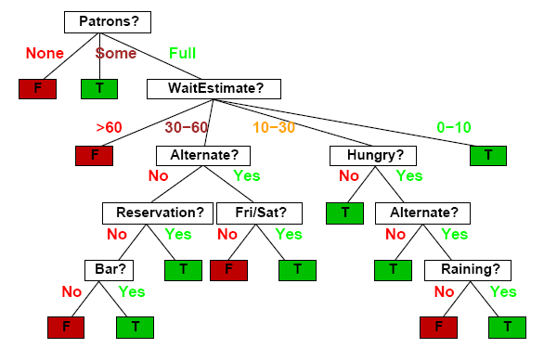
Decision Trees
Should I wait at this restaurant?

Slide 12
Decision Tree Induction
(Recursively) partition examples according to the most important attribute.
Key Concepts
entropy
impurity of a set of examples (entropy = 0 if perfectly homogeneous)
(#bits needed to encode class of an arbitrary example)
information gain
expected reduction in entropy caused by partitioning

Slide 13
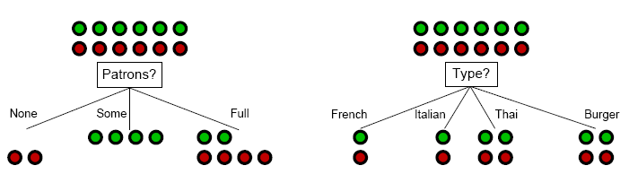
Decision Tree Induction: Attribute Selection
Intuitively: A good attribute splits the examples into subsets that are (ideally) all positive or all negative.

Slide 14
Decision Tree Induction: Attribute Selection
Intuitively: A good attribute splits the examples into subsets that are (ideally) all positive or all negative.

Slide 15
Decision Tree Induction: Decision Boundary

Slide 16
Decision Tree Induction: Decision Boundary

Slide 17
Decision Tree Induction: Decision Boundary

Slide 18
Decision Tree Induction: Decision Boundary

Slide 19
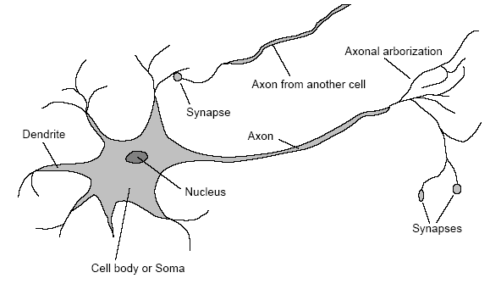
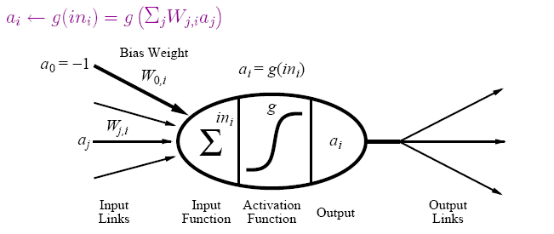
(Artificial) Neural Networks
Motivation: human brain
massively parallel (10¹¹ neurons, ~20 types)
small computational units with simple low-bandwidth communication (10¹⁴ synapses, 1-10ms cycle time)
Realization: neural network
units (≈ neurons) connected by directed weighted links
activation function from inputs to output

Slide 20
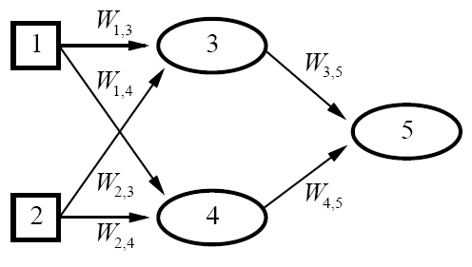

Neural Networks (continued)
neural network = parameterized family of nonlinear functions
types
feed-forward (acyclic): single-layer perceptrons, multi-layer networks
recurrent (cyclic): Hopfield networks, Boltzmann machines
[ connectionism, parallel distributed processing]

Slide 21
Neural Network Learning
Key Idea: Adjusting the weights changes the function represented by the neural network (learning = optimization in weight space).
Iteratively adjust weights to reduce error (difference between network output and target output).
Weight Update
perceptron training rule
linear programming
delta rule
backpropagation

Slide 22
Neural Network Learning: Decision Boundary
single-layer perceptron
multi-layer network

Slide 23
Support Vector Machines
Kernel Trick: Map data to higher-dimensional space where they will be linearly separable.
Learning a Classifier
optimal linear separator is one that has the largest margin between positive examples on one side and negative examples on the other
= quadratic programming optimization

Slide 24
Support Vector Machines (continued)
Key Concept: Training data enters optimization problem in the form of dot products of pairs of points.
support vectors
weights associated with data points are zero except for those points nearest the separator (i.e., the support vectors)
kernel function K(x_{i},x_{j})
function that can be applied to pairs of points to evaluate dot products in the corresponding (higher-dimensional) feature space F (without having to directly compute F(x) first)
efficient training and complex functions!

Slide 25
Support Vector Machines: Decision Boundary
Ф

Slide 26
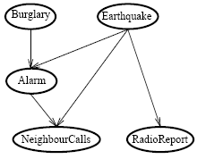
Bayesian Networks
Network topology reflects direct causal influence
Basic Task: Compute probability distribution for unknown variables given observed values of other variables.
[belief networks, causal networks]
 | A B | A ¬B | ¬A B | ¬A ¬B
C | 0.9 | 0.3 | 0.5 | 0.1
¬C | 0.1 | 0.7 | 0.5 | 0.9
conditional probability table
for NeighbourCalls

Slide 27
Bayesian Network Learning
Key Concepts
nodes (attributes) = random variables
conditional independence
an attribute is conditionally independent of its non-descendants, given its parents
conditional probability table
conditional probability distribution of an attribute given its parents
Bayes Theorem
P(h|D) = P(D|h)P(h) / P(D)

Slide 28
Bayesian Network Learning (continued)
Find most probable hypothesis given the data.
In theory: Use posterior probabilities to weight hypotheses. (Bayes optimal classifier)
In practice: Use single, maximum a posteriori (most probable) hypothesis.
Settings
known structure, fully observable (parameter learning)
unknown structure, fully observable (structural learning)
known structure, hidden variables (EM algorithm)
unknown structure, hidden variables (?)

Slide 29
Nearest Neighbor Models
Key Idea: Properties of an input x are likely to be similar to those of points in the neighborhood of x.
Basic Idea: Find (k) nearest neighbor(s) of x and infer target attribute value(s) of x based on corresponding attribute value(s).
Form of non-parametric learning where hypothesis complexity grows with data (learned model ≈ all examples seen so far)
[instance-based learning, case-based reasoning, analogical reasoning]

Slide 30
Nearest Neighbor Model: Decision Boundary

Slide 31
Learning Logical Theories
Logical Formulation of Supervised Learning
attribute → unary predicate
instance x → logical sentence
positive/negative classifications → sentences Q(x_{i}),¬Q(x_{i})
training set → conjunction of all description and classification sentences
Learning Task: Find an equivalent logical expression for the goal predicate Q to classify examples correctly.
Hypothesis ∧ Descriptions ╞═ Classifications

Slide 32
Learning Logic Theories: Example
Input
Father(Philip,Charles), Father(Philip,Anne), …
Mother(Mum,Margaret), Mother(Mum,Elizabeth), …
Married(Diana,Charles), Married(Elizabeth,Philip), …
Male(Philip),Female(Anne),…
Grandparent(Mum,Charles),Grandparent(Elizabeth,Beatrice), ¬Grandparent(Mum,Harry),¬Grandparent(Spencer,Pete),…
Output
Grandparent(x,y) ⇔
[∃z Mother(x,z) ∧ Mother(z,y)] ∨ [∃z Mother(x,z) ∧ Father(z,y)] ∨
[∃z Father(x,z) ∧ Mother(z,y)] ∨ [∃z Father(x,z) ∧ Father(z,y)]

Slide 33
Learning Logic Theories
Key Concepts
specialization
triggered by false positives (goal: exclude negative examples)
achieved by adding conditions, dropping disjuncts
generalization
triggered by false negatives (goal: include positive examples)
achieved by dropping conditions, adding disjuncts
Learning
current-best-hypothesis: incrementally improve single hypothesis (e.g., sequential covering)
least-commitment search: maintain all hypotheses consistent with examples seen so far (e.g., version space)

Slide 34
Learning Logic Theories: Decision Boundary

Slide 35
Learning Logic Theories: Decision Boundary

Slide 36
Learning Logic Theories: Decision Boundary

Slide 37
Learning Logic Theories: Decision Boundary

Slide 38
Learning Logic Theories: Decision Boundary

Slide 39
Analytical Learning
Prior Knowledge in Learning
Recall:
Grandparent(x,y) ⇔
[∃z Mother(x,z) ∧ Mother)] ∨ [∃z Mother(x,z) ∧ Father(z,y)] ∨
[∃z Father(x,z) ∧ Mother(z,y)] ∨ [∃z Father(x,z) ∧ Father(z,y)]
Suppose initial theory also included:
Parent(x,y) ⇔ [Mother(x,y) ∨ Father(x,y)]
Final Hypothesis:
Grandparent(x,y) ⇔ [∃z Parent(x,z) ∧ Parent(z,y)]
Background knowledge can dramatically reduce the size of
the hypothesis (greatly simplifying the learning problem).

Slide 40
Explanation-Based Learning
Amazed crowd of cavemen observe Zog roasting a lizard on the end of a pointed stick (“Look what Zog do!”) and thereafter abandon roasting with their bare hands.
Basic Idea: Generalize by explaining observed instance.
form of speedup learning
doesn’t learn anything factually new from the observation
instead converts first-principles theories into useful special-purpose knowledge
utility problem
cost of determining if learned knowledge is applicable may outweight benefits from its application

Slide 41
Relevance-Based Learning
Mary travels to Brazil and meets her first Brazilian (Fernando), who speaks Portuguese. She concludes that all Brazilians speak Portuguese but not that all Brazilians are named Fernando.
Basic Idea: Use knowledge of what is relevant to infer new properties about a new instance.
form of deductive learning
learns a new general rule that explains observations
does not create knowledge outside logical content of prior knowledge and observations

Slide 42
Knowledge-Based Inductive Learning
Medical student observes consulting session between doctor and patient at the end of which the doctor prescribes a particular medication. Student concludes that the medication is effective treatment for a particular type of infection.
Basic Idea: Use prior knowledge to guide hypothesis generation.
benefits in inductive logic programming
only hypotheses consistent with prior knowledge and observations are considered
prior knowledge supports smaller (simpler) hypotheses

Slide 43
Reinforcement Learning
k-armed bandit problem:
Agent is in a room with k gambling machines (one-armed bandits). When an arm is pulled, the machine pays off 1 or 0, according to some unknown probability distribution. Given a fixed number of pulls, what is the agent’s (optimal) strategy?
Basic Task: Find a policy π, mapping states to actions, that maximizes (long-term) reward.
Model (Markov Decision Process)
set of states S
set of actions A
reward function R : S × A → ℜ
state transition function T : S × A → Π(S)
T(s,a,s') = probability of reaching s' when a is executed in s

Slide 44
Reinforcement Learning (continued)
Settings
fully vs. partially observable environment
deterministic vs. stochastic environment
model-based vs. model-free
rewards in goal state only or in any state
value of a state: expected infinite discounted sum of reward the agent will gain if it starts from that state and executes the optimal policy
Solving MDP when the model is known
value iteration: find optimal value function (derive optimal policy)
policy iteration: find optimal policy directly (derive value function)

Slide 45
Reinforcement Learning (continued)
Reinforcement learning is concerned with finding an optimal policy for an MDP when the model (transition, reward) is unknown.
exploration/exploitation tradeoff
model-free reinforcement learning
learn a controller without learning a model first
e.g., adaptive heuristic critic (TD(λ)), Q-learning
model-based reinforcement learning
learn a model first
e.g., Dyna, prioritized sweeping, RTDP

Slide 46
Unsupervised Learning
Learn patterns from (unlabeled) data.
Approaches
clustering (similarity-based)
density estimation (e.g., EM algorithm)
Performance Tasks
understanding and visualization
anomaly detection
information retrieval
data compression

Slide 47
Performance Evaluation
Randomly split examples into training set U and test set V.
Use training set to learn a hypothesis H.
Measure % of V correctly classified by H.
Repeat for different random splits and average results.

Slide 48
Performance Evaluation: Learning Curves
classification accuracy
classification error
#training examples

Slide 49
Performance Evaluation: ROC Curves
false negatives
false positives

Slide 50
Performance Evaluation: Accuracy/Coverage
classification accuracy
coverage

Slide 51
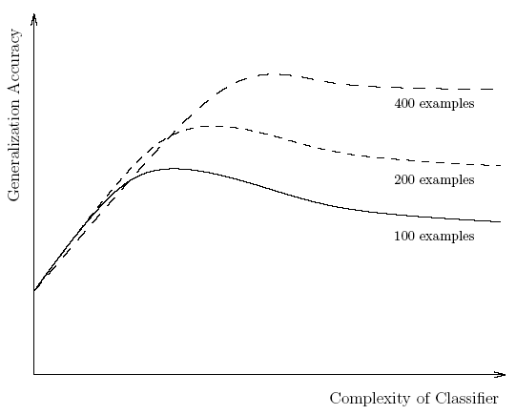
Triple Tradeoff in Empirical Learning
size/complexity of learned classifier
amount of training data
generalization accuracy
bias-variance tradeoff

Slide 52
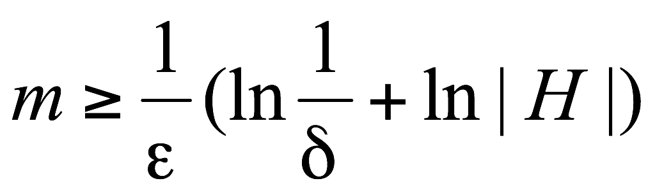
Computational Learning Theory
probably approximately correct (PAC) learning
With probability ≥ 1 - δ, error will be ≤ ε.
Basic principle: Any hypothesis that is seriously wrong will almost certainly be found out with high probability after a small number of examples.
Key Concepts
examples drawn from same distribution (stationarity assumption)
sample complexity is a function of confidence, error, and size of hypothesis space

Slide 53
Current Machine Learning Research
Representation
data sequences
spatial/temporal data
probabilistic relational models
…
Approaches
ensemble methods
cost-sensitive learning
active learning
semi-supervised learning
collective classification
…

