Slide 1
Machine learning with Python scikit-learn

Slide 2
Python
An object oriented interpreter-based programming language
Basic essentials
Data types are numbers, strings, lists, and dictionaries (hash-tables)
For loops and conditionals
Functions
Lists and hash-tables are references (like pointers in C)
All variables are passed by value

Slide 3
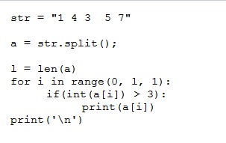
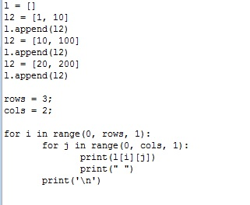
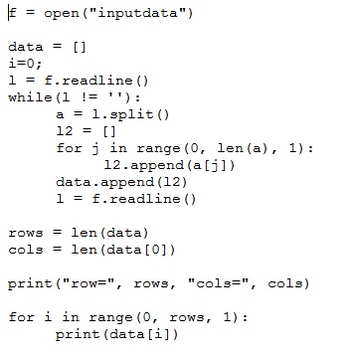
Python
Simple Python programs

Slide 4
Data science
Data science
Simple definition: reasoning and making decisions from data
Contains machine learning, statistics, algorithms, programming, big data
Basic machine learning problems
Classification
Linear methods
Non-linear
Feature selection
Clustering (unsupervised learning)
Visualization with PCA

Slide 5
Python scikit-learn
Popular machine learning toolkit in Python http://scikit-learn.org/stable/
Requirements
Anaconda
Available from https://www.continuum.io/downloads
Includes numpy, scipy, and scikit-learn (former two are necessary for scikit-learn)

Slide 6
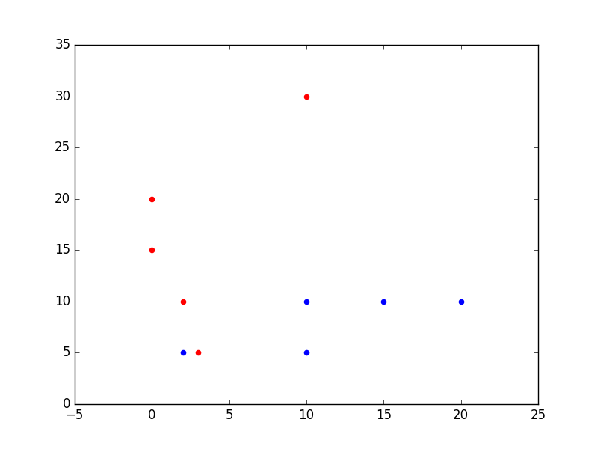
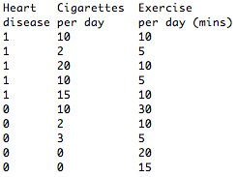
Data
We think of data as vectors in a fixed dimensional space
For example

Slide 7
Classification
Widely used task: given data determine the class it belongs to. The class will lead to a decision or outcome.
Used in many different places:
DNA and protein sequence classification
Insurance
Weather
Experimental physics: Higgs Boson determination

Slide 8
Linear models
We think of a linear model as a hyperplane in space
The margin is the minimum distance of all closest point (misclassified have negative distance)
The support vector machine is the hyperplane with largest margin
y
x

Slide 9
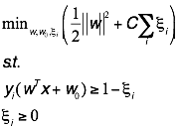
Support vector machine: optimally separating hyperplane
In practice we allow for error terms in case there is no hyperplane.

Slide 10
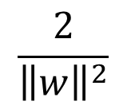


Optimally separating hyperplane with errors
y
w
x

Slide 11
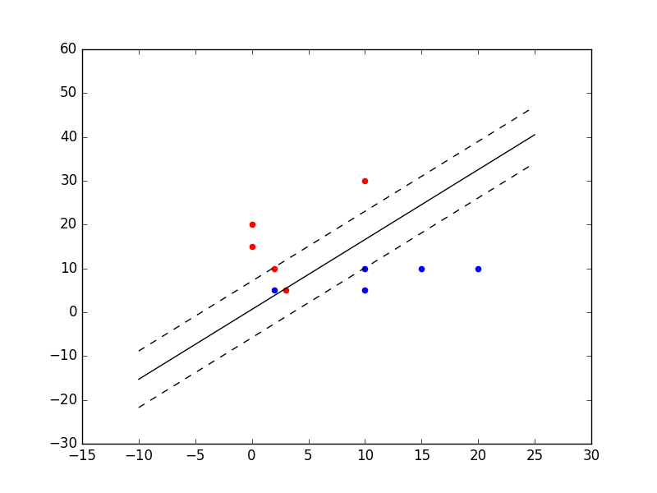
SVM on simple data
Run SVM on example data shown earlier
Solid line is SVM and dashed indicates margin

Slide 12
SVM in scikit-learn
Dataset are taken from the UCI machine learning repository
Learn an SVM model on training data
Which parameter settings?
C: tradeoff between error and model complexity (margin)
max_iter: depth of the gradient descent algorithm
Predict on test data

Slide 13
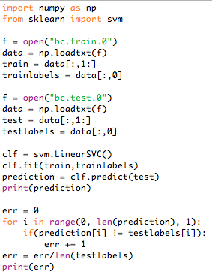
SVM in scikit-learn
Analysis of SVM program on breast cancer data

Slide 14
Non-linear classification
In practice some datasets may not be classifiable.
Remember this may not be a big deal because the test error is more important than the train one

Slide 15
Non-linear classification
Neural networks
Create a new representation of the data where it is linearly separable
Large networks leads to deep learning
Decision trees
Use several linear hyperplanes arranged in a tree
Ensembles of decision trees are state of the art such as random forest and boosting

Slide 16
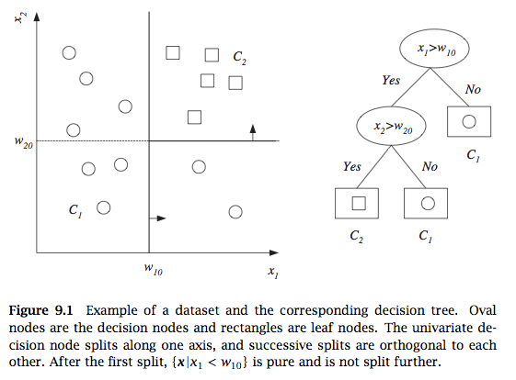
Decision tree
From Alpaydin, 2010

Slide 17
Combining classifiers by bagging
A single decision tree can overfit the data and have poor generalization (high error on test data). We can relieve this by bagging
Bagging
Randomly sample training data by bootstrapping
Determine classifier C_{i} on sampled data
Goto step 1 and repeat m times
For final classifier output the majority vote
Similar to tree bagging
Compute decision trees on bootstrapped datasets
Return majority vote

Slide 18

Variance reduction by voting
What is the variance of the output of k classifiers?
Thus we want classifiers to be independent to minimize variance
Given independent binary classifiers each with accuracy > ½ the majority vote accuracy increases as we increase the number of classifiers (Hansen and Salamon, IEEE Transactions of Pattern Analysis and Machine Intelligence, 1990)

Slide 19
Random forest
In addition to sampling datapoints (feature vectors) we also sample features (to increase independence among classifiers)
Compute many decision trees and output majority vote
Can also rank features
Alternative to bagging is to select datapoints with different probabilities that change in the algorithm (called boosting)

Slide 20
Decision tree and random forest in scikit-learn
Learn a decision tree and random forest on training data
Which parameter settings?
Decision tree:
Depth of tree
Random forest:
Number of trees
Percentage of columns
Predict on test data

Slide 21
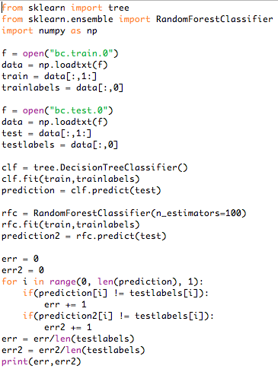
Decision tree and random forest in scikit-learn

Slide 22
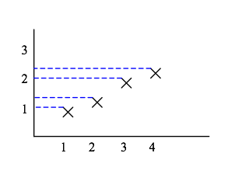
Data projection
What is the mean and variance here?

Slide 23
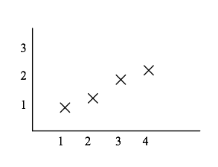
Data projection
Which line maximizes variance?

Slide 24
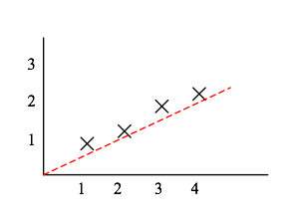
Data projection
Which line maximizes variance?

Slide 25
Principal component analysis
Find vector w of length 1 that maximizes variance of projected data

Slide 26
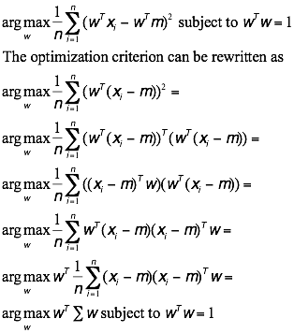
PCA optimization problem

Slide 27
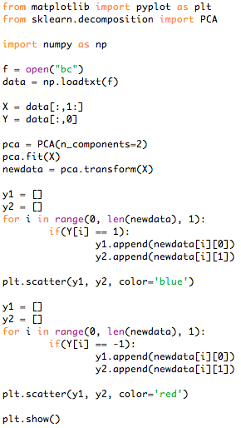
Dimensionality reduction and visualization with PCA

Slide 28
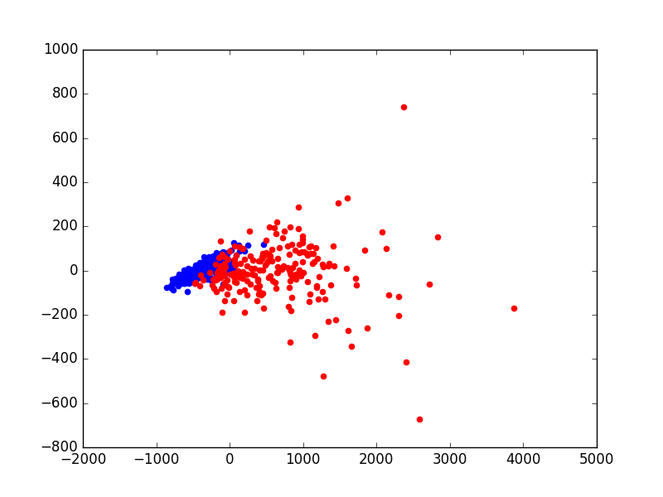
Dimensionality reduction and visualization with PCA
PCA plot of breast cancer data (output of program in previous slide)

Slide 29

Unsupervised learning - clustering
K-means: popular fast program for clustering data
Objective: find k clusters that minimize Euclidean distance of points in each cluster to their centers (means)

Slide 30


K-means algorithm for two clusters
Input:
Algorithm:
Initialize: assign x_{i} to C₁ or C₂ with equal probability and compute means:
Recompute clusters: assign x_{i} to C₁ if ||x_{i}-m₁||<||x_{i}-m₂||, otherwise assign to C₂
Recompute means m₁ and m₂
Compute objective
Compute objective of new clustering. If difference is smaller than then stop, otherwise go to step 2.

Slide 31
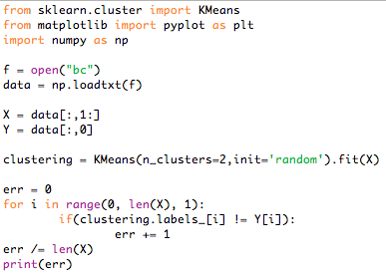
K-means in scikit-learn

Slide 32
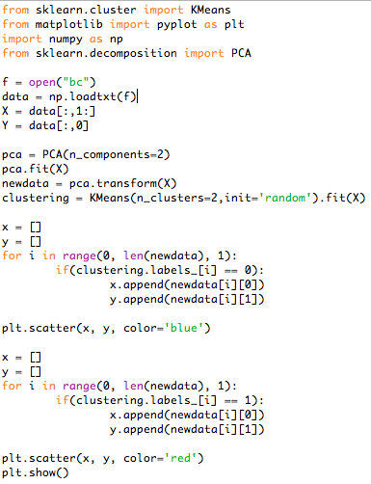
K-means PCA plot in scikit-learn

Slide 33
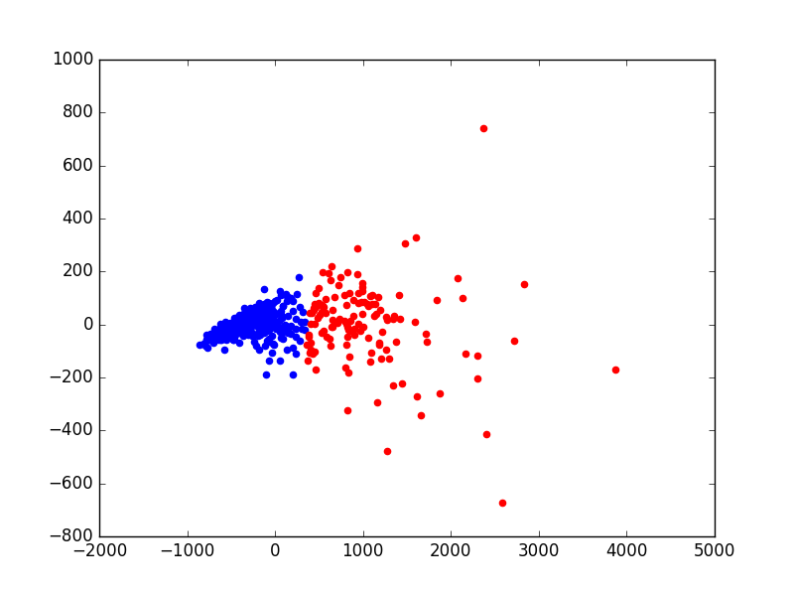
K-means PCA plot in scikit-learn
PCA plot of breast cancer data
colored by k-means labels
PCA plot of breast cancer data
colored by true labels

Slide 34
Conclusion
We saw basic data science and machine learning tasks in Python scikit-learn
Can we handle very large datasets in Python scikit-learn? Yes
For space use array from numpy to use a bytes for a char and 4 for float and int. Otherwise more space is used because Python is object oriented
For speed use stochastic gradient descent in scikit-learn and mini-batch k-means

