Slide 1
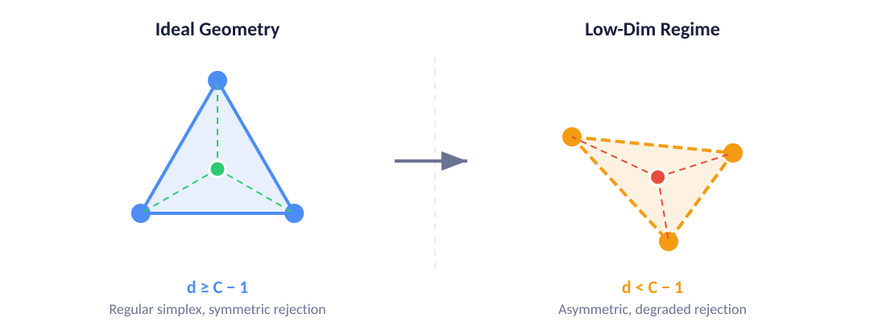
UCDSC: Open-Set Recognition for Medical Imaging
Base Paper Overview & Motivation for Extension
What UCDSC Does
Simplex-based class prototypes + uncertainty-aware rejection for open-set recognition on medical image datasets
Base Contributions
Strong OSR on medical datasets; combines prototype geometry, uncertainty regularization, and open-set rejection
Limitation
Simplex view assumes d ≥ C − 1; practical low-dim settings violate this
Key Insight: When d < C − 1, perfect simplex symmetry breaks, but rejection geometry survives with quantifiable degradation.
Our Direction
Extend theory beyond the strict simplex regime; study threshold selection, dimension sensitivity, and d < C − 1 behavior
Project Evaluation — Phase 2 | IIT | 2026
Notes:
1. UCDSC is an open-set recognition method for medical imaging using simplex-based prototypes and uncertainty-aware rejection. 2. The base paper achieves strong OSR on medical datasets by combining prototype geometry with uncertainty regularization. 3. Key limitation: the theoretical framework assumes embedding dimension d >= C-1. Real low-dimensional settings violate this. 4. Our work extends the framework to study what happens in the d < C-1 regime, where the simplex degrades but rejection geometry survives.

Slide 2

Our Approach & Contributions
Beyond the base paper: reproduction, analysis, and extension experiments
Theoretical Paper: Developed unified framework for simplex-ratio OSR across all dimensions. Key results: Lipschitz continuity of U, exact ball geometry for balanced equal-norm codes, sharp dichotomy theorem (λⱼ = 1 ⇔ regular simplex ⇔ d ≥ C−1), and conditional FAR bounds exponential in d.
Theory
1
Reproduced UCDSC baselines on BloodMNIST and DermaMNIST
2
Threshold calibration / operating-point analysis (FAR-KRR style)
Reproduction
Analysis
3
Low-dimension experiment on BloodMNIST (dim sensitivity)
4
CIFAR-100 as outside-medical stress test
Analysis
Extension
5
PathMNIST: cancer-domain d < C−1 extension (C=6, d=4)
6
Identified and fixed implementation issues for PathMNIST pipeline
Extension
Engineering
Framing: BloodMNIST & DermaMNIST are paper-aligned reproductions. CIFAR-100 & PathMNIST are extension experiments. PathMNIST is a theory-motivated low-dimensional extension.
Project Evaluation — Phase 2 | IIT | 2026
Notes:
1. We reproduced the core UCDSC baselines on BloodMNIST and DermaMNIST to validate the paper's claims. 2. We extended with threshold calibration analysis and a low-dimension sensitivity experiment. 3. CIFAR-100 is an outside-medical-domain stress test showing the method generalizes. 4. PathMNIST is our key theory-motivated extension: with C=6 known classes and d=4, we have d < C-1, directly testing the low-dimensional regime.

Slide 3
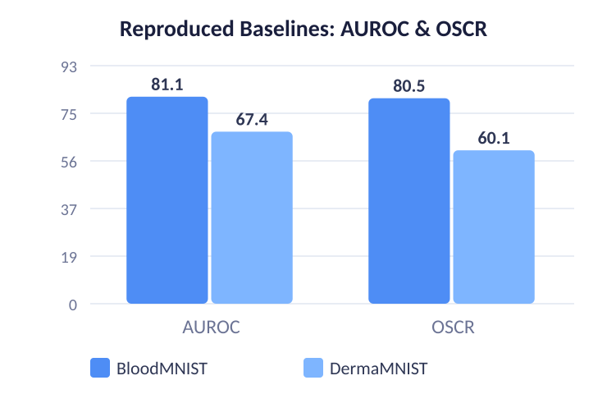
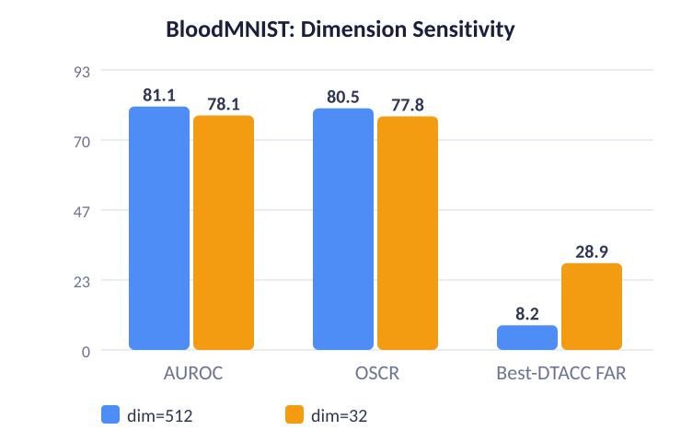
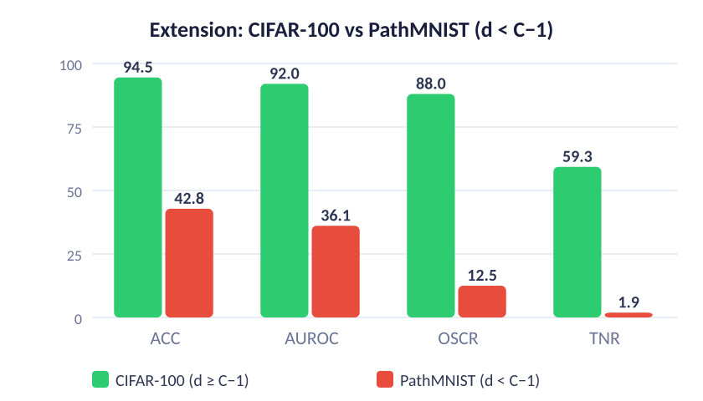
Experiment Results
Blood vs Derma
BloodMNIST baseline significantly stronger; DermaMNIST shows weaker open-set discrimination
Low Dimension Effect
dim 512→ 32: AUROC drops ~3 pts, Best-DTACC FAR triples (8%→29%)
CIFAR-100
Strong outside medical domain: AUROC 92.0, OSCR 88.0
Dataset | ACC | AUROC | OSCR | TNR
BloodMNIST | 98.2 | 81.1 | 80.5 | 34.6
DermaMNIST | 84.4 | 67.4 | 60.1 | 14.5
CIFAR-100 | 94.5 | 92.0 | 88.0 | 59.3
PathMNIST* | 42.8 | 36.1 | 12.5 | 1.9
* PathMNIST: d < C−1 extension (C=6, d=4) — not a reproduction
Theory Validation: PathMNIST in the d < C−1 regime shows weak, unstable open-set performance — qualitatively consistent with the prediction that low dimension degrades rejection geometry.
Project Evaluation — Phase 2 | IIT | 2026
Notes:
1. BloodMNIST baseline is much stronger than DermaMNIST across all metrics. 2. Lowering embedding dimension from 512 to 32 hurts open-set quality: AUROC drops ~3 points, and Best-DTACC FAR triples from 8% to 29%. 3. CIFAR-100 extension shows the method generalizes outside medical domain with AUROC 92.0. 4. PathMNIST in d < C-1 regime is weak and unstable, which validates our theoretical prediction about degraded rejection geometry.

Slide 4

Team Contributions
Equal distribution across theory, experimentation, implementation, and presentation
Mayank Sharma
Rohit Mourya
Danie George John
Theoretical reading and interpretation of UCDSC paper and the d < C−1 regime
Reproduced baseline analysis and comparison across BloodMNIST and DermaMNIST
Report/presentation narrative and consolidation of experiment findings
Theoretical understanding and framing of the low-dimensional extension
Threshold/dimension experiments and CIFAR-100 extension evaluation
Metrics organization, result comparisons, and final presentation content
Theoretical interpretation of PathMNIST as a d < C−1 extension experiment
PathMNIST pipeline execution, debugging, and final result generation
Artifact compilation, output validation, and demo/presentation material
Overall effort was distributed approximately equally across theory, experimentation, implementation, and presentation.
Project Evaluation — Phase 2 | IIT | 2026
Notes:
1. All three members contributed equally to the theoretical reading and interpretation work. 2. Mayank focused on reproduced baselines analysis and report narrative. 3. Rohit focused on threshold/dimension experiments and CIFAR-100 extension. 4. Danie focused on the PathMNIST pipeline execution and artifact compilation. 5. Presentation and report work was shared across all members.

