Slide 1
RepoLens
A github repository recommendation system

Slide 2
Our Vision
Open source developers often work on or contribute to various repositories.
Our project assists them in finding a repository most connected to them in order for them to contribute to whatever they are most interested in.

Slide 3
Dataset Creation
Github provides an API from which we can fetch user and repository data using an access token.
In order to train our models, we needed a large dataset of repositories which would cover a diverse range of topics, while being a reliable source.
For this we found the 100 most popular repositories (ranked by stars) ranging from the year 2008 to 2023.
There is a total of 1600 repositories used for training data.
The python requests module was used along with async functions to speed up the API requests.

Slide 4
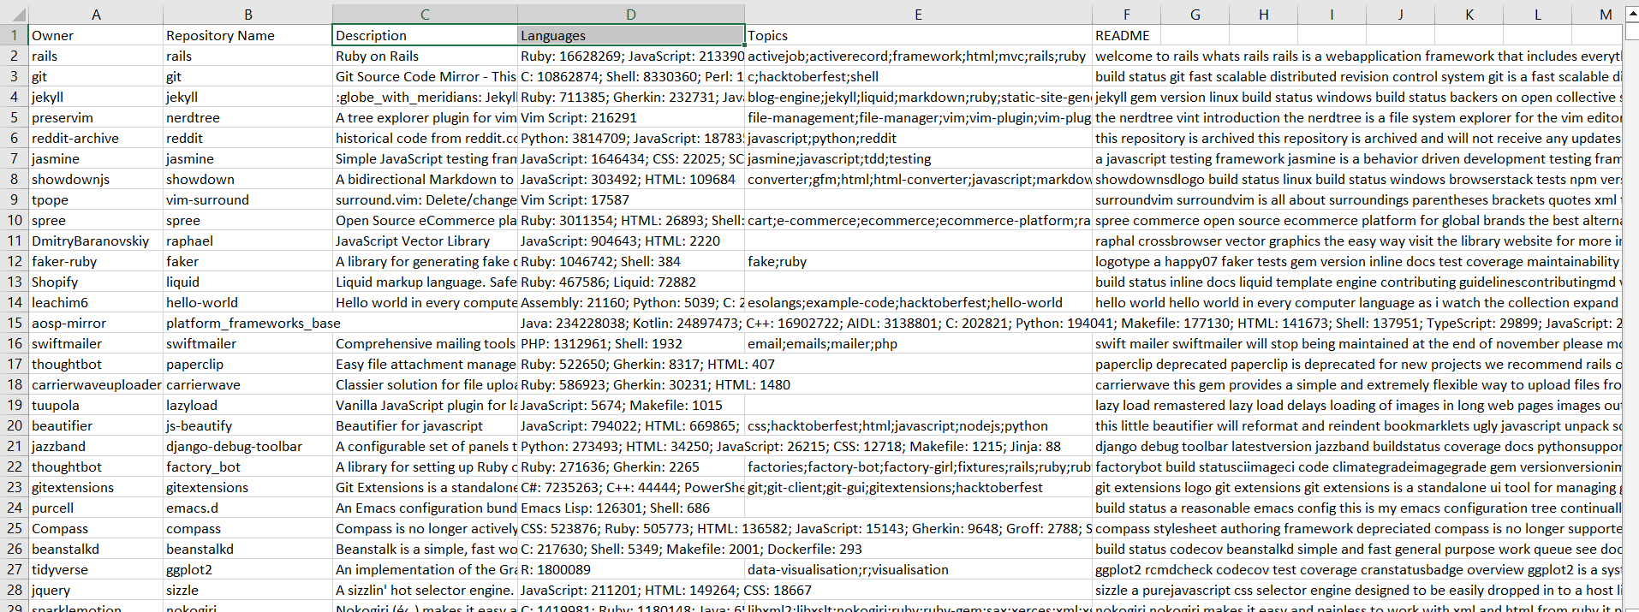
Dataset Description

Slide 5
Preprocessing
Many features such as stars, watchers, forks are a good measure of popularity. However we believed these features would not be helpful in personalized recommendations, hence they were dropped.
Text based features such as Description and README were useful for identifying similarities. NLP algorithms would work well for these.
Topics could be treated as one hot encoded binary vectors. Similarly programming languages could be treated as float vectors, each entry between 0 and 1, the fraction of the code it takes up.

Slide 6
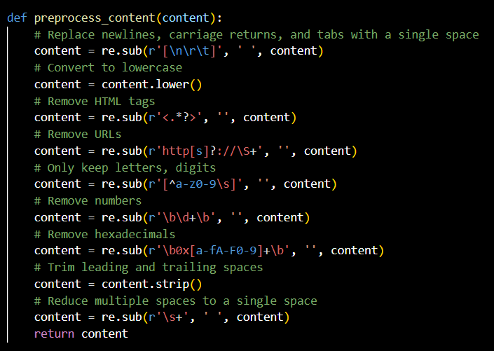
Text Preprocessing

Slide 7
NLP Models
The idea was to capture a mix of keywords and semantic structure. So we experimented with the following models:
TF-IDF
Doc2Vec (DM model)
BERT

Slide 8
Similarity Measurement
The key idea behind the recommendation engine is to measure similarity between two repositories.
Using NLP models, we could construct feature vectors for Description and README.
The one hot encoded binary and float vectors for topics and languages could be used directly.
To check for similarity between two vectors we use cosine similarity and Jaccard similarity metrics (the latter which is useful for one hot encoded vectors)
The final “recommendation score” is a weighted sum of the individual similarity scores.

Slide 9
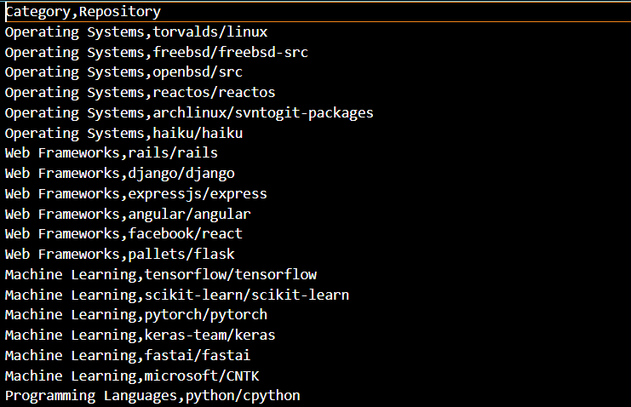
Test Data
For test data we handpicked 60 famous repositories and divided them into “rough” categories.
Ideally the recommender system would give the top 5 similarity scores for repositories belonging to the same category (ignoring itself)

Slide 10
Evaluation
For evaluation we used the metric of “precision” which is the number of recommended repositories belonging to the same category in the top 5, divided by 5.
We iterated through each repository in the test data and calculated its similarity to all the other repositories in the test data. The final score was the average of these 60 precision scores.
To provide perspective, the expected final score for purely random recommendation is approximately 8%

Slide 11
Conducting Tests
First we tried getting precision scores on one metric at a time. The following results were obtained:
Since descriptions were mainly small sentences, keywords provided a bigger impact as opposed to semantics. So a TF-IDF model trained on it alone gave a precision of approximately 36%
Topic based similarity alone also showed a high precision of 31%. Topics are a good metric of similarity, but are not present in many repositories
For READMEs, both keywords and semantics played a role. The order of precision by one model alone was: TF-IDF (25%) > Doc2Vec (23%) > BERT
Evaluating purely on the basis of BERT on the READMEs gave a very low precision of around 20%. That along with the heavy impact on performance led us to drop BERT as an option.

Slide 12
Hyperparameter Tuning
Since we had figured out a rough order of importance, we needed to combine the different models. The final recommendation score was calculated as follows:
RS = sim( desc, TF-IDF) * w1 + sim(topic) * w2 + sim(readme, TF-IDF)*w3 + sim(readme, D2V)*w4
We set w1 = 1, and calculated the other weights relative to it by plotting graphs. Note that the final recommendation score is not normalized. As we increase the weights, the score roughly improves up until a certain point after which it decreases.
An additional hyperparameter is the number of features in the TF-IDF and Doc2Vec. The number of features in TF-IDF is much larger than that of doc2vec, so w4 is much smaller than the other weights.

Slide 13
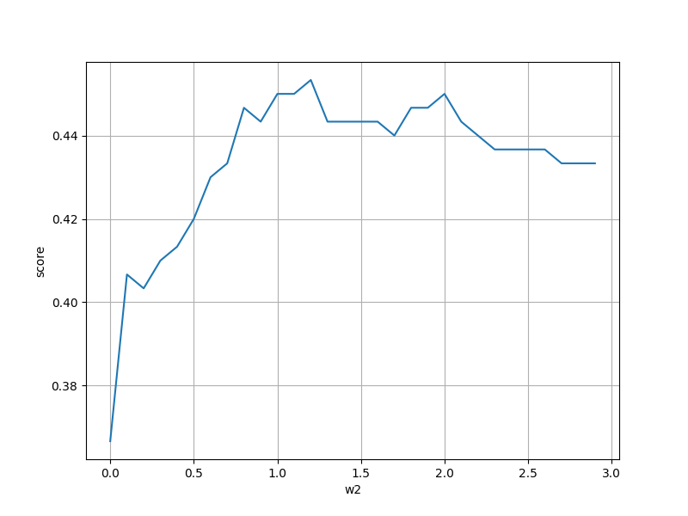
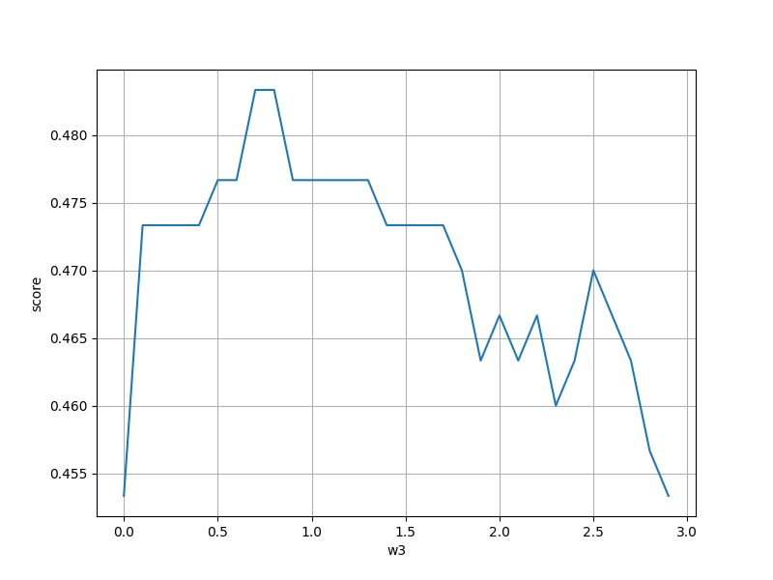
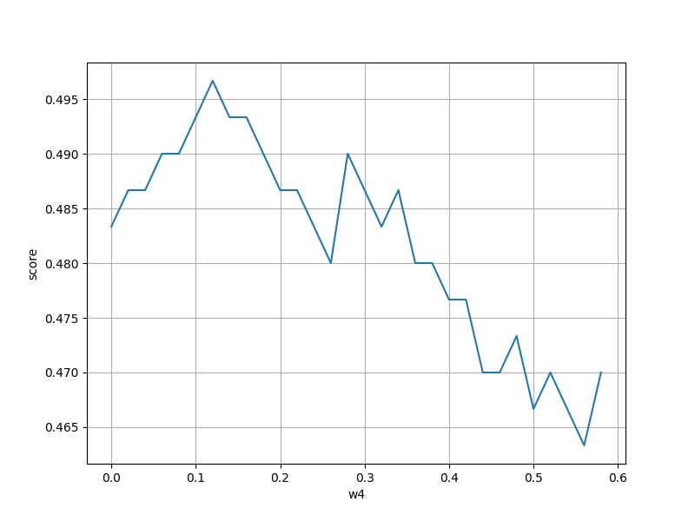
Graphs
Optimal hyperparameters leads to precision of around 50% (Meaning 2 to 3 correct recommendations out of 5)
w1 = 1, w2 = 1.2, w3 = 0.8, w4 = 0.12

Slide 14
Content-based Recommendation
Since we found out the optimal method to measure the similarities between two repositories, it was intuitive to perform content based recommendation. This involved the following steps.
Training the models on the train data of popular repositories throughout the years
Constructing a user profile by considering the repositories they have interacted with. This included both “created” repositories, and “starred” repositories
Creating an averaged user vector by taking the average of their repository vectors.
Getting the recommendation score for all the repositories in the dataset when compared to this user vector, as explained in the evaluation section.

Slide 15
Novelty 1: (Mitigating the Cold Start Problem)
The cold start problem is a well known issue with content based recommendation
If the user hasn’t interacted with any repositories, the program manually requests input from the user to generate a topic vector.

Slide 16
Novelty 2: (Language Filtering)
In the evaluation section, we avoided discussing the similarity in programming language as most people do not compare similarity between repositories on the basis of programming language.
For example, a remake of a library in a completely different programming language would still be considered very similar to the first. Hence we don’t factor this in.
However, the user can optionally choose to give additional weightage to similarity in programming language.

Slide 17
Novelty 3 (Trending and Connections)
One of the biggest problems with the current recommendation engine is that only popular repositories get suggested. This leads to lack of diversity and personalized content. So we came up with the following modifications:
Users tend to show a preference to trending data, or data that they are related to.
We define a new metric called as “distance”, which is a measure of how close a user is to the data. By default popular repos have a distance of 1000 (Very unrelated to the user)

Slide 18
Novelty 3 (Trending and Connections)
At the program runtime, we collect a list of 100 repositories in the last month sorted by stars. These are labelled as TRENDING. We define the top 50 repos to be at a distance of 1, and the next 50 to be at a distance of 2.
Similarly we use github’s following feature to create a network of users. This is similar to a graph where the the nodes are users, and a following is a directed edge between them.
Using a BFS traversal, we can explore the nearest neighbours of the user in this graph, and mark their distance. So users which are directly followed, are at a distance of 1.
For each user in this graph, up to two recent repositories are added to the dataset. These are labelled as CONNECTED
The final similarity scores are multiplied by a factor of (1 + 0.5/distance). Therefore the closest repositories are given an additional importance by a factor of 1.5. This metric was chosen by a series of manual evaluation of outputs to ensure a good mix of POPULAR, TRENDING, and CONNECTED repositories.

Slide 19
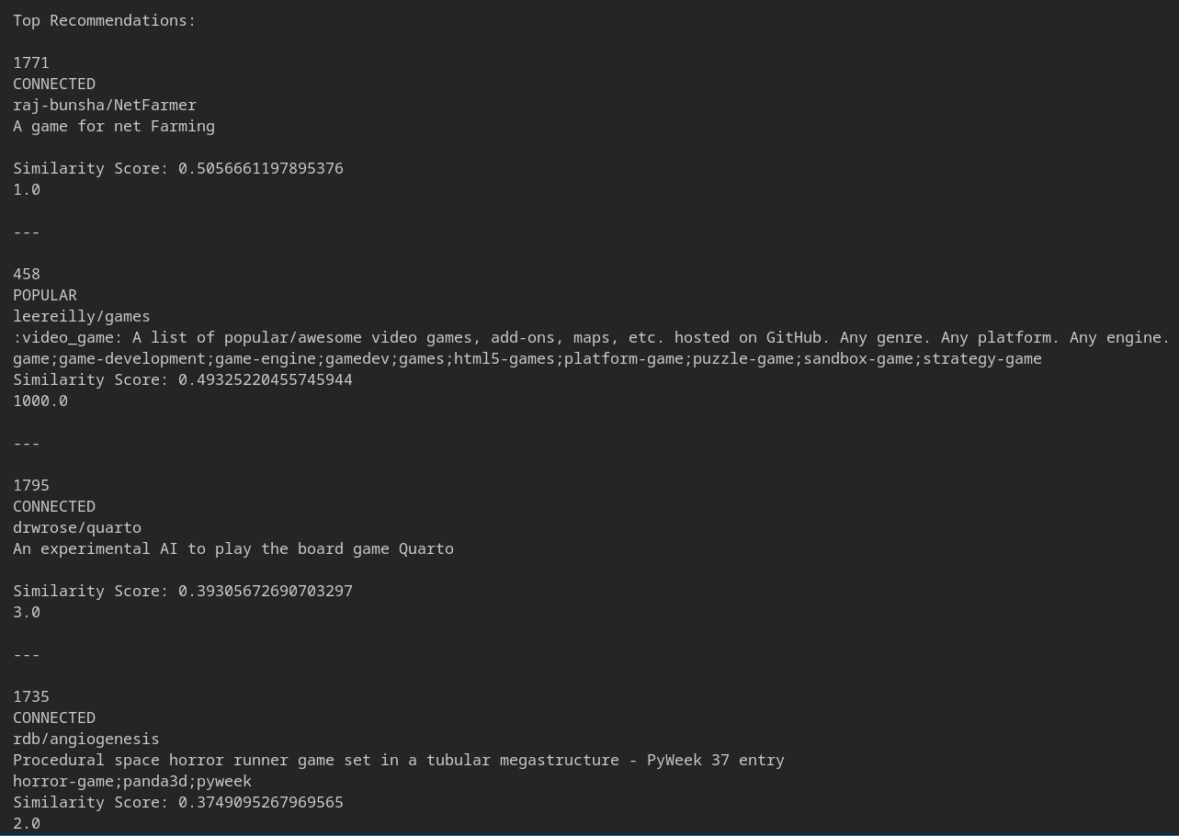
Results

Slide 20
Future Work
Taking average of the repositories may not always be the best approach to creating a user profile. Considering the case where the user has two distinct opposing interests, an ideal recommender system would suggest repositories which satisfy either one of these interests.
However taking the average might result in a vector which is between two extremes and unrelated to both.
The following are proposed solutions which we plan to implement in the future:
Assigning weights to user repositories based on date of creation so that the user vector mainly depends on the recent repositories.
Perform some method of clustering to gather specific interests.

