Slide 1
Details
Problem Statement: Expense Tracker application which will keep a track of IncomeExpense of a user on a day to day basis.
Problem Statement Number: PS10
Team Name: Cyber Knights
Team Leader Name: Mayank Joshi
College Name: MMCOE, Pune

Slide 2

Idea App holds a simple but heavy function to store and track all money related functions

Slide 3


Approach
Basic Requirement
Components To Be Added
As Per His Desire
One User Different Devices

Slide 4
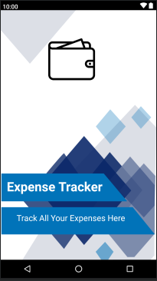
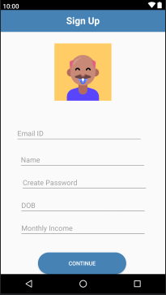
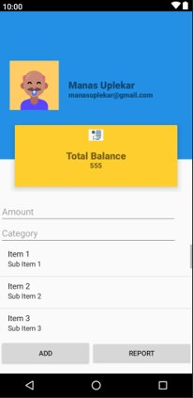
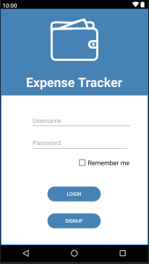
Splash Screen Sign Up Page a Dashboard Expense Tracker

Slide 5
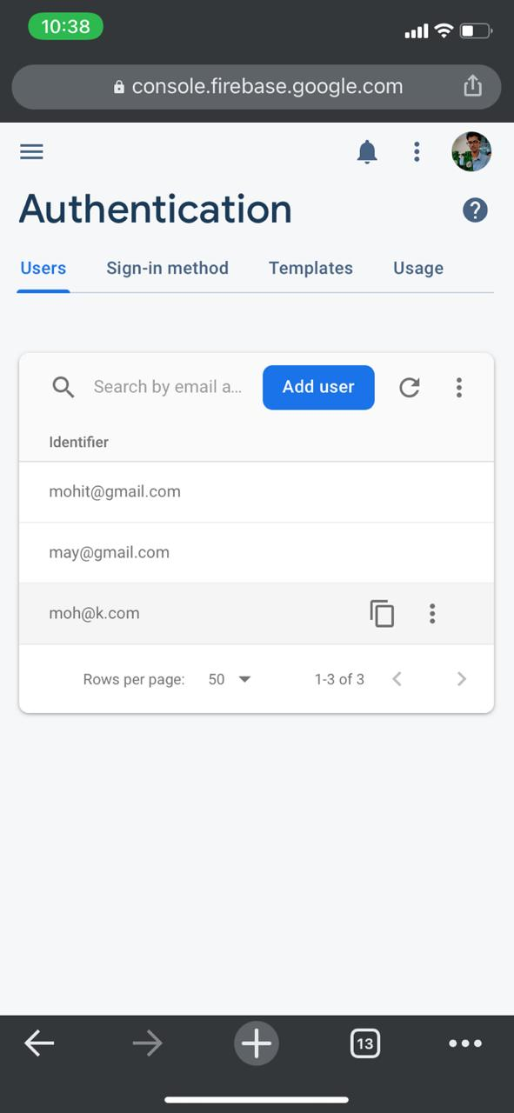
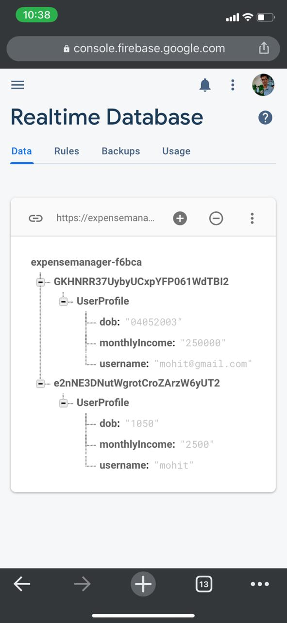
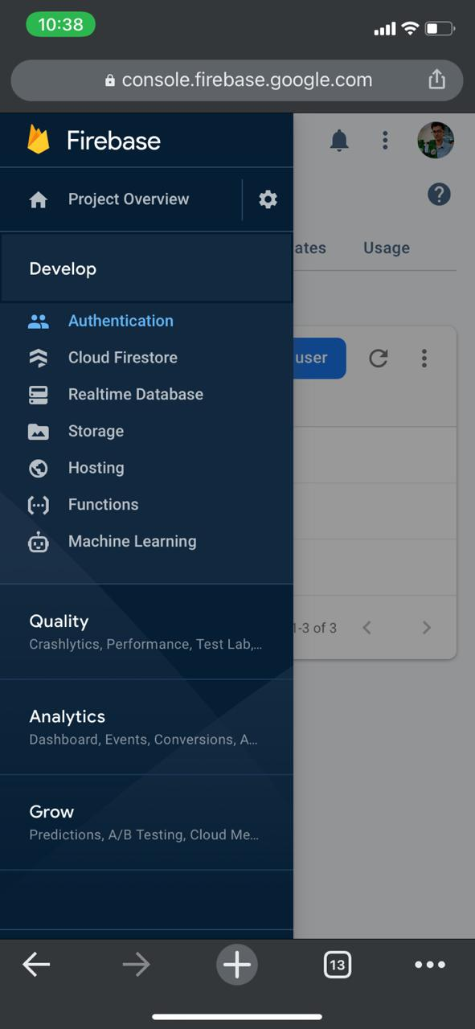
Firebase

Slide 6
Application
1.Track your transactions and savings
2.Add cash to set your further transactions
4.Save your data by signing up to app for easy backup
5.Dashboard for smart information management

Slide 7
Day 2 additions
Almost completed with the frontend
Started with backend and firewalll processes
Suggestions given by mentors added and many error issues solved
New changes in design

Slide 8
Day 3 additions
Presentation prepration
Dashboard coding
App Testing
Final touch ups

Slide 9

Thank You

