Slide 1
Netflix Data Analysis & Visualization
Project Report
Data Source: Kaggle

Slide 2
Data Cleaning & Preparation
Dataset Record: 1438 Rows, 8 Columns
Removed 3 Columns (drop)
Ratings categorized into four groups.
Type conversions (to_datetime/astype)
Split/explode multi-value columns
Filtering invalid rows

Slide 3
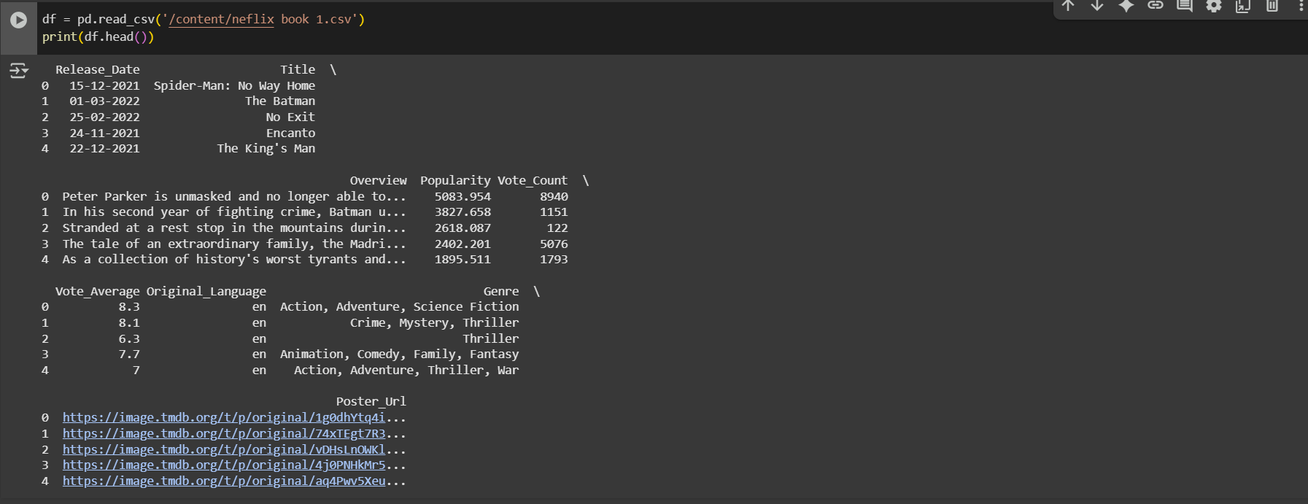
Getting Data

Slide 4
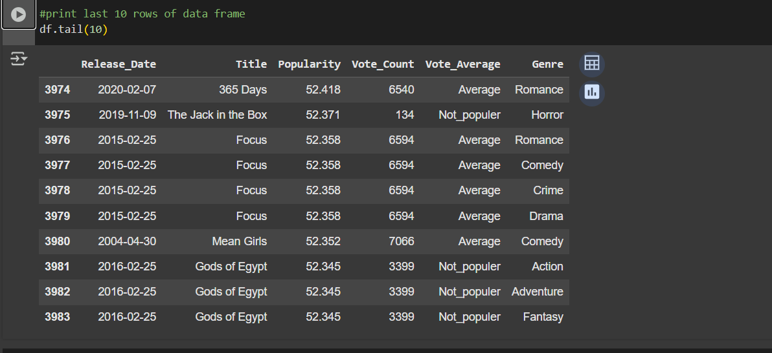
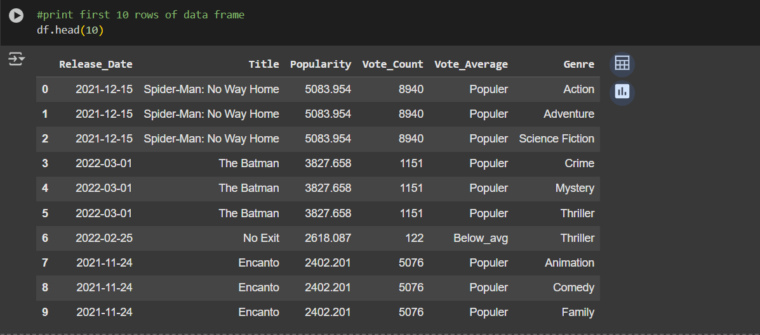
Top & Bottom 10 Rows

Slide 5
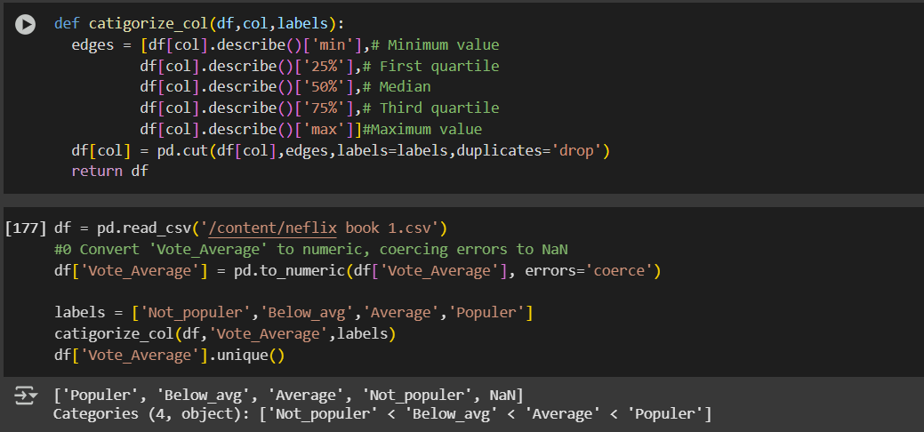
Categorized Rating

Slide 6
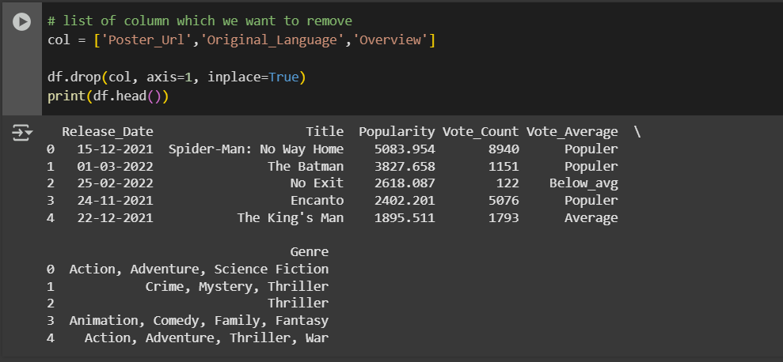
Remove Columns

Slide 7
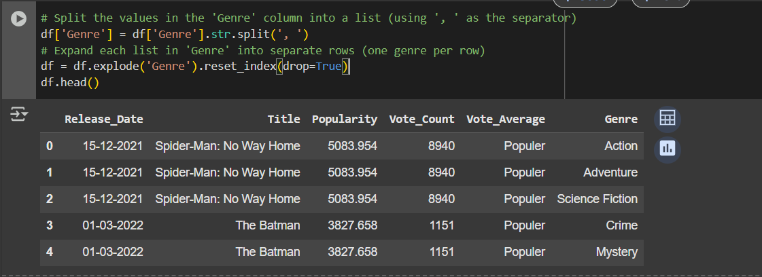
Splitting str. & Explode Columns

Slide 8
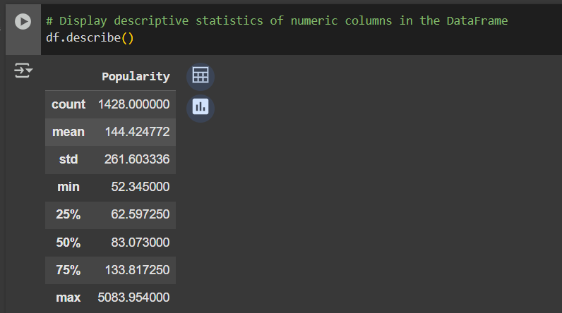
Popularity Statistics

Slide 9
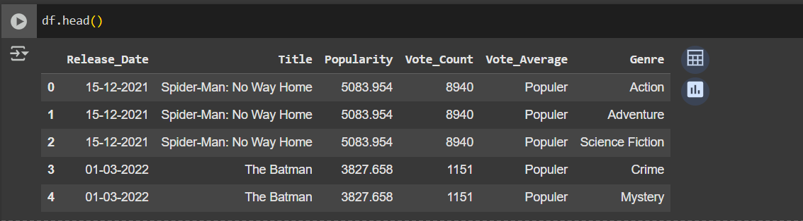
Visual Overview Of Cleaned Data

Slide 10
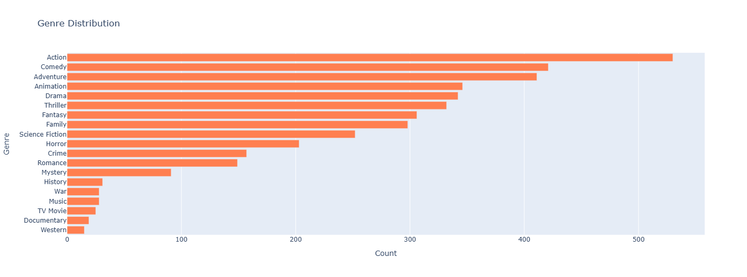
Analysis Visualizations Number of Movies by Genre

Slide 11
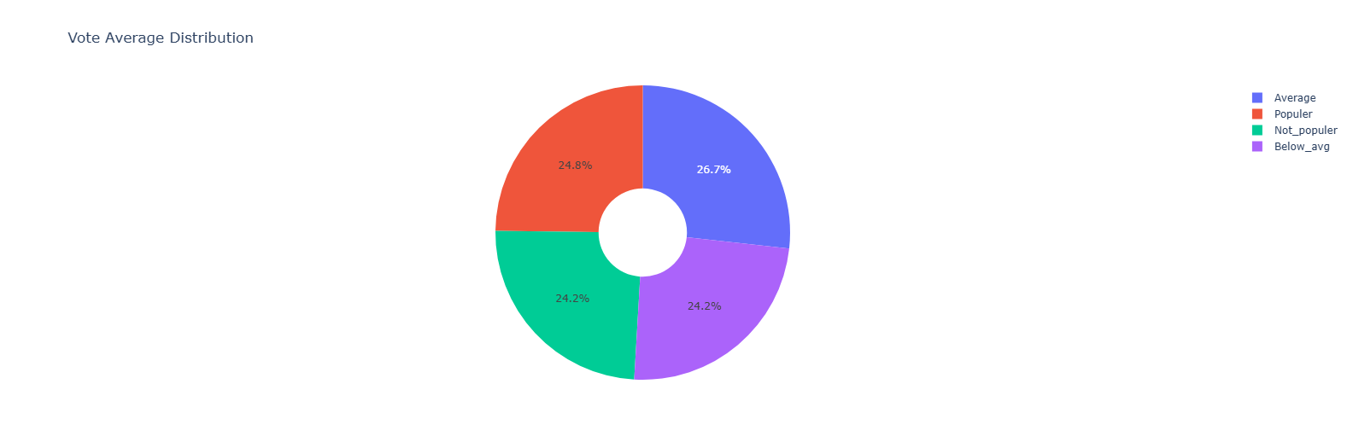
Distribution of Movie Ratings by Popularity

Slide 12
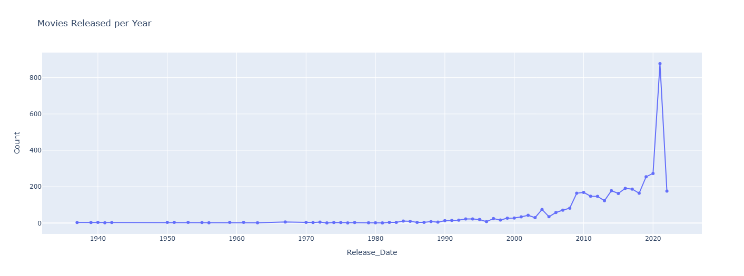
Line Chart For Trend of Movie Production Over the Years

Slide 13
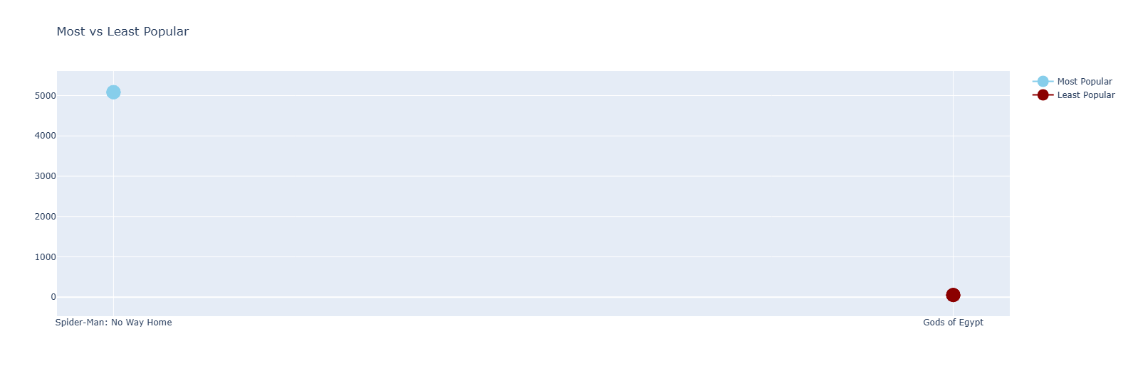
Most vs least Popular Movies

Slide 14
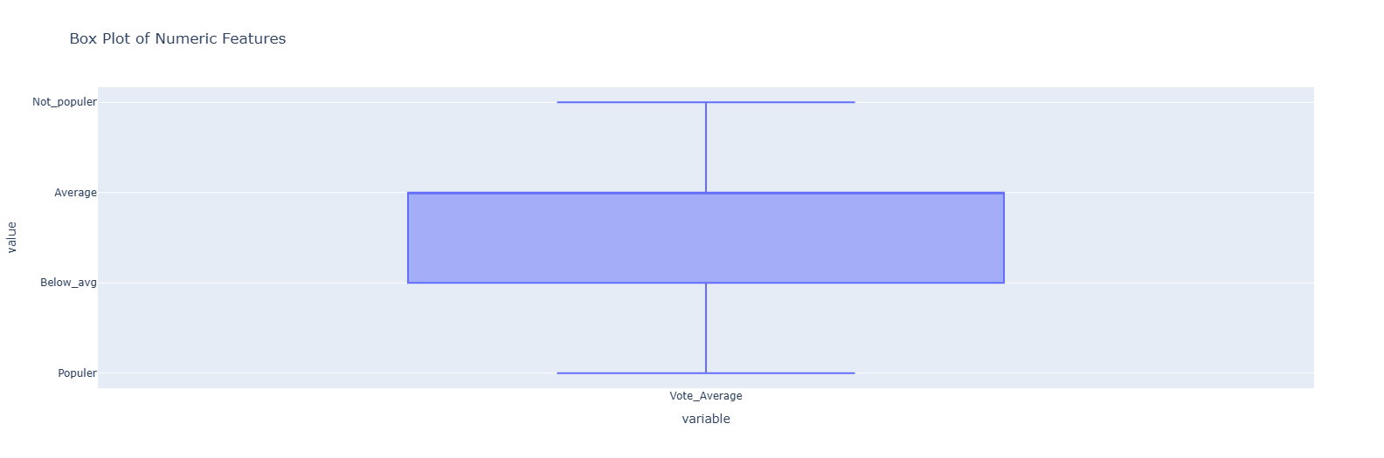
Distribution Data Between Vote Average

Slide 15
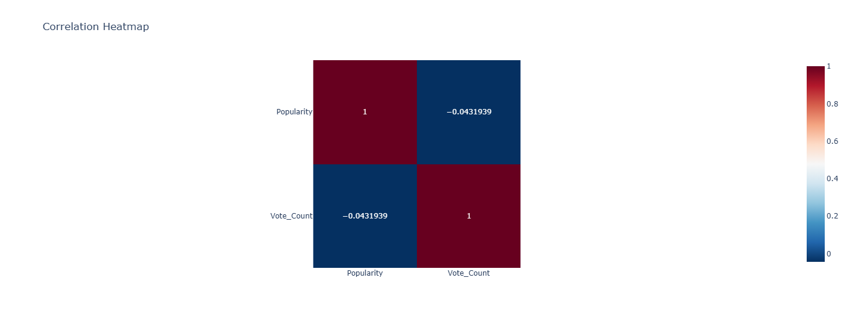
Correlation Between Popularity & Vote Average

Slide 16
Key Insights
The dataset required data type normalization (dates and categorical text standardization).
Handling duplicates and missing values improved data quality for modeling/visualization.
Exploding multi-valued fields (e.g., Genre) enabled accurate distribution analysis.
Outlier-aware summaries (quantiles/clipping) prevented skewed aggregates.
Feature engineering and groupings supported trend and composition charts.

