Slide 1
Shell Bootcamp 2024 3 Reflections for Week #<>
Mayank Malhotra
Date : 30-Aug-2024

Slide 2

About Me
"Embrace the journey, thrive in every challenge, and grow beyond limits."

Slide 3

My learnings from this week!

Slide 4

Learning 1 | My takeaways
Professionalism and Teamwork:
During the first three days of the workshop, we focused on developing professionalism and teamwork. We explored the traits that define a professional and the importance of professional behavior in the workplace. We also learned about the characteristics of a good team player and the significance of a growth mindset.
Key Learning:
The importance of maintaining professionalism and effective teamwork in a corporate environment.
Key Takeaway:
Adopting a professional approach and fostering teamwork can significantly enhance productivity and create a positive work culture.
Implementation in Energy Sector:
In the energy sector, where projects often involve multidisciplinary teams, professionalism and teamwork are essential for smooth operations and achieving project goals.

Slide 5
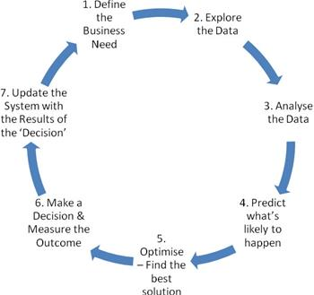
Learning 2 | My takeaways
Business Analyst Role and Requirement Analysis:
We delved into the role of a Business Analyst (BA) and the critical functions they perform, such as requirement elicitation, management, and traceability. We also learned about the importance of creating clear and concise Business Requirement Documents (BRD) and Software Requirement Specifications (SRS).
Key Learning:
The role of a BA is crucial in bridging the gap between stakeholders and developers, ensuring that project requirements are well-defined and managed.
Key Takeaway:
Effective requirement analysis and management are vital for the successful delivery of projects, minimizing risks and ensuring that the final product meets the stakeholders' needs.
Implementation in Energy Sector:
In the energy sector, accurate requirement analysis is crucial for developing systems that meet regulatory standards and operational needs, ensuring project success and compliance.

Slide 6
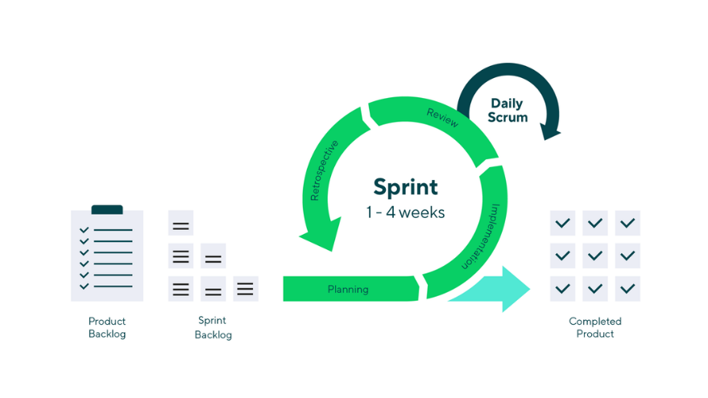
Learning 3 | My takeaways
Agile Methodologies and DevOps:
The last two days focused on Agile methodologies, where we explored the different roles, cycles, and components involved. We also covered DevOps practices, highlighting how they complement Agile by promoting continuous integration and delivery.
Key Learning:
Agile methodologies enable iterative development and continuous improvement, while DevOps practices streamline the deployment process, making it more efficient.
Key Takeaway:
Adopting Agile and DevOps in projects leads to faster delivery, higher quality products, and better alignment with customer needs.
Implementation in Energy Sector:
In the energy sector, Agile can be used to manage complex projects, allowing for flexibility and adaptability, while DevOps ensures that deployments are smooth and continuous, reducing downtime and operational risks.

Slide 7

Relevance of learnings for my organization

Slide 8
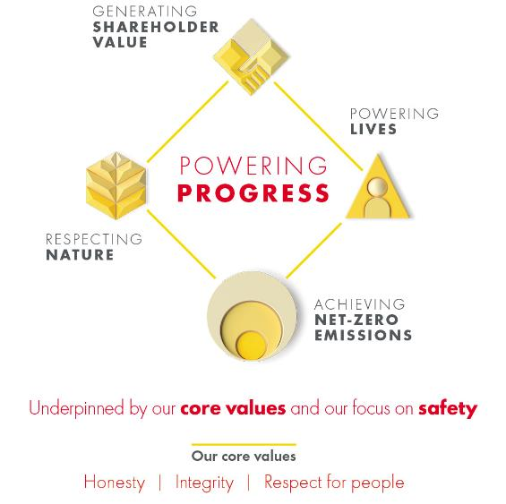
Learning 1 | Relevance for Shell
How Shell Implements It:
Shell emphasizes professionalism and teamwork through its core values and company culture, encouraging employees to collaborate effectively and maintain high standards of conduct.
How Shell Benefits:
By fostering a professional and collaborative environment, Shell enhances productivity, improves employee satisfaction, and ensures smooth project execution.

Slide 9
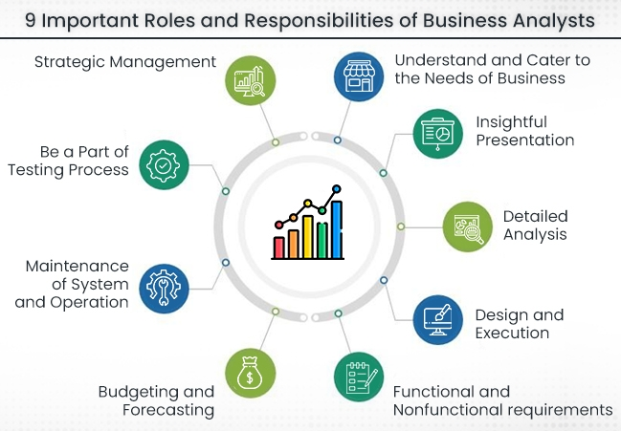
Learning 2 | Relevance for Shell
Business Analyst Role and Requirement Analysis:
How Shell Implements It:
Shell relies heavily on BAs to ensure that project requirements are accurately captured and managed, which is critical for the successful execution of its complex energy projects.
How Shell Benefits:
Effective requirement analysis helps Shell avoid costly mistakes, ensures regulatory compliance, and aligns project outcomes with business objectives.

Slide 10
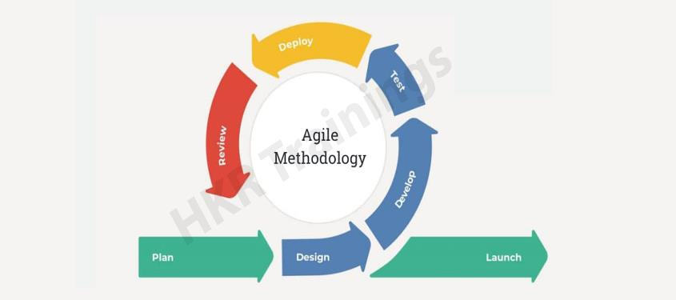
Learning 3 | Relevance for Shell
Agile Methodologies and DevOps:
How Shell Implements It:
Shell has adopted Agile and DevOps practices to manage its projects, particularly in software development and IT operations, allowing for quicker responses to market changes and technological advancements.
How Shell Benefits:
These practices help Shell deliver projects more efficiently, with higher quality and fewer disruptions, supporting its overall business strategy.

Slide 11

Challenges in implementing learning

Slide 12
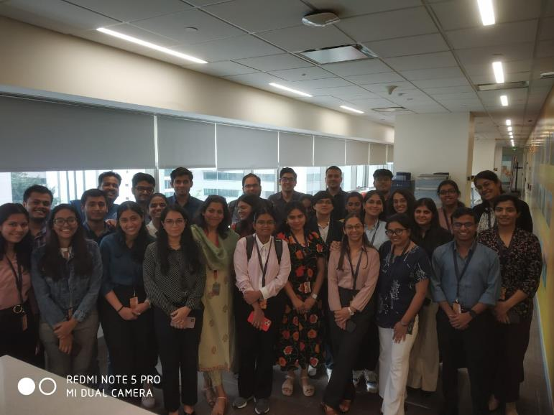
Challenge faced while implementing Learning 1
Challenge: Adapting to Shell’s high standards of professionalism and integrating effectively into existing teams.
Plan to Overcome: Engage in regular feedback sessions and participate actively in team activities to better align with the company’s culture.

Slide 13
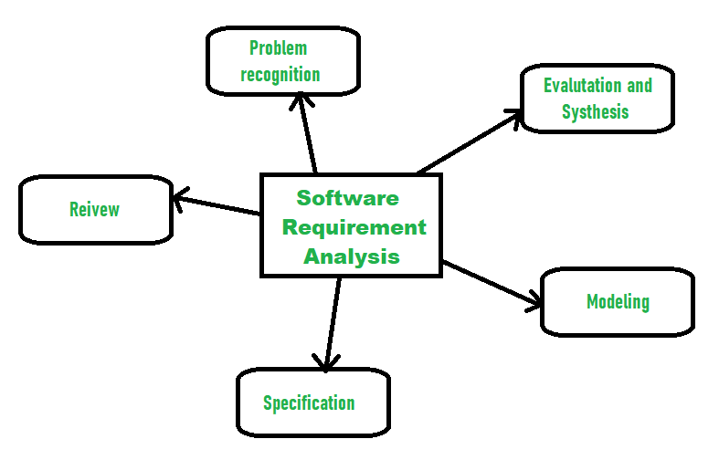
Challenge faced while implementing Learning 2
Challenge: Understanding and applying the requirement analysis processes in real-world projects.
Plan to Overcome: Work closely with experienced BAs and review existing project documentation to build a deeper understanding.

Slide 14
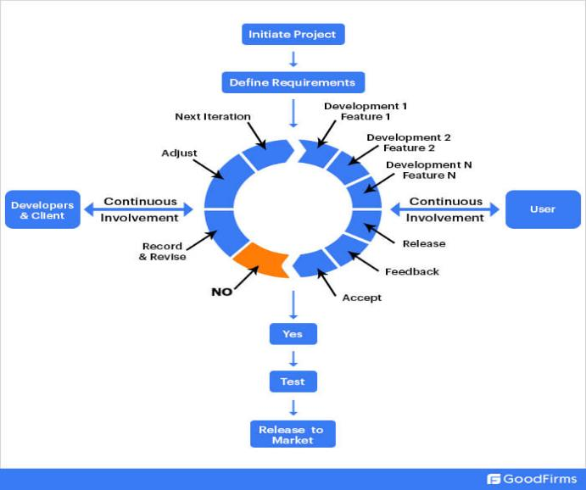
Challenge faced while implementing Learning 3
Challenge: Implementing Agile and DevOps practices in projects with established traditional methodologies.
Plan to Overcome: Propose pilot projects to introduce these practices gradually and demonstrate their benefits.

Slide 15

Action Plan

Slide 16
My Action Plan for this Week
Actions
Timeline
Status
Engage in ongoing professional development.
Apply requirement analysis techniques to current projects.
Participate in Agile meetings and contribute to DevOps initiatives.
Focus on professionalism and teamwork.
Implement requirement analysis in projects.
Introduce Agile practices in my work.
By the End of the week I was able to implement these learning at my workplace.

Slide 17

Learning is also Fun!

Slide 18
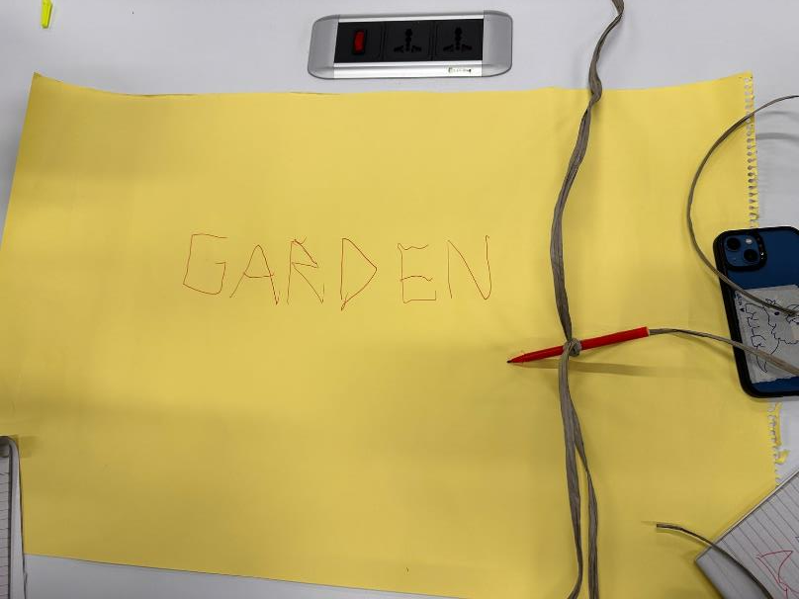
Learning is also Fun!
Group Activities:
Teamwork Activity: One of the highlights of the week was the teamwork exercise where we had to hold a pen using strings as a team and coordinate to write a word. This activity was not only challenging but also fun, as it required strong communication and coordination among team members.
Presentation Exercise: We were grouped into teams of six and tasked with creating a presentation on a topic of our choice. Our team chose "Memory and False Memory," which led to engaging discussions and creative collaboration. The process of working together to create and present the PPT was enjoyable and informative.
Funny Incidents:
During the teamwork exercise, one team member accidentally pulled too hard on their string, causing the pen to fly off the paper. This led to a burst of laughter from everyone on the table, lightening the mood and making the learning experience more memorable.
[Add a graphic or a picture of how you/your team enjoyed the new learning]

Slide 19

Summary
Quick Summary (for the Current Week):
During this week, I focused on enhancing my professional skills and technical foundations. The first three days were dedicated to soft skills, where I learned about professionalism, stakeholder management, and teamwork. The last two days were focused on technical aspects, including business analysis, requirement management, and Agile methodologies. These sessions were designed to build a solid foundation for my role as a Software Engineer.
Importance of Topics for the Upcoming Week:
Software Testing (02-Sep-24): Vital for ensuring that software is reliable, functional, and free of defects before it reaches end-users.
DevOps (03-Sep-24): Central to automating the software development lifecycle, enabling continuous delivery and integration.
Cloud (04-Sep-24): Key to leveraging scalable infrastructure and services that are essential for modern application development.
DBMS (05-Sep-24): Critical for managing and retrieving data efficiently, which is foundational to most software applications.
Case Work (06-Sep-24): A practical application of the week's learnings, allowing me to synthesize and apply my knowledge in real-world scenarios.
Connectivity of Topics from the Current Week:
The soft skills learned this week, such as stakeholder management and teamwork, are directly applicable to the upcoming technical sessions. Understanding stakeholder needs and working effectively in teams will enhance my ability to manage software testing processes, DevOps practices, and cloud deployment. The technical training on business analysis and Agile methodologies also prepares me to understand the broader context in which these tools and processes are applied, making the transition to next week's topics seamless and cohesive.

Slide 20
Thank You

