Slide 1
Shell Bootcamp 2024 3 Reflections for Week 2
Mayank Malhotra
Date : 6-Sept-2024

Slide 2

About Me
"Embrace the journey, thrive in every challenge, and grow beyond limits."

Slide 3

My learnings from this week!

Slide 4
Learning Day 1 | My takeaways
Learning: I learned about the Agile methodology, particularly user stories and their role in organizing software development. The importance of the Definition of Ready, Done, and Acceptance Criteria was emphasized, alongside roles in Agile like Scrum Master and Product Owner.
Key Learning: I now understand the purpose of testing, types of software testing (manual, exploratory, functional, non-functional), and testing hierarchy (unit, integration, system, acceptance).
Key Takeaway: Creating user stories and understanding the different testing types ensures that the software being developed is robust and aligns with business requirements.
Implementation in Energy Sector: In energy companies, software must be reliable and tested thoroughly. Agile methodologies help Shell manage complex projects, like ensuring safe operational software for energy production systems

Slide 5
Learning Day 2 | My takeaways
Learning: I learned about test case development, using Gherkin for test case creation, 508 Compliance Testing, and the entire software testing life cycle (STLC). We also explored the importance of bug reporting, priority, and severity.
Key Learning: Knowing the different types of testing and writing clear test cases are vital to uncovering issues early in the development process.
Key Takeaway: Understanding bug lifecycles and cost of bug fixing at each stage helps reduce the potential negative impact of software bugs.
Implementation in Energy Sector: Testing software that controls energy systems is crucial to prevent breakdowns. Shell must ensure all testing is thorough, considering the high risks in energy environments.

Slide 6
Learning Day 3 | My takeaways
Learning: The session on DevOps was enlightening, especially learning about different architectures (one-tier, two-tier, N-tier) and APIs (REST, SOAP). The value of CI/CD in maintaining application efficiency was clear.
Key Learning: DevOps enables smoother integration and deployment processes, minimizing human error.
Key Takeaway: Implementing CI/CD ensures faster delivery of services, which is crucial for an industry like energy where uptime is critical.
Implementation in Energy Sector: CI/CD pipelines automate repetitive tasks in software updates, ensuring that Shell’s operational systems are always available without downtime.

Slide 7
Learning Day 4 | My takeaways
Learning: We compared PostgreSQL and SQL, practiced writing queries, and conducted group activities involving test case creation in Gherkin.
Key Learning: SQL plays an essential role in data management, which is central to maintaining robust software systems.
Key Takeaway: Mastering SQL allows me to handle complex queries and databases, which is key in any data-heavy application Shell might manage.
Implementation in Energy Sector: Energy companies generate vast amounts of data that need to be structured and accessible; SQL helps manage that efficiently.

Slide 8
Learning Day 5 | My takeaways
Learning: This was a hands-on session where we applied our knowledge to a case study, developed test cases, bug reports, and implemented a CI/CD pipeline.
Key Learning: Applying theoretical knowledge to real-world scenarios solidified my understanding.
Key Takeaway: The integration of test cases, bug tracking, and CI/CD in a single case study gave a holistic view of the software development lifecycle.
Implementation in Energy Sector: Real-time software updates and rigorous testing are crucial for keeping energy production safe and efficient.

Slide 9

Relevance of learnings for my organization

Slide 10
Learning Day 1 | Relevance for Shell
Shell Implementation: Shell benefits from Agile and thorough testing by ensuring efficient product development cycles. Using tools like Azure DevOps helps the teams collaborate and maintain transparency across projects.
Shell’s Benefit: This structured approach reduces risks in system failures and guarantees that business requirements are well-defined, which is critical for large-scale projects in energy production.

Slide 11
Learning Day 2 | Relevance for Shell
Shell Implementation: The STLC and bug tracking ensure software and systems Shell relies on are well-maintained and tested.
Shell’s Benefit: The focus on reducing bugs early in the process saves time, resources, and minimizes operational risks.

Slide 12
Learning Day 3 | Relevance for Shell
Shell Implementation: Shell likely uses CI/CD in its digital transformation projects, ensuring continuous improvement of its technology infrastructure.
Shell’s Benefit: Continuous integration and delivery help Shell deploy updates more safely and faster, preventing any long downtimes in critical systems.

Slide 13
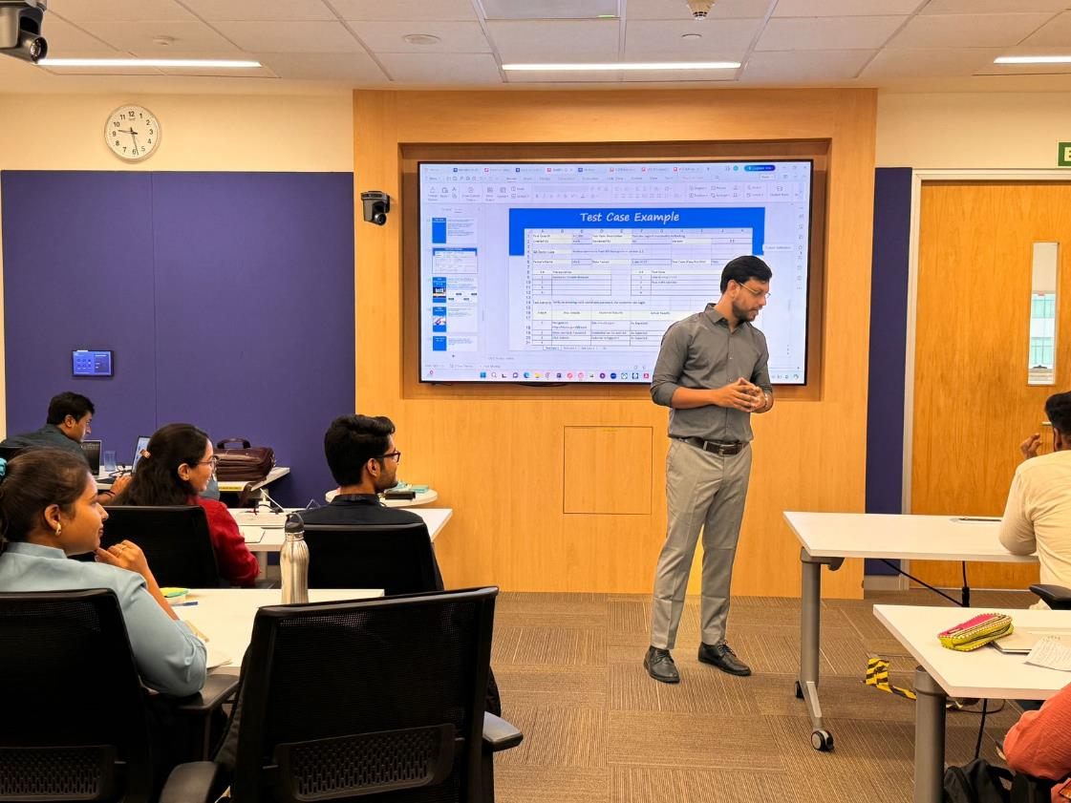
Learning Day 3 | Relevance for Shell

Slide 14
Learning Day 4 | Relevance for Shell
Shell Implementation: Shell's data-driven decisions rely on robust DBMS solutions.
Shell’s Benefit: A good understanding of SQL allows Shell to manage data more efficiently, helping to drive digital transformation initiatives.

Slide 15
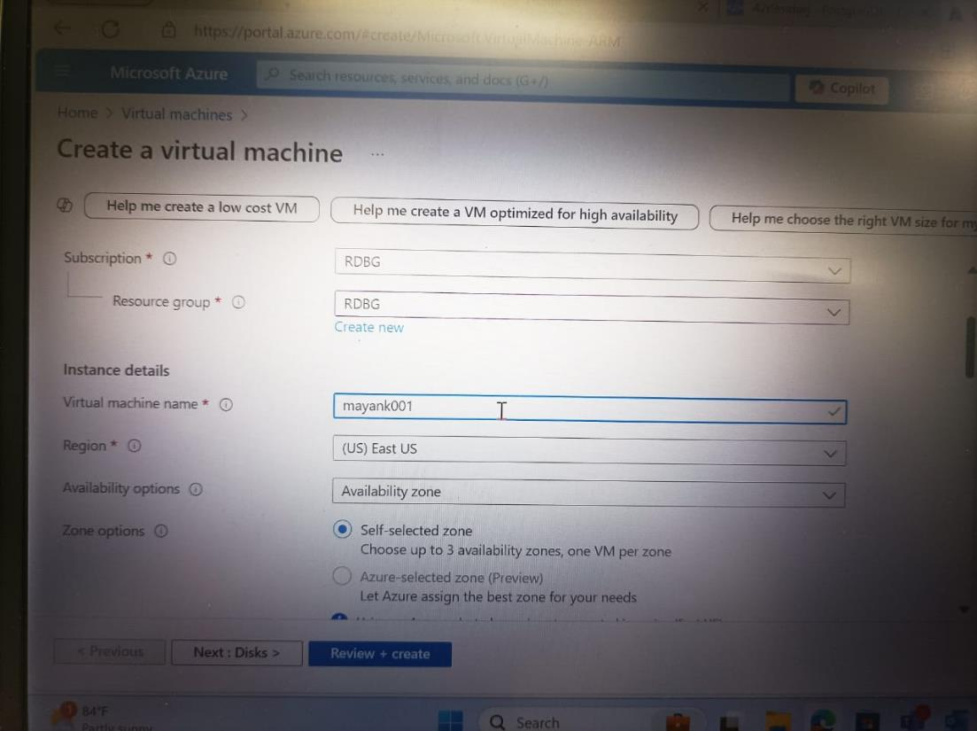
Learning Day 4 | Relevance for Shell

Slide 16
Learning Day 5 | Relevance for Shell
Shell Implementation: Case studies allow Shell teams to simulate real scenarios before full-scale deployment.
Shell’s Benefit: Hands-on practice leads to fewer errors in production, ensuring safe and efficient energy operations.

Slide 17
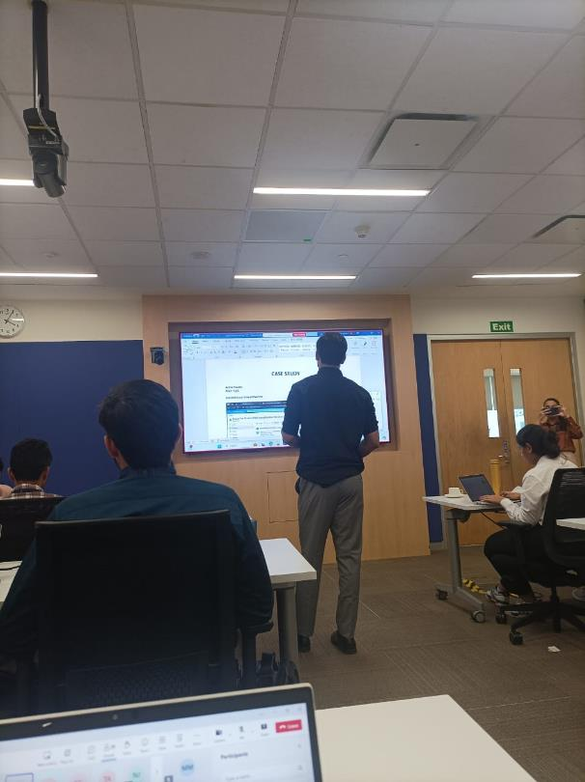
Learning Day 5 | Relevance for Shell

Slide 18

Challenges in implementing learning

Slide 19
Challenge faced while implementing Learning Day 1
Challenge: Writing user stories initially felt vague, and defining acceptance criteria was difficult.
Plan to Overcome: Collaborating more with stakeholders and refining requirements upfront will improve user stories and testing clarity.

Slide 20
Challenge faced while implementing Learning Day 2
Challenge: Understanding priority and severity categorization was confusing.
Plan to Overcome: Study more real-life examples of bugs and how their priority and severity were defined will provide clarity in categorization.

Slide 21
Challenge faced while implementing Learning Day 3
Challenge: Implementing CI/CD for the first time was challenging due to the technical setup and understanding the various components.
Plan to Overcome: Practicing hands-on more frequently and seeking mentorship from DevOps experts will help in better understanding.

Slide 22
Challenge faced while implementing Learning Day 4
Challenge: Crafting complex SQL queries was initially tricky.
Plan to Overcome: I plan to practice SQL queries regularly and learn advanced techniques.

Slide 23
Challenge faced while implementing Learning Day 5
Challenge: Managing multiple tasks (test cases, CI/CD, bug reporting) simultaneously in a limited time was overwhelming.
Plan to Overcome: Improve time management by breaking down tasks into smaller, manageable segments and focusing on each sequentially.

Slide 24

Action Plan

Slide 25
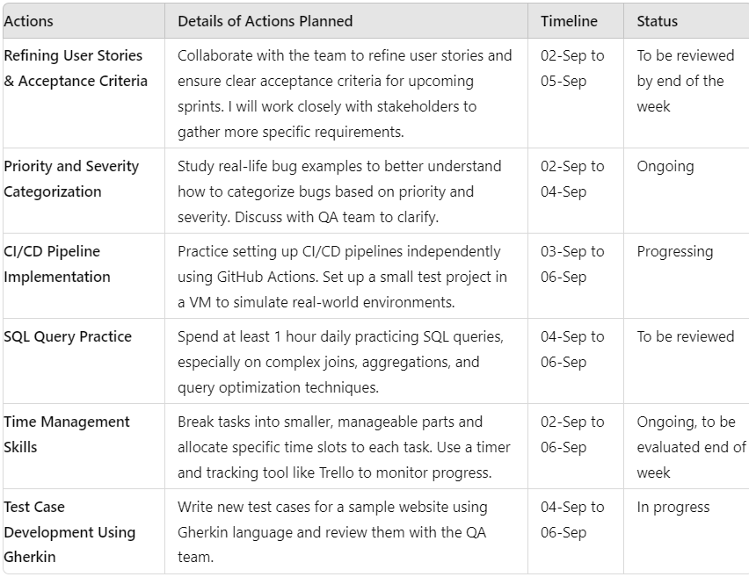
My Action Plan for this Week

Slide 26

Learning is also Fun!

Slide 27
Learning is also Fun!
Group Activity:
During the Test Case Development using Gherkin task, our group was writing test cases for a website’s login feature. One teammate jokingly wrote a scenario:
"Given the user is in bed, When the user attempts to open the laptop, Then the user should stay in bed and continue sleeping."
This led to a hilarious session where we wrote more funny test cases like "user drops coffee on the keyboard."
New Learning through Humor:
While it was lighthearted, the humor helped us think creatively about edge cases and realize the importance of covering all possible scenarios, even the unlikely ones. It was a great way to make learning enjoyable!

Slide 28
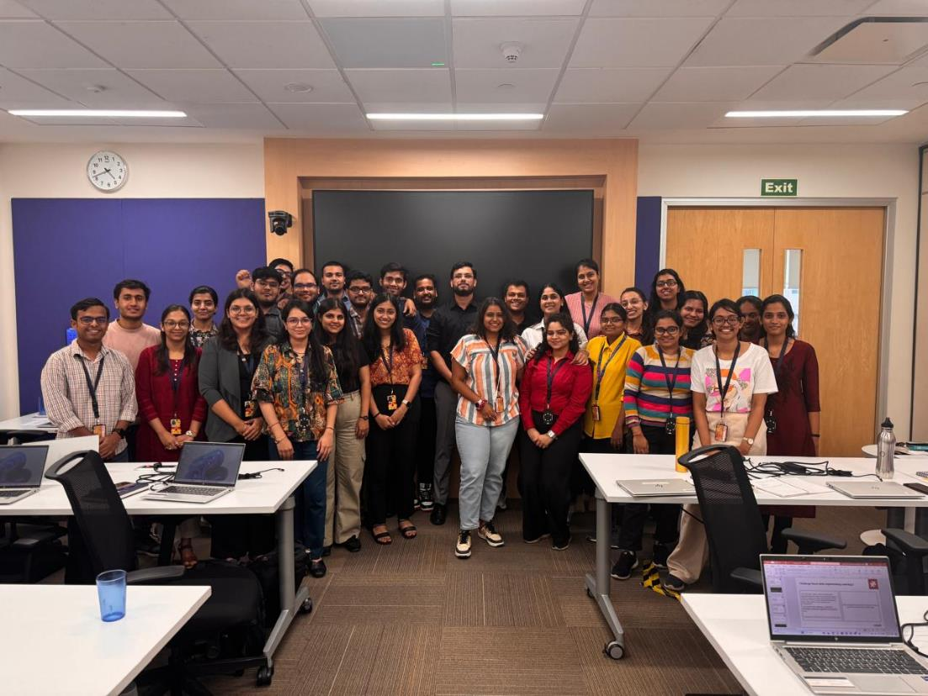
Learning is also Fun!

Slide 29
Thank You

