Slide 1
ELECTION RESULT PREDICTION AND ANALYSIS BASED ON TWITTER DATASET
Submitted By
Shubham Kshirsagar (RA1711008020060)
Mayank Kumar (RA1711008020069)
Ashish Srivastava (RA1711008020098)
Mentor
Dr. R.KAVITHA

Slide 2
ABSTRACT
Sentiment Analysis probes public opinion on user generated content on Web like blogs, social media or e-commerce websites.
Business owners and advertising companies are using Sentiment Analysis to start new business strategies and to identify opportunities for new product development.
The machine learning classifier algorithms cross validation were applied on the dataset and the results were tabulated for comparing and estimating which classifier algorithm yields the best accuracy.
Other performance metric values like F Score, Precision, Recall were also calculated for comparison of various classifier performances on Sentiment Analysis. It was found that ML method combined with K Fold cross validation has produced the best accuracy in prediction.
We have also applied SetiStrength algorithm to find out the intensity or the strength of positive and negative comments from each sentence.

Slide 3
INTRODUCTION
Online sources such as Twitter provide a lot of meta-data,which can help in providing information such as location,time-stamps, and number of followers, etc.
The results retrived could be utilized over the years to provide application-centric results.
With the increase in availability of real-time online data streams, event detection methods have become the primary and fast mode of finding anomalous patterns or trends occur-ring in different communities earlier than the traditional media.
The data collected are primarily are utilised to train systems to learn about a persons attitude towards a candidate.
Maintaing the contextual relationship among tweets.
processing all the data to its extremes may lead to redundant computations and incur high computational cost.

Slide 4
LITERATUTE SURVEY
Ms. Jasleen Kaur ,proposed utilizing computational etymology and content mining with a specific end goal to foresee conclusion of content notion, mostly as positive or negative.
David Garcia, proposed that multimodal sentiment analysis is a promising approach to leverage complementary channels of information for sentiment analysis and often outperforms the unimodal methods.
The dominant approaches in sentiment analysis are based on machine learning techniques (Pang, Lee, & Vaithyanathan, 2002; Read, 2005, Wang, Manning, 2012). Traditional approaches frequently use the Bag Of Words (BOW) model, where a document is mapped to a feature vector, and then classified by machine learning techniques.
The use of lexicon-based techniques has a number of advantages (Taboada, Brooke, Tofiloski, Voll, & Stede, 2011). First, the linguistic content can be taken into account through mechanisms such as sentiment valence shifting (Polanyi & Zaenen, 2006) considering both intensifiers (e.g. very bad) and negations (e.g. not happy).

Slide 5
EXISTING SYSTEM
Existing methods primarily cast the problem as a supervised document classification task. These can be divided into two categories: one relies on manual feature engineering that are then consumed by algorithms such as SVM, Naive Bayes, and Logistic Regression the other represents the more recent deep learning paradigm that employs neural networks to automatically learn multi-layers of abstract features from raw data. The existing system was build using the data mining techniques. In this method they deal with small level dataset. Here this system will have a very low accuracy score like 60 to 70 % only.
Dis – Advantage:
Low level data
Low accuracy score

Slide 6
PROPOSED SYSTEM
Proposed was implement by machine learning techniques. Here we apply the classification algorithm for classification. Then we collect all the twitter data’s from the internet. Using the data’s we extract all the future and getting more numbers data’s also. So we apply the Logistic regression model to classify the values and we get the more accuracy score like above 80%.
Advantage:
Improve the accuracy score
Deal with large amount dataset

Slide 7
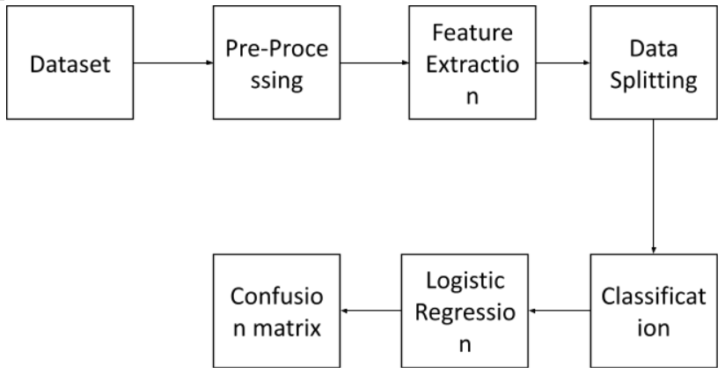
SYSTEM ARCHITECTURE

Slide 8
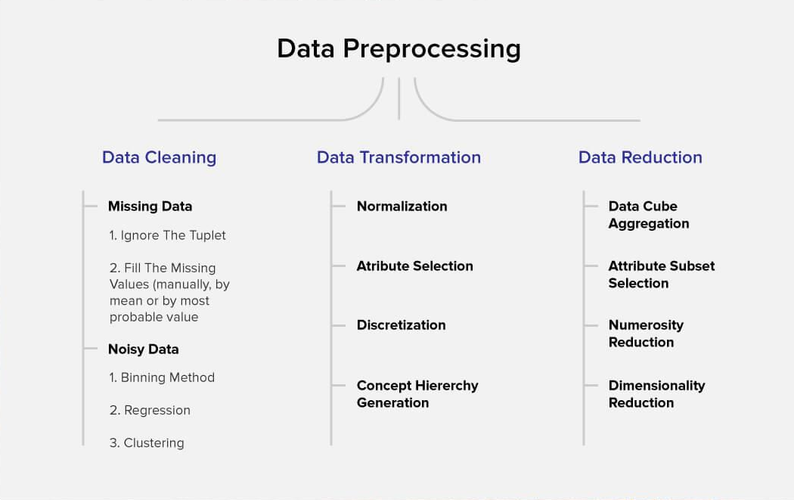
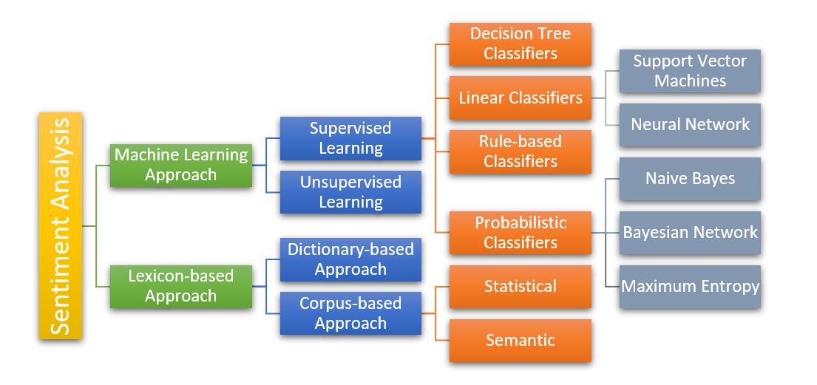
MODULES
Data Pre-processing:
Data pre-processing is done to obtain cleaner data which in turn will provide ease of processing the data further to obtain meaningful results, steps pre-process the data.
Sentiment Detection:
In this Phase, the reviews and opinions are further analysed to calculate the sentiment polarity and subjectivity.

Slide 9
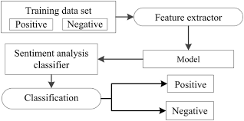
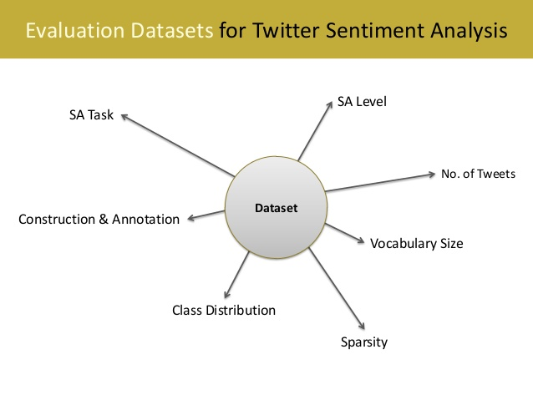
Sentence Classification:
Once the subjectivity and polarity scores are being generated the sentiments can be classified as positive, negative, and neutral.
Evaluation:
The information gained from the analysis is required to be presented in such a manner that it reflects meaningful information from the unstructured data by visualizing and plotting the results.

Slide 10
PAKAGES AND LIBRARIES
import numpy as np
import pandas as pd
from sklearn.ensemble import RandomForestClassifier
from sklearn.model_selection import train_test_split
from sklearn.preprocessing import StandardScaler, MinMaxScaler, PolynomialFeatures
from sklearn.metrics import roc_auc_score
import seaborn as sns
import matplotlib.pyplot as plt
import warnings
warnings.simplefilter("ignore")

Slide 11
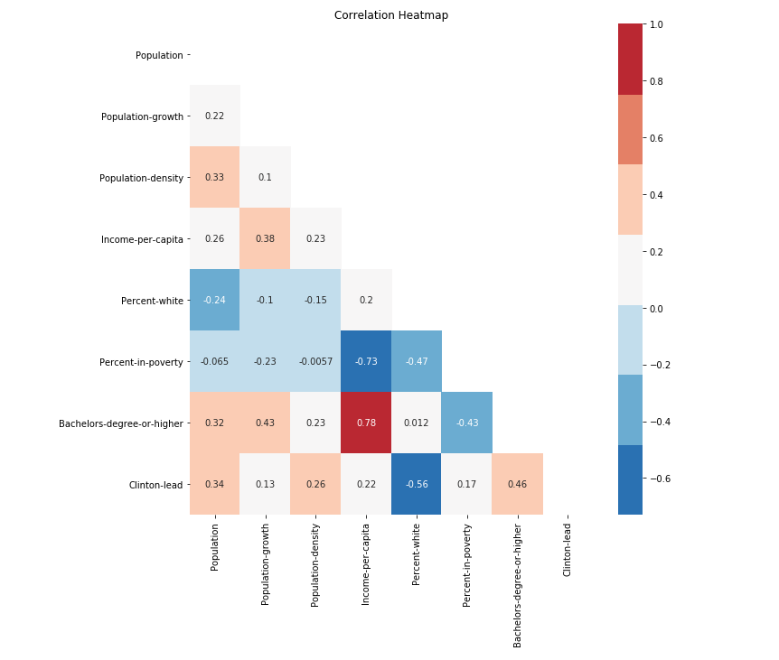
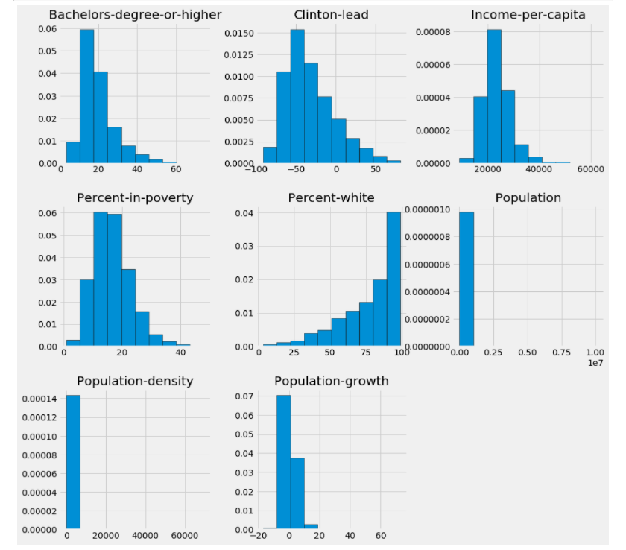
RESULT / OUTPUT
The first screen shot demonstrates the heat map, and shows which factor influences the election result most.
The second screen shot is a graphical/metric view of all the components used in order to obtain the suitable winner from a region.

Slide 12
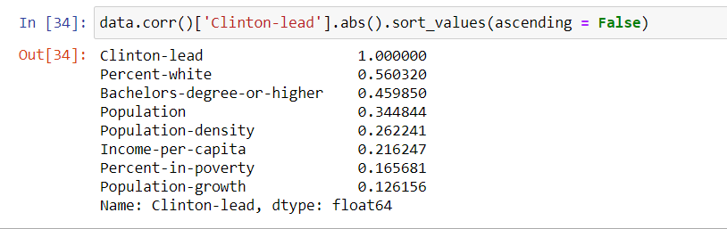
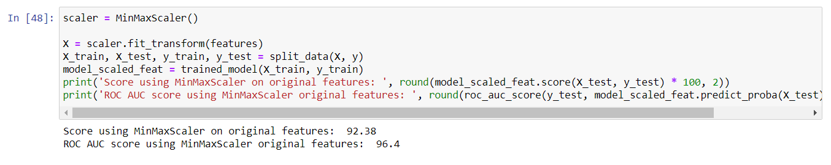
The data shows which factor are most important in the descending order, as we can see %-white has 0.56 and degree-holders 0.45 influences most.
This is the final result which shows how Random Forest algorithm helps us improve the system and gets us very precise results with an accuracy score of over 90%.

Slide 13
CONCLUSION
Our system tends to process huge amount of data in comparison to the existing system which processes small amount of data.
Existing system has procured accuracy score of as lower as 60% whereas our system with the use of Random Forest algorithm tends to procure accuracy of greater than 90%.
Cost of computation in our system is way lower than the existing systems.
Random forest algorithm is better compared to Naïve Bayes and SVM since it sums up all the possible outcomes of all the decision trees and then produces results.

Slide 14
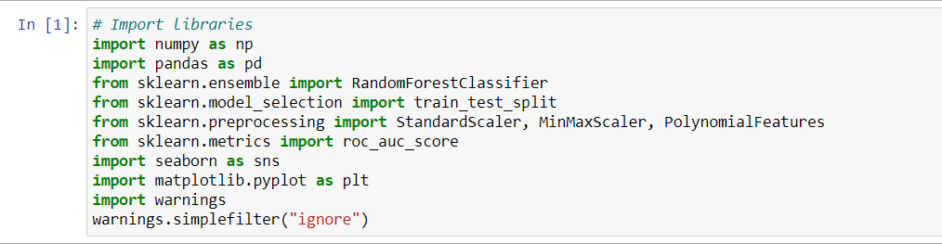
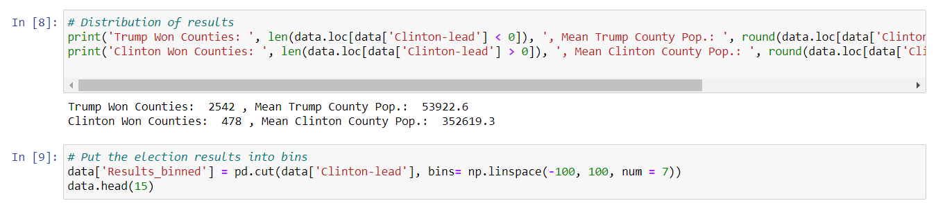
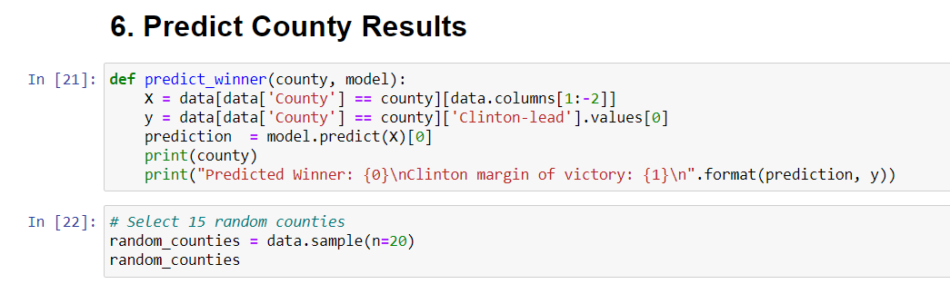
SAMPLE SOURCE CODE

Slide 15
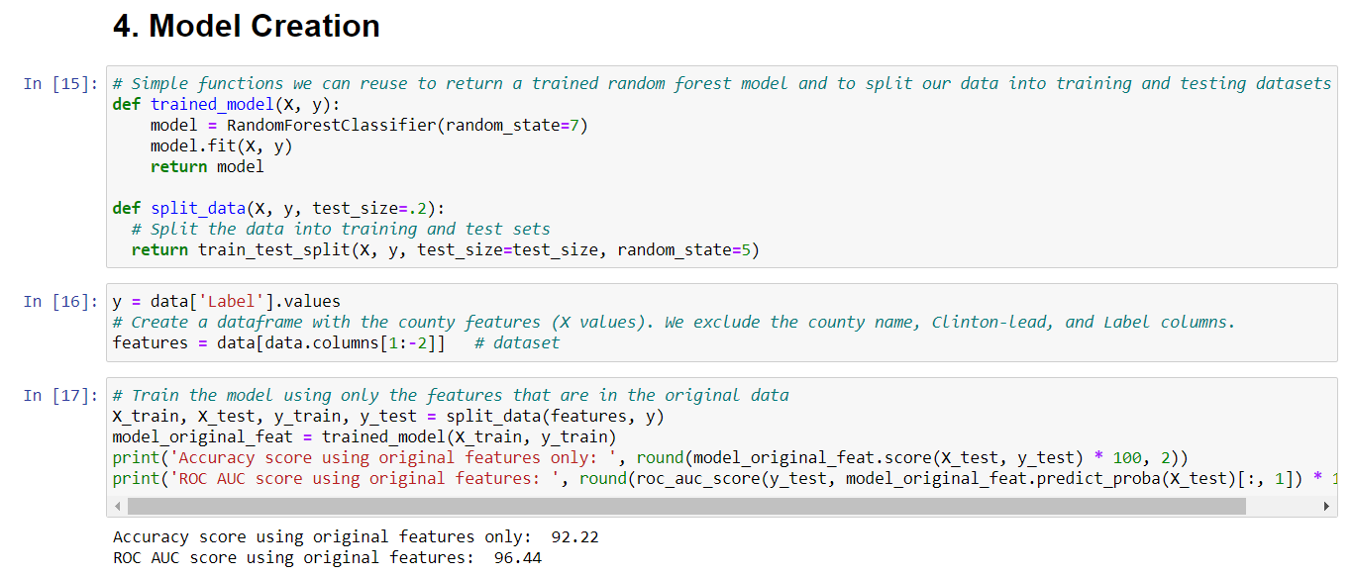
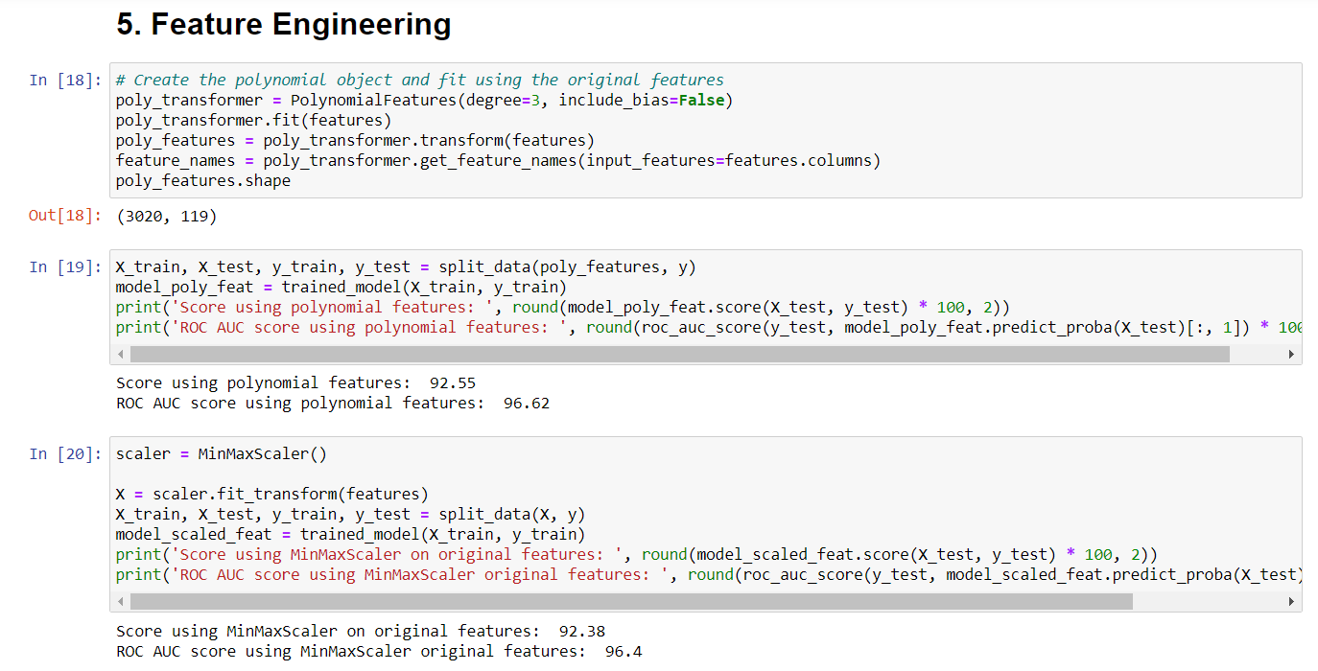

Slide 16
REFERENCES
[1] J. Kaur, S. S. Sehra, and S. K. Sehra, ‘‘A systematic literature review of sentiment analysis,’’ Int. J. Comput. Sci. Eng., vol. 5, no. 4, pp. 22–28, 2017.
[2] M. Soleymani, D. Garcia, B. Jou, B. Schuller, S.-F. Chang, and M. Pantic, ‘‘A survey of multimodal sentiment analysis,’’ Image Vis. Comput., vol. 65, pp. 3–14, Sep. 2017, doi: 10.1016/j.imavis.2017.08.003.
[3] D. Vilares, M. A. Alonso, and C. Gómez-Rodríguez, ‘‘Supervised sentiment analysis in multilingual environments,’’ Inf. Process. Manage., vol. 53, no. 3, pp. 595–607, May 2017, doi: 10.1016/j.ipm.2017.01.004.
[4] O. Araque, I. Corcuera-Platas, J. F. Sánchez-Rada, and C. A. Iglesias, ‘‘Enhancing deep learning sentiment analysis with ensemble techniques in social applications,’’ Expert Syst. Appl., vol. 77, pp. 236–246, Jul. 2017, doi: 10.1016/j.eswa.2017.02.002.
[5] S. Wang and C. D. Manning, ‘‘Baselines and bigrams: Simple, good sentiment and topic classification,’’ in Proc. 50th Annu. Meeting Assoc. Comput. Linguistics, vol. 2, Jeju Island, South Korea, 2012, pp. 90–94. [Online]. Available: http://dl.acm.org/citation.cfm?id=2390665.2390688

Slide 17
THANK YOU

