Slide 1
Joint Reasoning on Hybrid-knowledge sources for Task-Oriented Dialog
Mayank Mishra, Danish Contractor and Dinesh Raghu
IBM Research

Slide 2
Introduction
Traditional dialog systems use structured knowledge sources for response generation
Relevant knowledge might also reside in unstructured knowledge
Notes:
Most existing work on task-oriented dialog systems assume that the knowledge required for completing a task (eg: booking a restaurant reservation or a train ticket etc), resides in structured knowledge sources.
However, relevant knowledge might also reside in unstructured knowledge sources.
Recent approaches like HyKnow and SeKnow have tried to tackle this problem where the information might not only be structured (like tables, jsons etc) but also unstructured like (FAQs, documents, reviews etc).

Slide 3
Terminology
Structured knowledge: Information about an entity in a tabular format which can be easily queried
Unstructured knowledge: Information about an entity in documents. For example, menu for a restaurant, customer reviews etc
Entity: All the information about a restaurant/hotel etc
Notes:
We introduce some terminology here that we use in the paper.
We define structured knowledge as information residing in json data or tables that can be queried easily using a well-defined query or a belief state.
Unstructured knowledge however, refers to a set of reviews or documents. For the dataset we deal with in this paper, it is a set of FAQs (question, answer pairs).
We define an entity as the information in the knowledge corpus about a hotel or a restaurant etc.

Slide 4
Traditional ToD systems
Belief state
area = center,
cuisine = Chinese
User: I need to book a reservation for 2 for dinner.
System: Sure, I can help with that. What is your palette?
User: I prefer Chinese cuisine.
System: There are 8 well-rated Chinese restaurants in the city.
User: I would prefer if restaurant is near the Central part of the town.
Belief State Generation
Entity Retrieval
Dialog context
Restaurants:
Chinese Restaurant A
Chinese Restaurant B
…
+
Response Generation
Retrieved Entities
Restaurant A is open till 9 PM in the night.
Shall I book it for you?
System Response
Notes:
This is how traditional task-oriented dialog systems work.
Most ToD systems model the problem as a 3-step process: belief state generation, retrieving the relevant entities using this belief state and then finally generating the response using the context, belief state and fetched entities.
Given a dialog context, a model is tasked with generating a belief state. This belief state is then used to query the knowledge for a set of entities that match the belief state.
After, the entities have been fetched, the model is tasked with generating the next system response for the given dialog context based on the belief state and the fetched set of entities.
For example, in the figure here, the user asks for a Chinese restaurant in the center part of the town. A belief state generator extracts the belief state from the dialog context which is used to query a structured DB and fetch a set of entities. The dialog context, belief state and the fetched entities are then used to generate the response.

Slide 5
Limitations of current methods
Recent SOTA models make limiting assumptions for the said problem
Traditional dialog systems use structured knowledge sources for response generation
Relevant knowledge might also reside in unstructured knowledge
Notes:
However, knowledge is not always actually in structured knowledge sources. There has been a lot of work in developing methods that use both structured and unstructured knowledge sources but most of these methods make limiting assumptions about the nature of the knowledge sources and thus can’t be used in real world settings.
First, current dialog systems are designed to reason over knowledge sources that encode separate pieces of information about the entities. For instance, zip code or address might always be in structured knowledge whereas phone number is always in unstructured knowledge. This is a problem observed in the dataset and model released by the SOTA SeKnow model [Gao at al.]
Second, systems memorize the source of the source of information and thus don’t work when the source of information (or the knowledge modality) is changed during test time.
Third, most systems assume that each agent response can contain information from only one source type, either structured or unstructured.

Slide 6
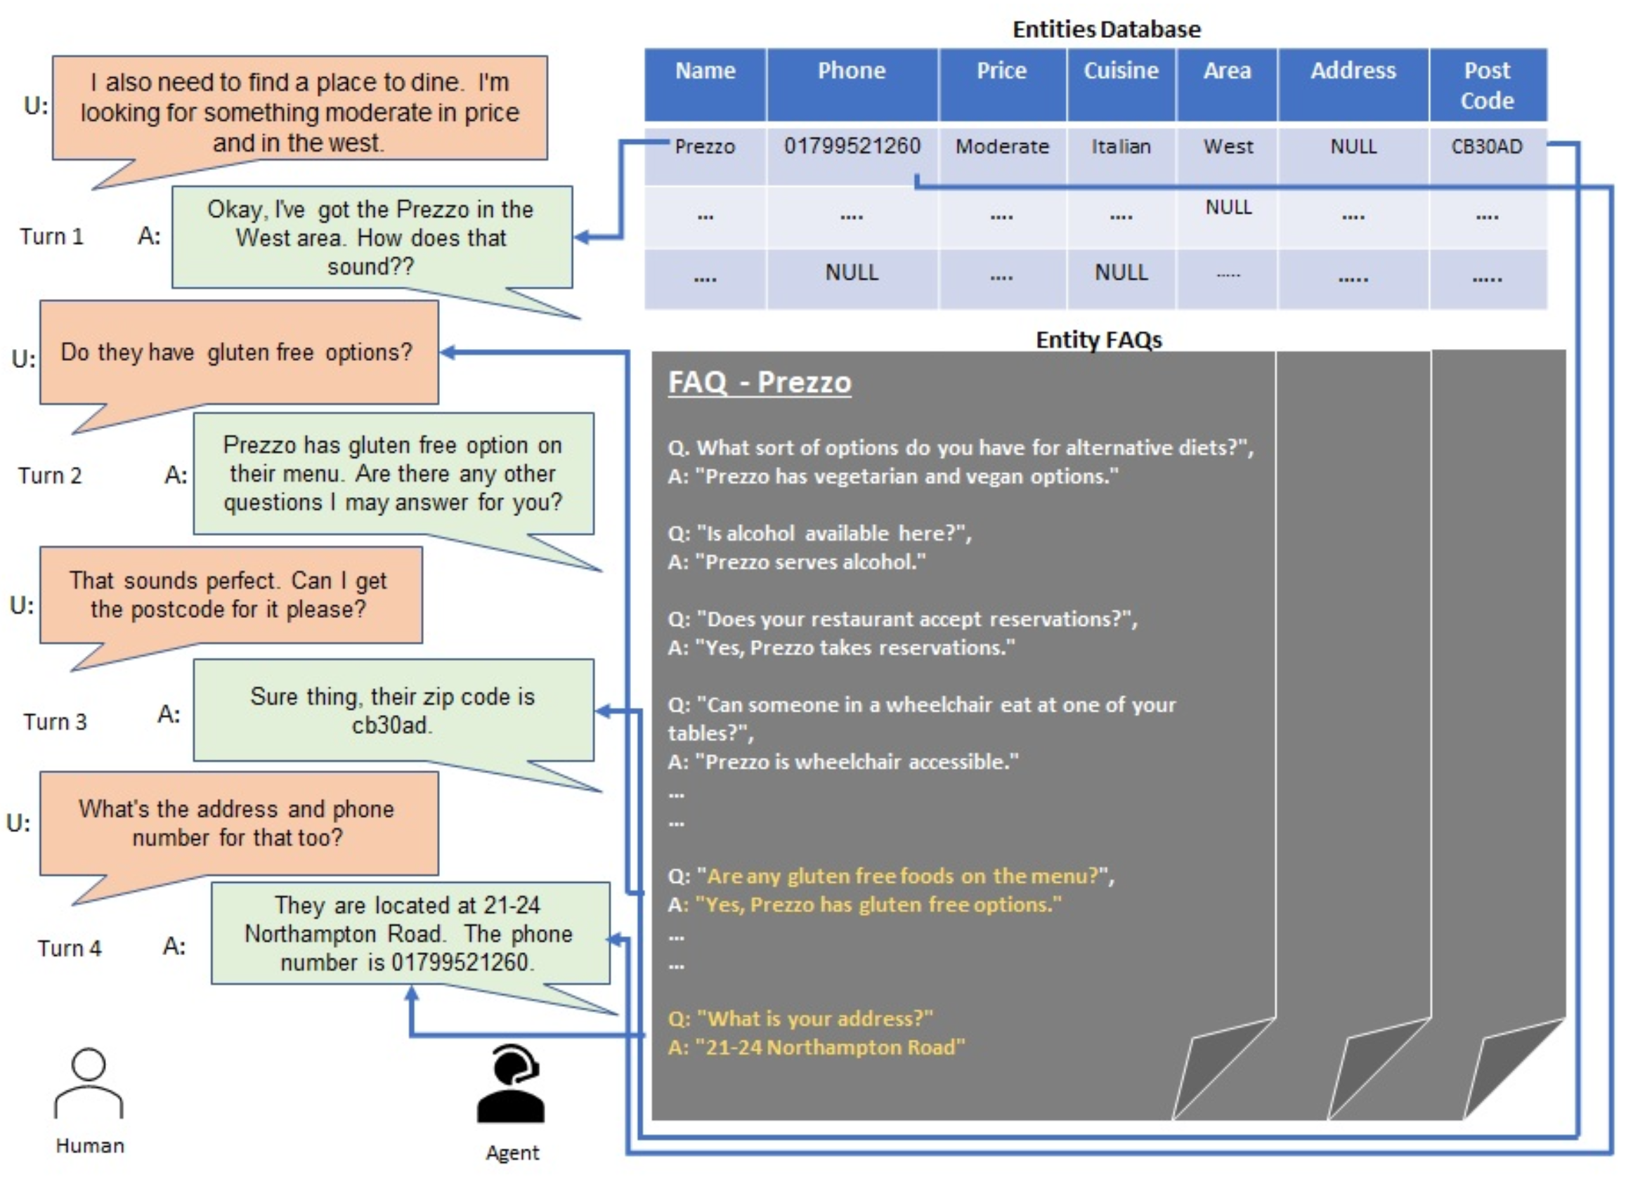
Notes:
So, if you look at this example:
1. In the first turn, the user is asking for a moderately priced restaurant in the west and the agent answers with the name of the restaurant which is fetched from the structured knowledge.
2. In the second turn, the user requests for gluten free options and the agent needs to look up the FAQs from the unstructured knowledge to check if they have gluten-free options available.
3. Similarly, for the 3rd turn the agent needs to look up the zip code from the structured knowledge.
4. And for the final turn the agent replied with the exact address (which is fetched from the unstructured knowledge) and the phone number (which is looked up in the structured knowledge source).

Slide 7
Our contributions
Release a new version of DSTC-9 MultiWoZ dataset (called HybridToD) which is devoid of the mentioned limitations
Propose a model that fuses information from both structured and unstructured sources to generate the response
Notes:
1. Most current systems learn that certain slot-values only come from structured and certain slot-values from unstructured sources due to the biases in the datasets used during training. To mitigate this problem, we create a dataset (which we call HybridToD) which is devoid of such assumptions.
2. We demonstrate that our models when trained on this dataset can fuse information from both structured and unstructured knowledge sources for response generation and beats SOTA systems on standardized metrics.

Slide 8
HybridToD dataset
We use the SeKnow-MultiWoZ dataset and modify it to remove the aforementioned limitations
We construct a graph G(V, E):
Each vertex in V is a unique slot-value pair
An edge exists between 2 vertices if the slot-values represented by these vertices occur in the same utterance in the training dataset
We find a maxcut of this graph which ensures that we modify the maximum number of utterances in the dataset
We move entities from one of the resulting halves of maxcut from structured source to unstructured knowledge
Notes:
We consider the modified dataset proposed by SeKnow. For simplicity, we will refer to this dataset as SeKnow-MultiWoZ. The SeKnow-MultiWoZ dataset consists of a json DB for the structured source of information and a corpus of FAQs about the entities which are used as unstructured knowledge.
We modify this dataset using a systematic procedure to remove the aforementioned limitations.
To modify the dataset, we construct a graph G(V, E):
Each vertex in V is a unique slot-value pair
An edge exists between 2 vertices if the slot-values represented by these vertices occur in the same utterance in the training dataset
We find a maxcut of this graph which ensures that we modify the maximum number of utterances in the dataset. For finding the maxcut, we use the approximate MaxCut-BM algorithm since finding the maxcut is a hard problem.
Once we have found a good approximate solution to the maxcut problem, we move slot-values from one of the resulting halves of maxcut from structured source to unstructured knowledge.
To move the slot-values we use pre-defined templates of the FAQs.
This results in a new structured and unstructured knowledge source that affects the maximum number of utterances in the resulting dataset.
We call this new dataset as HybridToD.

Slide 9
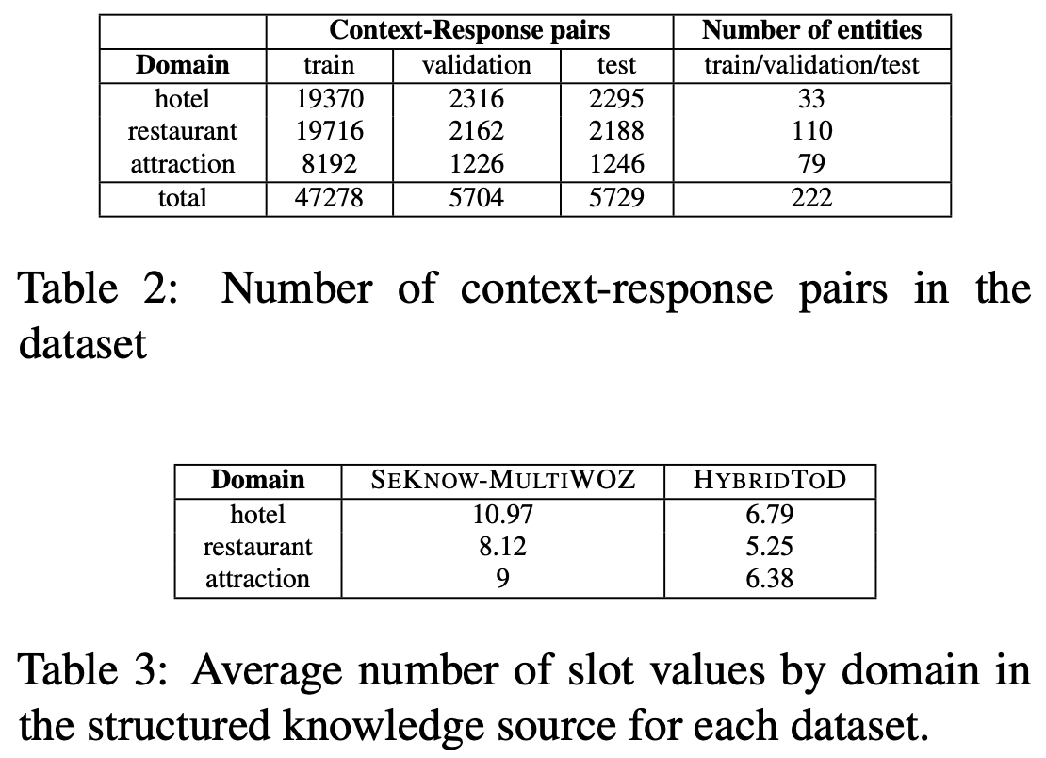
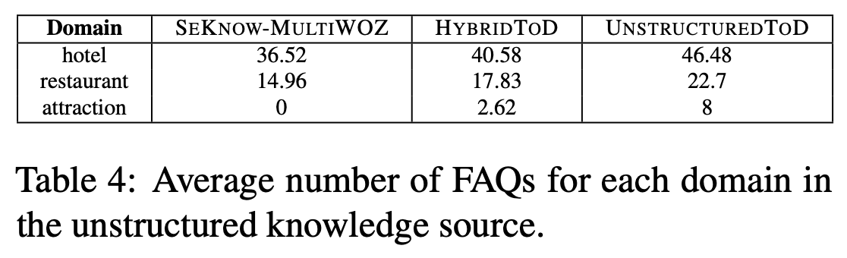
HybridToD dataset
Notes:
So, this slide shows the dataset distribution.
We have 3 domains in the dataset, hotels, restaurants and attractions which in total amount to 222 entities and a total of 47.2k context-response pairs for training and 5.7k context-response pairs for the test split.
We also show the distribution of slot-values in structured source in the original SeKnow-MultiWoZ dataset and the HybridToD dataset, similarly with the FAQs in the unstructured knowledge source.

Slide 10
Our model
User: I need to book a reservation for 2 for dinner.
System: Sure, I can help with that. What is your palette?
User: I prefer Chinese cuisine.
System: There are 8 well-rated Chinese restaurants in the city.
User: I would prefer if restaurant is near the Central part of the town.
Entity Retrieval
Dialog context
Restaurants:
Chinese Restaurant A
Chinese Restaurant B
…
+
Response Generation
Retrieved Entities
Restaurant A is open till 9 PM in the night.
Shall I book it for you?
System Response
Notes:
Unlike, the traditional task-oriented dialog systems, our model doesn’t generate the belief state.
We instead model the problem in a different way.
We use an entity retriever that ranks each entity based on the dialog context.
We then take the best ranked entity and pass it along with the dialog context for response generation.
The advantage of this kind of modeling is that, we can directly generate the response unlike SOTA methods like SeKnow which generate a templatized response and fill in the slot templates in the templatized response using an entity.
The templatized reponse generation becomes problematic when you move slot-values from structured to unstructured since, filling in the slot templates becomes non-trivial in such a case.

Slide 11
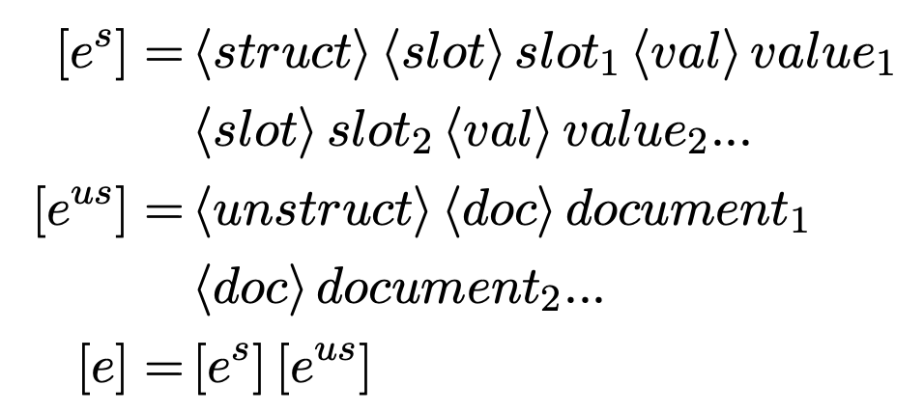
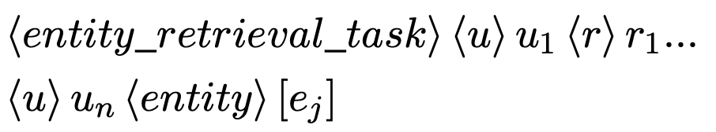
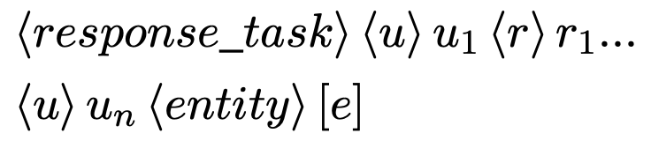
Our model
We train a BART model for both the entity retrieval and response generation tasks
We score each of the entities using the BART model and take the best one
The best entity is used along with the dialog context to generate the response
Entity Representation
Input for Entity Retrieval
Input for Response Generation
Notes:
We train a BART model for both the entity retrieval and response generation tasks.
We use the same BART model for both the tasks and use special tokens for the task.
To represent the structured information, we concatenate its slot values and the unstructured information is represented as the concatenation of its FAQs.
These both, in turn are joined together to represent an entity.
For both the entity retrieval task, and the response generation task, we use special token markers to denote the tasks and prompt the BART model respectively.

Slide 12
Experiments
We train all the models on HybridToD and evaluate on SeKnow-MultiWoZ, HybridToD and a completely unstructured knowledge source
We also show that training on SeKnow-MultiWoZ leads to a model memorizing the source of information leading to sub-optimal performance when the knowledge modality is changed at test time
We compare our models on response generation performance to the SOTA baseline SeKnow

Slide 13
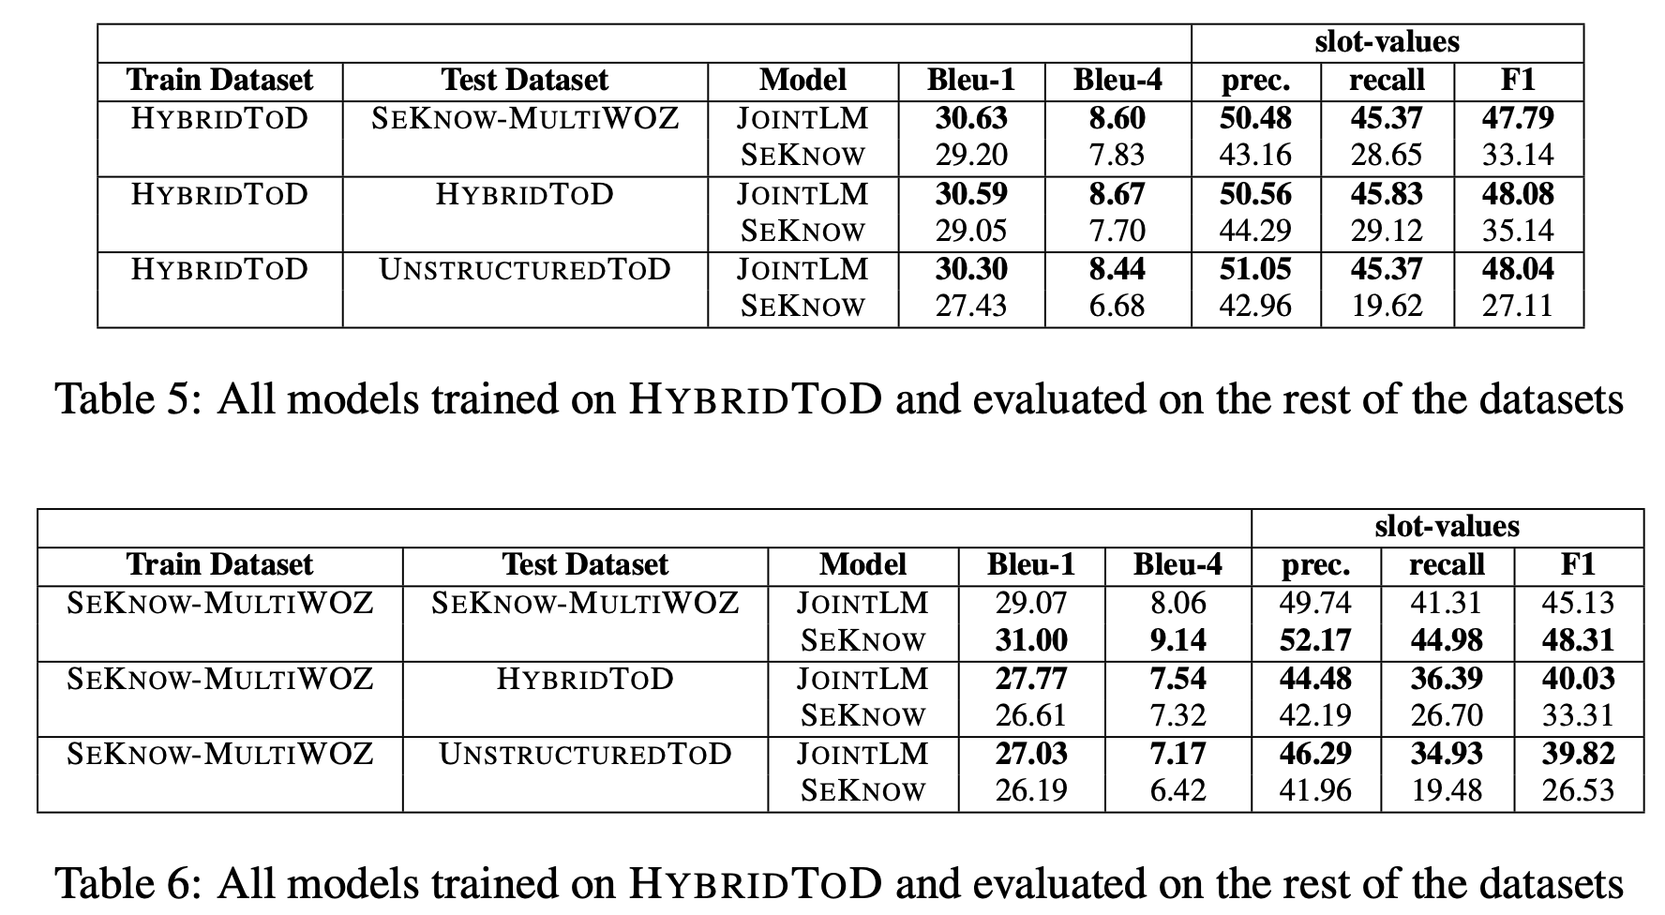
Results
Notes:
For evaluating the response generation performance, we evaluate BLEU and the entity slot-value F1 filling performance of the model.
From the tables, it can be seen that training JointLM on HybridToD and testing on datasets sees little to no change in response generation performance.
Whereas, SeKnow shows a more pronounced performance drop than JointLM when the test dataset has a different slot-value distribution across the structured and unstructured knowledge sources.
We hypothesize that SeKnow learns the source of information which is confirmed by the experimental results. SeKnow also generates a templatized response and it becomes hard to fill in the slot-values in these templates as more and more slot-values are moved to the unstructured knowledge sources.

Slide 14
Conclusion
In this paper, we have created and released a new dataset for advancing the research in ToD systems which require both structured and unstructured information
Through extensive experiments, we have also shown that existing approaches don’t work well with changing slot-value distribution at inference time
We also propose a model which shows superior performance to SeKnow and is also more robust to changing slot-value distribution at inference time

Slide 15
Thank you

