Slide 1
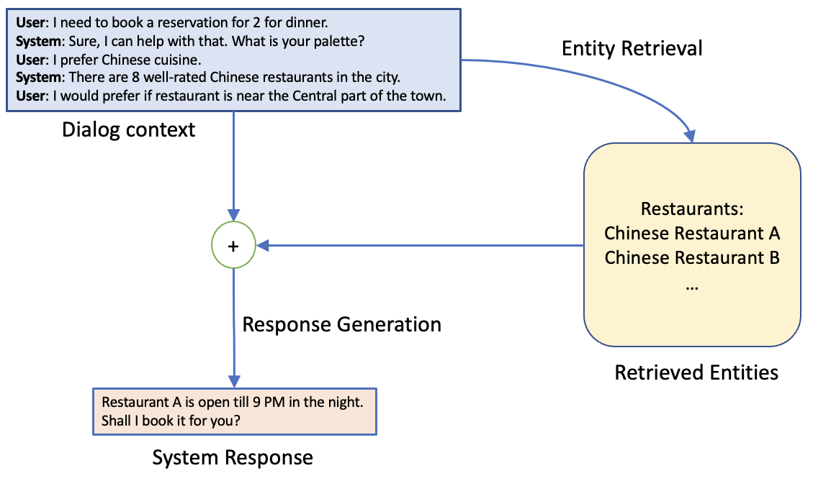
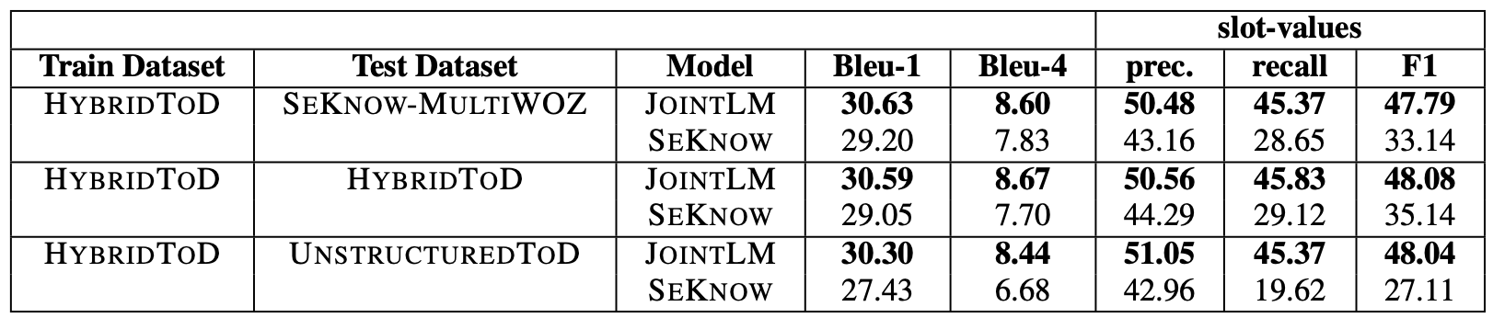
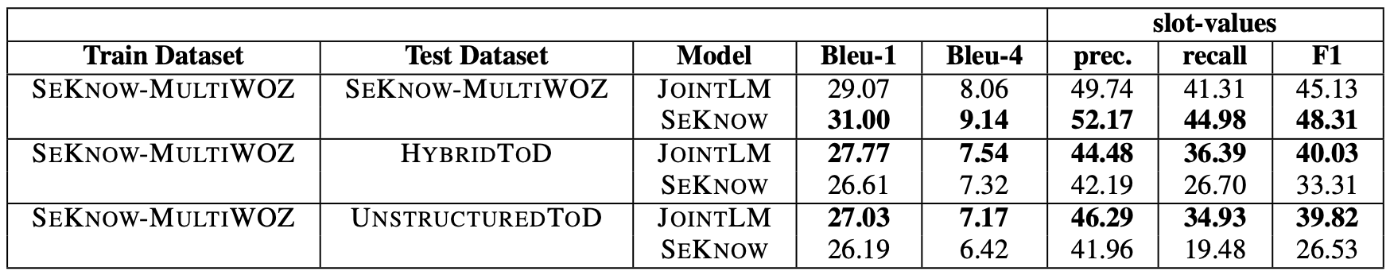
Joint Reasoning on Hybrid-Knowledge sources for Task-Oriented Dialog
Mayank Mishra, Danish Contractor and Dinesh Raghu
IBM Research, New Delhi, India
Introduction
Our model (JointLM)
Traditional ToD systems use structured knowledge for response generation but information may also reside in unstructured sources
Recent approaches like HyKnow and SeKnow [Gao et al.] have tried to tackle this problem but their models make limiting assumptions
They assume that certain information is always in structured sources (for eg. Phone number) and certain information is always in unstructured knowledge
We train a BART model for both entity retrieval and response generation tasks
The model weights are shared for both the tasks and the input contains the special tokens for the two tasks
HybridToD dataset
We create a new dataset by systematically modifying the MultiWoZ dataset proposed by SeKnow [Gao et al.]
We define an entity as the structured information + unstructured information of the entity
We create a graph G(V, E) where V, the set of vertices represents all the slot values in the knowledge and an edge e ∈ E exists between two vertices if the slot-values represented by these vertices occur in at least one utterance in the dialog dataset.
We find a maxcut of this graph so that we affect the most utterances in the dataset
We show that training our model on this dataset leads to generalization to change in knowledge modalities at test time and that our model (JointLM) doesn’t learn the source of the information (unlike other SOTA models like SeKnow [Gao et al.])
During the entity retrieval stage, our model scores each entity in the knowledge sources based on the dialog context and we pick the best entity for response generation
For the response generation phase, we concatenate the best entity’s structured slot-values and knowledge in unstructured sources (FAQs for our dataset) to the dialog context and generate the next system response
Experiments & Results
We train JointLM on HybridToD and SeKnow-MultiWoZ and show the performance on HybridToD, SeKnow-MultiWoZ and UnstructuredToD (where all knowledge has been moved to unstructured knowledge sources)
Entity Retrieval Performance
Response Generation Performance

