Slide 1
American Sign Language Recognition using Deep Convolutional Networks
Mayank Reddy Saddi
A20423747
Sai Manukar Reddy Bapathi
A20427621

Slide 2
Problem Statement
Sign language is unique type of communication that often goes understudied.
The problem we are investigating is sign language recognition through classification.
Being able to recognize sign language is an interesting neural network problem while simultaneously being extremely useful for deaf people to interact with people who don’t know how to understand American Sign Language (ASL).
we present a method for using deep convolutional networks to classify images of both the the letters and digits in American Sign Language.

Slide 3
Background Material
Convolutional Neural Networks have been extremely successful in image recognition and classification problems, and have been successfully implemented for human gesture recognition in recent years .
With the use of cameras that sense depth and contour, the process is made much easier via developing characteristic depth and motion profiles for each sign language gesture
The use of depth sensing technology is quickly growing in popularity, and other tools have been incorporated into the process that have proven successful.

Slide 4
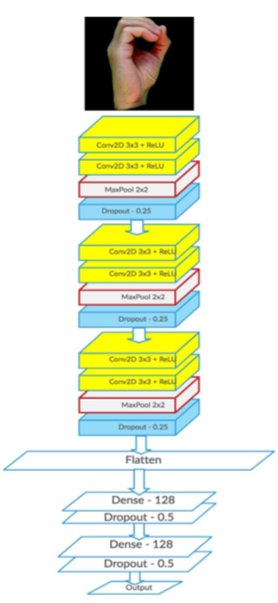
Proposed Solution
Our basic approach was to implement segmentation to extract images and train the data using neural model that predicts the letter of the sign displayed.
Our task was that of classification using deep convolutional neural networks to classify every letter in ASL.
The inputs were fixed size high-pixel images, 200 by 200or 400 by 400, being padded and resized to 200 by 200.
The network architecture is depicted beside

Slide 5
Implementation
The first step of implementation is segmentation which segments the skin from the background using background-subtraction techniques.
The dataset was generated by capturing the images was split into training set and validation set for each sign.
The second step of implementation is building a neural model and training the dataset generated.
The generated dataset is trained in the neural model built which then predicts the letter incorporated with the sign interactively on the screen

Slide 6
Result

Slide 7
THANK YOU

