Slide 1
Colorization of Black and White Photos using Neural Networks
Mayank Reddy Saddi
A20423747

Slide 2
Problem Statement
This project addresses the problem of generating an automized method to colorize black and white images.
Previous solutions to this problem relied heavily on significant human input to hallucinate possible colors for sections of black and white images.
The goal of the project is to take a simple greyscale image as input and use a Convolutional Neural Network model trained on multiple images to generate a colorized output which is realistic.
The produced output does not require to match the exact ground truth image but instead should be realistic enough to fool an average Joe.

Slide 3
Background Material
Earlier colorization was done manually E.g., using photoshop.
Time Consuming and difficult.
Some services allow colorization with significant user input.
Colorization techniques are classified into
- Scribble based methods
- Example based colorization

Slide 4
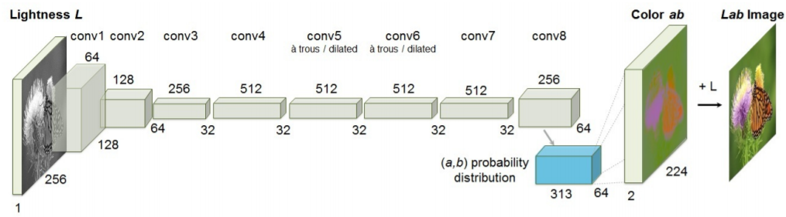
Proposed Solution
CNN are known to have the ability to detect patterns, features and objects from greyscale images
Thus we use CNN to train a model on number of colored images.
Greyscale images are sent as input to the model and it must predict the colors.
Once trained the model will learn the patterns in the images and most associated color with those patterns.
Based on it it will predict most plausible color and produce a colored image.

Slide 5
Implementation
The first step of implementation is acquisition of data. CelebA and LFW data sets have many images.
Next we process the images to be converted from RGB to CIE Lab color space.
Once converted we extract the L component of the image which forms the greyscale image.
Given greyscale image model predicts a and b values. These values are compared with actual a and b values of image using MSE.
The CNN learns parameters which produce the minimum loss and once learned will be able to predict accurately.
Once the model is built if greyscale image is passed to the model it will generate a colored version of it.

Slide 6
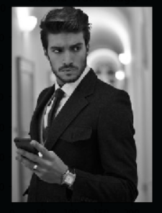
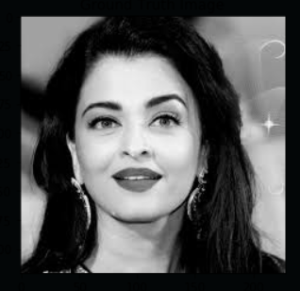
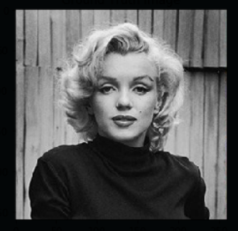
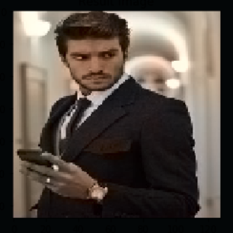
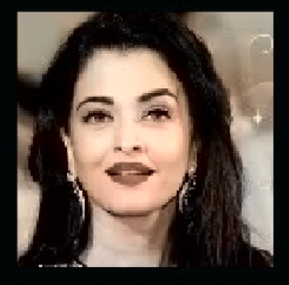
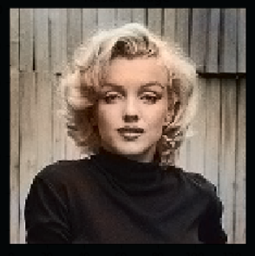
Result

Slide 7
THANK YOU

