Slide 1
Pseudo Vision System
for obstacle detection and path recognition

Slide 2
Team Members:
Name Roll no Role
Ayushi Garg 3BE\4048\06 Hardware Designing
Isha Gautam 3BE\4054\06 User Interface
Mayank Kumar Dadheech 3BE\4057\06 Path Detection
Sumit Singh 3BE\4074\06 Obstacle Detection
Project Guide:
Mr. Shripal Vijayvargiya

Slide 3
Objective
To Develop a prototype autonomous system for recognition of path and detection of obstacles.

Slide 4
Motivation
This system after proper development will find its application in public and private transport vehicles .
With the help of this system, vehicles will be able to reach their destination without any human assistance.
This will help reduce accidents caused by human errors.
Some other applications include autonomous ship’ collision avoidance system , Wheeled Mobile Robots, blind and visually impaired system , space exploration and related terrestrial applications.

Slide 5
System requirements
Capable of identifying path to be traced using captured images
Capable of detecting and avoiding obstacles in the path
Capable of avoiding collision with the obstacle and finding alternate path

Slide 6
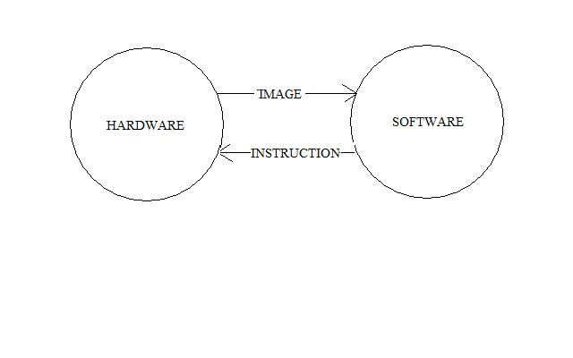
System Design

Slide 7
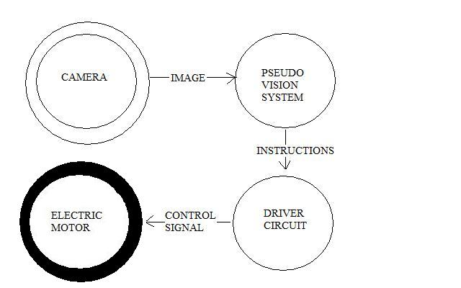
Hardware Components

Slide 8
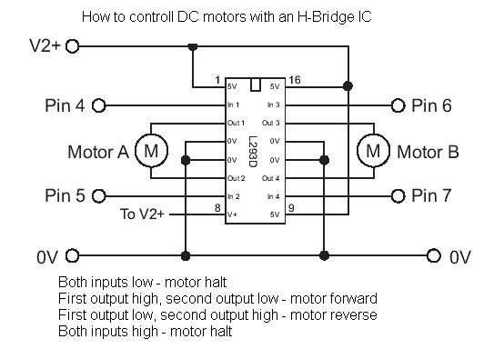
Driver Circuit

Slide 9
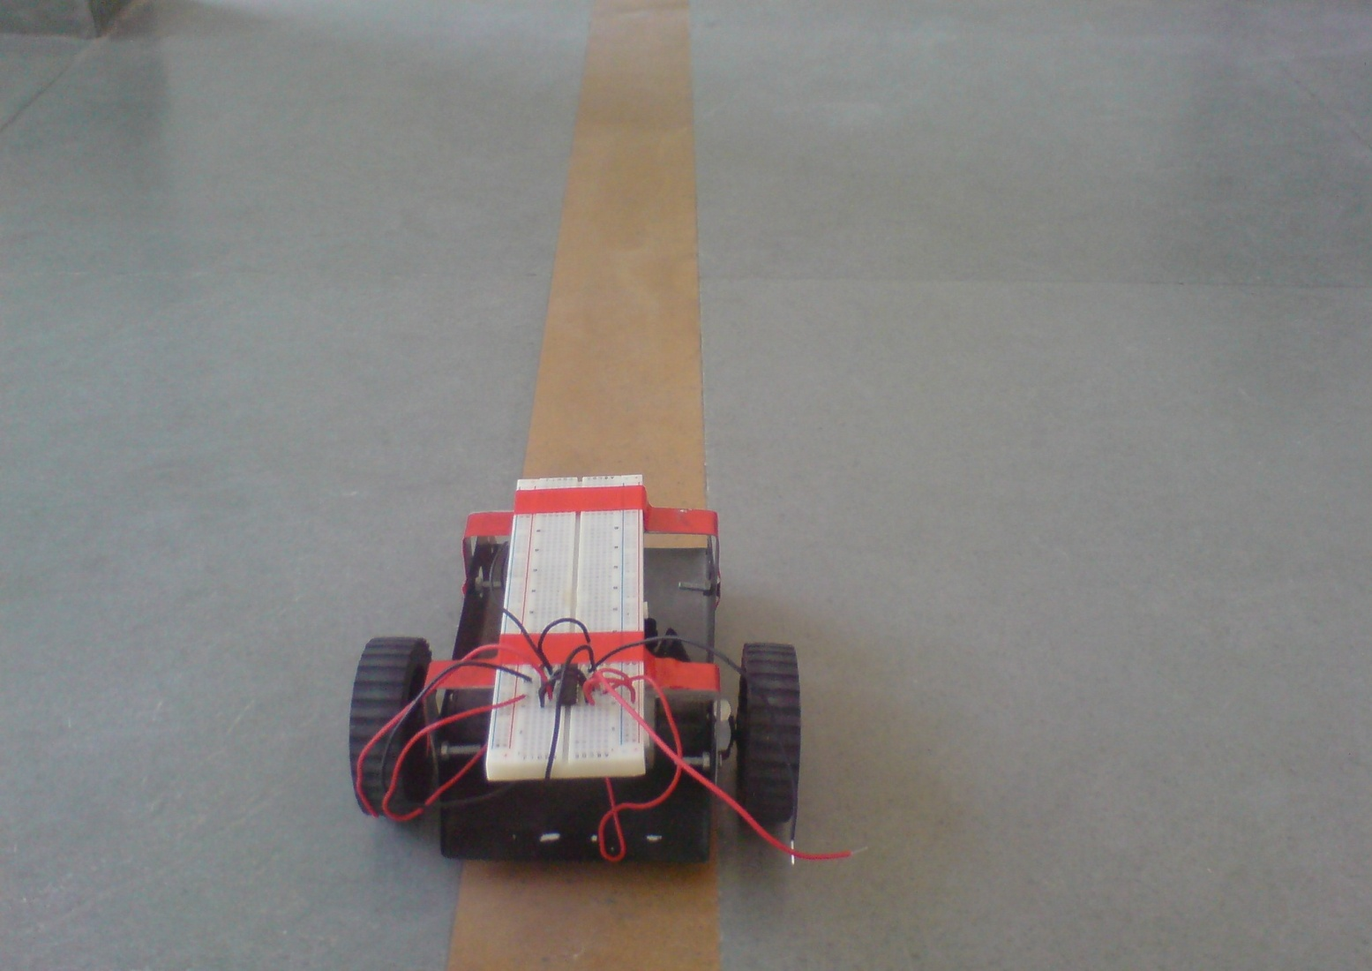
ROBOT PROTOTYPE

Slide 10
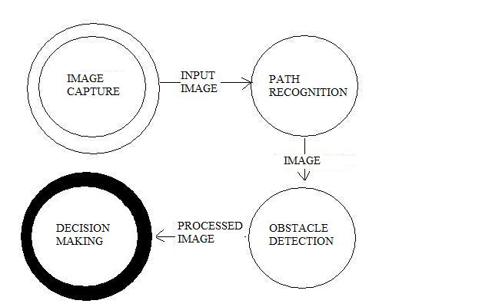
Software Components

Slide 11
Path Recognition
Image Capture
Histogram Equalization
Convolution Filter
Reducing Sparkling Effect
Binary Image

Slide 12
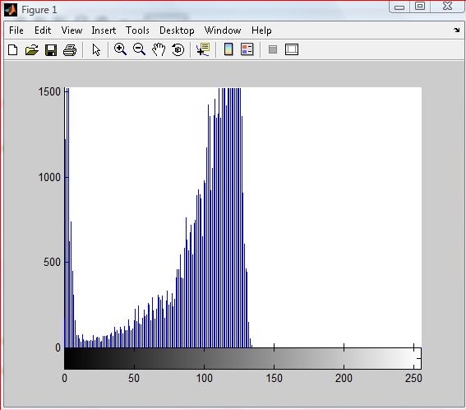

CAPTURED IMAGE
IMAGE
HISTOGRAM

Slide 13
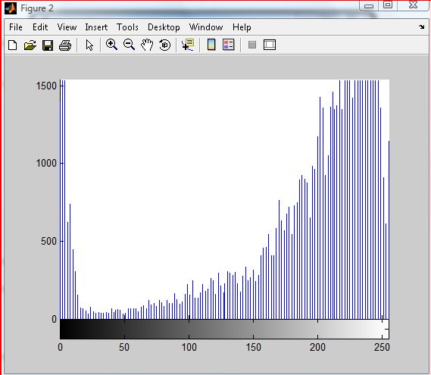
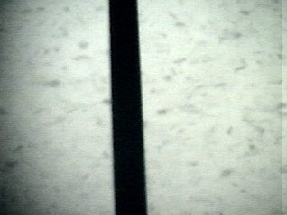
NORMALIZED IMAGE
IMAGE
HISTOGRAM

Slide 14

IMAGE AFTER USING 3X3 CONVOLUTION FILTER

Slide 15
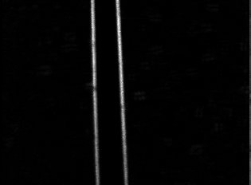
Reducing sparkling effect

Slide 16
Obstacle Detection
Image Capture
Floor Identification
Dilate
Negate
Side Fill
Erode
Smoothening

Slide 17
Decision Making
Create Fuzzy Sets
Fuzzy Inference
Defuzzyfication

Slide 18
Use Case Diagrams

Slide 19
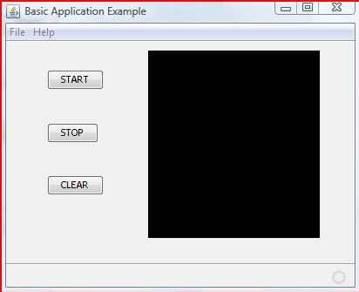
Graphical User Interface

Slide 20
Acknowledgement
We express our gratitude to our Project Guide Mr. Shripal Vijayvargiya for giving valuable guidance and advices.
We would also like to thank Mr. J Goswami for help provided in hardware designing .
We convey our sincere thanks to Dr. Madhvi Sinha, H.O.D Computer Science Department and all faculty members for their consistent encouragement and facilities provided.

