Slide 1
Presentation on
Searching Using Natural Language Queries
Under Guidance of:
Prof. Animesh Mukherjee
Associate Professor
Prof. Pawan Goyal
Assistant. Professor
Dept. of Comp. Science and Engineering
Mentor:
Suman Kalyan Maity
Presented by:
Group No. 5
Pranjal Kanojiya (16CS60R49)
Rahul Upadhya (16CS60R22)
Samaksh Narayan Garg (16CS60R24)
Sunil Parmar (16CS60R59)
Abhishek Tiwari (16CS60R83)
Mayank Tyagi (16CS60R85)

Slide 2
OBJECTIVES
Build a search retrieval interface that processes queries typed in natural language.
Different from traditional Keyword-based search as it deals with meaning of sentence.
Stemming and removal of stop words is not done.
Connectors like “how”, “and”, “the” become important.

Slide 3
Example
Objective : To find the Burj Khalifa Height
Keyword-based search query: “Burj Khalifa Height”.
But in Natural Language Query: “How high is the Burj Khalifa?”.

Slide 4
DATASET
DBPedia
It is a semantic web that allows users to semantically query relationships and properties of Wikipedia resources.
The DBPedia project uses the Resource Description Framework (RDF) to represent the extracted information.
Consists of:
3 billion RDF triples,
580 million extracted from the English edition of Wikipedia and
2.46 billion from other language editions

Slide 5
DATASET (contd.)
For querying it uses RDF(Resource Description Framework) query language
Data is accessed using an SQL-like query language for RDF called SPARQL

Slide 6
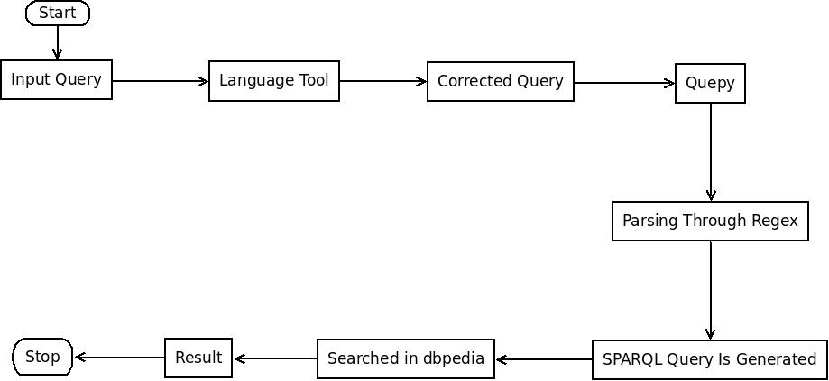
Flow Diagram

Slide 7
APPROACH/IMPLEMENTATION
Used Language Tool for correcting spelling and grammatical mistakes in the query
The rules through which the Language Tool makes corrections are specified in grammar.xml
The corrected query is passed to QUEPY tool in which the query is matched against regular expression that are specified in form of lemmas and POS tags
In order to write regular expression we used Spacy tool to generate Parse Tree with POS tag.

Slide 8
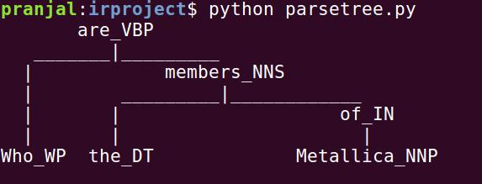
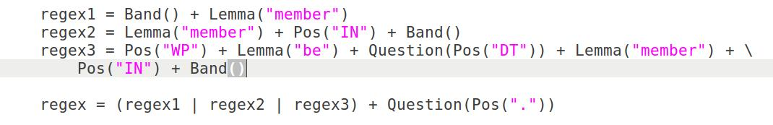

Slide 9
APPROACH/IMPLEMENTATION (contd.)
If the query matches the regular expression the query is converted to corresponding SPARQL form
This SPARQL query is then processed on DBPedia to get the results

Slide 10
EXPERIMENTS
The language tool generates a list of words corresponding to the correction required in the sentence
We choose the first word proposed by the language tool for replacement in the query
This word replacement can be improved by considering the context of the word in the query

Slide 11
EXPERIMENTS (contd.)
For regular expression in QUEPY, REfO is used which matches regular expressions for arbitrary sequences of objects
No query is generated if the query doesn’t matches the regular expression
The regular expressions uses lemmas and POS tags to specify similar group of words that are mentioned in WordNet Synsets
There are various labels through which dataset of DBPedia is accessed and we need to know the database label in which a particular kind of query is processed

Slide 12
Types of Queries Supported
WHAT IS
WHO IS
WHERE IS
MOVIES(eg. Movies of Brad Pitt)
Music(eg. Who are the the)
Person/People(Who is Bill Gates)

Slide 13
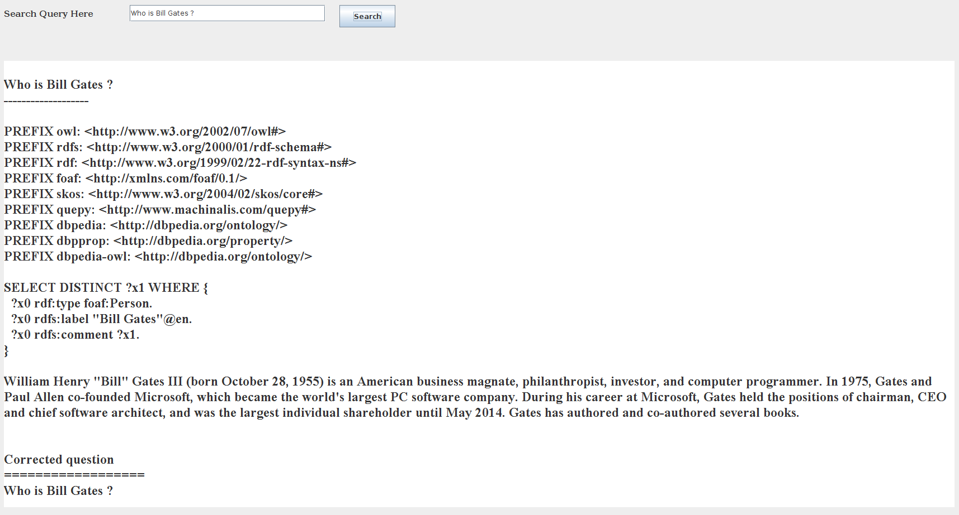
DEMO

Slide 14
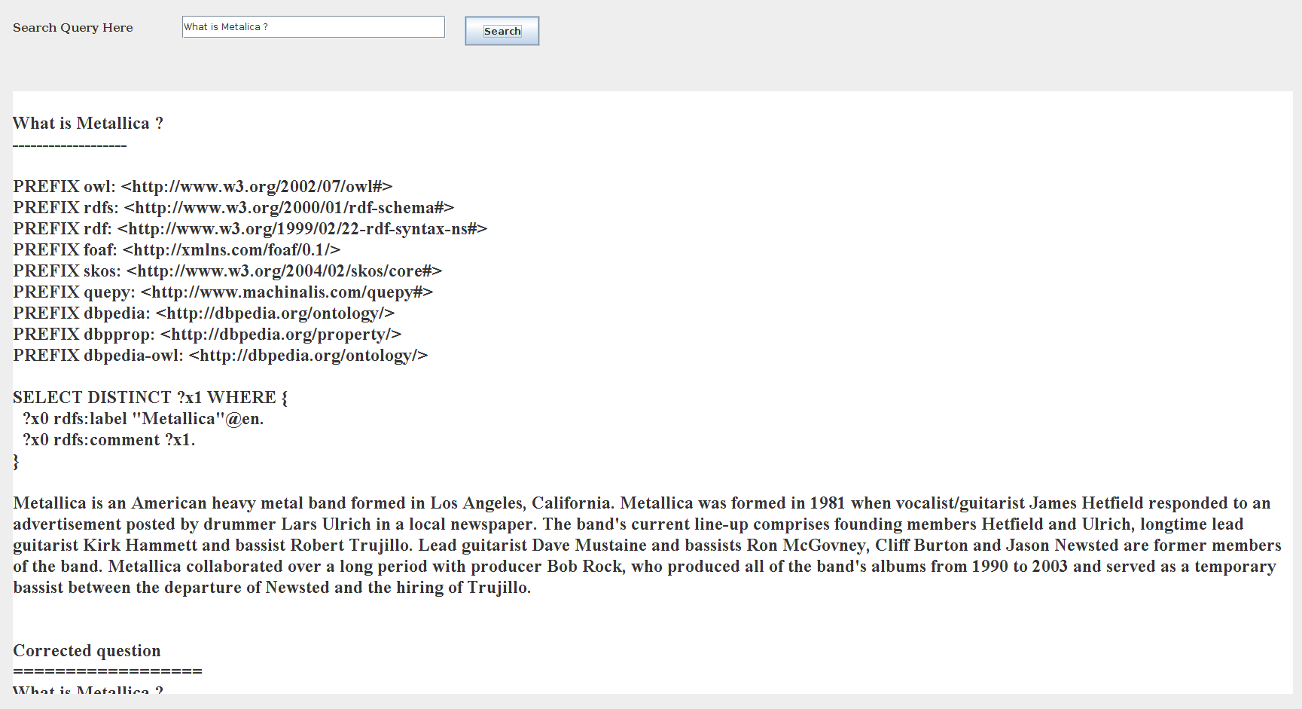
DEMO (contd.)

Slide 15
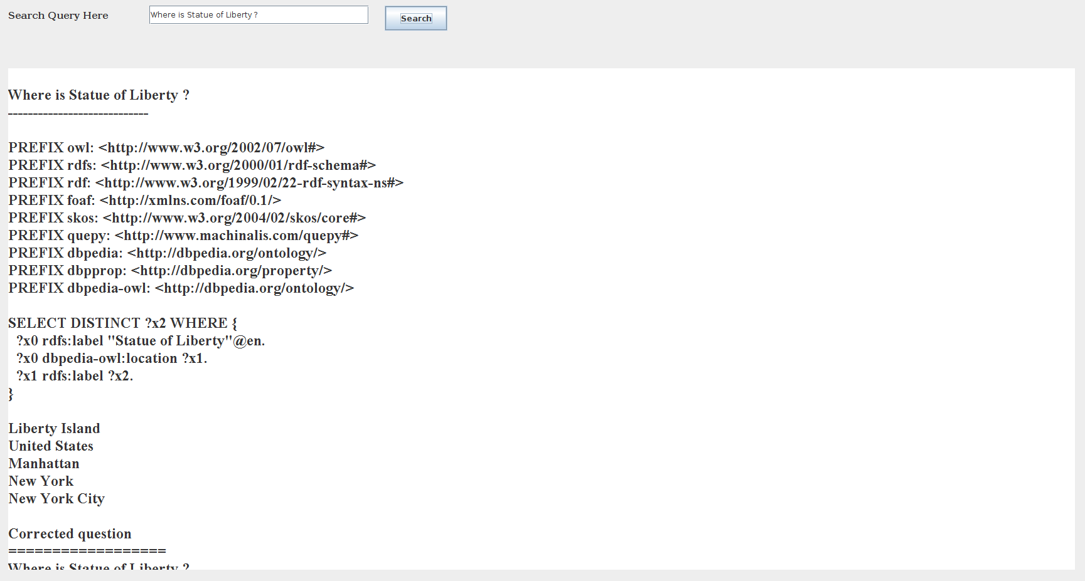
DEMO (contd.)

Slide 16
Future Work
Domain of Questions can be increased
Context based spelling correction
Other extensive database can be used for better results

Slide 17
References
http://quepy.readthedocs.io/en/latest/tutorial.html
https://languagetool.org
www.nltk.org
David H.D. Warren, Fernando C.N. Pereira, 1982, An efficient easily adaptable system for interpreting natural language queries, Computational Linguistics archive, 110-122
Andre Freitas, Edward Curry, Natural Language Queries over Heterogeneous Linked Data Graphs: A Distributional-Compositional Semantics Approach, 2014, Proceedings of the 19th international conference on Intelligent User Interfaces, 279-288

