Slide 1
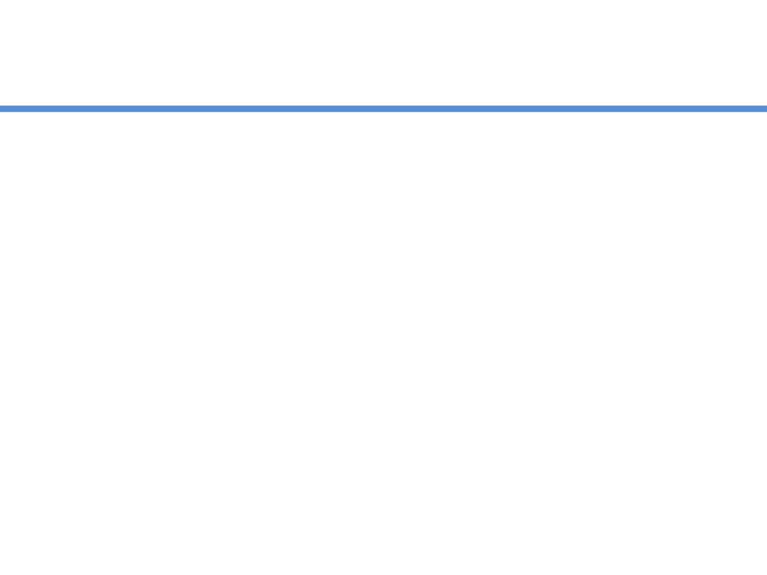
Spring MVC

Slide 2
Servlet WebApplication
Client requests for the URL
Particular servlet is mapped and response generated
Response is sent to the client
Application
request
Servlet
DB
response
Servlet
request
Servlet
POJO
response

Slide 3
JSP WebApplication
Client requests for the URL
Particular JSP is mapped and response generated after processing the request
Response with the data is sent to the client
Application
request
JSP
DB
response
JSP
request
JSP
POJO
response

Slide 4
WebApplication ??
Developers found
Both are not so good
HTML code embedded into Java code
Java code embedded into HTML code
Servlet
JSP
Two responsibilities mixed together, and makes it difficult to work independently

Slide 5
MVC
MVC says we can overcome all such problems
M
V
C
odel
iew
ontroller
Separate out
Presentation
Business Layer
HTML
JSP
Servlet

Slide 6
MVC
M
V
C
odel
Represents data
iew
Represnts UI part
ontroller
Manages the application flow, makes a call to some sort of service producing Model and then passes on the model to view

Slide 7
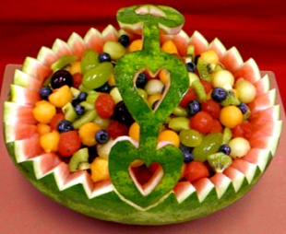

Example - MVC
Decorates with Fruits
Decorates with Cream
Machine to prepare Vanilla Cake
Machine to prepare Chocolate Cake
Machine to prepare Strawberry Cake
Your Cake Shop

Slide 8
MVC
HTML code
Showing Model
Application
View
Java Object
“Can be DO”
Some Business Service Producing Model (Data)
Model
Some Business Service Producing Model (Data)
Controller
Some Business Service Producing Model (Data)

Slide 9
Spring MVC
Web Application development Framework
Based on MVC guidelines
Let’s move to Spring MVC

Slide 10
Spring MVC Web App
Scans the URL and tell the exact address of the Guy who can generate the data for this web page
Handler Mapping
Prepares data, creates a Java object to hold data
www.webSite/WebPage
Front
Controller
Dispatcher Servlet
Data Generator
Controller
JavaObject holding Data
Final Response
View
View Resolver

