Slide 1
String

Slide 2
String
String is defined as a sequence of characters
Java implements strings as objects of type String
Unlike many other languages that implement string as character arrays
String is a class in java that is final
Defined in java.lang package
Also data type in java

Slide 3
String
String a = "Arun";
String b = new String();
String c = new String("Arun");
Heap
a
Java object reference
Arun
1111
b
Java object reference
4444
c
Java object reference
Arun
5555

Slide 4
String
String a = "Hello";
String pool
Java object reference
String b = "Hello";
Heap
String c = new String("Hello");
String d = new String(“Good");
if(a==b){
System.out.println("Same ");
}
if(a==c){
System.out.println("Same ");
}
else{
System.out.println("Not Same");
}
a
Hello
1421
Good
b
Hello
c
5645
d
Good
7761

Slide 5


String
String a = "Hello";
No one is pointing, but still in the memory
String b = "Hello";
String c = a;
b = "Good";
a
Hello
b = "Java ";
Good
b
Java
c

Slide 6
String is Immutable
String a = "Hello";
String b = "Java";
a+b;
a
Hello
b = "Good";
b
Good
a = a+b;
Java
String c = "Java";
c
HelloGood
HelloJava

Slide 7
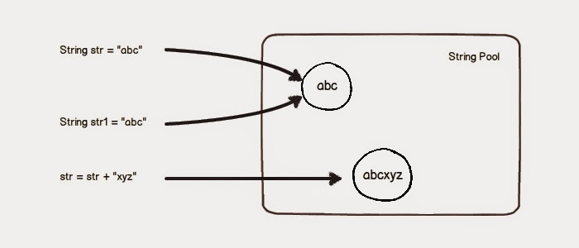
String is Immutable

Slide 8
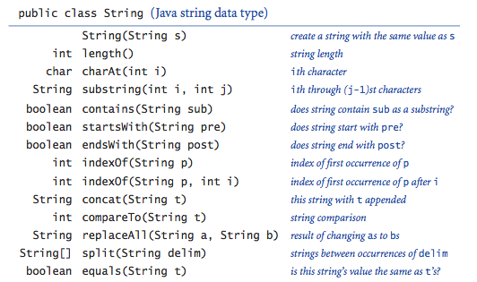
String methods

Slide 9
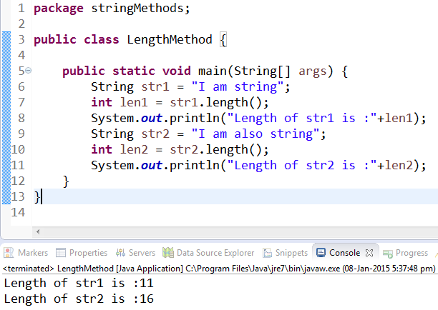
String methods

Slide 10
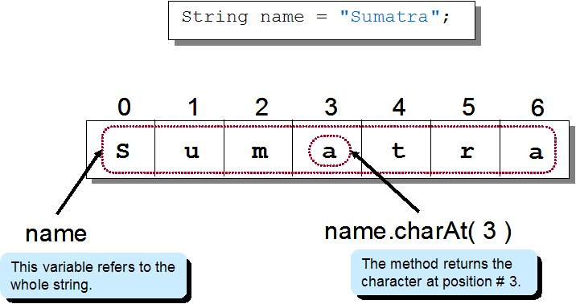
String methods

Slide 11
String methods
index
String str = "Vegetables";
0 1 2 3 4 5 6 7 8 9
int len= str.length;
V e g e t a b l e s
char c= str.charAt(3);
1 2 3 4 5 6 7 8 9 10
String str2 = “Fresh”.concat(str);
position
boolan isFound = str.contains(“table”);
10
e
isFound = str.startsWith(“Veg”);
str2
isFound = str.endsWith(“bles”);
FreshVegetables
Vegeta
str2 = str.substring(0, 6);
boolean isMatched = str.equals(“vegetables”);
isFound
isMatched
isMatched = str.equalsIgnoreCase(“vegetables”);
false
true

Slide 12
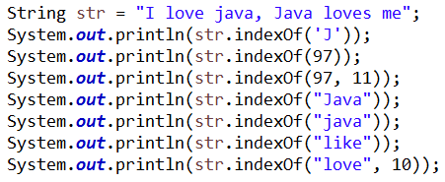
String methods
index
0
1
2
3
4
5
6
7
7
8
8
9
10
10
11
11
12
13
13
14
14
15
16
17
18
18
19
20
21
22
23
24
25
I
l
l
o
o
v
v
e
e
j
j
a
a
v
v
a
a
,
J
J
a
a
v
v
a
a
l
l
o
o
v
v
e
e
s
m
e
l
i
k
e
97 → a
Not found
13
8
14
13
7
-1
18

Slide 13
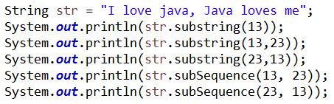
String methods
index
0
1
2
3
4
5
6
7
8
9
10
11
12
13
13
14
15
16
17
18
19
20
21
22
23
23
24
25
I
l
o
v
e
j
a
v
a
,
J
J
a
a
v
v
a
a
l
l
o
o
v
v
e
e
s
s
m
m
e
e
1
2
3
4
5
6
7
8
9
10
11
12
13
13
14
15
16
17
18
19
20
21
22
23
23
24
25
26
position
Java loves me
Java loves
error
error
IndexOutOfBoundsException

Slide 14
Immutable
String is Immutable :
Immutable means unchangeable
When you invoke a = “hello", you are actually changing the reference of a to a new object created by the String literal “hello“
String s = “hello";
s.substring(0,4);
System.out.println(s); // output is :hello
String a = s.substring(0,4);
System.out.println(a); // output is : hell
Notes:
Demo z = new Demo("the field");
z.setField("a new field");
System.out.println( z.getField());
// prints "a new field"
Here we are trying to substring the String s, which refers “some text” from 4th index but it will not change the String s, because it is Immutable, but when we pass the substring to String a, it will do because now we are just passing a string to a not changing the string.

Slide 15
String Memory Layout
String can be constructed by :
assigning a string literal to a String reference - just like a primitive
using the "new" operator
String Literals
String Object Heap
Example :
S1
S2
S3
S4
S5
String S1 = “Hello";
String S2 = “Hello";
String S3 = “Hello World";
String S4 = new String();
String S5 = new String();
String Pool
Heap
Hello
String Objects
String Objects
Hello World
Notes:
Note :
In java 8 String Pool and Heap are combined, and String pool is created inside Heap.

Slide 16
String methods
String methods
concat(String a) : Concate one string content into another string
String a = "Hello";
System.out.println( a.concat("Bye"); //Output is HelloBye
System.out.println(a); //Output is Hello
toLowerCase(): Convert String into small case
String a = "Hello";
a = a.toLowerCase(); // a’s value is hello
charAt(int index):Returns the character located at the specified index
String a = "Hello";
System.out.println( a.charAt(1)); //output is e

Slide 17
String methods
String methods
equalsIgnoreCase(String a): Determines the equality of two strings, ignoring case
String a = "Hello";
String b = "HELLO";
if( a.equalsIgnoreCase(b))
System.out.println("Equals"); //output is : Equals
else
System.out.println("Not Equals");
split(): J2SE 1.4 added the split() method to the String class to simplify the task of breaking a string into substrings, or tokens
Output :
This
is
a
String
Object
String a = "This is a String Object";
String x[] = a.split(" ");
for(i=0; i < x.length; i++){
System.out.println( x[i] );
} }

Slide 18
String & StringBuffer
StringBuffer & StringBuilder
String | StringBuffer
Data type and class in java | class in java
Immutable | Mutable
comes under character datatype | comes under reference data type
Slower in concatenation operation | Faster in concatenation operation

Slide 19
StringBuffer & StringBuilder
StringBuffer & StringBuilder
StringBuffer | StringBuilder
Mutable | Mutable
synchronized | Non-synchronization
Thread Safe | Not Thread Safe
Used when need to modify String | Used when need to modify String

Slide 20
String, StringBuffer & StringBuilder Example
String s = new String(“Hello");
s.concat(“User");
System.out.println(s); //Hello
Hello
StringBuffer sb = new StringBuffer(“Hello");
sb.append(“User");
System.out.println(sb); //HelloUser
HelloUser
StringBuilder sc = new StringBuilder(“Hello“);
sc.append(“User");
System.out.println(sc); //HelloUser
HelloUser
Notes:
Demo z = new Demo("the field");
z.setField("a new field");
System.out.println( z.getField());
// prints "a new field"
Here we are trying to substring the String s, which refers “some text” from 4th index but it will not change the String s, because it is Immutable, but when we pass the substring to String a, it will do because now we are just passing a string to a not changing the string.

Slide 21
String, StringBuffer & StringBuilder
performance
int N = 100000;
long t;
{
String sb1 = new String("hello");
t = System.currentTimeMillis();
for (int i = N; i >= 0; i--) {
sb1.concat("hi");
}
print(“String time:“ + (System.currentTimeMillis () - t));
}
{
StringBuffer sb2 = new StringBuffer("hello");
t = System.currentTimeMillis();
for (int i = N; i >= 0; i--) {
sb2.append("hi");
}
print(“StringBuffer time:" +
(System.currentTimeMillis() - t));
}
{
StringBuilder sb3 = new StringBuilder("hello");
t = System.currentTimeMillis();
for (int i = N; i >= 0; i--) {
sb3.append("hi");
}
print(“StringBuilder time:" +
(System.currentTimeMillis() - t));
}
Notes:
time take by String :34
time take by StringBuffer :20
time take by StringBuilder :10

