Slide 1
Web Apps

Slide 2
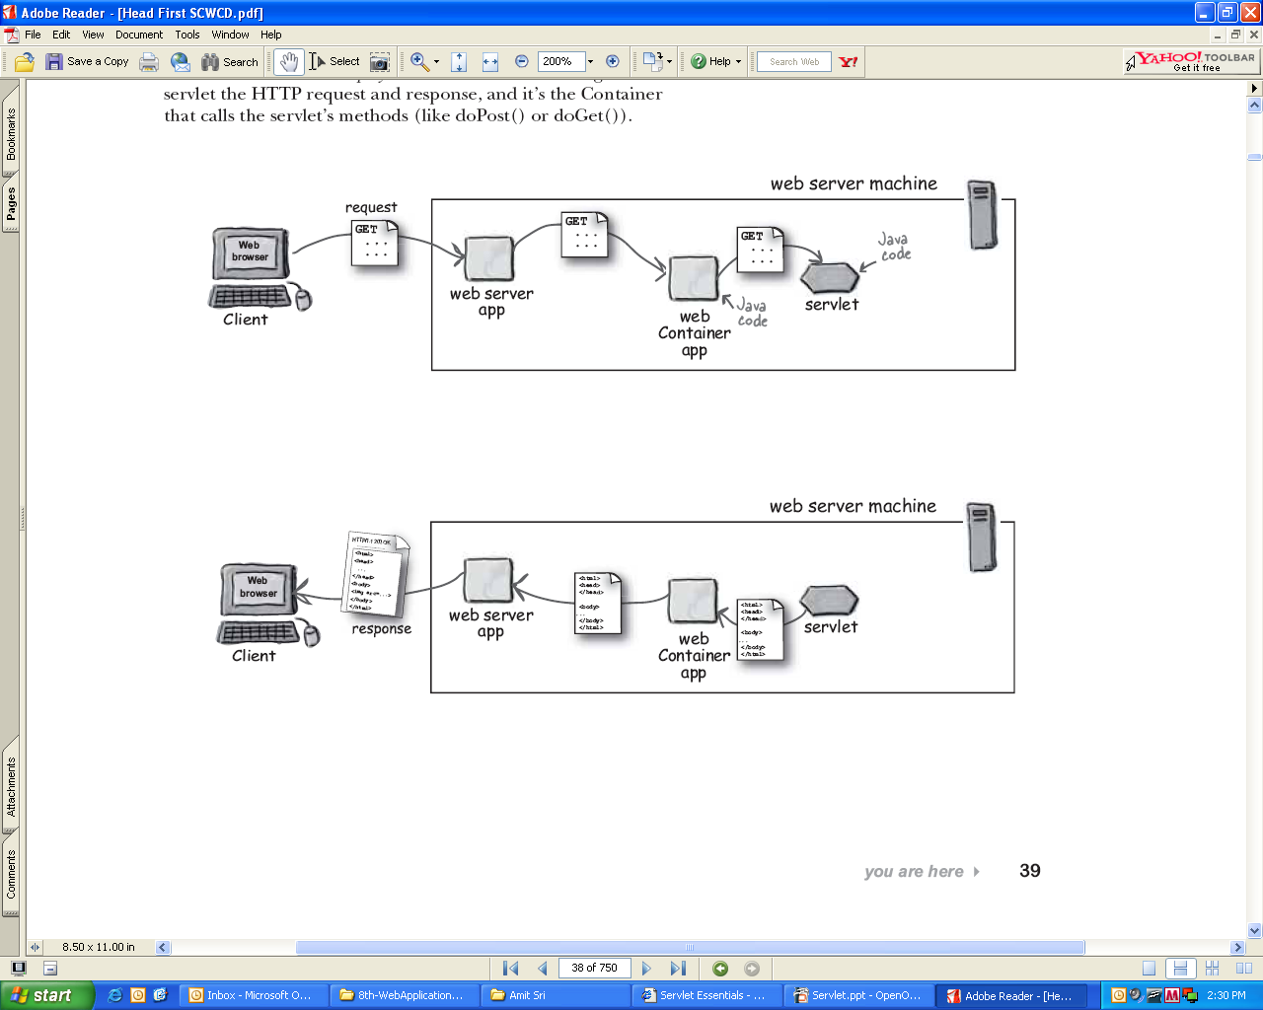
Introduction

Slide 3
WEB
What is Internet?
Essentially a global network of computing resources
What is WWW?
All resources and users on the Internet that use the Hypertext Transfer Protocol (HTTP)
Way of exchanging information between computers on the Internet
What is HTTP?
Protocol being used to transfer hypertext documents
What is URL?
Uniform Resource Locator used to specify addresses on the World Wide Web

Slide 4
WEB
What is Website?
Collection of various pages written in HTML markup language
What is Web Server?
Every Web site sits on a computer known as a Web server
Always connected to the internet
Given a unique address

Slide 5
Server
Every Web site sits on a computer known as a Web server
Always connected to the internet
When you register a Web address known as a domain name (DEMO.COM) you have to specify the IP address of the Web server that will host the site
Loads up with Dedicated Servers that can support your web-based operations

Slide 6
Server
Web server
Serves content to the web using http protocol
Exclusively handles HTTP/HTTPS requests
Tomcat : Servlet
IIS : ASP (.NET)
Jetty : Servlet
Apache : Php, CGI
Application server
Hosts and exposes business logic and processes
WebLogic Application Server : EJB
MTS : COM+
WAS : EJB
Jboss : EJB
One containing the other one and vice versa in some cases

Slide 7
Server
In short
Web server is a server that serves web pages to users via http
Application server is a server that hosts the business logic for a system
Supports the deployment of many types of distributed applications
Often hosts both long running processes and a services not meant for human consumption
REST/JSON services, SOAP, RPC, etc

Slide 8
ApplicationServer Vs WebServer
 | Application Server | Web Server
What is it? | Exposes business logic to client applications via various protocols including HTTP | Handles HTTP protocol
Job | Used to serve web based applications and enterprise based applications | Used to serve web based applications
Functions | To deliver various applications to another device | Keeping HTML, PHP, ASP etc files available for the web browsers to user
Supports | Distributed transaction and EJB's | Servlets and JSP
Resource utilization | High | Low

Slide 9
ApplicationServer Vs WebServer
Function
The main function of a web server is to keep files active for web site browsing
An Application server facilitates this process and tries to make for easy data access of an application
Multi Threading
Web Server does not support the concept of multi-threading
Application Server has features like connection pooling, isolation pooling, multi-threading, and majorly the Transaction feature

Slide 10
ApplicationServer Vs WebServer
Load Limit
A web server program has defined load limits
It can handle only a limited number of concurrent client connections
Application server has a much higher capacity
Model
Web servers support to deploy .war files only
Application servers support to deploy .war and .ear files

Slide 11
ApplicationServer Vs WebServer
Example
Consider an online store that provides real-time pricing and availability information
Most likely, the site will provide a form with which you can choose a product
When you submit your query, the site performs a lookup and returns the results embedded within an HTML page
The site may implement this functionality in different ways
With an application server
Without an application server (with web server)

Slide 12
ApplicationServer Vs WebServer
Example
Web server
The Web server takes your request, then passes it to a server-side program able to handle the request
The server-side program looks up the pricing information from a database or a flat file
Once retrieved, the server-side program uses the information to formulate the HTML response
Then the Web server sends it back to your Web browser
Web server simply processes HTTP requests by responding with HTML pages

Slide 13
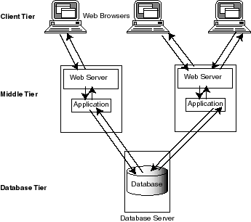
ApplicationServer Vs WebServer
Example

Slide 14
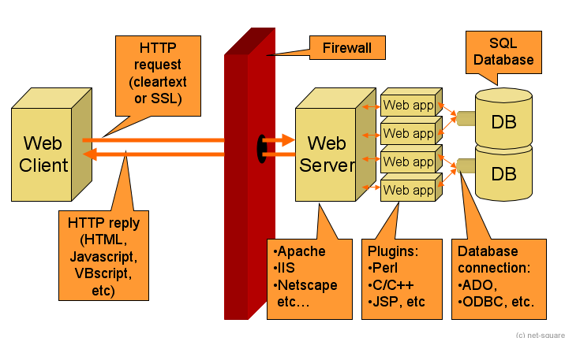
ApplicationServer Vs WebServer
Example

Slide 15
ApplicationServer Vs WebServer
Example
Application server
You can now put the business logic for the pricing lookup onto an application server
Your app can simply call the application server's lookup service
Your app can then use the service's result when the script generates its HTML response

Slide 16
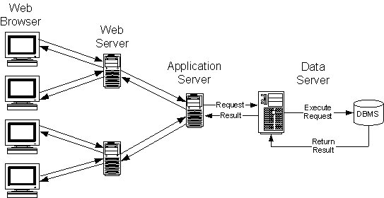
ApplicationServer Vs WebServer
Example

Slide 17
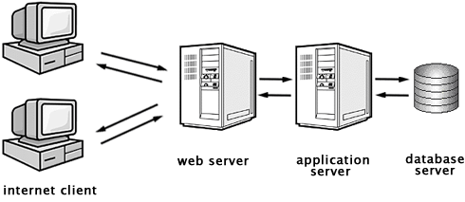
ApplicationServer Vs WebServer
Example

Slide 18
ApplicationServer Vs WebServer
Example
Application server
By separating the pricing logic from the HTML response-generating code, the pricing logic becomes far more reusable between applications
A second client, such as a cash register, could also call the same service as a clerk checks out a customer

Slide 19
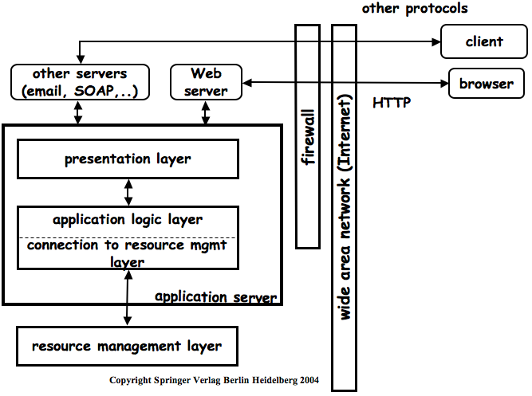
ApplicationServer Vs WebServer
Example

Slide 20
ApplicationServer Vs WebServer
Example
To summarize
The Web server handles HTTP requests by replying with an HTML page
The application server serves application logic

Slide 21
Leading Web Server
Apache HTTP Server
Most popular web server in the world
Open source software
Can be installed on almost all operating systems
Internet Information Services
High performance Web Server from Microsoft
runs on Windows NT/2000 and 2003 platforms

Slide 22
Leading Web Server
Lighttpd - pronounced lighty
Open source web server is fast, secure and consumes much less CPU power
Run on Windows, Mac OS X, Linux and Solaris operating systems
Jagsaw
W3C's Server
Open source and free and can run on various platforms
Written in Java
Can run CGI scripts and PHP programs

Slide 23
Tomcat
Web Server

Slide 24
Tomcat
Open Source, Java-based web application container
Created to run servlet and JSP web applications
Tomcat also provides additional functionality that makes it a great choice for developing a complete web application solution
Include the Tomcat Manager application
Specialized realm implementations
Tomcat valves

Slide 25
Tomcat
Tomcat Manager Web Application
Packaged with the Tomcat server
Provides the functionality to manage web applications
Install, start, stop, remove, and report on web applications

Slide 26
Tomcat
Specialized Realm Implementations
Container-managed security methods for protecting resources within the container
“databases” of users that can be authenticated by the container are called realms
MemoryRealm
JDBCRealm

Slide 27
Tomcat
Tomcat Valves
Technology introduced with Tomcat 4
Valves allow you to associate an instance of a Java class with a particular Catalina container
The configured valve class is then acting as a preprocessor for all requests coming to the container
Servlet API defines similar functionality in form of Filters

Slide 28
Architecture

Slide 29
Tomcat Architecture
Tomcat instance consists of grouping of the application containers, which exist in the well-defined hierarchy
<Server> <Service>* <Connector />* <Engine> <Host>* <Context> </Context>* </Host> </Engine> </Service> </Server>

Slide 30
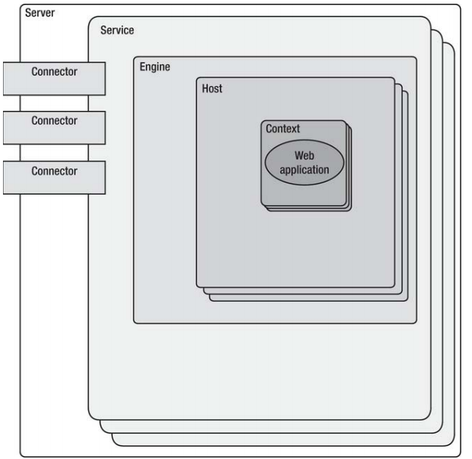
Tomcat Architecture

Slide 31
Tomcat Architecture
The Server
Represents the entire Catalina servlet engine and is used as a top-level element for a single Tomcat instance
The <Server> element may contain one or more <Service> containers
The Service
Holds a collection of one or more <Connector> elements that share a single <Engine> element

Slide 32
Tomcat Architecture
The Connector
Defines the class that does the actual handling requests and responses to and from a calling client application
The Engine
Each defined <Service> can have only one <Engine> element, and this single <Engine> component handles all requests received by all of the defined <Connector> components defined

Slide 33
Tomcat Architecture
The Host
The <Host> element defines the virtual hosts that are contained in each instance of a Catalina <Engine>
The Context
Most commonly used container in a Tomcat instance
Each <Context> element represents an individual web application that is running within a defined <Host>
No limit to the number of contexts that can be defined within a <Host>

Slide 34
Installation

Slide 35
Installation
Download Tomcat
Unzip the binary
Configure Environment Variables
Set CATALINA_HOME (required)
Set CATALINA_BASE (optional)
Set JAVA_HOME (required)
Path
https://tomcat.apache.org/download-70.cgi
Notes:
Java is prerequisite

Slide 36
Start Tomcat
Open cmd and go to the bin folder
Open cmd and from any location
Go to the browser
startup.bat
%CATALINA_HOME%\bin\startup.bat
http://localhost:8080/

Slide 37
Shutdown Tomcat
Open cmd and go to the bin folder
Open cmd and from any location
You can use Ctrl+c
shutdown.bat
%CATALINA_HOME%\bin\shutdown.bat

Slide 38
Start + Shutdown
Open cmd and go to the bin folder
catalina start
catalina stop

Slide 39
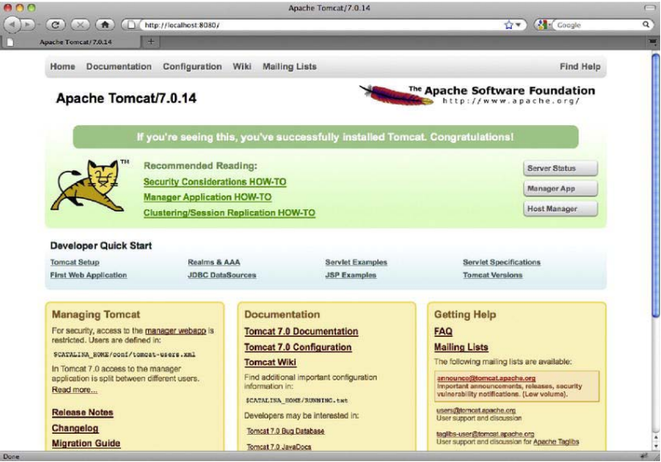
Testing Installation

Slide 40
Deployment

Slide 41
Deploy
Put war file in
webapps directory

