Slide 1

EDGE ANOMALY DETECTION
Preventing silent hardware failures at the edge.
Millions of smart fans, air purifiers and motors accumulate mechanical wear and thermal drift that nobody can see - until something seizes.
// 01
Unannounced wear
Smart home appliances suffer silent mechanical wear and thermal degradation that compounds long before anyone notices.
// 02
Cloud is too slow
Streaming 24n raw sensor data to the cloud introduces latency, infrastructure cost and user privacy risk.
// 03
No instant cut-off
Traditional cloud-bound Al cannot guarantee the millisecond safety cut-off a critical breakdown demands.
THE MISSION
Real-time, zero-cloud anomaly detection on constrained edge hardware - using a model built from scratch.

Slide 2






'10,000
Synthetic telemetry rows from the Al412020 corpus
DATA • FEATURES • PIPELINE
Telemetry engineering & feature normalization
Five signals, five scales
Every feature speaks in its own units. Without normalization. no slngle model can compare them.
AIR TEMPERATURE
PROCESS TEMPERATURE
ROTATIONAL SPEED
1,540rpm
TORQUE
40nm
TOOL WEAR
107min
raoge - 295 - 385 K range - 385 - 315 K
Severe class Imbalance
Hardware fanures are vanlshlnglyrare-maklngthe actual signaleasyto miss.
range - 1,888 - 2,588
range - 3 - 75 NM
range - O - 253 ain
FAILURE SHARE
N 3.4%
96.6 % normal operation
FAILURE
ENGINEERING SOLUTION
An automated data_prep.py pipeline inputs missing values and fits a Standard Scaler , exporting frozen scale parameters to
Scaler.pkl so live edge streams stay normalized.

Slide 3

Ultra-lightweight,
zero-cloud architecture.
ARCHITECTURE
FOOTPR1NT
On-disk binary of the trained artifact
STAGE 81
STAGE 82
STAGE 03
Isolation Forest
Raw telemetry
Five sensor channels stream froma single smart-home device at framerate.
•
Standard Scaler
Frozen scaler.pkl. re-applies the same scale to every incoming frame.
•
Unsupervised ensemble that learns statistical bounds of normal operation. Saved as anomaly_model.pkl.
ALGORITHH
Isolation Forest
Unsupervised ensemble. trainedentirely from scratch - no pretralned weights. no labels required.
FOOTPRINT
200 kB binary
anomaly model.pkl ls small enough to live in MCU on board flash.
RUNTIME
edge_inference.py
Independent Inferencescript that scales and scoresa slngle frame locally - no network calls.
LOCAL ALERT
Sub-milliSecond decision
from sensor > scaLer.PKL > anomaly_model.pk1. > local alert

Slide 4
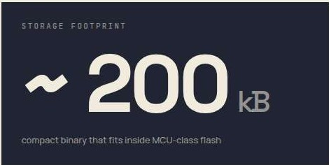
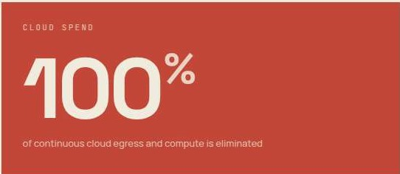
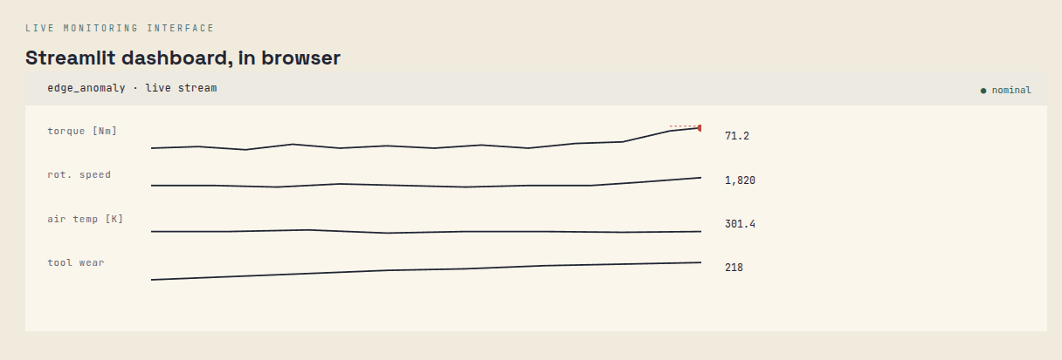
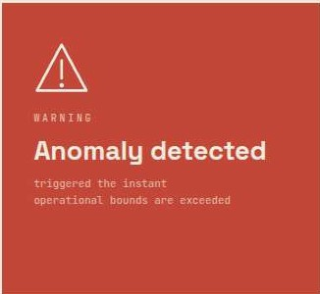
IMPACT • LIVE DEMO
•
Sub-millisecond inference and real-time alerting.
INFERENCE LATENCY
LIVE PIPELINE • APP.PY
< 1 ms
Per data frame on commodity edge hardware
DECISION SCORE

Slide 5
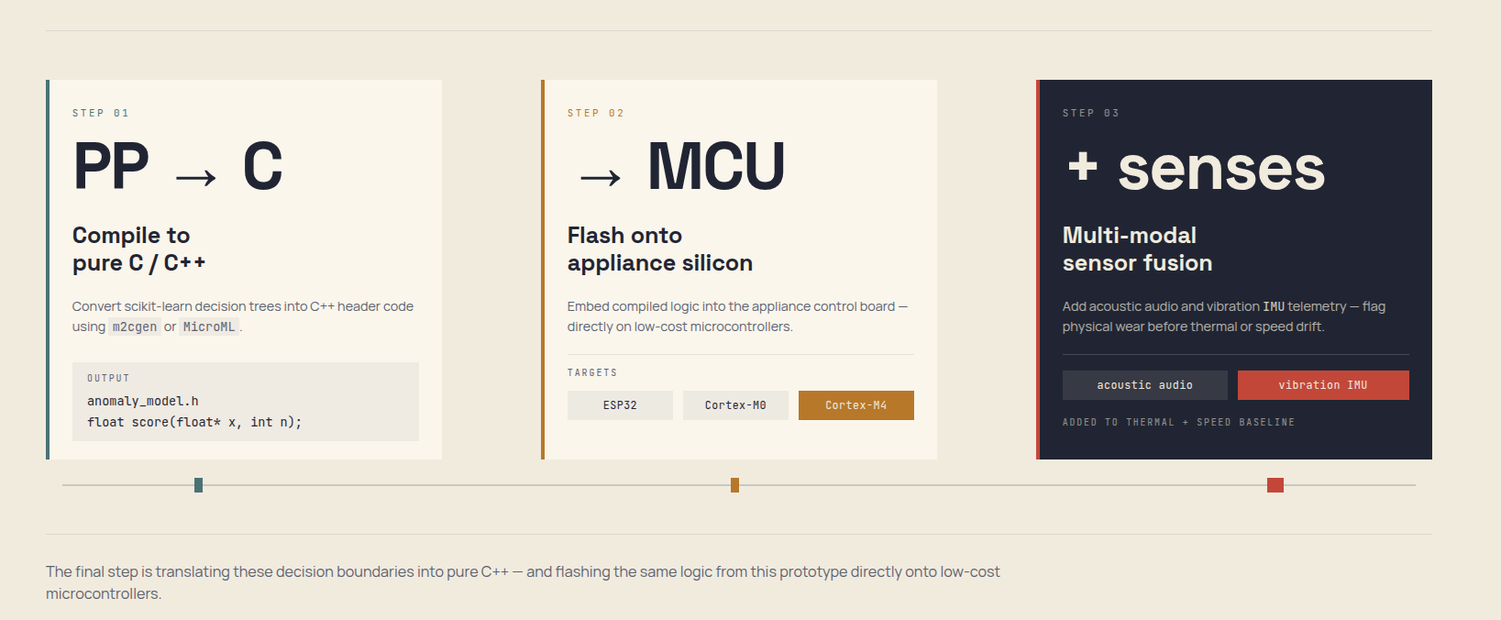
ROAD MAP
From Python prototype
to microcontroller silicon.
PRODUCTION TRAJECTORY

