Slide 1

IILM UNIVERSITY
Greater Noida, Uttar Pradesh · School of Computer Science and Engineering
INTERNSHIP PRESENTATION
Momentum — Personal Productivity Dashboard
A Web Development internship project, submitted in partial fulfilment of the degree of B.Tech (CSE)
STUDENT NAME
ENROLLMENT NUMBER
Mayank Pandey
25scs1003002626
PROGRAM & SEMESTER
ORGANIZATION
B.Tech CSE — 3rd Semester
Codec Technologies Pvt. Ltd.

Slide 2
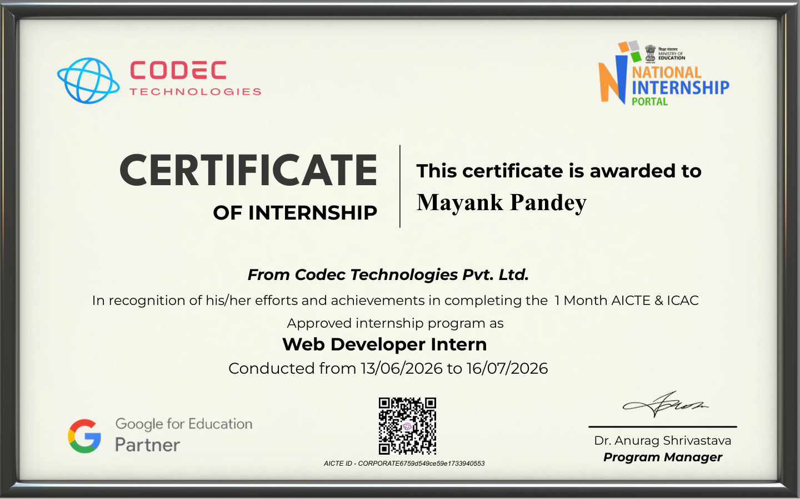
PROOF OF COMPLETION
Internship Completion Certificate
Issued by Codec Technologies Pvt. Ltd. · 13 June 2026 – 16 July 2026 · Role: Web Developer Intern
MOMENTUM · INTERNSHIP PRESENTATION
02 / 10

Slide 3
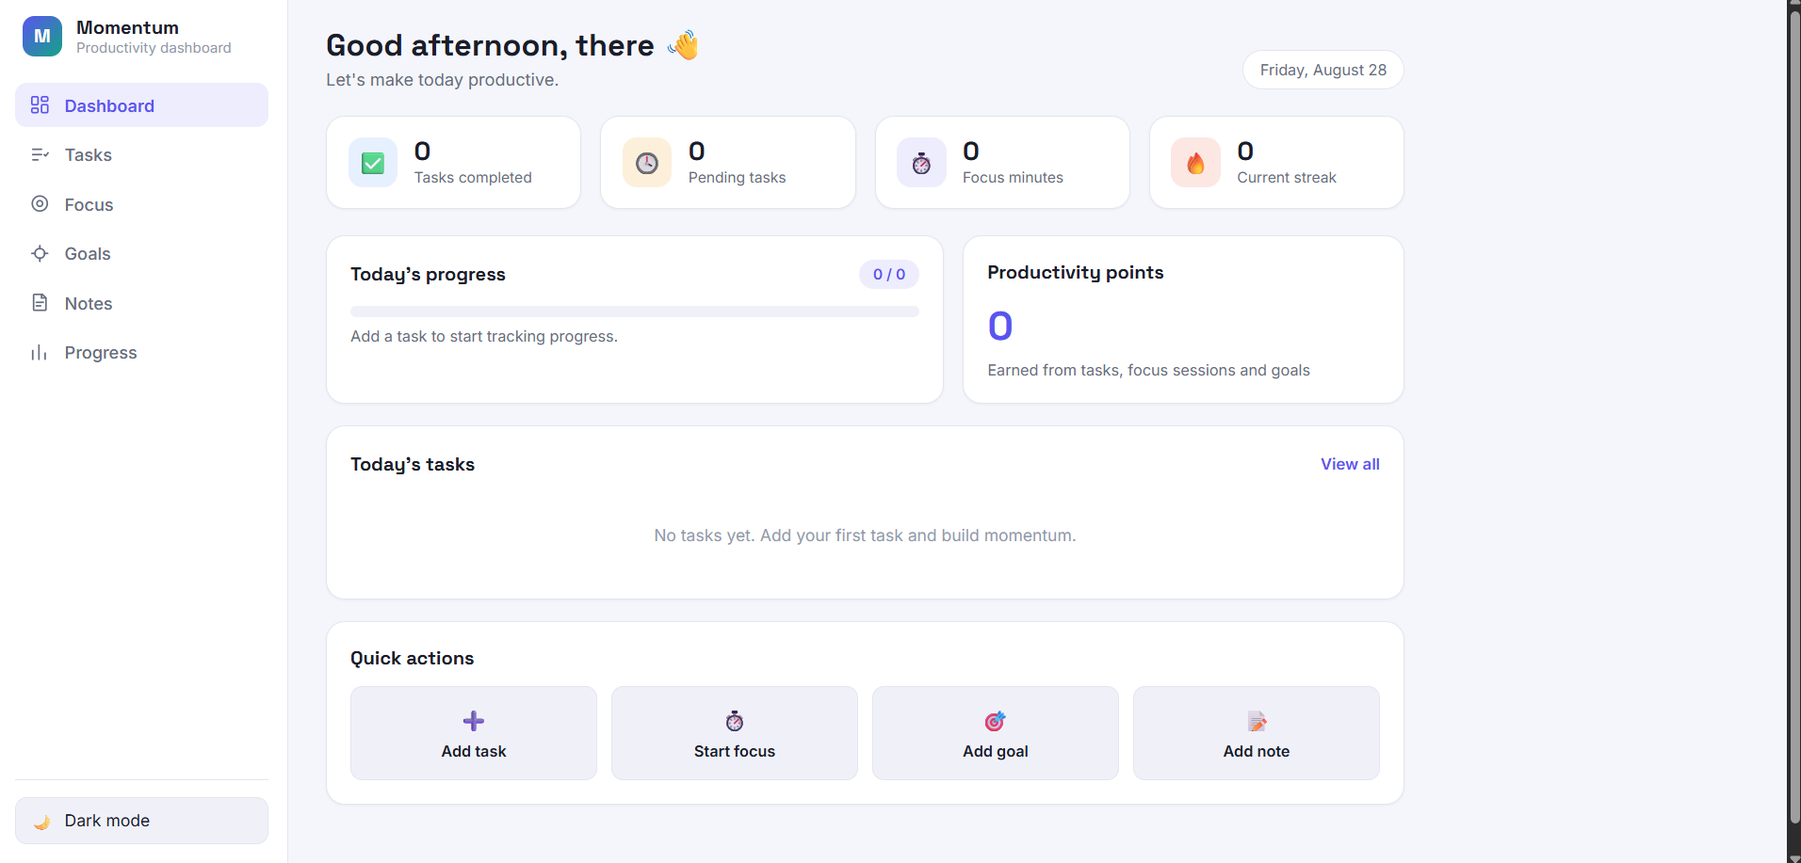
PROJECT OVERVIEW
One dashboard for everyday productivity
Momentum is a browser-based productivity dashboard built as the internship's project component. It brings task management, focus sessions, daily goals, notes and progress tracking into a single, lightweight interface — implemented with HTML, CSS and vanilla JavaScript, with no backend or build step.
Client-side app
HTML · CSS · JS
localStorage
Data persists locally between sessions, and the interface adapts to desktop, tablet and mobile screens with light and dark themes.
Momentum dashboard — live interface
MOMENTUM · INTERNSHIP PRESENTATION
03 / 10

Slide 4
ORGANIZATION PROFILE
Codec Technologies Pvt. Ltd.
A global platform connecting learners and talent to meaningful career opportunities, delivering IT and business-consultancy services across 27+ countries with a focus on global innovation and strategic growth.
🌍
GLOBAL REACH
🧑‍💻
INTERNSHIP MODE
IT & business consultancy across 27+ countries
Hybrid, Pan-India engagement
🛠️
ASSIGNED ROLE
📅
DURATION
Web Developer Intern
13 June 2026 – 16 July 2026
MOMENTUM · INTERNSHIP PRESENTATION
04 / 10

Slide 5
THE BRIEF
Problem statement & objectives
KEY OBJECTIVES
PROBLEM STATEMENT
Design a clean, responsive productivity dashboard using standard web technologies
Managing personal productivity often means switching between separate apps for tasks, notes, goals and time management — fragmenting focus and making it hard to see daily priorities clearly.
Momentum addresses this by giving users a single, simple web interface to organize and track these activities without a complex setup or external backend.
Implement task creation, completion, filtering and daily progress tracking
Provide a focus-session timer with statistics and productivity points
Persist application state with browser localStorage — no server database
Support light/dark themes and responsive navigation across devices
Apply accessibility practices: semantic markup, focus states, reduced motion
Deploy the finished static site through GitHub Pages
MOMENTUM · INTERNSHIP PRESENTATION
05 / 10

Slide 6
SCOPE & TOOLKIT
What's in scope, and what it's built with
IN SCOPE
OUT OF SCOPE
Dashboard, tasks, focus timer, goals, notes, progress, achievements, productivity points and theme switching — entirely client-side.
User authentication, cloud sync, a server-side database, multi-user collaboration or a REST API — noted as future extensions.
TECHNOLOGIES & TOOLS USED
HTML5
CSS3
JavaScript
localStorage
Structure & semantics
Responsive presentation
Application logic
Client-side persistence
VS Code
Live Server
Git & GitHub
GitHub Pages
Development environment
Local testing
Version control
Public deployment
MOMENTUM · INTERNSHIP PRESENTATION
06 / 10

Slide 7
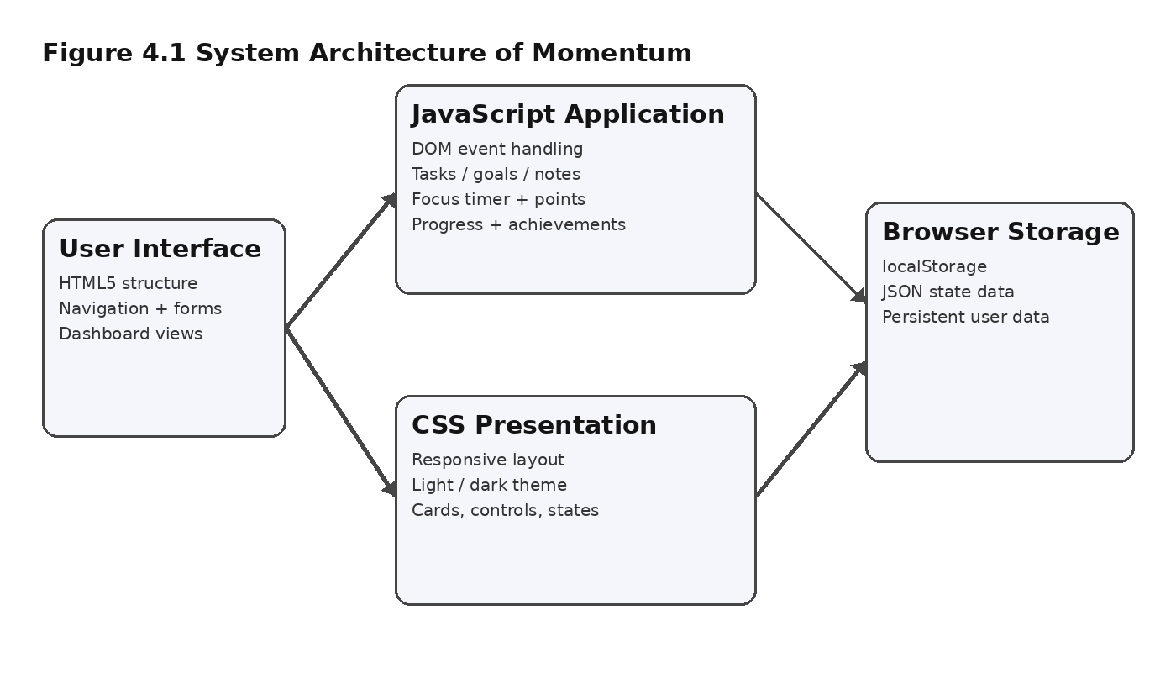
UNDER THE HOOD
A simple, static client-side architecture
The browser loads the HTML document, applies the CSS presentation layer and runs the JavaScript application logic. State is held in memory and persisted to localStorage as JSON — no application server or database is required.
MOMENTUM · INTERNSHIP PRESENTATION
07 / 10

Slide 8
METHODOLOGY
From requirements to public deployment
1
2
3
4
5
6
7
Requirements
UI Planning
HTML / CSS
JS Logic
Persistence
Testing
Deployment
Defined tasks, focus, goals, notes and progress as the core modules.
Dashboard-first layout with sidebar and mobile navigation.
Semantic structure with responsive, theme-aware styling.
State, events, timers, points and rendering in vanilla JS.
A localStorage wrapper saves and loads JSON safely.
Manual testing of every module across screen sizes.
Published to GitHub Pages from the GitHub repository.
MOMENTUM · INTERNSHIP PRESENTATION
08 / 10

Slide 9
RESULTS
Outcomes of the internship project
EXPECTED OUTCOMES
LEARNING OUTCOMES
Functional task management with priorities & live dashboard stats
Practical experience in semantic HTML, responsive CSS layout, JavaScript event handling and DOM manipulation, state management, browser storage, accessibility fundamentals, local testing and static-site deployment.
The internship also built experience organizing a small application into reusable modules and documenting it clearly for academic and portfolio purposes.
Working focus-session timer with stored statistics and points
Goal and note management inside the same interface
Persistent browser-side data using localStorage
Responsive layout across desktop, tablet and mobile
Light/dark theming and a public GitHub Pages deployment
MOMENTUM · INTERNSHIP PRESENTATION
09 / 10

Slide 10
CONCLUSION
Momentum shows a complete front-end workflow — from
planning and interface design to a live, deployed product.
Built without frameworks or a backend, the project demonstrates that thoughtful HTML, CSS and JavaScript alone can produce a responsive, accessible and genuinely useful productivity tool.
7
100%
Live
Feature modules
Client-side, no backend
Deployed on GitHub Pages
Thank you
Mayank Pandey · B.Tech CSE, 3rd Semester · IILM University, Greater Noida

