Slide 1

Fast Algorithms for Projected Clustering
CHAN Siu Lung, Daniel
CHAN Wai Kin, Ken
CHOW Chin Hung, Victor
KOON Ping Yin, Bob

Slide 2
Clustering in high dimension
Most known clustering algorithms cluster the data base on the distance of the data.
Problem: the data may be near in a few dimensions, but not all dimensions.
Such information will be failed to be achieved.

Slide 3
Example
Y
Z
Y
X
X

Slide 4
Other way to solve this problem
Find the closely correlated dimensions for all the data and find clusters in such dimensions.
Problem: It is sometimes not possible to find such a closed correlated dimensions

Slide 5
Example
Z
Y
X

Slide 6
Cross Section for the Example
Z
Y
X
X

Slide 7
PROCLUS
This paper is related to solve the above problem.
The method is called PROCLUS (Projected Clustering)

Slide 8
Objective of PROCLUS
Defines an algorithm to find out the clusters and the dimensions for the corresponding clusters
Also it is needed to split out those Outliers (points that do not cluster well) from the clusters.

Slide 9
Input and Output for PROCLUS
Input:
  The set of data points
  Number of clusters, denoted by k
  Average number of dimensions for each clusters, denoted by L
Output:
  The clusters found, and the dimensions respected to such clusters

Slide 10
PROCLUS
Three Phase for PROCLUS:
  Initialization Phase
  Iterative Phase
  Refinement Phase

Slide 11
Initialization Phase
Choose a sample set of data point randomly.
Choose a set of data point which is probably the medoids of the clusters

Slide 12
Medoids
Medoid for a cluster is the data point which is nearest to the center of the cluster

Slide 13
Initialization Phase
All Data Points
Choose by Random
Size: A × k
Random Data Sample
Choose by Greedy Algorithm
Size: B × k
the set of points including Medoids
Denoted by M
Choose in Iterative Phase
Size: k
The medoids found

Slide 14
Greedy Algorithm
Avoid to choose the medoids from the same clusters.
Therefore the way is to choose the set of points which are most far apart.
Start on a random point

Slide 15
Greedy Algorithm
Minimum Distance to the points in the Set
 | A | B | C | D | E
A | 0 | 1 | 3 | 6 | 7
B | 1 | 0 | 2 | 4 | 5
C | 3 | 2 | 0 | 5 | 2
D | 6 | 4 | 5 | 0 | 1
E | 7 | 5 | 2 | 1 | 0
A | B | C | D | E
- | 1 | 3 | 6 | 7
A Randomly Choosed first
Set {A}
A | B | C | D | E
- | 1 | 2 | 1 | -
Choose E
Set {A, E}

Slide 16
Iterative Phase
From the Initialization Phase, we got a set of data points which should contains the medoids. (Denoted by M)
This phase, we will find the best medoids from M.
Randomly find the set of points M_{current}, and replace the “bad” medoids from other point in M if necessary.

Slide 17
Iterative Phase
For the medoids, following will be done:
  Find Dimensions related to the medoids
  Assign Data Points to the medoids
  Evaluate the Clusters formed
  Find the bad medoid, and try the result of replacing bad medoid
The above procedure is repeated until we got a satisfied result

Slide 18
Iterative Phase- Find Dimensions
For each medoid m_{i}, let D be the nearest distance to the other medoid
All the data points within the distance will be assigned to the medoid m_{i}
B
A
δ
C

Slide 19
Iterative Phase- Find Dimensions
For the points assigned to medoid m_{i}, calculate the average distance X_{i,j} to the medoid in each dimension j
B
A
C

Slide 20
Iterative Phase- Find Dimensions
Calculate the mean Y_{i} and standard deviation σ_{i} of X_{i, j} along j
Calculate Z_{i,j} = (X_{i,j} - Y_{i}) / σ_{i}
Choose k × L most negative of Z_{i,j} with at least 2 chosen for each medoids

Slide 21
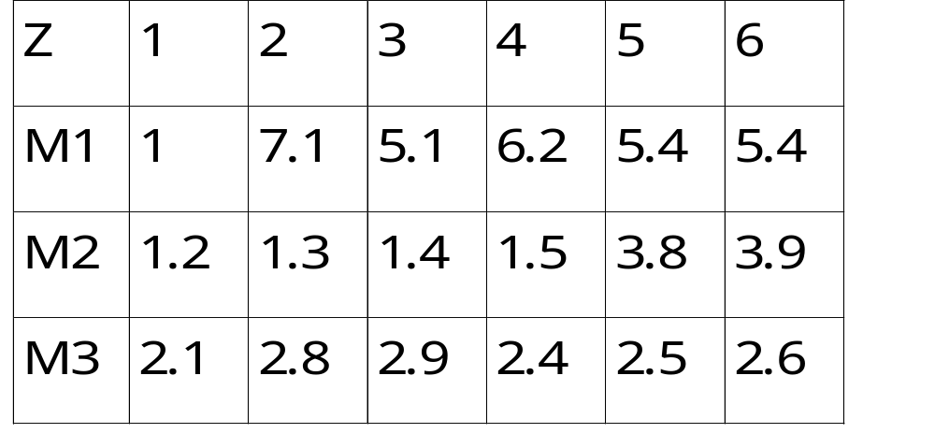
Iterative Phase- Find Dimensions
Suppose k = 3, L = 3
Result:
D1 <1, 3> D2 <1, 2, 3, 4> D3 <1, 4, 5>

Slide 22
Iterative Phase - Assign Points
For each data point, assign it to the medoid m_{i} if its Manhattan Segmental Distance for Dimension D_{i} is minimum, the point will be assigned to m_{i}

Slide 23
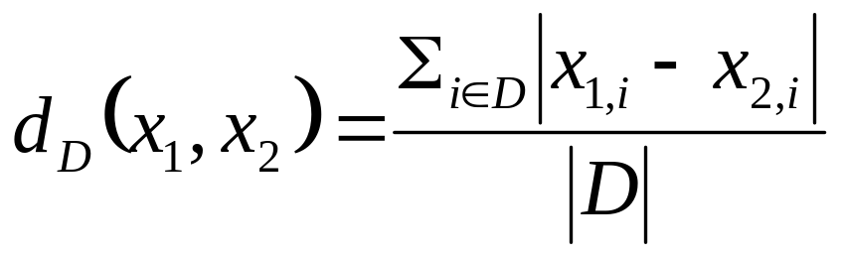
Manhattan Segmental Distance
Manhattan Segmental Distance is defined relative to a dimension.
The Manhattan Segmental Distance between the point x₁ and x₂ for the dimension D is defined as:

Slide 24
Example for Manhattan Segmental Distance
Z
x₂
x₁
Y
a
b
X
Manhattan Segmental Distance for Dimension (X, Y)
= (a + b) / 2

Slide 25
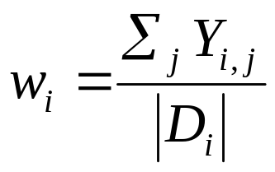
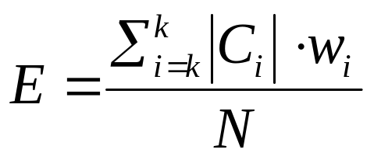
Iterative Phase-Evaluate Clusters
For each data points in the cluster i, find the average distance Y_{i,j} to the centroid along the dimension j, where j is one of the dimension for the cluster.
Calculate the follows:

Slide 26
Iterative Phase-Evaluate Clusters
The value will be used to evaluate the clusters. The lesser the value, the better the clusters.
Try to compare the case when a bad medoid is replaced, and replace the result if the value calculated above is better
The bad medoid is the medoid with least number of points.

Slide 27
Refinement Phase
Redo the process in Iterative Phase once by using the data points distributed by the result cluster, but not the distance from medoids
Improve the quality of the result
In iterative phase, we don’t handle the outliers, and now we will handle it.

Slide 28
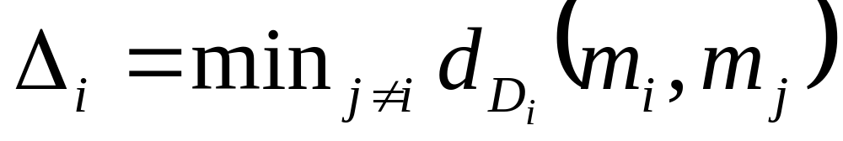
Refinement Phase-Handle Outliers
For each medoid m_{i} with the dimension D_{i}, find the smallest Manhattan segmental distance Δ_{i} to any of the other medoids with respect to the set of dimensions D_{i}

Slide 29
Refinement Phase-Handle Outliers
Δ_{i} is the sphere of influence of the medoid m_{i}
A data point is an outlier if it is not under any spheres of influence.

Slide 30
Result of PROCLUS
Result Accuracy
Input
Dimensions
Points
Found
Dimensions
Points
A
3, 4, 7, 9, 14, 16, 17
21391
1
4, 6, 11, 13, 14, 17, 19
18701
B
3, 4, 7, 12, 13, 14, 17
23278
2
3, 4, 7, 9, 14, 16, 17
21915
C
4, 6, 11, 13, 14, 17, 19
18245
3
3, 4, 7, 12, 13, 14, 17
23975
D
4, 7, 9, 13, 14, 16, 17
15728
4
4, 7, 9, 13, 14, 16, 17
16018
E
3, 4, 9, 12, 14, 16, 17
16357
5
3, 4, 9, 12, 14, 16, 17
16995
Outliers
-
5000
Outliers
-
2396
Actual clusters
PROCLUS results

Slide 31



