Slide 1
Kafka with Spark
CS5543 : Tutorial 11

Slide 2
Spark and Kafka

Slide 3
Kafka Producer

Slide 4
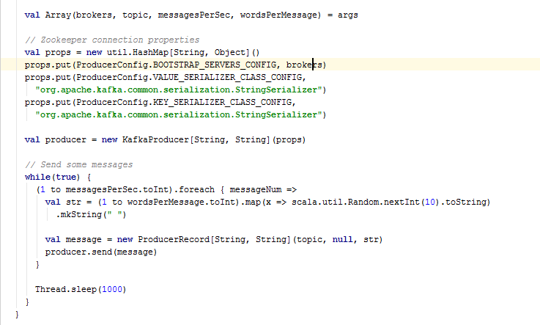
Kafka Producer in Scala

Slide 5
Spark Streaming

Slide 6
Dependencies
libraryDependencies ++= Seq( "org.apache.spark" % "spark-streaming-kafka_2.10" % "1.3.0", "org.apache.spark" % "spark-core_2.10" % "1.3.0", "org.apache.spark" % "spark-streaming_2.10" % "1.3.0", "org.apache.spark" % "spark-yarn_2.10" % "1.3.0" )

Slide 7
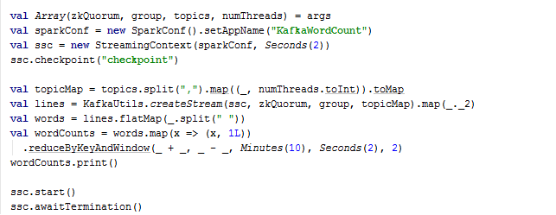
Kafka Stream
Kafka Spark is based on Spark Streaming Feature

Slide 8
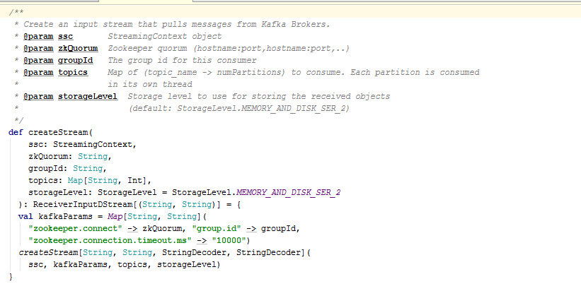
Zookeeper details for KafkaStream

Slide 9
Deploying Kafka Producer
java –cp Spark-Kafka-Producer KafkaWordCountProducer <metadataBrokerList> <topic> <messagesPerSec> <wordsPerMessage>
java –cp Spark-Kafka-Producer KafkaWordCountProducer localhost:2181 testkafka 20 10

Slide 10
Deploying Spark – Kafka Consumer
spark-submit --master local[*] --class KafkaWordCount Spark-Kafka.jar localhost:2181 mygroup testkafka 2

Slide 11
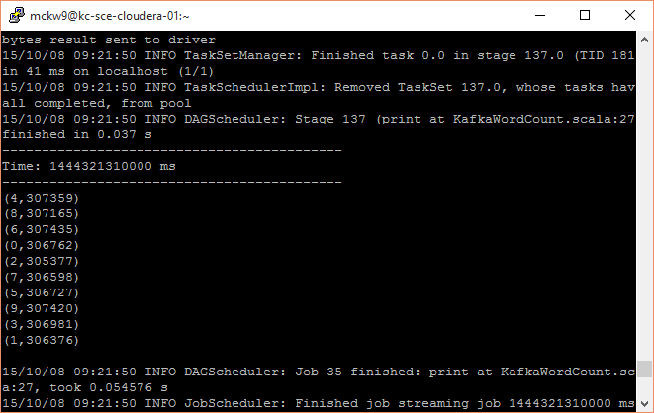
Results

Slide 12
References
http://www.michael-noll.com/blog/2014/10/01/kafka-spark-streaming-integration-example-tutorial/
https://github.com/apache/spark/blob/master/examples/src/main/scala/org/apache/spark/examples/streaming/KafkaWordCount.scala

Slide 13
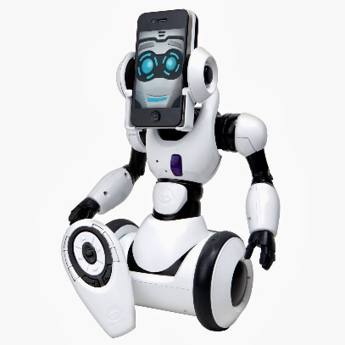
Full Work Flow
1
3
4
2
3
Streaming
Data From iOS
Kafka Producer
Kafka Topics
Spark
(Kafka Consumer)
Results
5

Slide 14
Full Work Flow
Text Field and Send button are added to existing Robo-Me Server Code.
On Tapping Send Button, The Data is Send to Kafka Producer.
Kafka Producer then populates the Kafka-Topics
The Spark Consumer Subscribes to The Kafka Topics
The Results from The Spark are sent back to the Robot

Slide 15
iOS to Kafka Streaming
- (IBAction)tappedOnSend:(id)sender {
if (isRunning) {
NSString *msg = [NSString stringWithFormat:@"%@ \n",self.KafkaInput.text];
NSData *data = [msg dataUsingEncoding:NSUTF8StringEncoding];
GCDAsyncSocket *socket = [connectedSockets lastObject];
if (socket != nil) {
[socket writeData:data withTimeout:-1 tag:ECHO_MSG];
[self displayText:[NSString stringWithFormat:@"Message sent : %@ \n",msg]];
} else {
NSLog(@"Socket not available");
}
NSLog(@"Inside Send");
}
}

Slide 16
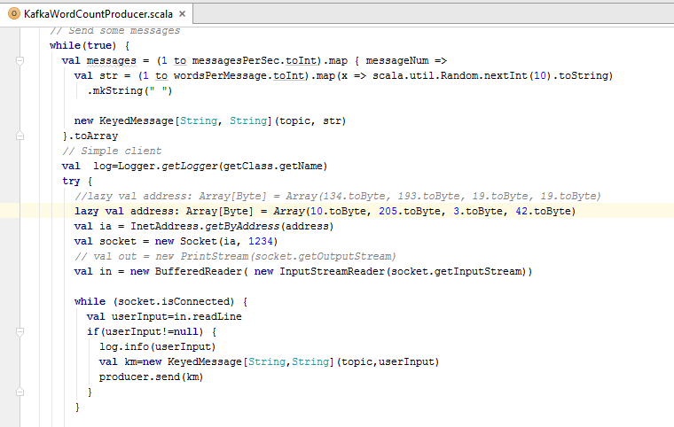
Kafka Producer (Receiving from iOS)

Slide 17
Spark Kafka Consumer to iOS (Results) Similar to what we discussed in Previous Tutorials
def sendCommandToRobot(string: String) { // Simple server try { lazy val address: Array[Byte] = Array(10.toByte, 205.toByte, 3.toByte, 42.toByte) val ia = InetAddress.getByAddress(address) val socket = new Socket(ia, 1234) val out = new PrintStream(socket.getOutputStream) //val in = new DataInputStream(socket.getInputStream()) out.print(string) out.flush() out.close() //in.close() socket.close() } catch { case e: IOException => e.printStackTrace() } }

