Slide 1
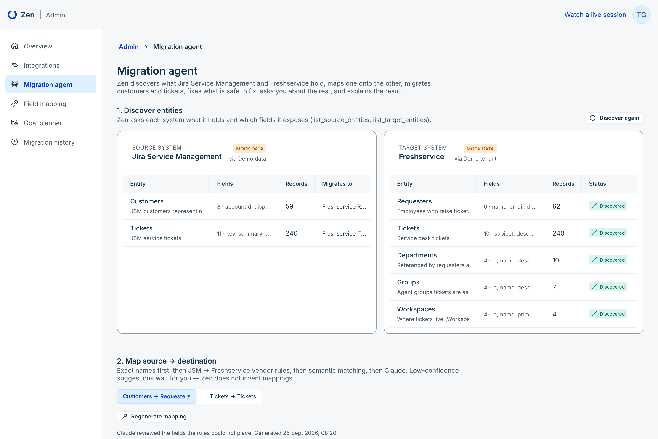
ZEN
ZEN | AUTONOMOUS MIGRATION AGENT
Moving to Freshservice?
Let an agent do the migration.
Zen discovers what Jira Service Management and Freshservice hold, maps one onto the other, migrates customers and tickets, fixes what is safe to fix, asks a human about the rest — and explains the result with Claude.
DISCOVER → MAP → MIGRATE → REVIEW → EXPLAIN
JSM → FRESHSERVICE · CUSTOMERS + TICKETS
Notes:
Zen is an autonomous migration agent. Today: Jira Service Management customers and tickets into Freshservice requesters and tickets. Five steps — discover, map, migrate, review, explain.

Slide 2
THE PROBLEM
ITSM migrations fail in the details, not the big picture
Moving from one service desk to another is mostly careful, repetitive work — and the mistakes surface late.
01
02
03
04
Mapping is manual
Dirty data surfaces late
Retries create duplicates
People do the routine fixes
Every field, every picklist value, every reference (requester, department, workspace) is matched by hand in spreadsheets.
Missing emails, unknown departments, custom priorities and blank summaries only fail when the target API rejects them.
Re-running a half-finished migration creates the same requester or ticket twice unless someone tracks every ID.
Admins spend their time normalising values and re-running batches instead of deciding the few cases that need judgement.
Zen turns this into an agent loop: the machine does the routine work, the human makes the exceptions.
Notes:
Nobody fails a migration because of the architecture diagram. They fail on a department called "Information Technology" that the target calls "IT", on a customer without an email, on a retry that creates a second requester.

Slide 3
WHAT ZEN DOES
One agent, five tools
Each tool is a real backend capability with its own API — the UI and the agent loop call the same endpoints.
1
DISCOVER
2
DISCOVER
3
MAP
4
MIGRATE
5
EXPLAIN
list_source_entities
list_target_entities
generate_mapping
run_migration
generate_migration_insights
Asks JSM which entities exist and which fields they expose.
Asks Freshservice for requesters, tickets, departments, groups, workspaces.
Proposes source → target fields with confidence and transformations.
Plans, pre-checks, migrates, remediates, pauses for review, reconciles.
Claude analyses the finished run and recommends what to fix next.
GET /api/agent/tools describes all five · every response is credential-free
Notes:
Five tools. Two discovery tools, a mapping tool, the migration executor, and Claude insights. They are plain HTTP endpoints, so they can be driven by the UI, a scheduler, or an LLM agent.

Slide 4
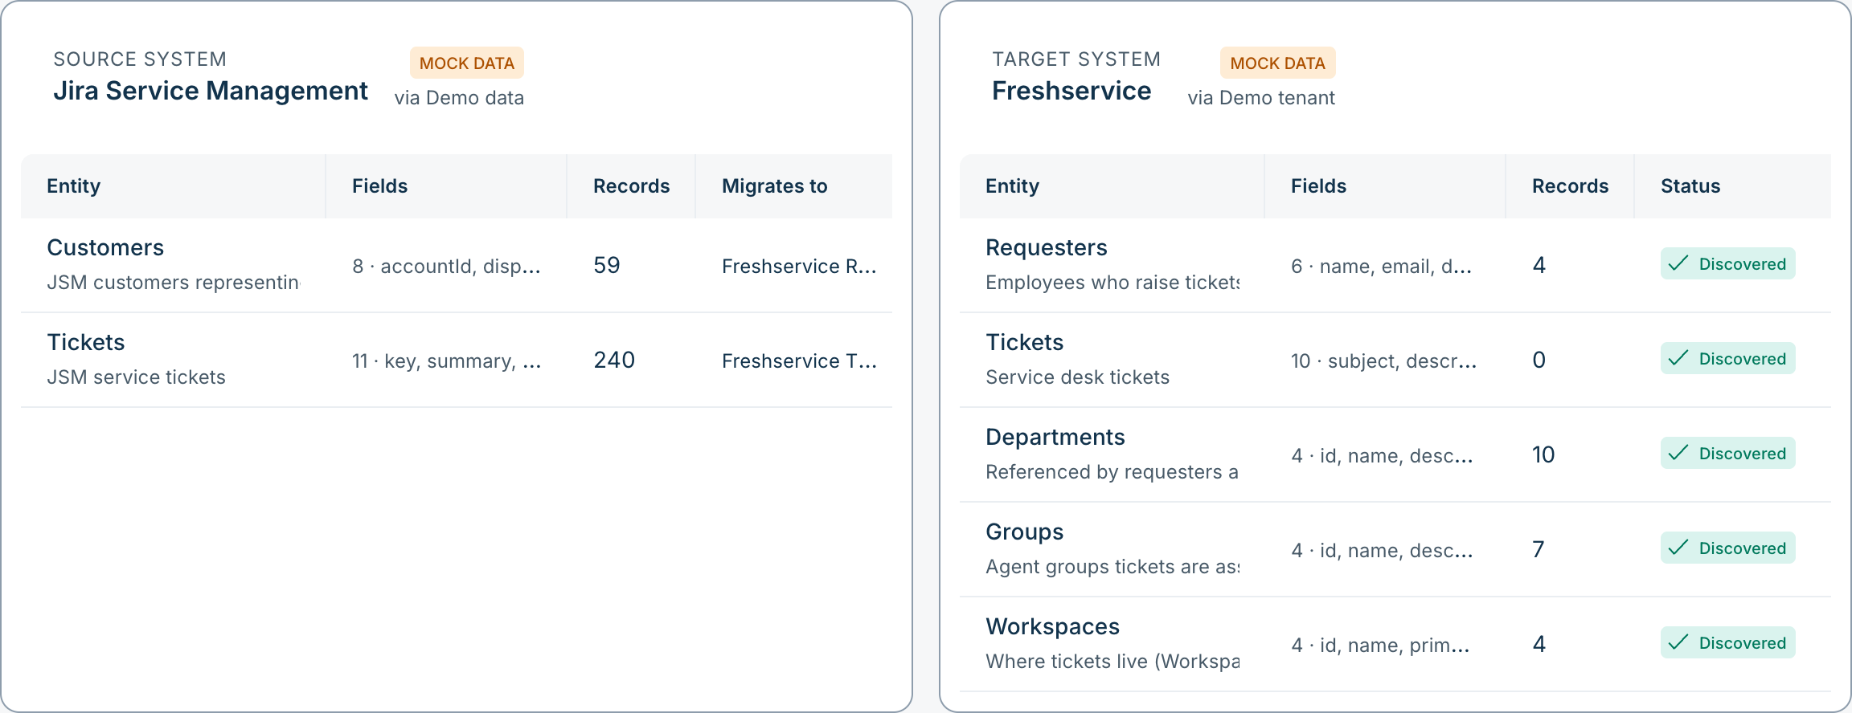
TOOL 1 + 2 · DISCOVER
Zen reads both systems before it moves anything
Every entity shows where its schema came from — and whether the data is real or simulated.
FRESHWORKS INTEGRATION
Freshservice REST API v2 — /api/v2 (requester fields, ticket form fields, departments, groups, workspaces).
Freshservice Product MCP — https://{domain}.freshservice.com/mcp. Tools discovered via tools/list, never assumed; REST is the fallback.
JSM via Jira Cloud REST v3 (fields, JQL search) + the project customer endpoint.
HONEST BY DESIGN
REAL API
MOCK DATA
The UI never passes simulated data off as real. Credentials stay server-side.
Notes:
Discovery is the first thing the agent does. Per the Freshworks hackathon cookbook we support both the Freshservice REST API v2 and the Freshservice Product MCP; MCP tool names are discovered at runtime. In this demo both systems are simulated, and the UI says MOCK DATA.

Slide 5
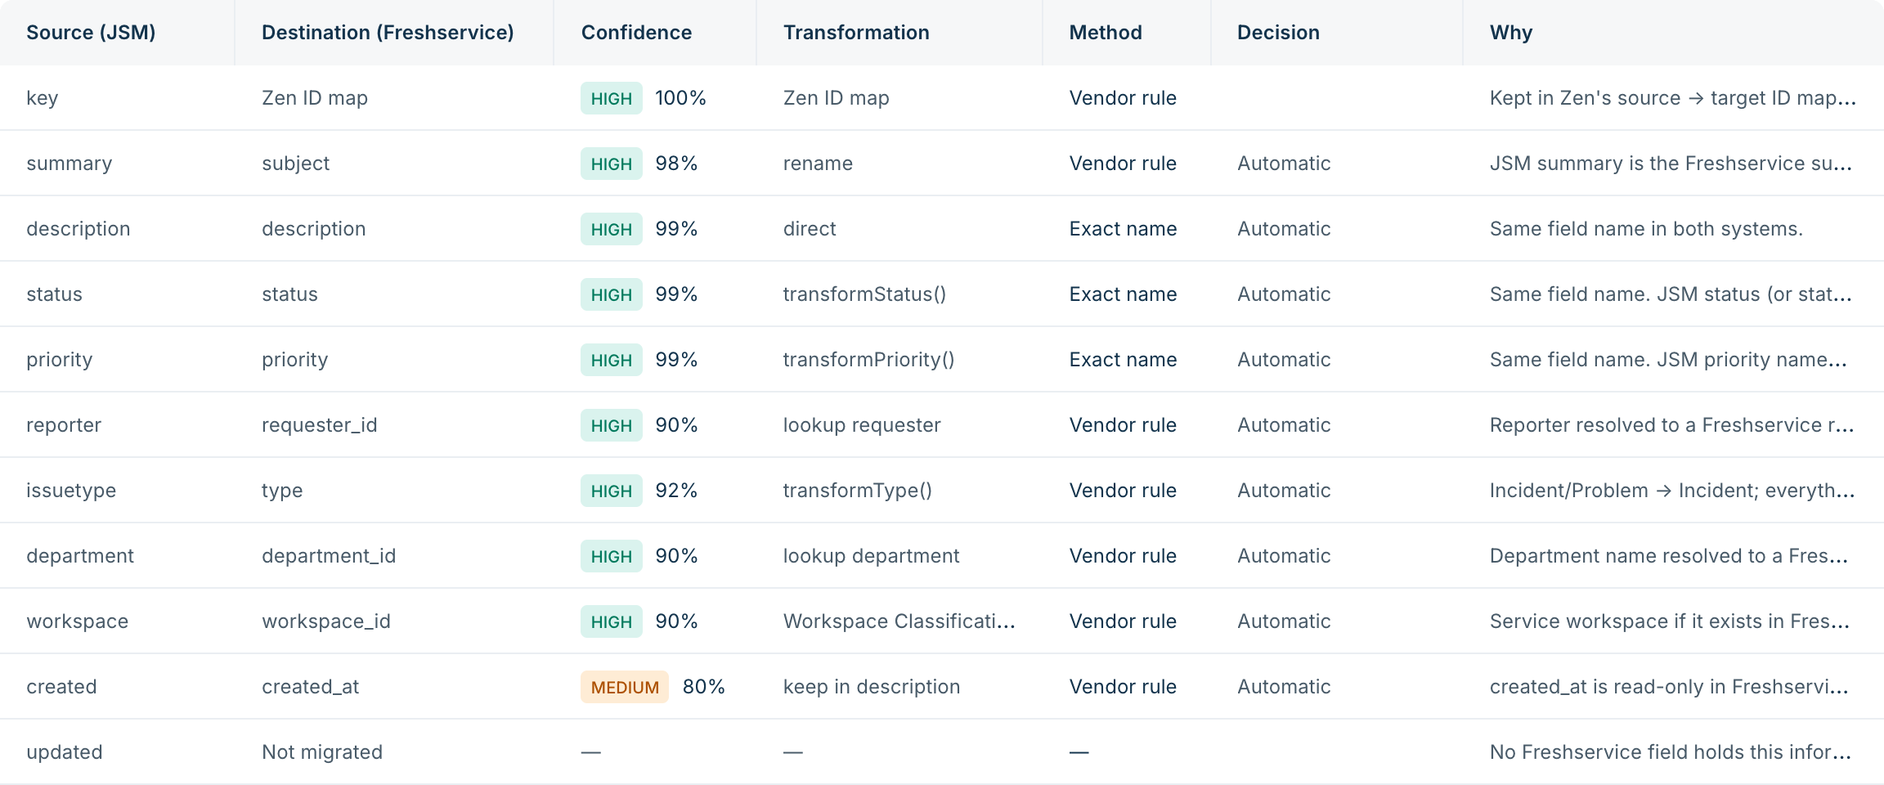
TOOL 3 · MAP
Mappings with confidence, transformations — and no guessing
Rules first, Claude second, a human for anything uncertain.
HOW A FIELD GETS MAPPED
1
Exact name description → description
2
JSM → Freshservice vendor rules summary → subject
3
Semantic match office → location
4
Claude fields the rules cannot place
CONFIDENCE
HIGH ≥ 90%
MEDIUM ≥ 75%
LOW → CONFIRM
Transformations: transformPriority() (Highest → 4 Urgent), transformStatus(), requester and department lookups, Workspace Classification. Unmapped fields stay unmapped.
Notes:
Generate mapping reads both schemas. Exact names, then known JSM-to-Freshservice rules, then semantic similarity, then Claude for the leftovers. Low confidence blocks the run until a human confirms. Freshservice priority is 1 Low to 4 Urgent, so JSM Highest becomes 4.

Slide 6
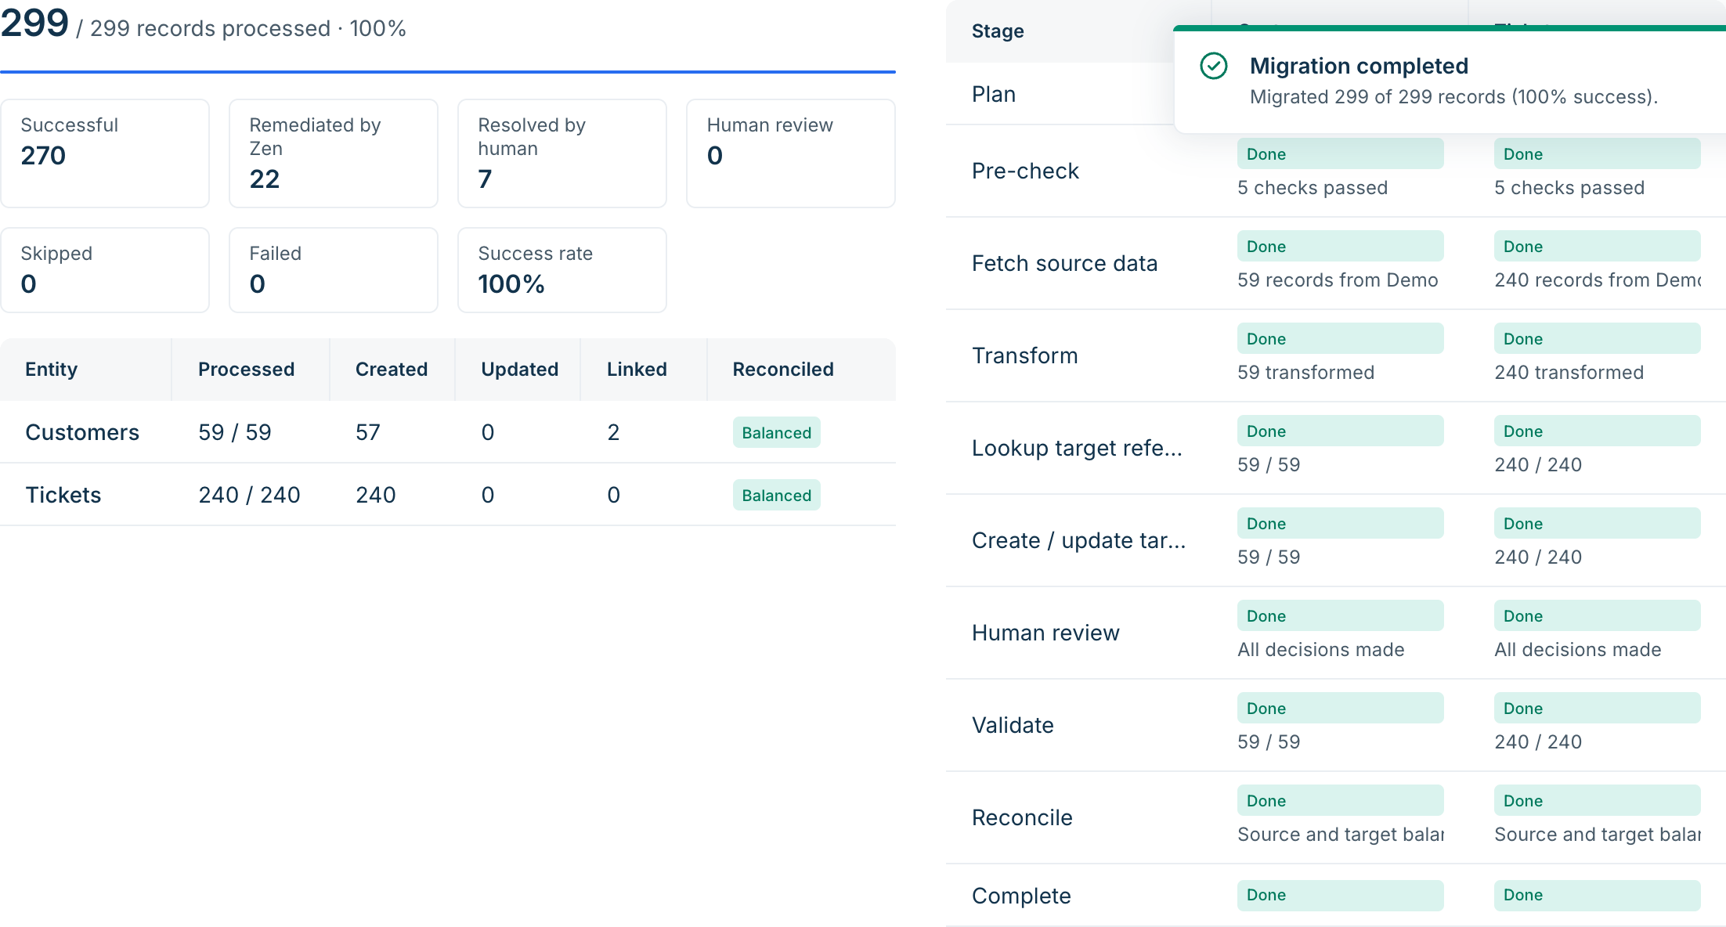
TOOL 4 · RUN MIGRATION
A resumable pipeline, driven by real state
Customers first — tickets reference requesters. Every number on screen comes from the record ledger.
Plan
Pre-check
Fetch
Transform
Look up refs
Create / update
Validate
Reconcile
Complete
Idempotent
Source → target ID stored the moment a record is written. Retries update or link — never duplicate.
Resumable
Each call does one bounded step and persists the run — works on serverless and schedulers.
Verified
Every written record is read back and checked; reconciliation balances source vs target.
Goal-aware
Runs can attach to a Goal Planner goal: its blackout windows and success criteria apply.
Notes:
Run migration follows the pipeline in the prompt: plan, pre-check, fetch, transform, look up references, create or update, validate, reconcile, complete — per entity. It is idempotent: the second run of the demo created zero records and updated all of them.

Slide 7
FAILURE HANDLING
Nine kinds of failure. Captured, typed, never hidden.
From the demo run: what went wrong, and who fixed it.
Failure type | Seen | Fixed by Zen | Human | What Zen does
Invalid department | 10 | 9 | 1 | 'Information Technology' → IT; placeholders like 'Dept-42' go to a human
Missing requester | 4 | 2 | 2 | ID map → search by email → search by name → human
Missing required field | 3 | 2 | 1 | Subject from description; name from email
API failure (5xx) | 3 | 2 | 1 | Retried with backoff; a persistent 500 goes to a human
Invalid priority | 3 | 2 | 1 | 'P1 - Critical' → Urgent; 'Whenever' needs a decision
Duplicate requester | 2 | 2 | 0 | Existing requester linked instead of created
Rate limit (429) | 2 | 2 | 0 | Backed off and retried
Invalid workspace | 2 | 2 | 0 | Re-routed by Workspace Classification
Missing email | 1 | 0 | 1 | Admin enters the email, Zen creates the requester
Totals in the demo: 30 failures across 29 records — 23 fixed automatically, 7 decided by a human, 0 left open.
Notes:
Every failure has a type, a severity and a remediation log: what failed, why, what Zen tried, and whether it worked. A fix only counts once Freshservice accepted the record.

Slide 8
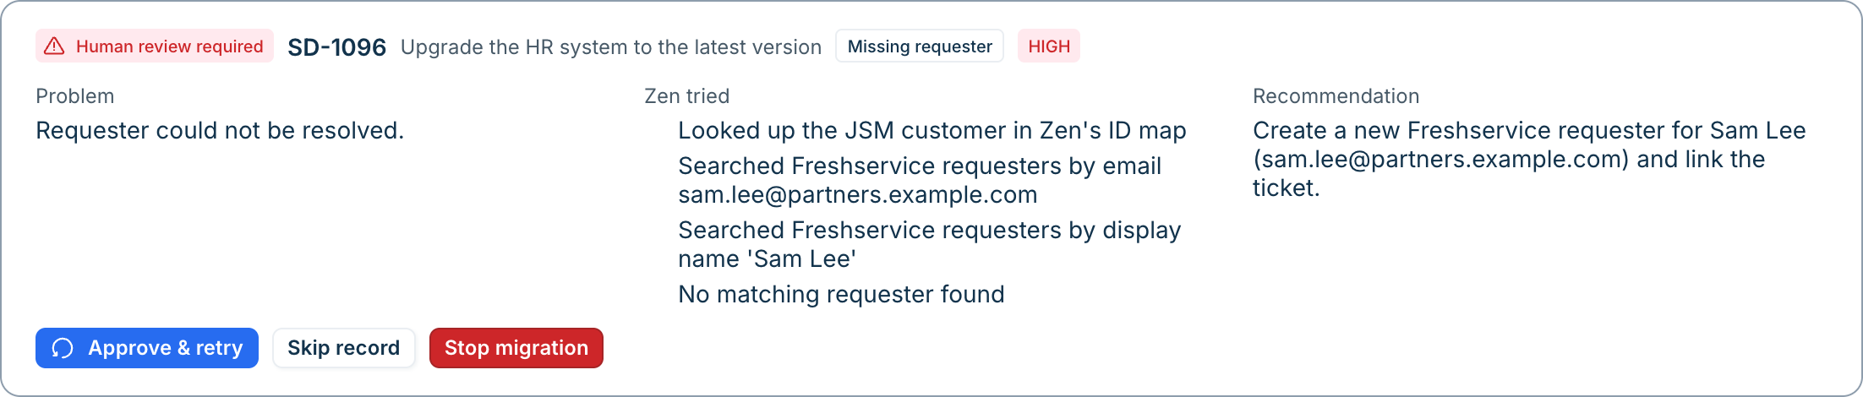
HUMAN IN THE LOOP
AI handles routine work. Humans handle exceptions.
When a safe fix isn’t possible, Zen stops at a review gate and shows its working.
What failed and why
What Zen tried
What to do
The problem in plain language, with the failure type and severity.
Every lookup and fix it attempted — ID map, email search, name search, normalisation.
A recommendation the admin can approve, skip, or stop the migration on.
Notes:
The migration never silently continues past a critical failure. Customers are reviewed before tickets start, because tickets need their requesters. Decisions are remembered, so a re-run does not ask again. A name match alone is never applied automatically — Zen recommends it and a human confirms.

Slide 9
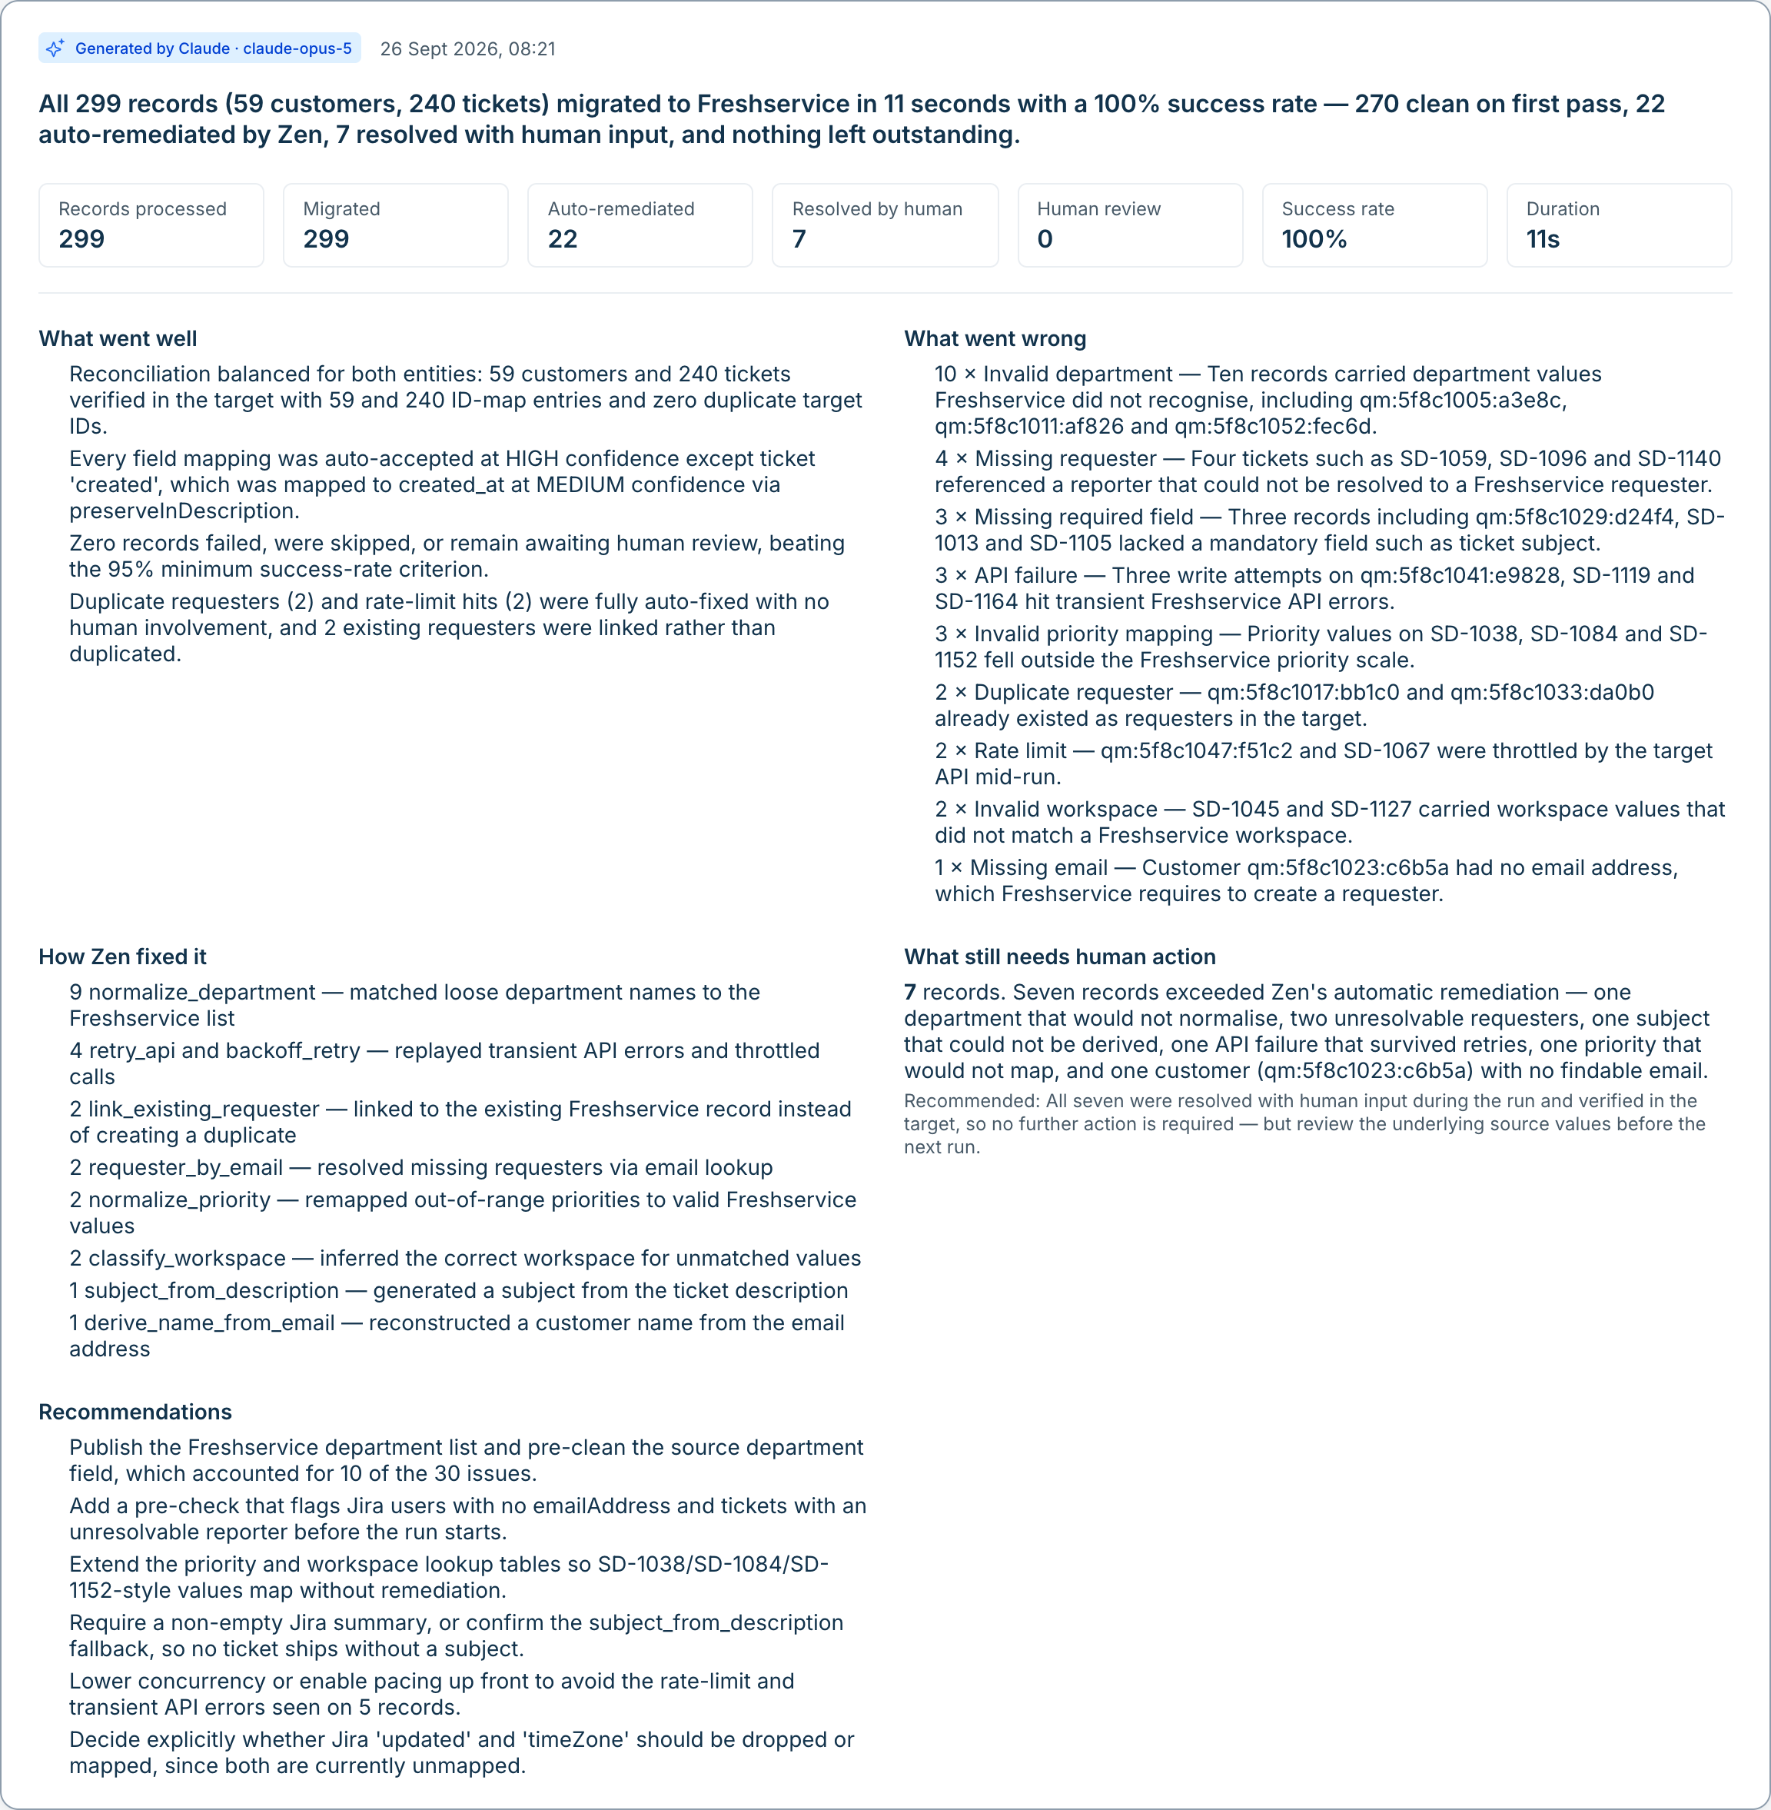
TOOL 5 · CLAUDE INSIGHTS
Claude explains the migration — from facts, not guesses
Zen computes the numbers from the ledger; Claude writes what went well, what went wrong and what to do next.
BUILT FOR TRUST
Structured output (JSON schema) — Summary, went well, went wrong, how Zen fixed it, needs a human, recommendations.
Claude is told to use only the facts it is given; every count comes from Zen.
No credentials, no emails or names in the prompt — record IDs only.
Without Claude, a rule-based summary is shown and labelled as such.
Notes:
Insights use Claude with a JSON-schema response. The facts sent to Claude are counts, failure categories, remediation outcomes, mappings and reconciliation — no credentials and no personal data. In the demo the label reads Generated by Claude.

Slide 10
DEMO RESULTS
One run, end to end — every record accounted for
Simulated JSM + Freshservice tenant with controlled failures built in. Numbers are from the actual run shown in the demo.
299
270
22
7
0
records migrated
clean on the first pass
fixed by Zen
decided by a human
duplicates
59 customers + 240 tickets
no failure at all
accepted by Freshservice
at two review gates
2 existing requesters linked
THEN WE RAN IT AGAIN
0 created · 297 updated · 2 still linked and no questions asked — Zen remembered every human decision.
Reconciliation: customers 59 / 59 · tickets 240 / 240 · every record read back from the target.
Notes:
These are the real numbers from the demo run on the simulated tenant — not projections. The second run proves idempotency: nothing was created twice.

Slide 11
ARCHITECTURE
Vendor-neutral core, pluggable adapters
The engine only sees normalised entities; JSM and Freshservice details live in adapters.
SourceAdapter · JSM
Zen migration engine
TargetAdapter · Freshservice
Jira Cloud REST v3: fields, JQL search
JSM project customers (config)
Demo tenant when not configured
Normalised entities (customer, ticket, requester)
Mapping + transformations
Remediation + human review gate
Idempotent source → target ID map
Validate + reconcile
Product MCP (tools/list) for reads
REST API v2 for writes + fallback
Live writes need an explicit switch
Security
Claude (claude-opus-5)
Runs on
Credentials server-side only (env / secrets)
No PII or keys in Claude prompts
Field mapping for what rules can’t place · department matching · migration insights
Firebase Hosting + Functions v2
React + Freshworks Dew UI
Notes:
SourceAdapter and TargetAdapter isolate the vendors. Adding another source — ServiceNow, Zendesk — means another adapter; the engine does not change.

Slide 12
WHERE IT STANDS
Working today, and what comes next
WORKING AND TESTED
NEXT
All five tools, end to end in the UI and over the API
Customers → Requesters and Tickets → Tickets
Nine failure types with remediation and review
Idempotent re-runs, validation and reconciliation
Claude mapping suggestions and insights (live Claude calls)
78 automated backend tests
Connect a Freshservice sandbox (REST v2) and verify live writes
Turn on Freshservice Product MCP for discovery on a real tenant
Confirm the JSM project-customer endpoint for live customer reads
More entities: attachments, knowledge articles, assets
Run large migrations as scheduled waves from the Goal Planner
Notes:
Be clear with judges: the demo runs on a simulated JSM and Freshservice tenant. The live REST and MCP paths are implemented but have not been exercised against a real tenant yet — that is the next step.

Slide 13
Zen does the migration.
You make the decisions that matter.
Discover → Map → Migrate → Review → Explain
Live demo: /agent
Notes:
Close with the live demo on /agent: discover, generate mappings, run, approve the review items, show insights, then re-run to show zero duplicates.

