Slide 1

ZEN
ZEN | AI-NATIVE ENTERPRISE
Your customer is stuck.
Zen can see why.
An AI onboarding agent that sees the customer’s screen, guides every step, and brings in a human only when it matters.
Zen sees the active screen and points to the next action.
SEE → UNDERSTAND → GUIDE → ESCALATE
AI ONBOARDING FOR B2B SAAS

Slide 2
THE PROBLEM
Onboarding still scales with headcount.
Every new customer adds scheduling, repetition and avoidable delay.
5 days
40×
1 step
Waiting for a slot
The same walkthrough
Silent drop-off
The customer is ready Monday.
The specialist is free Friday.
Your best CSM repeats one
setup call over and over.
One confusing screen and the
customer quietly disappears.
The bottleneck is not knowledge. It is context, timing and availability.

Slide 3
THE INSIGHT
A chatbot answers questions.
Zen sees the work.
It reads the live screen, knows which step the customer is on, and acts on what it sees — not on what it was asked.

Slide 4
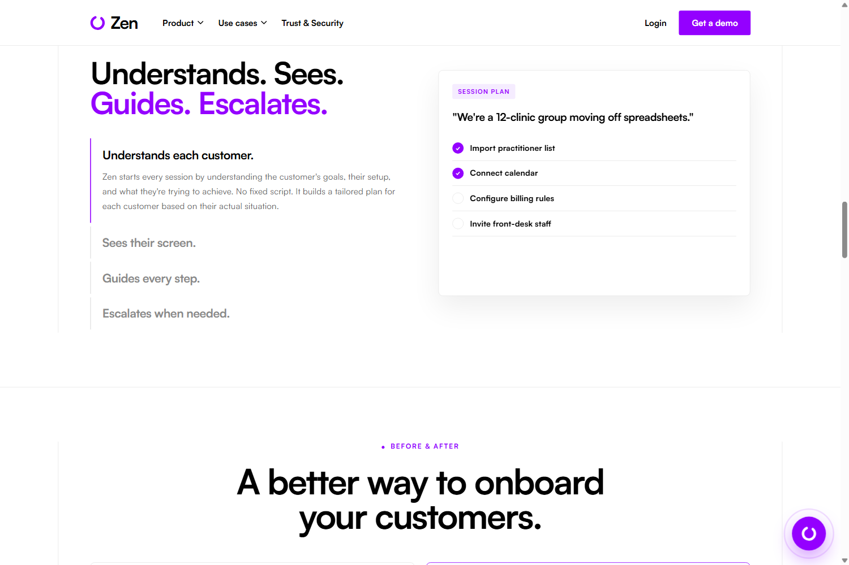
HOW IT WORKS
See. Understand. Guide. Escalate.
One loop that runs on every session, adapted to each customer.
1
See
Reads the live screen and the customer’s actual setup.
2
Understand
Builds a plan around their goal — no fixed script.
3
Guide
Highlights the exact next action and waits.
4
Escalate
Hands to a human with full context attached.

Slide 5
EXAMPLE 01
Zen points. The customer acts.
The instruction appears where the work is happening — not in a help article.
IN THE MOMENT
Customer goal
Connect the accounting system
Zen finds the right integration, spotlights the real button, and waits until it is done.
1
0
clear next step
tabs to search
Context turns documentation into action.

Slide 6

EXAMPLE 02
Zen catches the costly “small” mistake.
Understanding the setup — not just answering the question.
DEFAULT
GST 10%
Wrong for a health provider
ZEN CORRECTS
GST-FREE
Correct for this customer
Prevents rework • Protects trust • Speeds go-live

Slide 7
WHERE WE START
Healthcare operations SaaS.
Begin where setup is complex, regulated and repeated across many sites.
ONE CUSTOMER, ONE TAILORED PLAYBOOK
IDEAL CUSTOMER
1
Import practitioners
Roles, locations, provider IDs
Vertical SaaS serving multi-site clinics.
2
Connect systems
Calendar, accounting, payments
Practice management • Billing
Patient engagement • Workforce
3
Apply clinic policy
Tax rules, permissions, workflows
High configuration, thin CS capacity, costly setup errors.
Train each role
Front desk, clinicians, admins
4
Customization layer → customer policies · role-based flows · approved terminology

Slide 8
INTEGRATION
Embed once. Connect what they already run.
Zen orchestrates across systems — it does not replace the system of record.
YOUR PRODUCT
ZEN ORCHESTRATION
SYSTEMS ALREADY IN PLACE
Session + screen context
IDENTITY
Okta · Entra ID · WorkOS
</>
Web or mobile app
KNOWLEDGE
SharePoint · Confluence · Zendesk
Customer playbook
CUSTOMER
Salesforce · HubSpot · Gainsight
ONE-LINE SDK
Tool calls + policy checks
WORK
Teams · Slack · Jira
or secure session link
Human escalation
DATA
Segment · Snowflake · Power BI
Salesforce opens the session → Zen guides the setup → an unresolved issue becomes a Zendesk ticket with transcript → the outcome lands in Gainsight.

Slide 9
ENTERPRISE READY
A control plane around the agent.
Observable, governable and safe to put in front of customers.
CUSTOMER
ZEN AGENT
KNOWLEDGE
ENTERPRISE
Embedded widget
Goal planner
Product docs
CRM + support
Voice or text
Screen context
Approved answers
Slack / Teams
Screen share
Policy guardrails
Session memory
Analytics + data
CONTROL LAYER
IDENTITY & RBAC
AUDIT TRAIL
DATA BOUNDARIES
HUMAN APPROVAL
EVALUATION
Architecture is the production target. The hackathon submission is a working frontend prototype.

Slide 10

FOR THE BUSINESS
Automate the work. Keep the visibility.
Zen runs the sessions. Customer Success still owns the portfolio.
91%
self-serve rate
2.4 days
to first value
4
human escalations
Illustrative prototype metrics.

Slide 11

ZEN
High-touch onboarding.
Every customer.
No extra headcount.
Let’s see it live.
5 / 5
0
steps completed
human handoffs
Landing page → Guided session → Admin Hub

