Slide 1
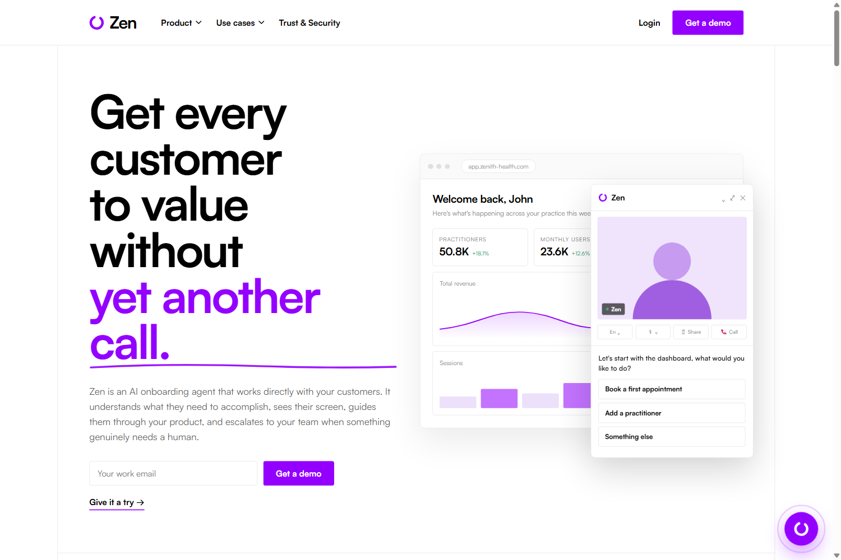
ZEN
Every customer
to value.
Without another call.
AI-guided customer onboarding that understands, sees, guides and escalates.
THE PROMISE
HACKATHON PROTOTYPE
High-touch onboarding at software scale.
Enterprise product vision • 2026

Slide 2
THE ENTERPRISE PROBLEM
Onboarding still scales with headcount.
Every new customer adds coordination, repetition and avoidable delay.
01
02
03
Scheduling drag
Repetitive work
Silent drop-off
Customer is ready Monday.
The next specialist slot is Friday.
Your strongest CSM repeats
the same setup for the 40th time.
One confusing integration step.
Customer leaves and never returns.
5 days
lost momentum
40×
same walkthrough
1 step
can stop activation
THE BOTTLENECK IS NOT KNOWLEDGE. IT IS CONTEXT, TIMING AND AVAILABILITY.

Slide 3
INITIAL MARKET WEDGE
Healthcare operations SaaS.
Start where onboarding is complex, regulated and repeated across many locations.
ONE CUSTOMER, A CUSTOM PLAYBOOK
IDEAL CUSTOMER
01
Import practitioners
Validate roles, locations and provider IDs
Vertical SaaS platforms serving multi-site clinics.
02
Connect systems
Calendar, accounting, payments and messaging
Practice management • Billing • Patient engagement • Workforce operations
03
Apply clinic policy
Tax rules, permissions and approved workflows
WHY THIS WEDGE
04
Train each role
Front desk, clinicians and administrators
High configuration + thin CS capacity + costly setup errors
CUSTOMIZATION LAYER → customer policies + role-based flows + approved terminology

Slide 4
THE ZEN LOOP
An agent that works with the customer.
Not another help-center bot. Zen observes progress and acts in the moment.
1
UNDERSTANDS
2
SEES
3
GUIDES
4
ESCALATES
Goal + setup
Live context
Next best action
Human judgment
“Connect accounting
for 12 clinics.”
Customer is on the
Integrations screen.
Highlights QuickBooks
and waits.
Pricing or edge case,
with context attached.
One session → one customer outcome → one structured learning signal

Slide 5

EXAMPLE 01 — LIVE GUIDANCE
Zen points. The customer acts.
The instruction appears exactly where work is happening—not in another tab.
IN THE MOMENT
Customer goal
Connect the accounting system
Zen identifies the right integration, spotlights the real button and waits for completion.
1
0
clear next step
tab switching
Why it matters
Context turns documentation into action.

Slide 6
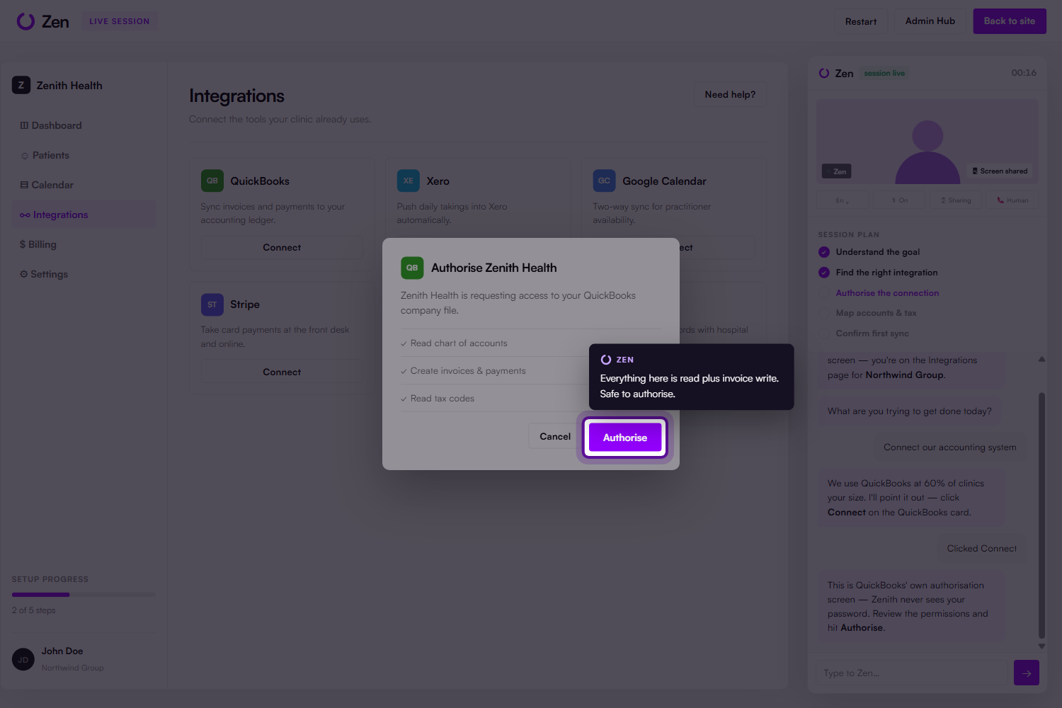
EXAMPLE 02 — CROSS-APP ONBOARDING
Guidance follows the workflow.
Zen stays with the customer through OAuth, permissions and third-party setup.
THE CUSTOMER JOURNEY
1
Discover
Find QuickBooks
2
Authorize
Review permissions
3
Configure
Map accounts
4
Validate
Run first sync
Customer remains in control

Slide 7

EXAMPLE 03 — RISK PREVENTION
Zen catches the costly “small” mistake.
The difference between answering a question and understanding the setup.
WRONG
GST 10%
Generic default
RIGHT
GST-FREE
Health-provider context
PREVENT REWORK • PROTECT TRUST • ACCELERATE GO-LIVE

Slide 8

THE OPERATING MODEL
Automation without losing visibility.
Zen runs the sessions. Customer Success keeps control of the portfolio.
91%
self-serve rate
Illustrative demo metric
2.4 days
time to value
Illustrative demo metric
4
human escalations
Only where judgment matters
PORTFOLIO INTELLIGENCE

Slide 9
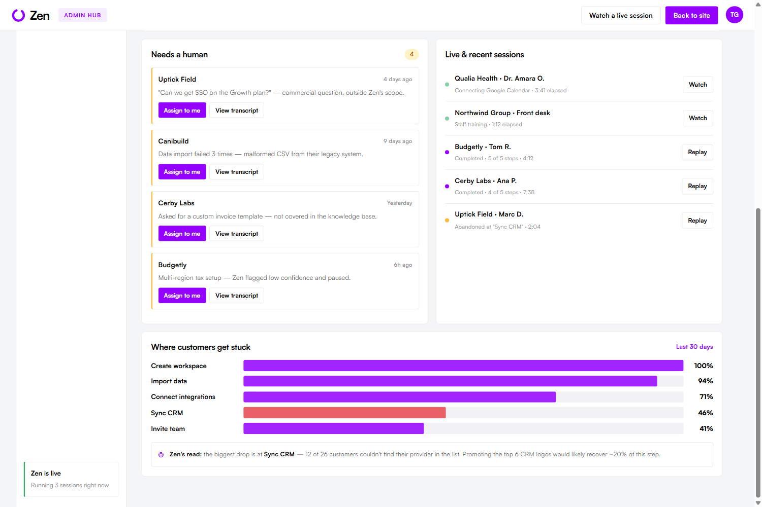
BEYOND TASK COMPLETION
Every session makes the product smarter.
Aggregate friction becomes a prioritised product signal—not another support ticket.
ZEN’S READ
“Users drop at
Sync CRM.”
12 of 26 customers could not find their provider.
RECOMMENDED FIX
Promote the top 6 CRM logos.

Slide 10
FITS THE EXISTING STACK
Embed once. Connect what enterprises already use.
Zen acts as an orchestration layer—not a replacement for systems of record.
YOUR PRODUCT
ZEN ORCHESTRATION
SYSTEMS ALREADY IN PLACE
IDENTITY
Okta • Entra ID • WorkOS
</>
Session + screen context
KNOWLEDGE
SharePoint • Confluence • Zendesk
Web app / mobile app
Customer-specific playbook
CUSTOMER
Salesforce • HubSpot • Gainsight
Tool calls + policy checks
WORK
Teams • Slack • Jira
1-LINE JS SDK
Human escalation
or native SDK / secure session link
DATA
Segment • Snowflake • Power BI
REST + WEBHOOKS + EVENTS
Example: Salesforce opens the session → Zen guides QuickBooks setup → unresolved issue creates a Zendesk ticket with transcript → outcome flows to Gainsight.

Slide 11
DESIGNED FOR ENTERPRISE
A control plane around the agent.
Production architecture: observable, governable and integration-ready.
CUSTOMER
ZEN AGENT
KNOWLEDGE
ENTERPRISE SYSTEMS
Embedded widget
Goal planner
Product docs
CRM + Support
Voice / text
Screen context
Approved answers
Slack / Teams
Screen share
Policy guardrails
Session memory
Analytics + Data
CONTROL LAYER
IDENTITY & RBAC
AUDIT TRAIL
DATA BOUNDARIES
HUMAN APPROVAL
EVALUATION
Architecture is the proposed production target; the submitted hackathon experience is a frontend prototype.

Slide 12
ENTERPRISE VALUE
Turn onboarding from a queue into a system.
Four stakeholder wins from one shared customer journey.
⏱
◎
↗
∞
CUSTOMER
CUSTOMER SUCCESS
PRODUCT
LEADERSHIP
Start now
Focus humans
See friction
Scale coverage
No calendar delay.
Guidance in context.
Escalate judgment.
Automate repetition.
Every struggle becomes
a roadmap signal.
More customers without
linear headcount.
NORTH STAR
Time from signed contract → first customer value

Slide 13
WHAT COMES NEXT
Onboarding is the wedge.
The same context-aware agent can support the full customer lifecycle.
NOW
NEXT
THEN
Onboarding
Adoption
Growth
Setup
Integrations
Training
Feature nudges
Stalled accounts
Role-based enablement
Expansion signals
Renewal readiness
Executive insights
One agent • One journey • A compounding customer intelligence layer

Slide 14

ZEN
High-touch onboarding.
Every customer.
No extra headcount.
Let’s see it live.
5 / 5
steps completed
0
human handoffs
Interactive prototype → Landing page → Guided session → Admin Hub
Prototype metrics shown are illustrative.

