Slide 1
06 | Debugging and Deploying on Azure
Stacey Mulcahy | Technical Evangelist
Rami Sayar | Technical Evangelist

Slide 2
Module Overview
Azure Websites Overview
Introduction to the Azure Dashboard
Deploying to Azure with Visual Studio
Deploying to Azure with Github
Debugging Remote Node Applications with Visual Studio

Slide 3
06 | Azure WebSites Overview
Stacey Mulcahy | Technical Evangelist
Rami Sayar | Technical Evangelist

Slide 4
Azure Websites
Easy to deploy a variety of different web sites : node, python, php, asp.net etc..
Can install some software from the gallery like WordPress or preconfigured stacks ( MEAN stack )
Has a few limitations such as cannot configure ports, compile native modules for Node

Slide 5
Azure Websites
Can configure custom domains
Can add FTP users
Can run multiple web sites
Ideal for a production / staging environment

Slide 6
06 | Introduction to the Azure Dashboard
Stacey Mulcahy | Technical Evangelist
Rami Sayar | Technical Evangelist

Slide 7
Introduction to the Azure Dashboard

Slide 8
06 | Deploying to Azure with Visual Studio
Stacey Mulcahy | Technical Evangelist
Rami Sayar | Technical Evangelist

Slide 9
Deploying to Azure with Visual Studio

Slide 10
06 | Deploying to Azure with Github
Stacey Mulcahy | Technical Evangelist
Rami Sayar | Technical Evangelist

Slide 11
Deploying to Azure with Github

Slide 12
06 | Remote debugging with Visual Studio
Stacey Mulcahy | Technical Evangelist
Rami Sayar | Technical Evangelist

Slide 13
Remote Debugging a node application with Visual Studio and Azure

Slide 14
06 | Configuration Overview
Stacey Mulcahy | Technical Evangelist
Rami Sayar | Technical Evangelist

Slide 15
Setting environment variables and connection strings.

Slide 16
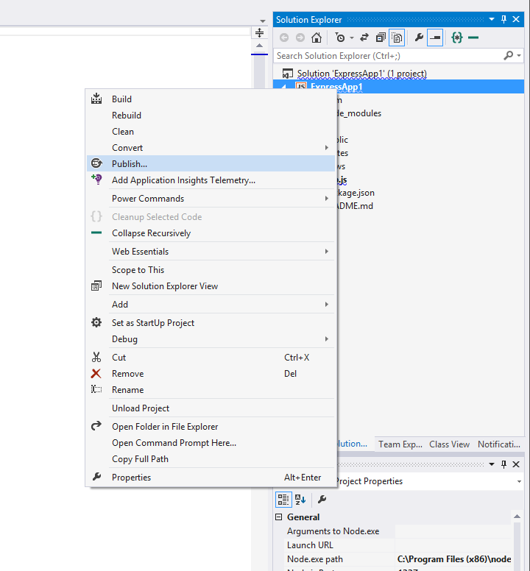
Azure Publishing

Slide 17
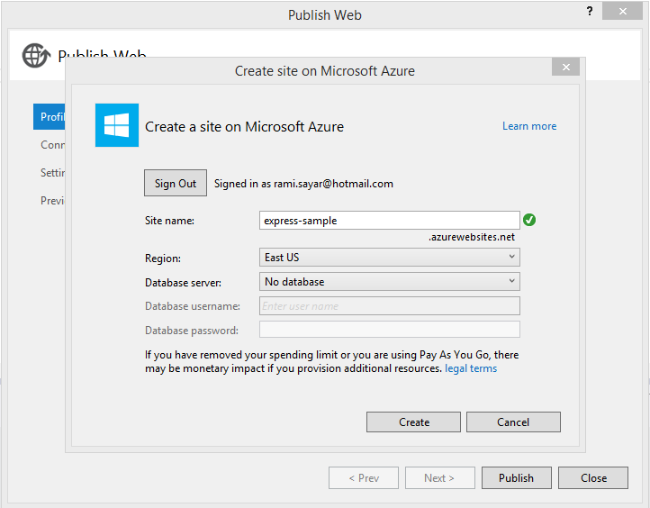
Why use Express?

Slide 18
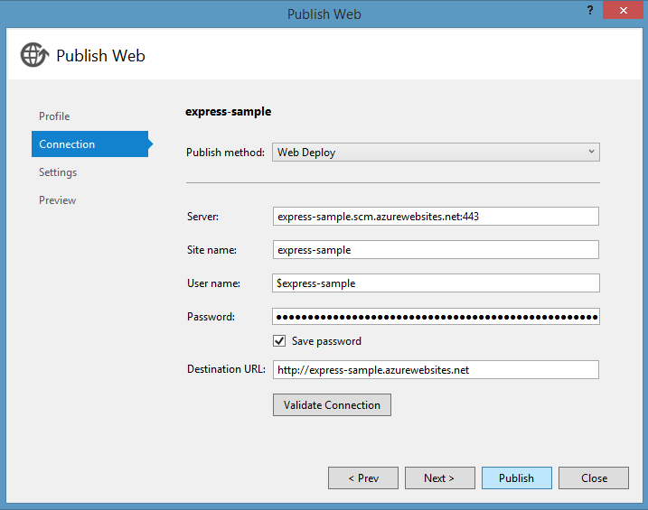
Why use Express?

Slide 19
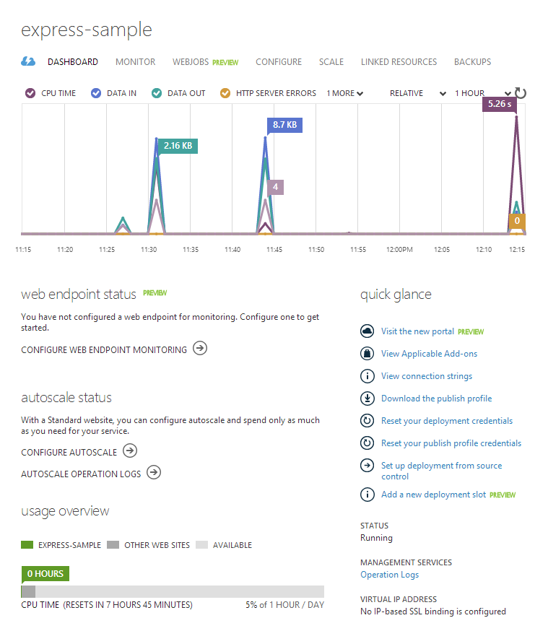
Why use Express?

