Slide 1
PRESENTATION ON ONLINE RAILWAY RESERVATION SYSTEM
PRESENTED BY:
JAGROOP SINGH(1893175)
MOHIT SAINI(1892494)
SIMARDEEP SINGH(1893285)
MAYANK AHUJA(1892643)
GAGANDEEP KAUR(1893548)
JAGDEEP KAUR(1893474

Slide 2
PARTICIPATION
Mohit Saini, Jagroop Singh, Simardeep Singh did prototyping, designing & contents of the project.
Mayank Ahuja, Gagandeep Kaur , Jagdeep Kaur did presentation, Wireframing, UML & use case diagram.

Slide 3
INDEX
INTRODUCTION
FEATURES
COMPETITORS
TARGET AUDIENCE
WORKING OF AN APPLICATION
UML AND USE CASE DIAGRAM

Slide 4
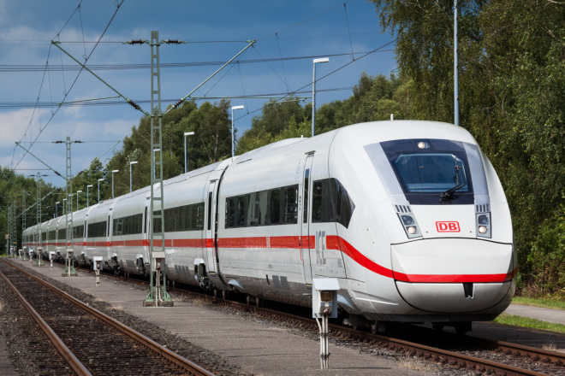
RAILWAY RESERVATION SYSTEM

Slide 5
INTRODUCTION
This system is basically concerned with the reservation of railway tickets to the passengers.
This project aim is to provide user friendly and easy online ticket booking application.
This project is used to develop a mobile application so that passenger can book their tickets online directly from their smart phones.

Slide 6
FEATURES
Searching of data is easy
Passengers don’t have to wait for long time
It is fast process
Time saving
We don’t need internet connection as your tickets stored offline
Secure debit & credit card processing
This application is available free of cost

Slide 7
COMPETITORS
IRCTC: The services of this application is available till 12:00AM but our application is available 24X7.
RAIL YATRI: This application is not able to cover all the shortest destination.
IXIGO:This application does not tell the right price of the train ticket.

Slide 8
TARGET AUDIENCE
People of all age groups travel in railway because it seems like so cheapest from passengers prospective.
This application overcomes the difficulties for people who have very hectic schedule.
It takes the OTP/password from user to confirm the booking.

Slide 9
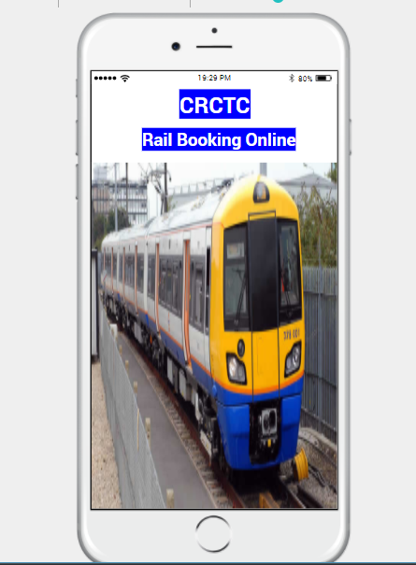
MAIN PAGE

Slide 10
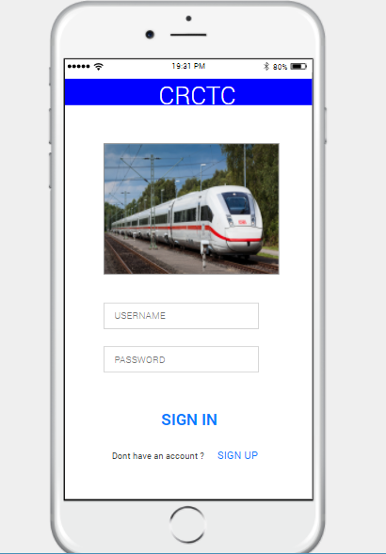
SIGN IN PAGE

Slide 11
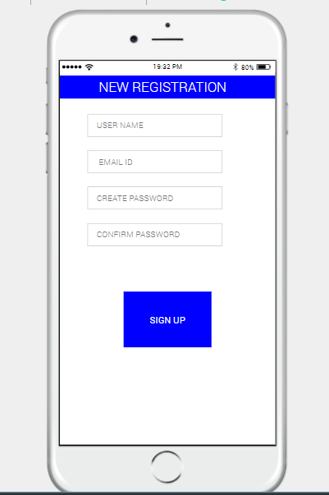
SIGN UP PAGE

Slide 12
SIGN IN PAGE

Slide 13
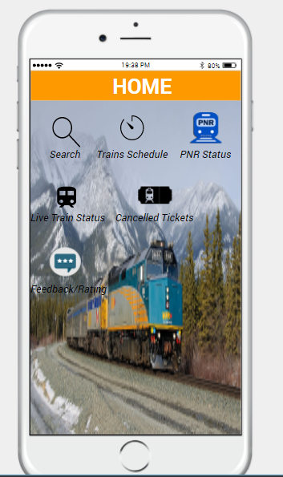
HOME PAGE

Slide 14
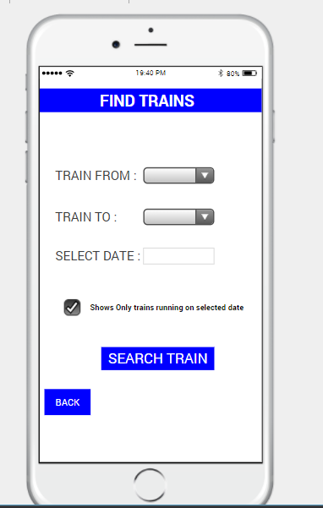
FIND TRAINS

Slide 15
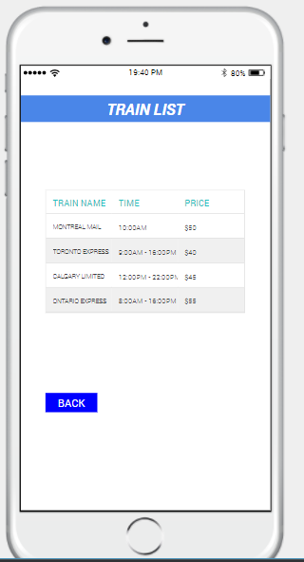
TRAIN LIST

Slide 16
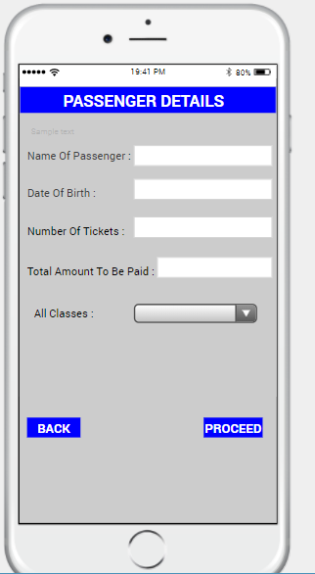
PASSENGER DETAILS

Slide 17
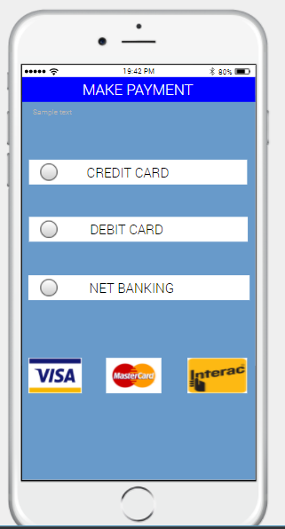
MAKE PAYMENT

Slide 18
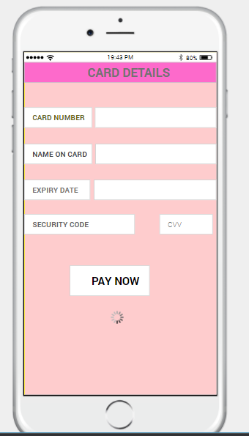
CARD DETAILS

Slide 19
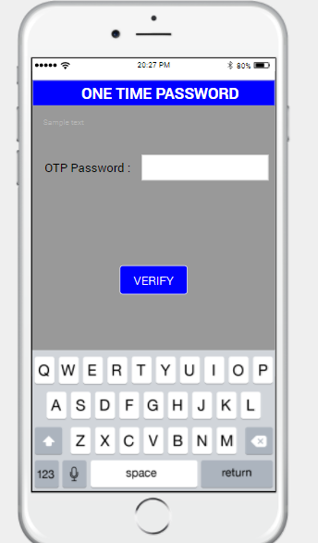
ONE TIME PASSWORD

Slide 20
HOME PAGE

Slide 21
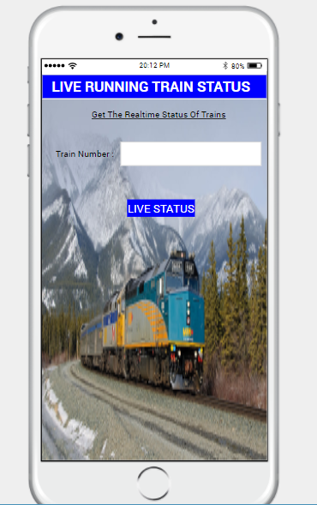
LIVE RUNNING TRAIN STATUS

Slide 22
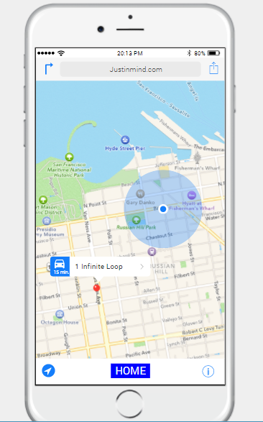
MAP

Slide 23
HOME PAGE

Slide 24
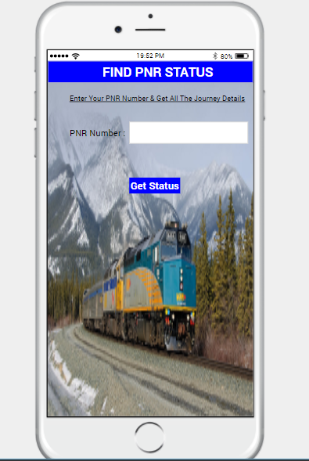
FIND PNR STATUS

Slide 25
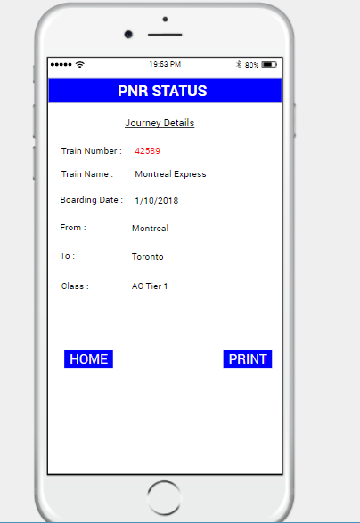
PNR STATUS

Slide 26
HOME PAGE

Slide 27
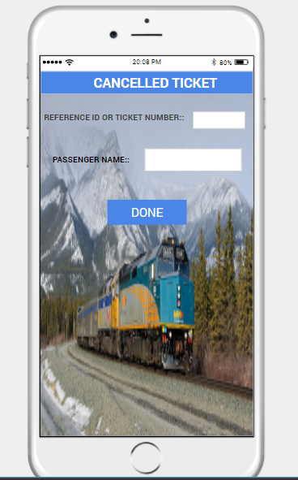
CANCELLED TICKET

Slide 28
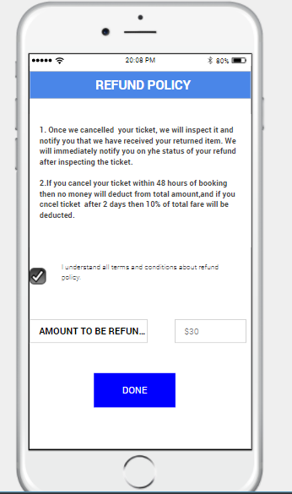
REFUND POLICY

Slide 29
HOME PAGE

Slide 30
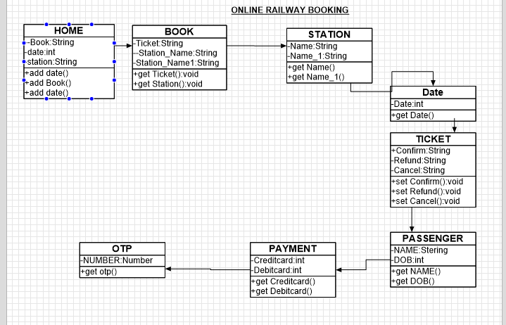
UML DIAGRAM

Slide 31
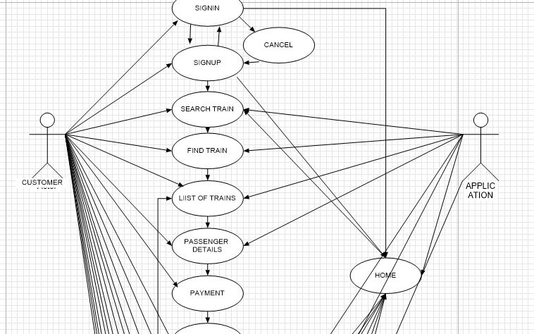
USE-CASE

Slide 32
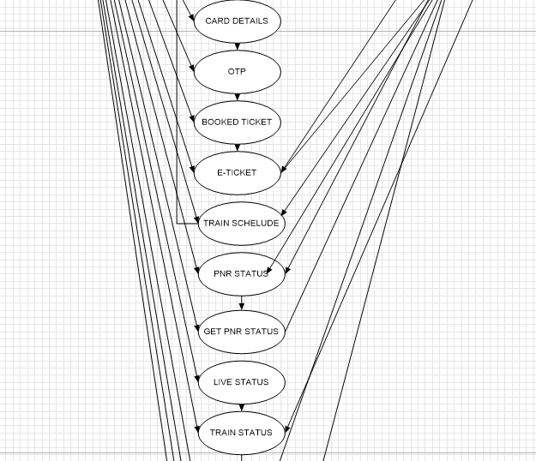

Slide 33
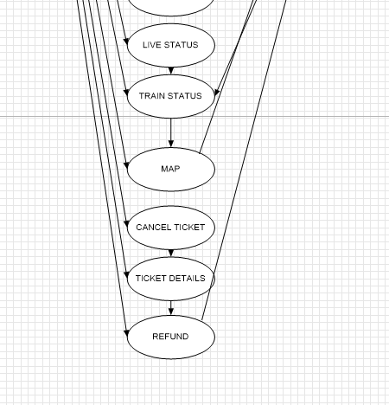

Slide 34
THANK YOU

