Slide 1



MedX- Covid-19 & Lung Disease Detection Portal
Group Members: 1714002 –Mayank Ahuja 1714011 –Deep Chothani 1714012 –Udit Dayani
Group ID: 26
Guide: Prof. Era Johri

Slide 2

PROBLEM DEFINITION
Analyzing blood/swab tests takes time and is costly, it even increases the human contact which further increases the spread of such deadly diseases and moreover to check the spread of the disease further X-ray reports are needed which makes the process protracted.
MedX checks whether the patient is infected from COVID-19 or not, by taking the X-ray reports and analyzing with previous data records with the help of neural networks. Our product will cater different kinds of lung diseases like covid-19, pneumonia, lung cancer and even suggests whether there is hospitalisation required or not based on the spread of disease in the lungs.

Slide 3

LITERATURE REVIEW
COVID-ResNet: A Deep Learning Framework for Screening of COVID19 from Radiographs. Muhammad Farooq1 and Abdul Hafeez2 In this research paper they have used ResNet50 to detect whether the person has covid19 pneumonia or not.[1]
Covid‐19: In this research paper, transfer learning technique is used to train the neural network by using various neural network like VGG19, Inception and Xception.[2]
Predicting COVID-19 Pneumonia Severity on Chest X-ray with Deep Learning, they have used the DenseNet deep learning model to achieve this. They have used Geographic extent and Opacity score as the metrics for accuracy.[3]
COVID-Net:The researchers have calculated the efficiency and sensitivity of a novel neural network which was created by Darwin.ai. This neural net is named covid-net and the dataset which it works on is Covidx.[4]

Slide 4
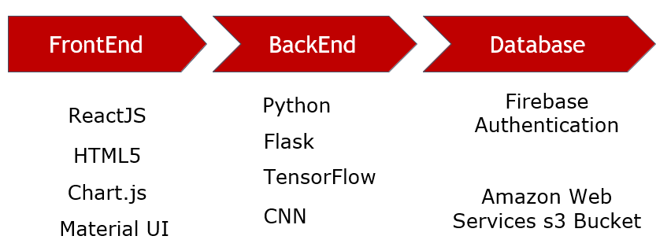
REQUIREMENTS
TECHNOLOGIES USED
Functional Requirements:
1.User-friendly and intuitive interface. 2.Automatic detection of COVID-19
3. Automatic detection of Pneumonia 4. Automatic detection of Lung Cancer
5. Displaying the feedback report for hospitalization, positivity and risk.
6. Dashboard showing statistics for current COVID-19 scenario around the world.
Non-Functional Requirements:
1.Security 2. Robustness 3.Scalability 4. Responsiveness 5. Interactivity

Slide 5
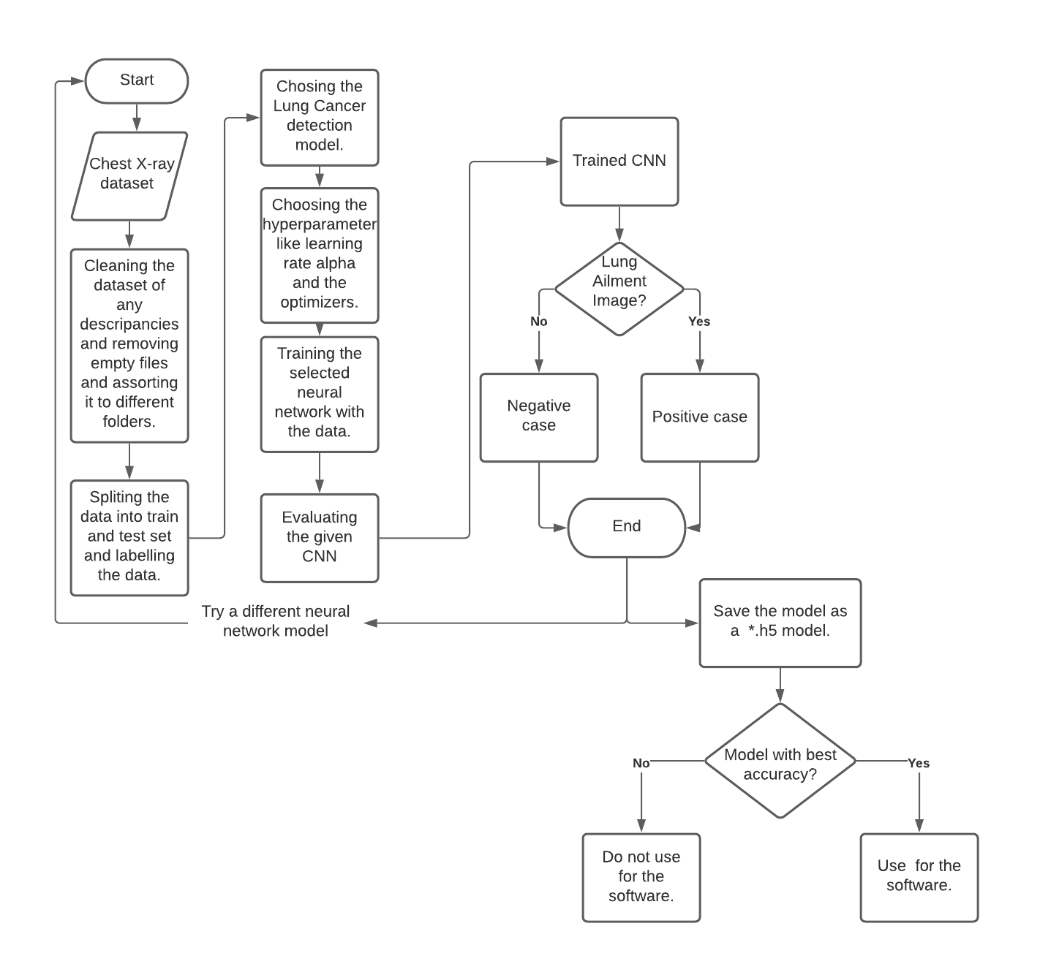
OVERVIEW

Slide 6
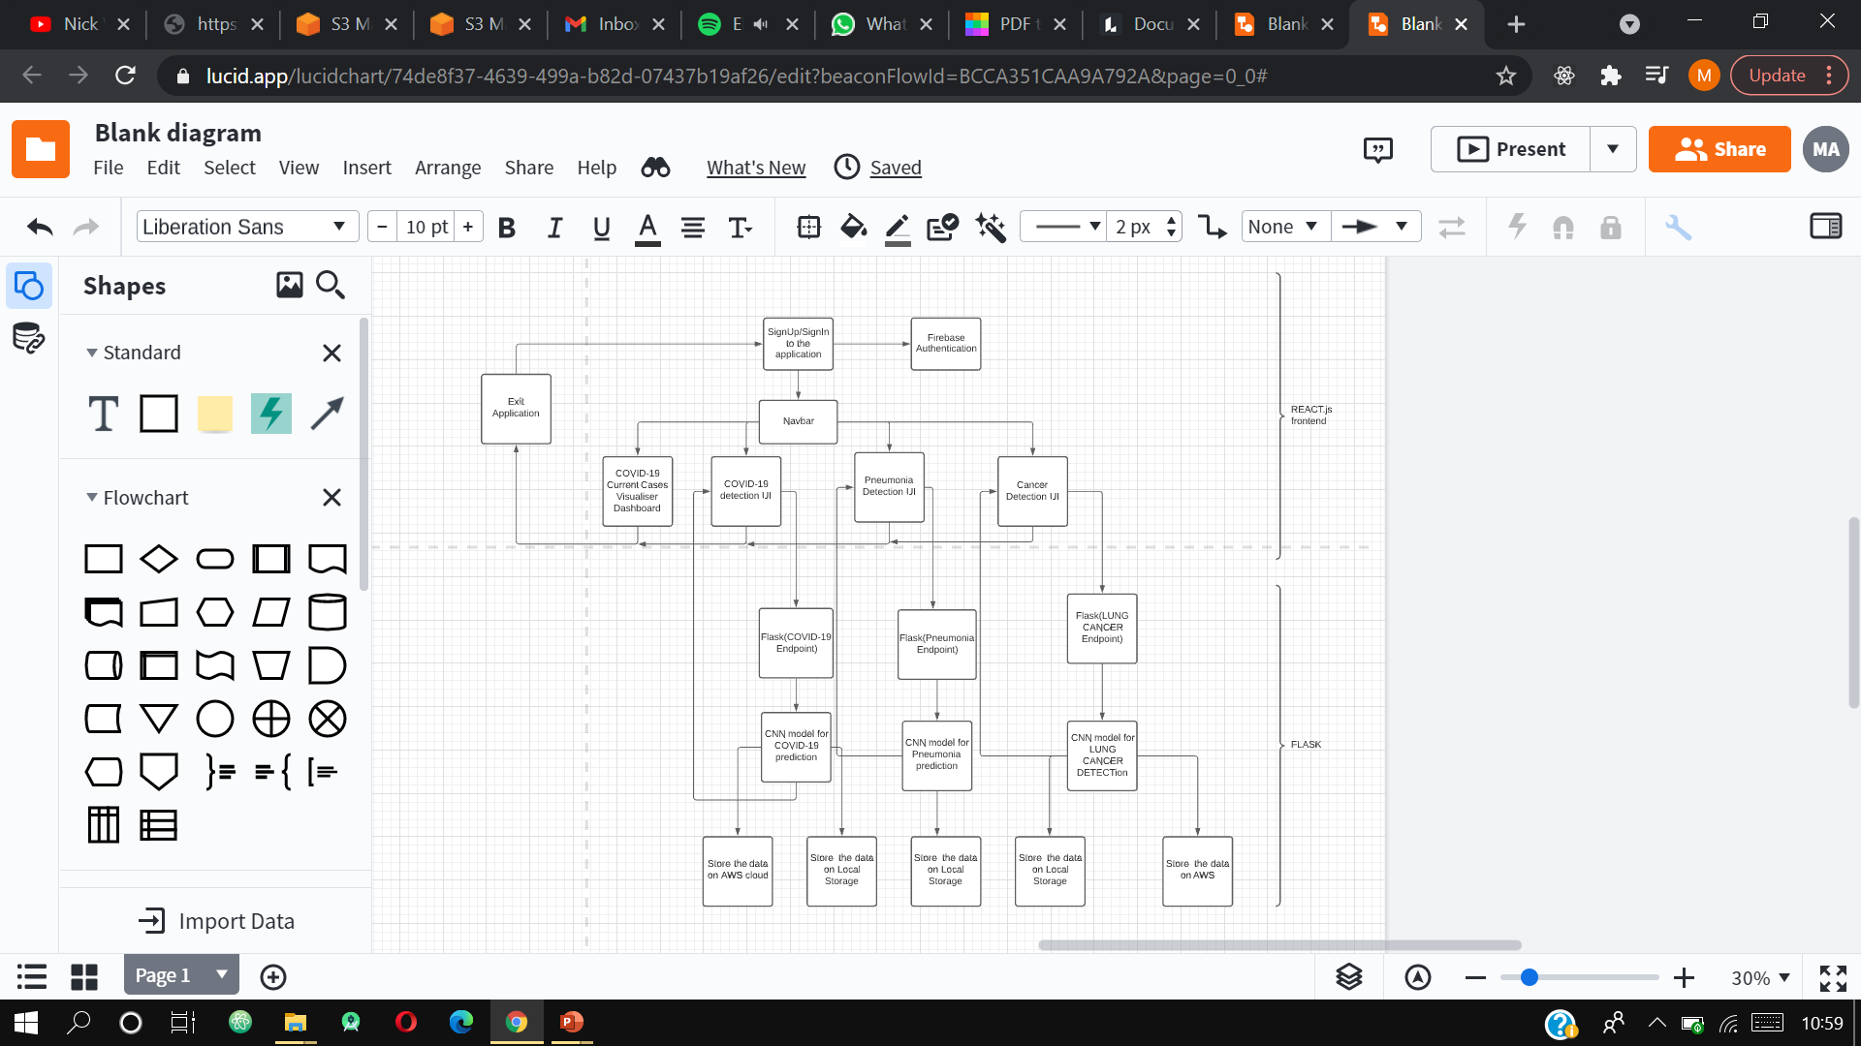
IMPLEMENTATION DETAILS
ReactJS
Frontend
Flask

Slide 7
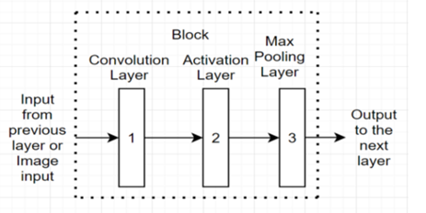
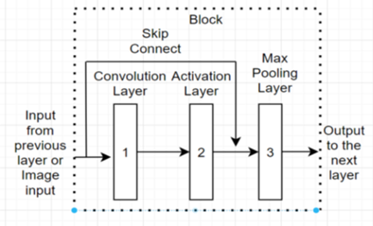


Methodology
Covid-19 & Lung Cancer Methodology:
Architecture of a Block:
A block is defined as a combination of 3 layers; convolution layer, activation layer and max pooling layer. There are (3*3) 64 filters or kernels for the convolution layer. The activation layer is that of the relu activation function and in the case of max pooling layer the pool size for max pooling is of (3*3).
Pneumonia Methodology: We tested VGG16, VGG19 and ResNet-50. In this we found that the test accuracy was 86.22%, 89.92% and 50% respectively. So, VGG-19 was selected as it had a slightly higher accuracy than VGG-16.

Slide 8
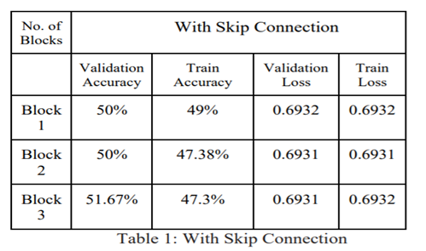
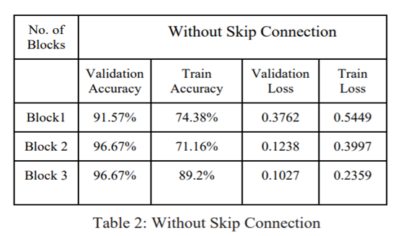
RESULTS & DISCUSSIONS
Covid-19:
Lung Cancer: 3-block without skip connection architecture gives 96.67% accuracy.
Pneumonia: VGG-19 is selected which gives the accuracy of 89.92% which was way better than VGG-16 & ResNet.

Slide 9
DOCUMENTS
Software Project Management Plan
Software Requirement Speciﬁcation
Software Design Document
Software Test Document

Slide 10
DEMO

Slide 11

CONCLUSION
There is a need of e-Pathology labs which reduces cost, time, disease spread, and able to suggest the solution, MedX just fulfils the need and able to detect whether the person is infected from covid-19 / pneumonia / lung-cancer using chest X-ray reports and also suggests whether the medical assistance is required or not with an accuracy of over 90%.
From the data for a shorter architecture of CNN having less number of blocks perform better if there are no skip connections. With skip connection we get a validation accuracy of about 50 percent but without the skip connection we have a validation accuracy of above 90 percent. So, we can conclude that model without the skip connection having 3 blocks has the greatest test and validation accuracy and can be used for the detection of COVID-19.
However a further study can reveal the effect of using batch normalization after each convolution layer and also reveal the influence of transfer learning and the relation between the number of layers and accuracy, to check if the accuracy keeps increasing on adding more layers.

Slide 12


REFERENCES
[1] Muhammad Farooq and Abdul Hafeez et al., “COVID-ResNet: A Deep Learning Framework for Screening of COVID19 from Radiographs” Arxiv, Mar 2020, arXiv:2003.14395
[2] Ioannis D. Apostolopoulos Tzani A Mpesiana et al., “ Covid‐19: automatic detection from X‐ray images utilizing transfer learning with convolutional neural networks.” Springer, April 2020, Springer 635–640 (2020)
[3] Joseph Paul Cohen Lan Dao , Paul Morrison , Karsten Roth , Yoshua Bengio , Beiyi Shen, MD Almas Abbasi, MD Mahsa Hoshmand-Kochi, MD Marzyeh Ghassemi , Haifang Li , Tim Q Duong. et al., “Predicting COVID-19 Pneumonia Severity on Chest X-ray with Deep Learning” NCBI. Jul 2020 arXiv:2005.11856
[4] Linda Wang , Zhong Qiu Lin , and Alexander Wong et al., “COVID-Net: A Tailored Deep Convolutional Neural Network Design for Detection of COVID-19 Cases from Chest X-Ray Images.” NCBI, Nov 2020 arXiv:2003.09871
[5] K. He, X. Zhang, S. Ren and J. Sun, "Deep Residual Learning for Image Recognition," 2016 IEEE Conference on Computer Vision and Pattern Recognition (CVPR), Las Vegas, NV, 2016, pp. 770-778, doi: 10.1109/CVPR.2016.90.
[6] M.S. Al-Tarawneh, “Lung cancer detection using image processing techniques,” Leonardo Electronic Journal of Practices and Technologies, vol. 20, pp. 147– 58, May 2012
[7] Joseph Paul Cohen, Paul Morrison, Lan Dao, Karsten Roth, Tim Q Duong Marzyeh Ghassemi et al. “COVID-19 Image Data Collection: Prospective Predictions are the Future.” Arxiv, Jun 2020, arXiv:2006.1198

Slide 13
REFERENCES
[8] Abiyev R. H., Ma’aitah M. K. S., Deep Convolutional Neural Networks for Chest Diseases Detection, Journal of Healthcare Engineering, 2018.
[9] Maria de la Iglesia Vayá, Jose Manuel Saborit, Joaquim Angel Montell, Antonio Pertusa, Aurelia Bustos, Miguel Cazorla, Joaquin Galant, Xavier Barber, Domingo Orozco-Beltrán, Francisco García-García, Marisa Caparrós, Germán González, Jose María Salinas et al. “BIMCV COVID-19+: a large annotated dataset of RX and CT images from COVID-19 patients.” Arxiv, Jun 2020 arXiv:2006.01174
[10] Joseph Paul Cohen, Paul Morrison, Lan Dao, Karsten Roth, Tim Q Duong Marzyeh Ghassemi et al. “COVID-19 Image Data Collection: Prospective Predictions are the Future.” Arxiv, Jun 2020, arXiv:2006.1198
[11] Ramprasaath R. Selvaraju, Michael Cogswell, Abhishek Das, Ramakrishna Vedantam, Devi Parikh, Dhruv Batra et al. “Grad-CAM: Visual Explanations from Deep Networks via Gradient-based Localization.” Arxiv,Oct 2016, arXiv:1610.02391t

Slide 14


THANK YOU
Any Doubts
Or Queries?

