Slide 2
Problem Statement
Stock market has been a popular topic of research in recent past.
Researchers have been using a variety of techniques including basic machine learning and neural networks.
What we are interested in, is how can we predict stock prices using sentiment analysis of twitter data.
Many researches have shown that twitter data have been very influential now-a-days for various predictions.
We are not only interested in whether stock price will go up or down, but we are interested in predicting actual future values.

Slide 3
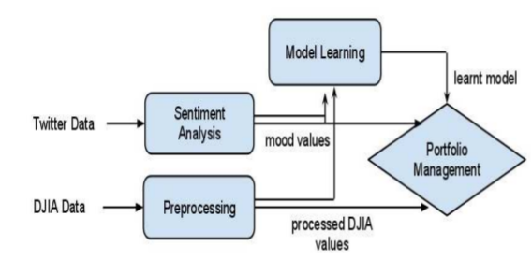
RELATED WORK
POMS (Profile of Mood States)
POMS is an established psychometric questionnaire which asks a person to share his or her current mood by answering 65 different questions.
POMS moods- Tension, Depression, Anger, Vigour, Fatigue and Confusion.
In order to do automate this analysis for tweets, the word list needs to be appropriately extended.
They followed very simpler approach of extending the list by considering all commonly occurring synonyms of the base 65 words using SentiWordNet and a standard Thesaurus.
Their technique
Anshul Mittal and Arpit Goel. Stock prediction using twitter sentiment analysis. Standford University, CS229 (2011 http://cs229. stanford. edu/proj2011/GoelMittalStockMarketPredictionUsingTwitterSentimentAnalysis. pdf ), 15, 2012.

Slide 4

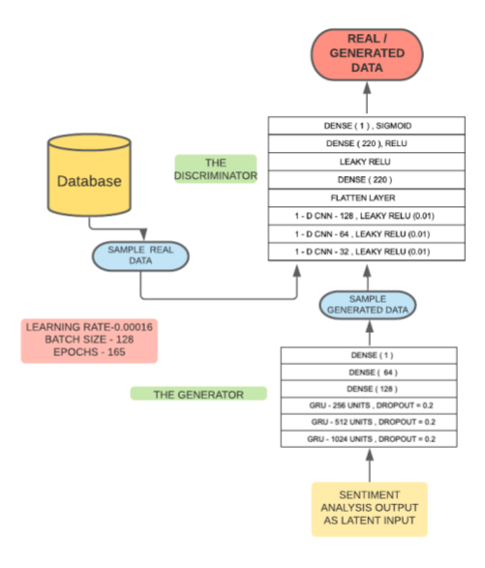
GAN(Generative Adversarial Network)
Generative Adversarial Network is deep learning model designed by Ian Goodfellow in 2014.
A machine learning (ML) model in which two neural networks compete with each other to become more accurate in their predictions.
Most GAN inputs random noise to generator, in their model they replaced noise vector with the outputs of the sentiment analysis for early convergence.
After classification of the data the discriminator calculates the loss between the two distributions - real and generated and back propagates to the generator as a signal to update its weights and create a better distribution which is similar to the real one.
Priyank Sonkiya, Vikas Bajpai, and Anukriti Bansal. Stock price prediction using bert and gan. arXiv preprint arXiv:2107.09055, 2021.
Ian Goodfellow, Jean Pouget-Abadie, Mehdi Mirza, Bing Xu, David Warde-Farley, Sherjil Ozair, Aaron Courville, and Yoshua Bengio. Generative adversarial nets. Advances in neural information processing systems, 27, 2014.

Slide 5
Building Our Dataset
Twitter Data
Stock Data
Last day Open and close prices
We got last day opening and closing price from YAHOO! Finance.
Twitter data for that day
Getting twitter data was a tough task as twitter API limit 3200.
Tried building programs but API blocks IP address.
Found a library snscrape, with which we could get unlimited twitter data.
Snscrape https://github.com/JustAnotherArchivist/snscrape

Slide 6
Analyzing Twitter Data
Collecting data from company's official accounts.
On analyzing we found data most of tweets were not related to stock market.
Collecting data from CEO/CTO official accounts.
On analysing we found the same, data is not related to stock market.
for example : “Happy Thanksgiving” was resulting as positive sentiment.
Solution we found was getting data based on ticker search.
for example : AMZN, MSFT
One strange behaviour that we found was we were never able to get tweets for TSLA
our IP’s got blocked every time we tried.

Slide 7
Text Preprocessing
Removing stop words for libraries which do lexicon-based sentiment analysis eg: VADER.
Removing jargon text such as links, emoticons, hashtags.
Replacing contraction words with normal words.
Grouping all tweets day into single row.
Then merging two dataset on date column.

Slide 8


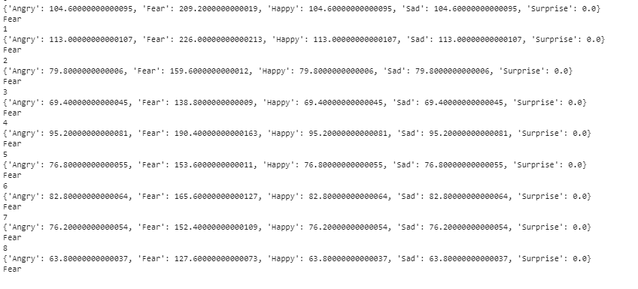


Sentiment Analysis
POMS
VADER
FLAIR
GPOMS algorithm to classify sentiments into angry, fear, happy, sad and surprise
NTLK and classify sentiments as positive,
negative and neutral.
FLAIR is an open-source library which inside uses BERT model to classify sentiment.
https://github.com/flairNLP/flair

Slide 9
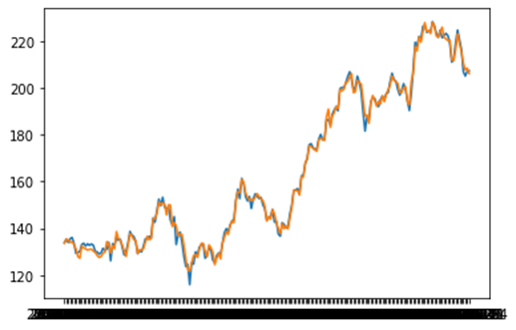
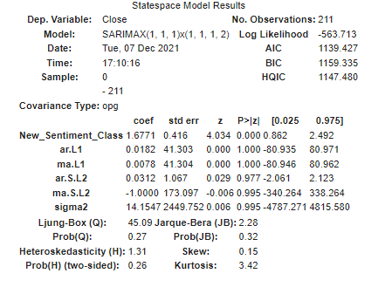
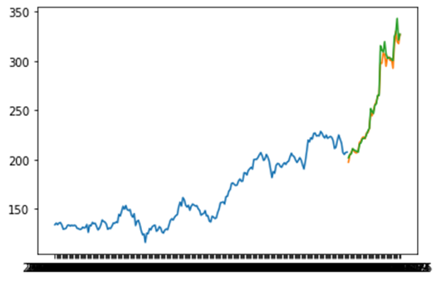
ARIMAX/AUTO-ARIMA
We shifted closing price of todays to yesterdays, to apply ARIMAX.
Training Graph
Testing Graph

Slide 10
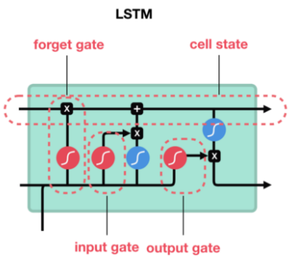
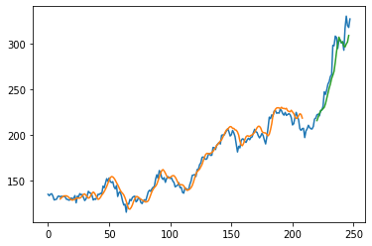


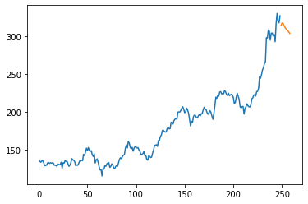
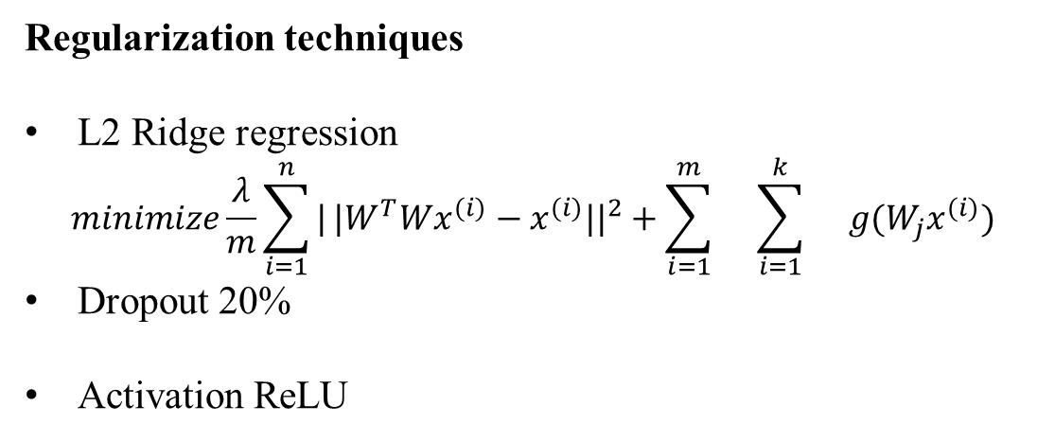
LSTM(Long short-term memory)
Solves vanishing gradient problem.
Internally LSTM have three gates Forget, Input and Output.
Original value
Training value
Stock Price
Testing value
Days
Regularization techniques
L2 Ridge regression
$$minimize\frac{λ}{m}\sum_{i=1}^{n}{|}|W^{T}Wx^{(i)}−x^{(i)}||^{2}+\sum_{i=1}^{m}{}\sum_{i=1}^{k}{}g(W_{j}x^{(i)})$$
Dropout 20%
Activation ReLU
Image credits : https://towardsdatascience.com/illustrated-guide-to-lstms-and-gru-s-a-step-by-step-explanation-44e9eb85bf21

Slide 11
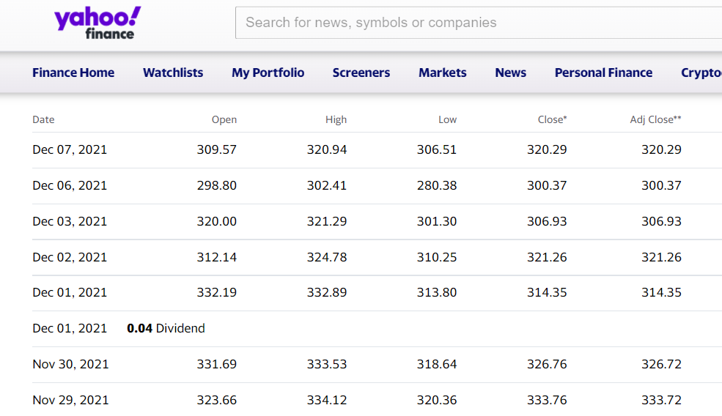
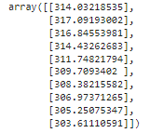
Original Prices vs Our predictions for NVDA

Slide 12
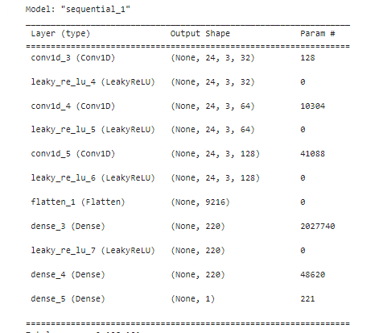
Where are we now?
Most of the implementation of GAN are done for images so far.
We had to do a lot of research how GAN performs and how can we incorporate on text data.
We are working on the model building of generator as we had to do make GAN model from scratch.
Hardware limits.
Discriminator

Slide 13
Q&A

