Slide 1
COVID’19
MAYANK ASNANI 9918103161
LARAIB KHAN 9918103240

Slide 2
PROBLEM STATEMENT
1) We developed and externally validated a predictive model and clinical tool that can be used to prognosticate the likelihood of COVID-19 critical disease based on data available early in a patient’s presentation.
For the derivation cohort, a total of 3,208 COVID-19 tests were conducted over the study period, of which 9.3% (299/3208) were positive. Clinical data including past medical history and presenting laboratory values were available for 29.1% (87/299) patients (median age, 48 years [range, 21-88 years]; 64.4% [56/87] male).
Interestingly, variables which have previously been reported to be associated with worse COVID-19 disease, most notably include people of older age and with hypertension.
2) People are overconfident and taking corona virus lightly.

Slide 3
STATE OF ART AND LIMITATIONS
The rapid spread of coronavirus disease 2019 (COVID-19) revealed significant constraints in critical care capacity. In anticipation of subsequent waves, reliable prediction of disease severity is essential for critical care capacity management and may enable earlier targeted interventions to improve patient outcomes. The purpose of this project is to develop and externally validate a prognostic website for predicting COVID-19 critical disease at presentation to medical care.

Slide 4
LIMITATIONS
This study has limitations. A limited small sample of patient data was reviewed retrospectively from two centers. As data was obtained retrospectively, there was no control over which laboratory data was collected, which varied with institutional practice patterns. However, the model performed well in a validation data set with incomplete laboratory values. Further testing on larger cohorts of patient data is needed. Conclusions may not be globally generalizable to different patient cohorts.

Slide 5
OBJECTIVES AND WORK DISTRIBUTION
To create patient and doctor tables and link them (Mayank)
To create covid forms to store patients details(Mayank)
To create Symptoms form to store Symptoms in a person.(Mayank)
To predict corona virus using machine learning(Mayank)
To create a website and link everything.(Laraib)

Slide 6
Proposed Design And Implemenation
In this study, we developed and externally validated a predictive model and clinical tool that can be used to prognosticate the likelihood of COVID-19 critical disease based on data available early in a patient’s presentation. By using collecting data from different countries and plotting graphs from separate institutions with different underlying patient characteristics, we achieved high calibration and discrimination. This model has the potential to be utilized by front-line healthcare providers to predict critical care demand and provide early indications of likelihood a patient’s condition may worsen. As therapeutic interventions become validated, this may enable early intervention in at-risk patients to improve outcomes.

Slide 7
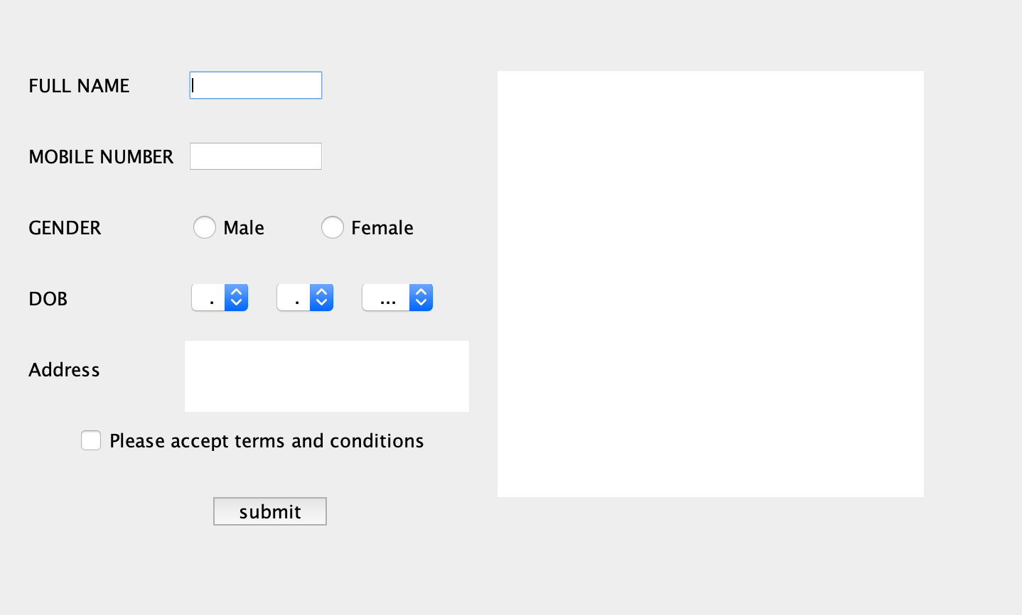
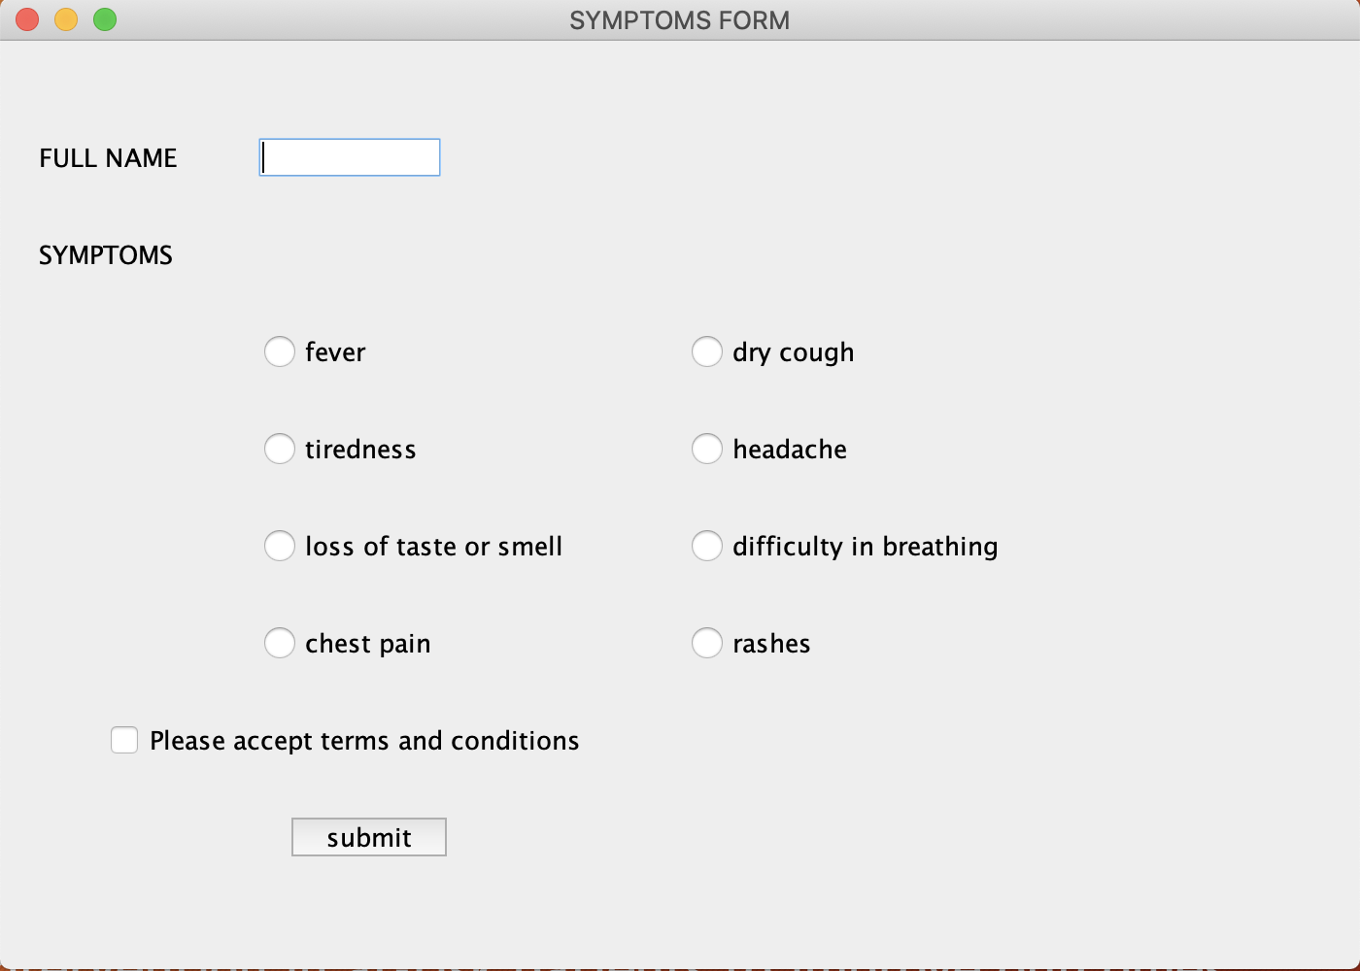
Fig1. patients form
Fig2. symptoms form

Slide 8
Interestingly, variables which have previously been reported to be associated with worse COVID-19 disease, most notably including older age and hypertension, were less predictive in our sample than body mass index, total number of comorbidities and several laboratory values. The tool performed well in the validation set even though there was a higher rate of missing data for some values , which were not frequently performed at the validation institution.
Front-line medical providers have been inundated with critically ill COVID-19 patients. A simple web-based tool utilized at patient presentation may facilitate decision making by simplifying integration of numerous clinical variables. Our model has a high negative predictive value, which can increase physician confidence in determining which patients may be discharged safely at presentation.

Slide 9
This is of particular utility in settings of high healthcare utilization, especially when physicians are treating higher than expected numbers of patients and/or working outside of their standard practice. Our model has high positive predictive value, highlighting those patients for whom admission and close clinical monitoring may be appropriate.

Slide 10
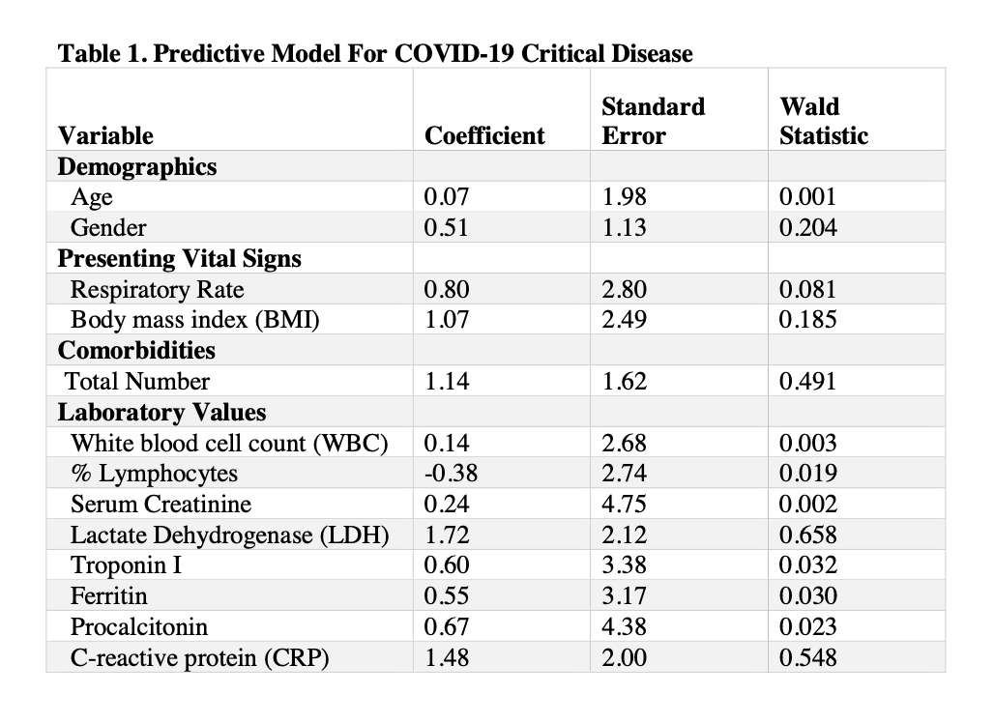
RESULTS AND ANALYSIS

Slide 11
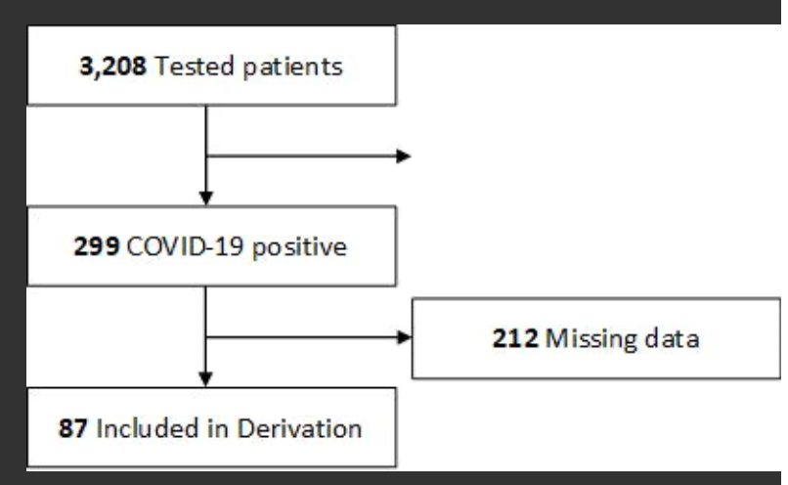
Flow Diagram of the Derivation Cohort

Slide 12
For the derivation cohort, a total of 3,208 COVID-19 tests were conducted over the study period, of which 9.3% (299/3208) were positive. Clinical data including past medical history and presenting laboratory values were available for 29.1% (87/299) patients (median age, 48 years [range, 21-88 years]; 64.4% [56/87] male). Most common comorbidities included obesity (35.6%, 31/87), hypertension (36.8%, 32/87), and diabetes (24%, 24/87). Critical disease was present in 24.1% (21/87).
After feature selection, the following factors associated with greatest increased risk of critical disease were used in model training: age, gender, total number of comorbidities (which included cardiovascular disease, coronary artery disease, chronic kidney disease, asthma/chronic obstructive pulmonary disease, diabetes mellitus, hypertension, and obesity), BMI, respiratory

Slide 13
Front-line medical providers have been inundated with critically ill COVID-19 patients. A simple web-based tool utilized at patient presentation may facilitate decision making by simplifying integration of numerous clinical variables. Our model has a high negative predictive value, which can increase physician confidence in determining which patients may be discharged safely at presentation. This is of particular utility in settings of high healthcare utilization, especially when physicians are treating higher than expected numbers of patients and/or working outside of their standard practice. Our model has high positive predictive value, highlighting those patients for whom admission and close clinical monitoring may be appropriate.

Slide 14
CONCLUSIONS
We present a predictive model and clinical tool which can be used to prognosticate the likelihood of COVID-19 critical disease based on data at patient presentation. Further testing is needed on larger patient cohorts to establish generalizability. In subsequent analyses, we intend to evaluate whether this model can be applied to daily trends of clinical data in admitted patients to predict patient disposition.

Slide 15
FUTURE SCOPE
By this study, we’re creating a predictive model that’ll store in the information of patients and doctors in tables and forms , will store the symptoms and will predict corona virus which will make people aware.
Also , This model has the potential to be utilized by front-line healthcare providers to predict critical care demand and provide early indications of likelihood a patient’s condition may worsen. As therapeutic interventions become validated, this may enable early intervention in at-risk patients to improve outcomes.

