Slide 1
Energy Forecasting for Windfarms
Pooja Kannan – 002845657
Mayank Chadha - 002697016

Slide 2
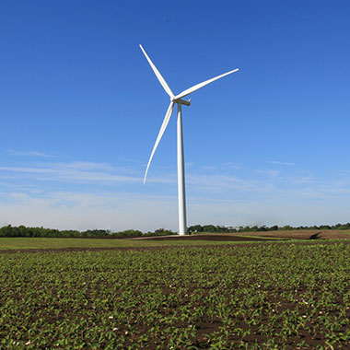
Introduction
Wind turbines converts kinetic energy and generate electricity using a generator.
Parameters effecting electricity generation:
Location of wind turbine – Onshore, offshore, nearshore
Size of turbine or capacity
Length of the blades
Why is it Important?
Energy Production Planning – balance supply & demand.
Cost Reduction – Manage maintenance schedules.
Sustainable environment.

Slide 3

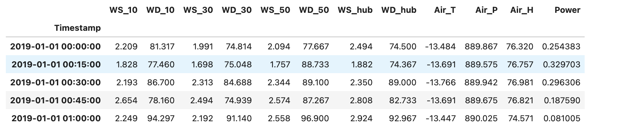
Understanding the data
First few datapoints
WS - wind speed at positions 10, 30, 50 and hub in meters
WD – Wind Direction at positions 10, 30, 50 and hub in meters
Air – Temperature, Pressure, Humidity
Time interval – Every 15 seconds

Slide 4
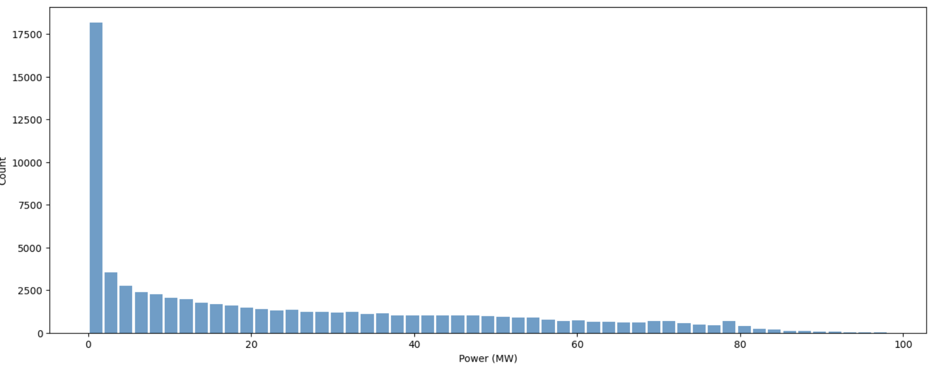
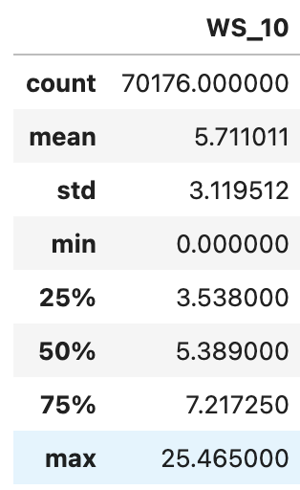
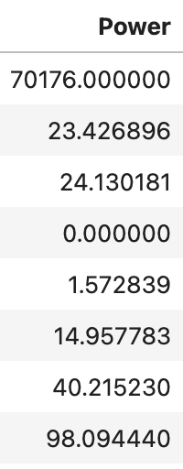
Understanding the data
Histogram
Describing the data

Slide 5
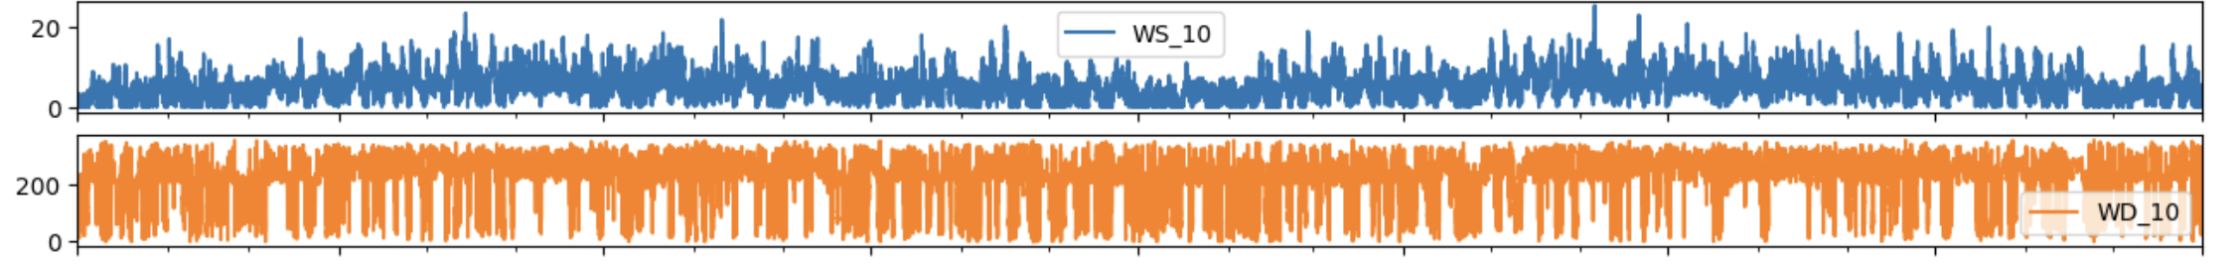
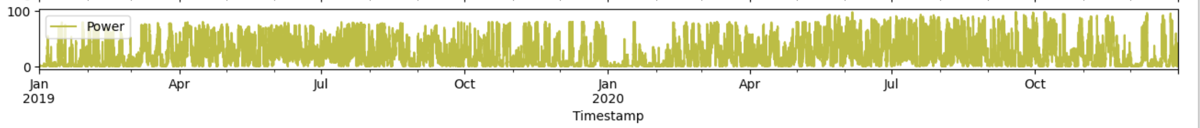
Understanding the data
Explaining Trend & Seasonality
Wind speed has some trend
Wind direction looks like white noise
Power also has some trend

Slide 6
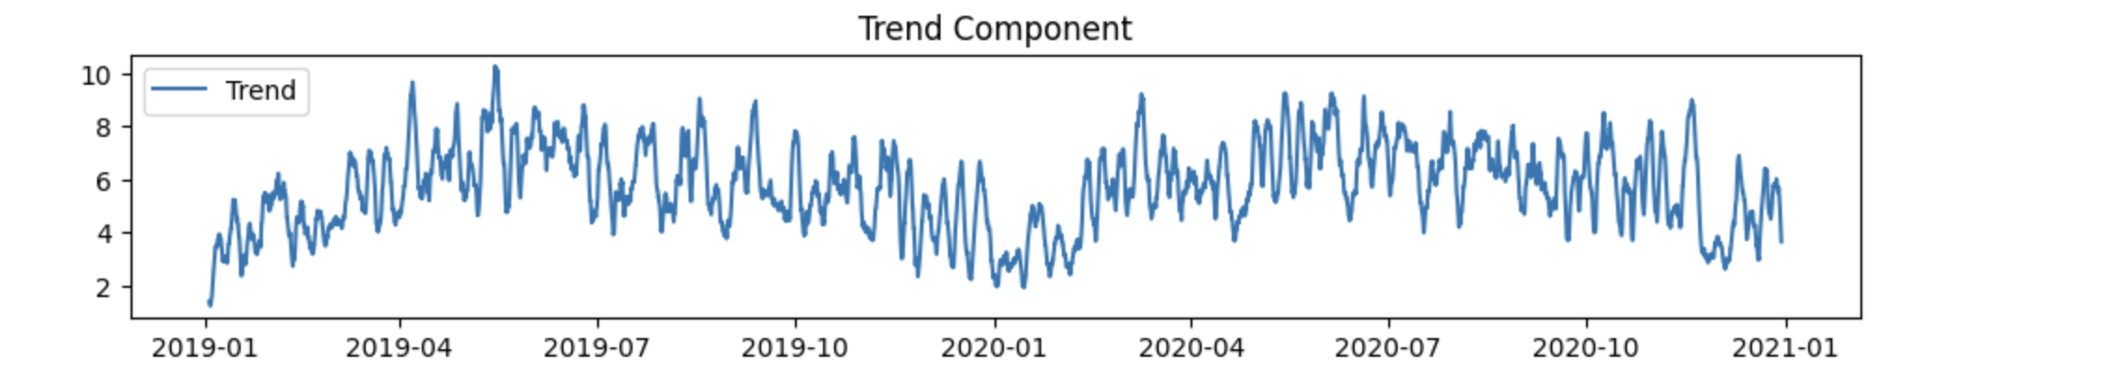
Understanding the data
Explaining Trend & Seasonality
Decomposing the signal to see the trend for power

Slide 7
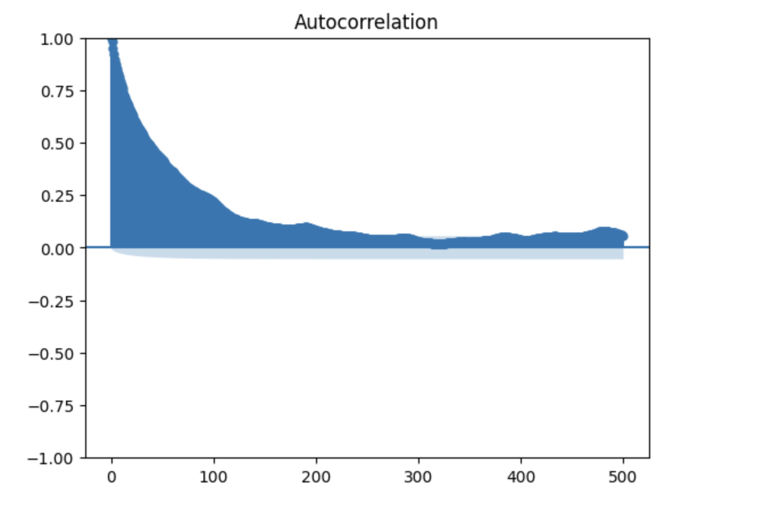
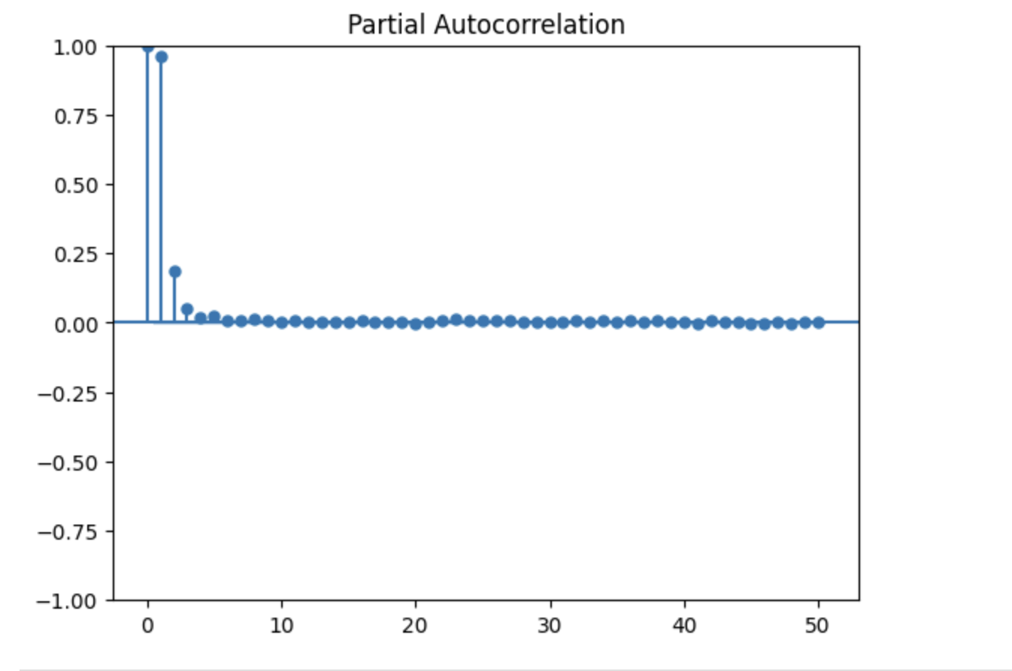
Understanding the data
ACF (Power)
PACF (Power)

Slide 8
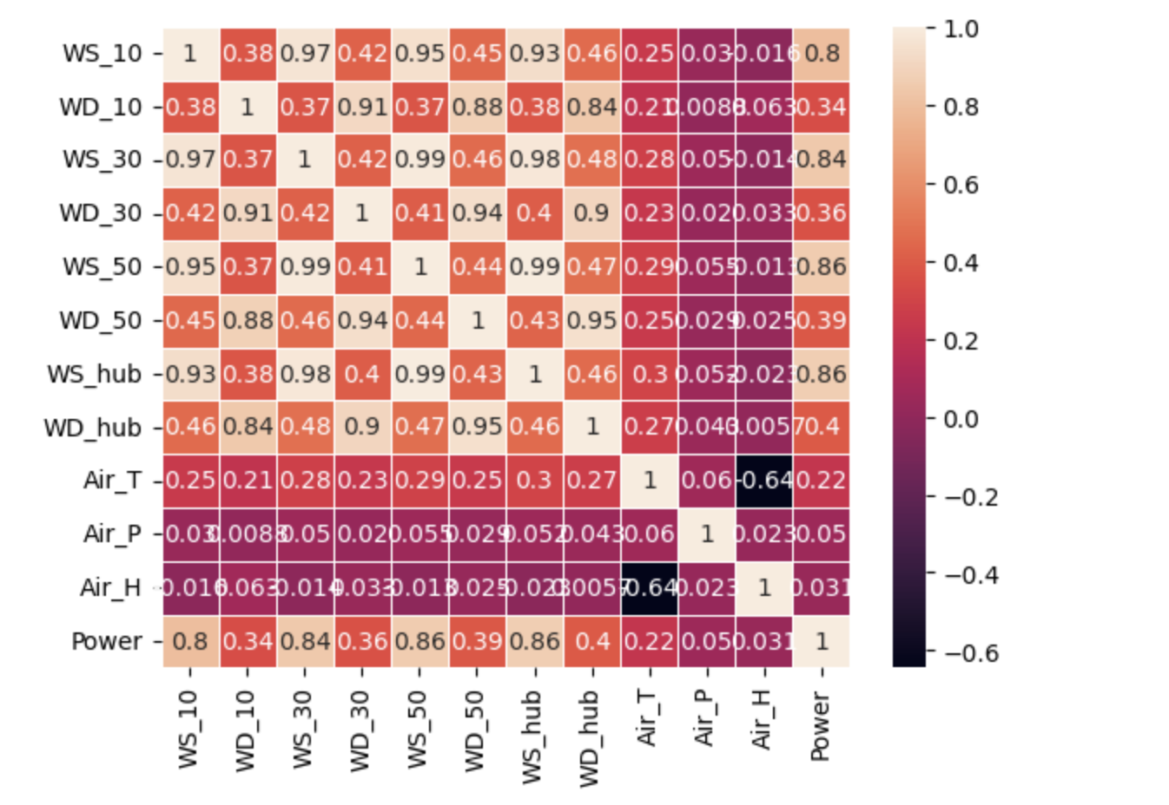
What is interesting
Heatmap
Power has strong correlation to wind speed at different heights.
Correlation increases slightly as the distance increases.
No significant correlation between wind direction and Air

Slide 9

Data preprocessing
Dividing the data into test and training set without shuffling the data to persist the trend
Removing Wind direction as there is no significant relation
20% data for testing
Removing Air Temperature, Pressure and Humidity as there is no significant relation

Slide 10
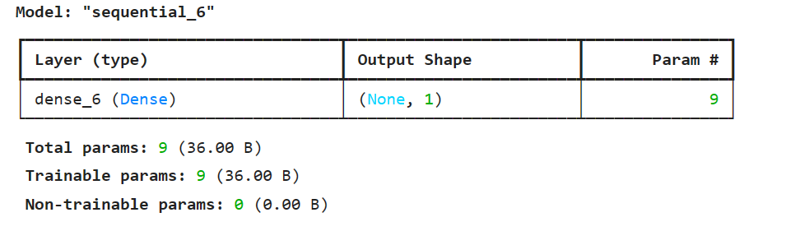
Model Selection & Training
Linear regression
Learning rate set to 0.05
Batch size – 16
No of cycles (epochs) – 30

Slide 11
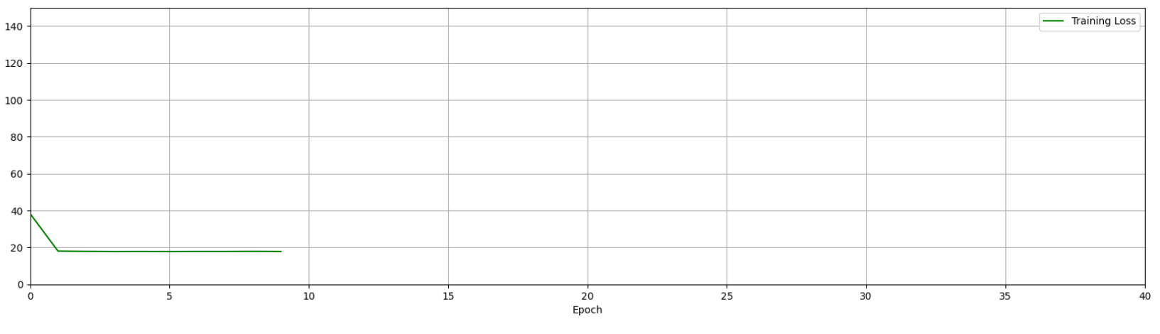
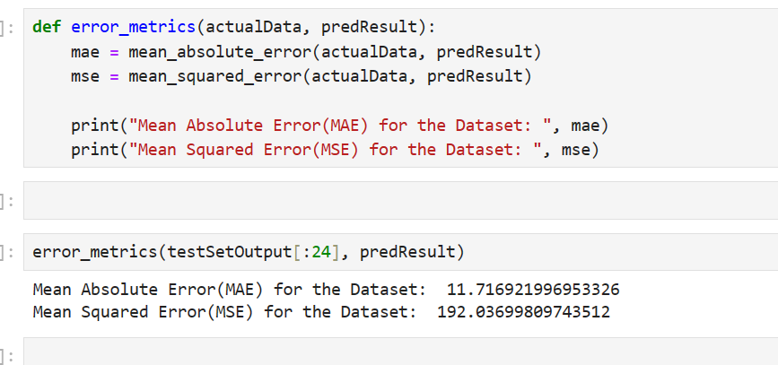
Loss Calculation
Mean Squared Error (MSE)
Loss Reduces and then slowly converges

Slide 12
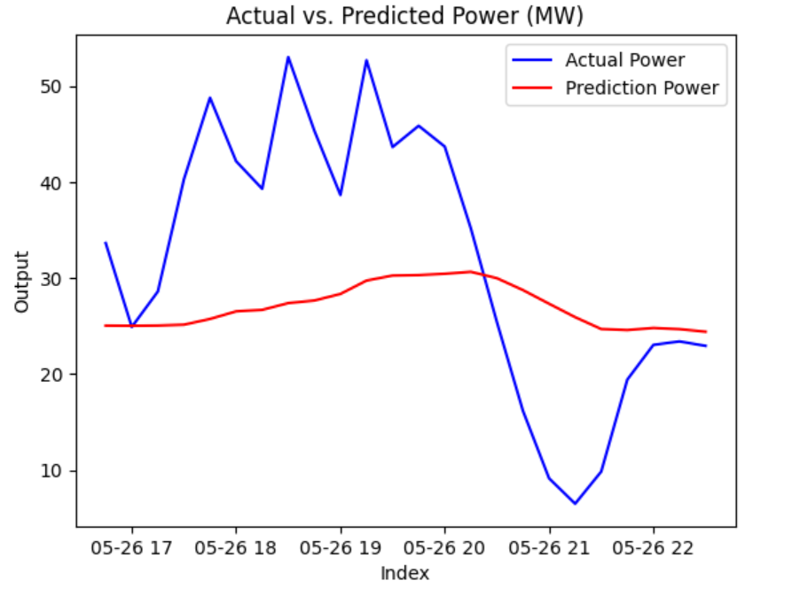
Model Performance

Slide 13
Future Improvements
Employ statistical methods to reduce dimensionality in your dataset, which could reveal underlying patterns that are not obvious with direct correlation.
Create additional features like the turbine capacity might additionally help.

Slide 14
Thank You

