Slide 1
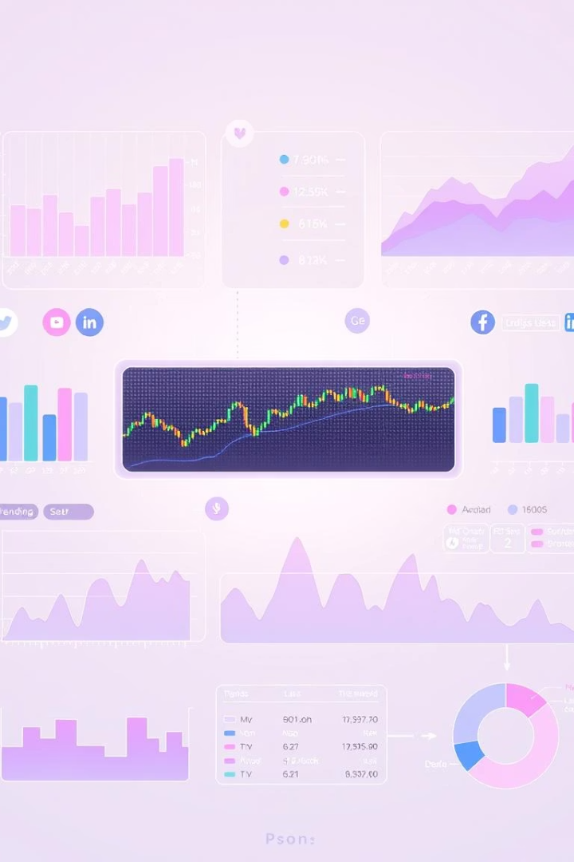
Reddit Sentiment Analysis for Stock Movement Prediction
This research explores how sentiment from Reddit posts can predict stock market movements. By analyzing comments related to stock tickers using three sentiment models—a Large Language Model (LLM), XGBoost, and Logistic Regression—this study aims to assess the predictive power of social media sentiment on stock returns. The project combines social media analytics with machine learning to enhance short-term stock return forecasting, highlighting potential applications in market monitoring and retail trend detection.

Slide 2

Background and Related Work
Investor Sentiment
Social Media Role
Reddit's Advantage
Investor sentiment significantly influences short-term market behavior, driven by psychological and crowd factors beyond fundamentals.
Platforms like Twitter and Reddit shape retail investor opinions, providing real-time discussions on stocks and market events.
Reddit offers longer, context-rich posts with stock tickers, making it ideal for extracting nuanced financial sentiment compared to Twitter.

Slide 3

Problem Statement
Core Challenge
Model Fusion
Can sentiment from Reddit posts accurately predict daily stock return direction despite noisy, unstructured content?
Using multiple models (LLM, XGBoost, Logistic Regression) to label sentiment aims to improve prediction reliability.
Market Impact
Reddit's growing influence in retail investing makes understanding its sentiment crucial for forecasting stock movements.

Slide 4
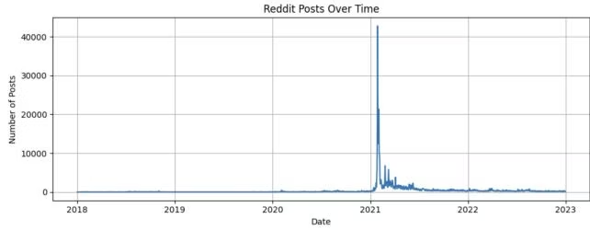
Dataset Description
Reddit Stock Posts
Sentiment140 Dataset
Stock Price Data
Collected from Kaggle, includes posts on seven tickers like AAPL, TSLA, and GME with titles, content, timestamps, and tickers.
Contains 1.6 million labeled tweets used to train XGBoost and Logistic Regression sentiment classifiers.
Historical daily prices from 2018 to 2023 for the seven tickers, merged with Reddit posts by date and ticker.

Slide 5
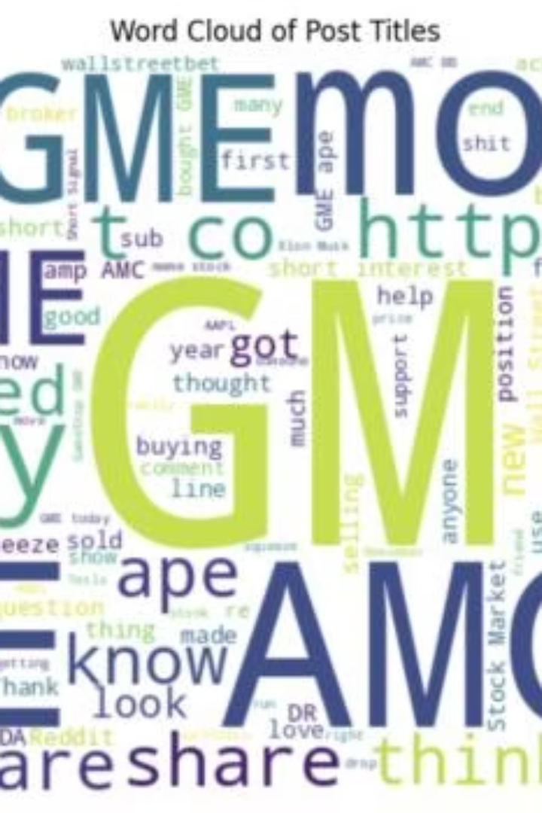



Data Collection and Preprocessing
Text Cleaning
Titles and post bodies were cleaned and combined into a unified text field for sentiment analysis.
Label Mapping
Sentiment140 tweets were labeled binary (positive/negative), excluding neutral samples for clear classification.
Stock Data Alignment
Daily stock returns were computed and merged with Reddit posts by ticker and date, filtering ambiguous sentiment cases.

Slide 6
Methodology
Sentiment Models
Fusion Strategy
Stock Return Prediction
Applied LLM for contextual sentiment, and trained XGBoost and Logistic Regression on Sentiment140 tweets using TF-IDF features.
Combined three model outputs: posts with full disagreement were discarded; neutral predictions dominated; majority vote decided final label.
Trained XGBoost classifier on Reddit posts with fused sentiment to predict daily stock return direction (up, down, neutral).

Slide 7
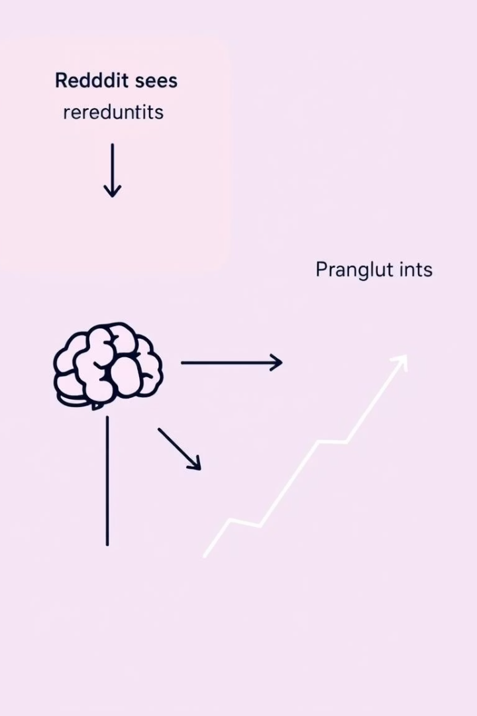
Sentiment Analysis and System Model
Hybrid Sentiment Classification
Fusion Rules
Neutral labels take precedence; disagreements lead to post removal; majority agreement finalizes sentiment.
LLM captures nuanced financial language; XGBoost and Logistic Regression provide scalable, complementary predictions.
Prediction Pipeline
Sentiment-labeled posts merged with stock returns to train XGBoost for forecasting daily stock movement direction.

Slide 8
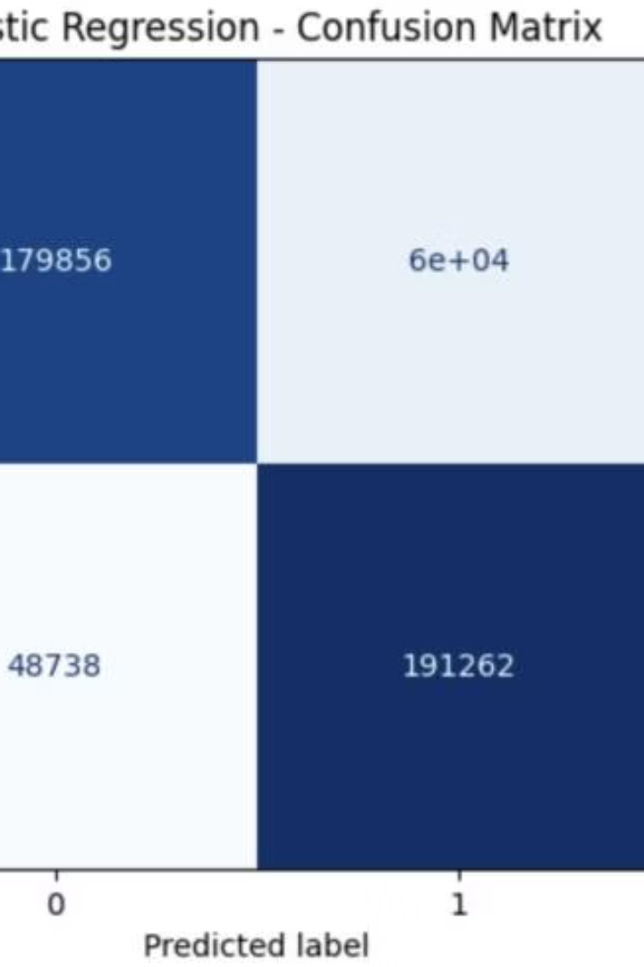
Algorithm Performance and Experimental Results
Model Strengths
Challenges
LLM excels in context and sarcasm; XGBoost shows high precision; Logistic Regression offers interpretability.
Class imbalance leads to high accuracy but poor minority class detection; ambiguous language affects all models.
Metrics
Overall accuracy 66%, macro precision 64%, recall 65%, F1-score 62%, highlighting room for improvement.

Slide 9
Business Insights and Future Work
Business Applications
Future Enhancements
Deployment
Sentiment signals can inform trading strategies, risk management, and detect retail investor trends around key events.
Incorporate advanced LLMs fine-tuned on finance, add external data like news and volatility, and explore temporal models.
Develop real-time dashboards and expand coverage to global markets and multiple languages for broader applicability.

Slide 10

Critical Evaluation and Conclusion
Strengths
LLM captures nuanced sentiment; fusion strategy improves label reliability; XGBoost models complex patterns effectively.
Limitations
Neutral class bias, limited metadata, and occasional LLM uncertainty reduce prediction granularity and accuracy.
Conclusion
Reddit sentiment analysis shows promise for stock prediction, but integrating richer data and models is needed for practical forecasting.

