Slide 1

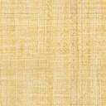

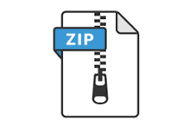


data_Ingestion_artefacts_dir
gcp_data_file_path
Data Ingestion config
output_file_path
Google Storage Bucket
csv_data_file_path
Data Ingestion config
archive.zip
archive.zip
initiate_data_ingestion
get_data_from_gcp
extract_data
zip_data_file_path
ner.csv
data ingestion config
Prepare data ingestion artefacts
csv_data_file_path
Data Ingestion artefacts
To continue to data transformation

Slide 2
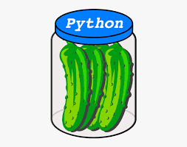

data_transformation_artefacts_dir
lables_to_ids_path
Ids_to_lables_path
zip_data_file_path
Ids_to_lables_gcp_path
data ingestion artefacts
Data transformation config
csv_data_file_path
df_train_path
Data transformation config
df_val_path
df_test_path
ner.csv
splitting_data
unique_labels_path
lables_to_ids.pkl
Ids_to_lables.pkl
df_train.pkl
df_val.pkl
df_test.pkl
unique_labels.pkl
Prepare data ingestion artefacts
lables_to_ids_path
Ids_to_lables_path
Model training artifacts
df_train_path
Data transformation artifacts
df_val_path
df_test_path
To continue to model training
unique_labels_path

