Slide 1

Welcome to the Java Interview
Help course
This is Mayank Chugh, I am a software architect in CMM level 5 company
Various interview questions - in upcoming videos. You can watch those videos in any order. You can pick a topic and quickly review watch it.
Hands-On lectures. For those hands on lectures you can use intellij idea ide or Eclipse or Spring tool suite STS.
Please leave your question in comment section. I will try to respond you ASAP.
I recommend that you share your interview experiences and also try to answer other student questions as it is a great way of learning and sharing.
Lastly please share your feedback, subscribe my channel and press the bell icon to get you notify for upcoming videos.

Slide 2
Welcome to the Java Interview Help course
About Me
Choose steps as below for your About me – at least use 5 – 7 steps from below
Step 1: Start with your Name
Step 2. “Your designation” with Company Name
Step 3. Responsibility (Role)
Step 4. Total years of experience with all the skills set.
Step 5. Strength.
Step 6. Domain in which you have worked or working.
Step 7. List the entire Project Client name.

Slide 3
Welcome to the Java Interview Help course
About Me
Step 1: Start with your Name
Hi, I am Mayank Chugh, I have started my career as a Java developer in [2XXX]. Since then I have constantly sought to improve and develop my skills.
Step 2. “Your designation” with Company Name
Currently, I am working as [Technical Architect / Developer] with XYZ Ltd.
Step 3. Responsibility (Role)
My current role requires me to be pivotal in managing & delivering complex business & system solutions including requirements gathering, analysis, solution design, configuration, execution, delivery, Monitoring, controlling and ongoing maintenance/support.

Slide 4
Welcome to the Java Interview Help course
About Me
Step 4. Total years of experience with all the skills set.
While working across the Java Technology Stack I have designed, developed and delivered applications using various in Core Java/J2EE, Sturts 1.x, Spring Boot, Microservices, Design Pattern, WebLogic , Oracle, Log4j, XML and Maven.
I have worked closely with the product owners, stakeholders and business analysts to get the requirements right and with the Junior developers to implement the Non-Functional Requirements like security, scalability, reliability etc.
I have also worked with the Devops engineers to set up the CI/CD pipeline for our projects using tools like Maven, Jenkins and AWS EKS.
I have also worked with various AWS Components such as EC2 ,S3 ,EKS,ELB, EBS, SNS, Cloudwatch to deploy our apps to the cloud.

Slide 5
Welcome to the Java Interview Help course
About Me
Step 5. Strength.
I have proficient with programming languages; I have an inquisitive nature that ensures I analyze my work and the problems I encounter in detail; I am quick to learn new concepts and can apply them to a variety of situations, and I am a strong team worker who can collaborate with and work alongside others to complete challenging projects and also resolve complex issues and problems.
I am highly self-motivated, technically astute and you can rely on me to get up to speed quickly in the role whilst being a cooperative, responsive and adaptable member of your team.

Slide 6
Welcome to the Java Interview Help course
Various important components of Java
HelloWorld.java
JRE
JRE
JDK
Windows
Linux
rt.jar
rt.jar
JVM Windows
Javac
java
JIT
Machine Code
OS
Byte Code
java
-Djava.compiler=NONE

Slide 7
Welcome to the Java Interview Help course
Constructors
Class Car
Class Car
extends
Honda
Int speed;
Car() {
this(90);
this.speed = 1500;
}
start(){
stop(){

Slide 8
Welcome to the Java Interview
Help course
Tell us about yourself
This icebreaking question is a great opportunity to market our skills and all the great work we have been doing over the years.
It is like fishing where we will leave several technical baits hoping that the interviewer will be caught in one or most of them and ask us questions from those topics as the interview progresses.
This is the very first question we will be responding to, and it conveys a lot about our communication, confidence and experience.
So we should prepare six to 12 points and practice those points 30 to 40 times, at least.
In the next lecture. I will share some important points from my about me that I have been using over the years that will help you. And you can use it as a template if you want to.

Slide 9


Slide 10
Java Interview Course Series
Tell us about yourself
Can you tell us about yourself or can you talk about your work experience while walking us through your résumé, no matter what the question is and how it is asked, this icebreaking question is a great opportunity
to market our skills and all the great work we have been doing over the years.
It is like fishing where we will leave several technical baits hoping that the interviewer will be caught
in one or most of them and ask us questions from those topics as the interview progresses.
This is the very first question we will be responding to, and it conveys a lot about our communication,
confidence and experience.
So we should prepare six to 12 points and practice those points 30 to 40 times, at least in the next
lecture.
I will share some important points from my about me that I have been using over the years that will
help you.
And you can use it as a template if you want to.

Slide 11
Interview Q&A
What is the pillar of oops concept
  Encapsulation
  Inheritance
  Polymorphism
  Abstraction
Where did you use this concepts in your project
Explain Exception hierarchy in Inheritance
parent child override scenario
can we override static and private method ?
what is the difference of java 7 and java 8 interface
Java 8 Default method ,static method

Slide 12
Interview Q&A
7. What is final, finally and finalize ?
  final : keyword
  finally : block
  finalize : method
8. What is equals and hashcode method and its contract
  Hashcode : used to generate unique or reference number of an object through which we can easily identify uniqueness of an object
  Equals : used to compare object based on its content
  Both method present in java.lang.Object class

Slide 13
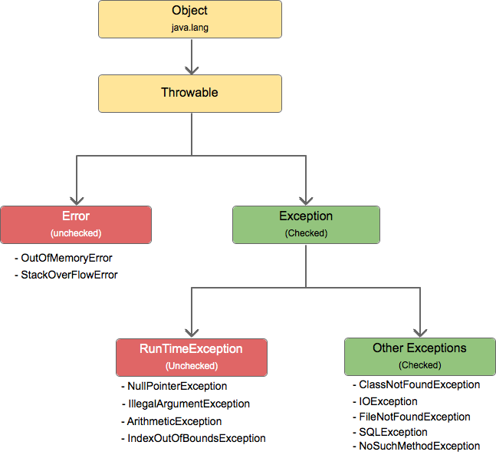
Interview Q&A
9. What is exception and its hierarchy

Slide 14
Interview Q&A
10. why checked exception also called as compile time exception , is it occurs in compile time ?
11. How to write custom exception
12. Throw and throws Exception
13. Exception tricky programming question (Exception order)
14. try , catch finally return statement scenario questions
15. is finally block always executed ?

Slide 15
Interview Q&A
16. How many way we can create String object ?
17. String object creation scenario
18. What is SCP and how it works ?

Slide 16
Interview Q&A
19. Why String is immutable
  Immutable simply means unmodifiable or unchangeable.
  Key points :
  String pool is possible only because String is immutable in Java. This way Java Runtime saves a lot of heap space because different String variables can refer to the same String variable in the pool.
  If String is not immutable then it would cause a severe security threat to the application. For example, database username, password are passed as String to get database connection and in socket programming host and port details passed as String. Since String is immutable, its value can’t be changed otherwise any hacker could change the referenced value to cause security issues in the application.
  Since String is immutable, it is safe for multithreading. A single String instance can be shared across different threads. This avoids the use of synchronization for thread safety.
  Since String is immutable, its hashcode is cached at the time of creation and it doesn’t need to be calculated again. This makes it a great candidate for the key in a Map and its processing is faster than other HashMap key objects. This is why String is the most widely used as HashMap keys.

Slide 17
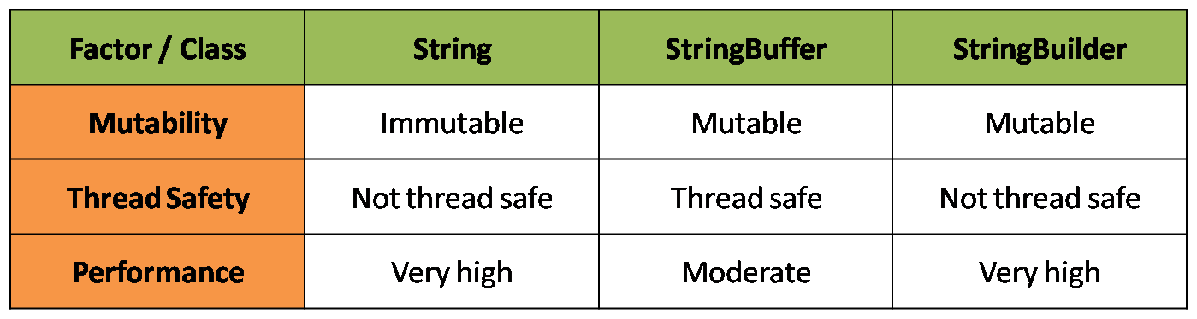
Interview Q&A
20. how to use mutable class and what is the difference between StringBuffer and StringBuilder

Slide 18
Interview Q&A
21. How to write your own custom immutable class
  Make your class final
  Declare all instance variable with private and final
  Say no to setter methods
  Initialize all variables in constructor
  You can initialize variables in constructor
  Perform cloning of mutable objects while returning from getter method
    you can go with clone method but its always not recommended, I will show you its disadvantages

Slide 19
Interview Q&A
22. Which one is good to store password in java String or char[] & Why
  Here are a few reasons which make sense to believe that character array is a better choice for storing the password in Java than String
  Since Strings are immutable in Java if you store the password as plain text it will be available in memory until the Garbage collector clears it and also String literal is stored String pool for reusability there is a pretty high chance that it will remain in memory for long duration
  Because its difficult to destroy literal from SCP as GC unable to perform cleanup activity in SCP only it will destroy once jvm restarted so which may leads a high security threat
  Since anyone who has access to memory dump can find the password in clear text and that's another reason you should always use an encrypted password than plain text

Slide 20
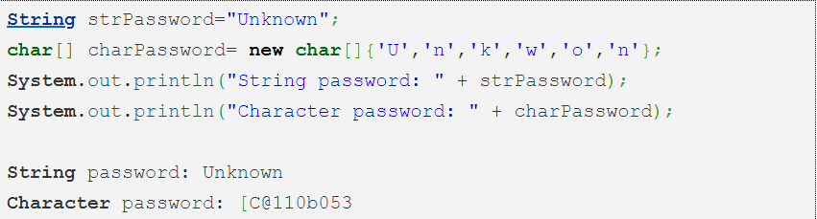
Interview Q&A
  Since Strings are immutable there are no way contents of Strings can be changed because any change will produce new String, while if you char[] you can still set all his elements as blank or zero. So Storing the password in character array clearly mitigates security risk of stealing passwords.
  With String there is always a risk of printing plain text in log file or console but if use Array you won't print contents of array instead its memory location get printed. though not a real reason but still make sense.

Slide 21
Interview Q&A
23. What is Marker interface (tagging interface) ? Can we create our own marker interface ?
  A marker interface is an interface that has no methods or constants inside it. Java has many built-in marker interfaces, such as Serializable, Cloneable, and Remote.
  It provides run-time type information about objects, so the compiler and JVM have additional information about the object.
  Let's take the example of the Cloneable interface. If we try to clone an object that doesn't implement this interface, the JVM throws a CloneNotSupportedException. Hence, the Cloneable marker interface is an indicator to the JVM that we can call the Object.clone() method.

