Slide 1

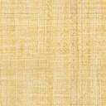

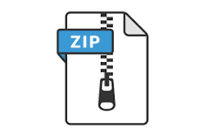


data_Ingestion_artefacts_dir
gcp_data_file_path
Data Ingestion config
output_file_path
csv_data_file_path
Data Ingestion config
archive.zip
archive.zip
initiate_data_ingestion
get_data_from_gcp
extract_data
zip_data_file_path
ner.csv
data ingestion config
Prepare data ingestion artefacts
csv_data_file_path
Data Ingestion artefacts
To continue to data transformation

